Slide 1
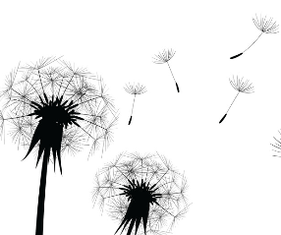


Slide 2
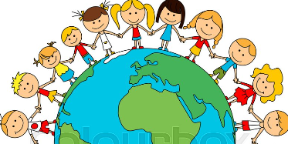


Slide 3
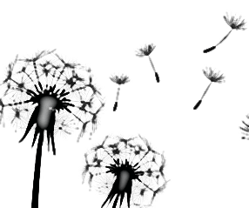
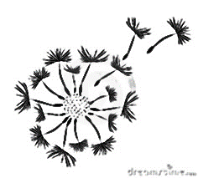

Slide 4



Slide 5
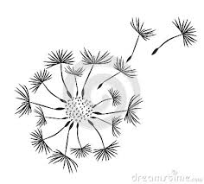
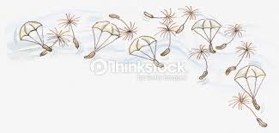

Slide 6

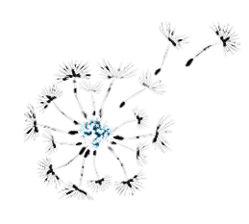
World Cultures
Little Umbrella Club

Slide 7

Little Umbrella Club
World Cultures

Slide 8
World Cultures
Little Umbrella Club

Slide 9
World Cultures
Little Umbrella Club

Slide 10
Little Umbrella Club
Cultivating world cultures

Slide 11

Little Umbrella Club
Cultivating world cultures

Slide 12
Little Umbrella Club
Cultivating world cultures

Slide 13
