Slide 1
Kaggle Competition
Rossmann Store Sales

Slide 2
kaggle
What is Kaggle?
A data science competitions :
Upload your predictions.
Scores your solution
Shows your score on the leaderboard

Slide 3
Registration
Site: https://www.kaggle.com/competitions
Account: IKDD_1(Group Number)

Slide 4
Rossmann Store Sales
Competition url: https://www.kaggle.com/c/rossmann-store-sales
Data url: https://www.kaggle.com/c/rossmann-store-sales/data
Leaderboard: https://www.kaggle.com/c/rossmann-store-sales/leaderboard

Slide 5
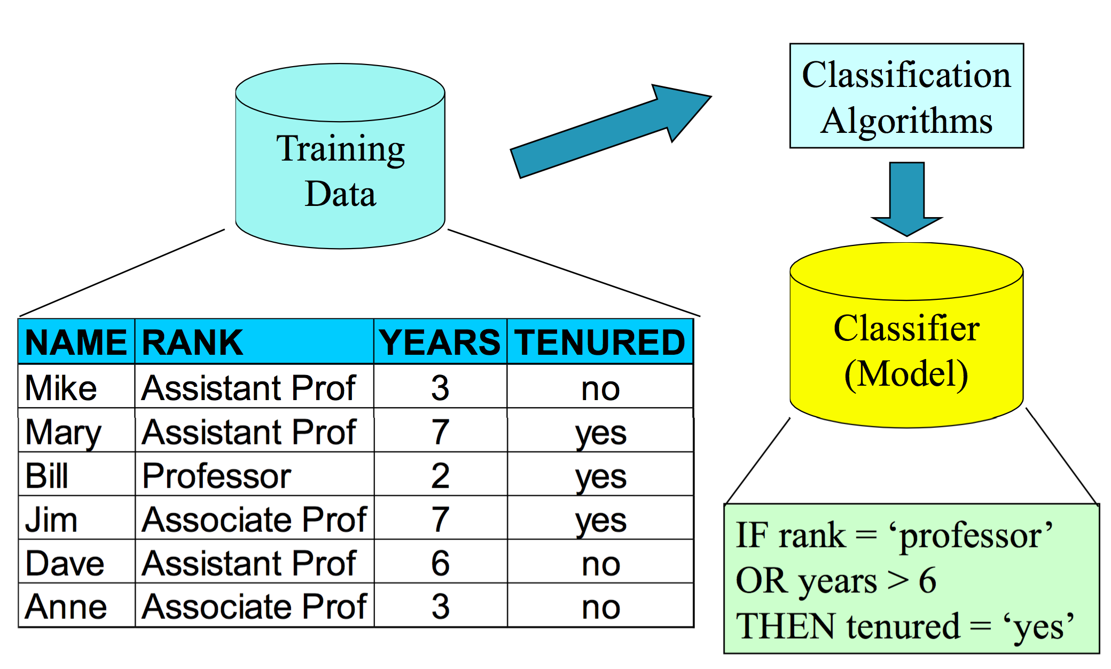
Classification

Slide 6
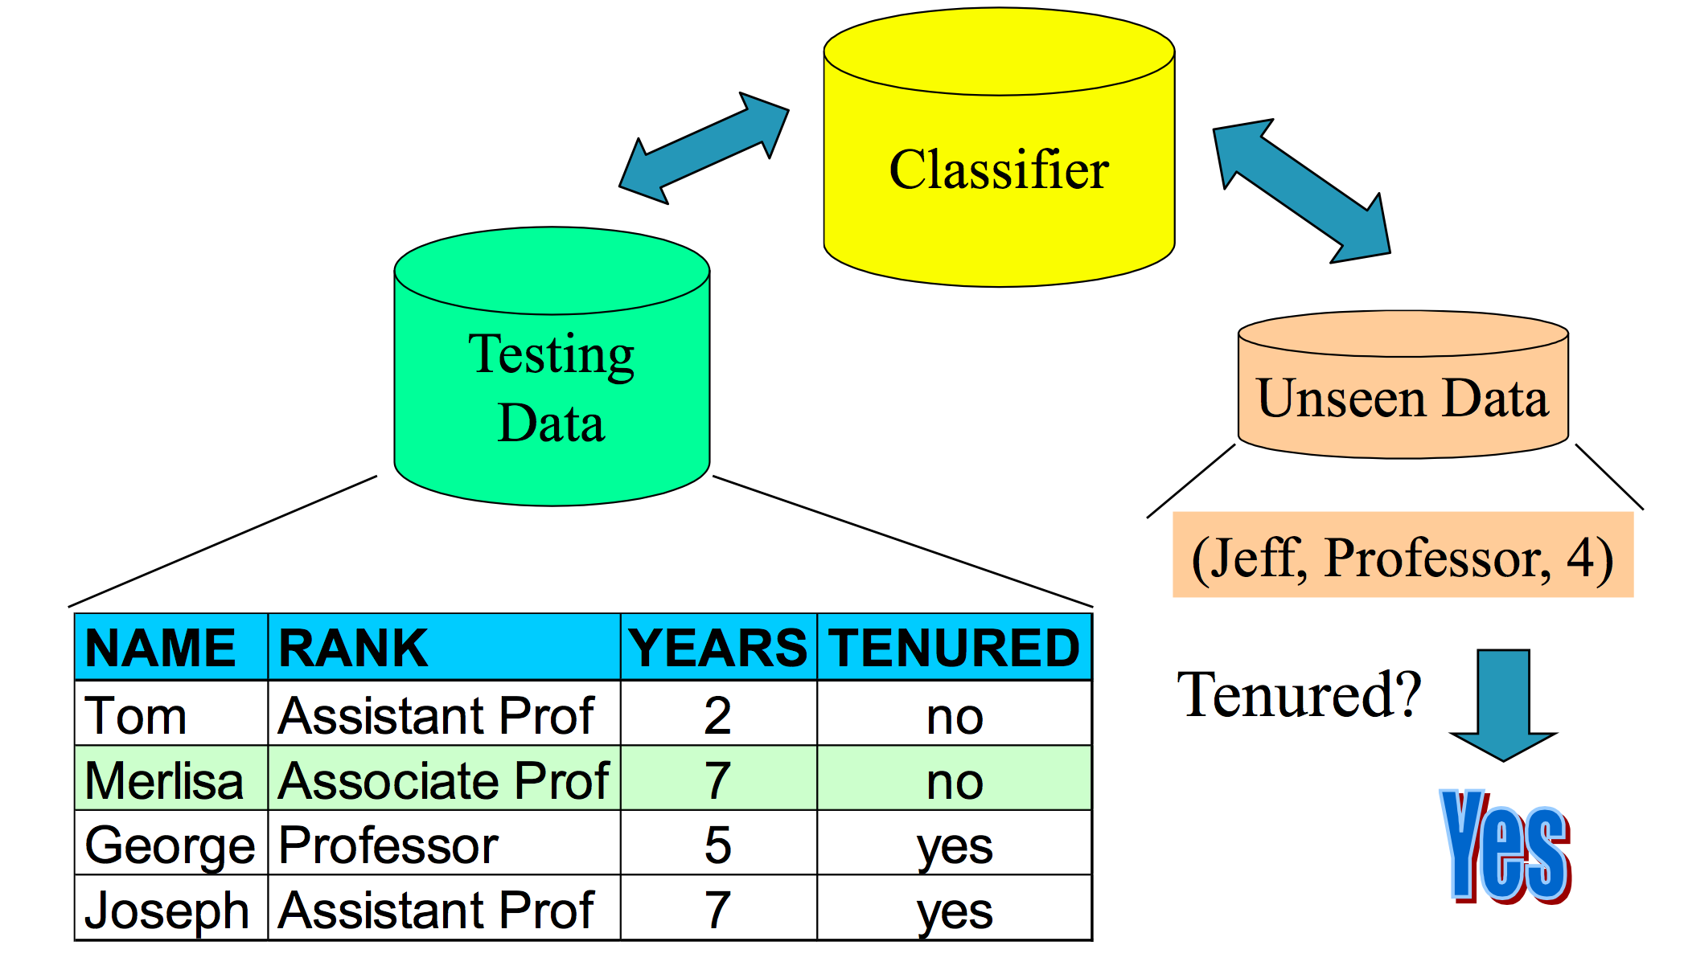
Prediction

Slide 7
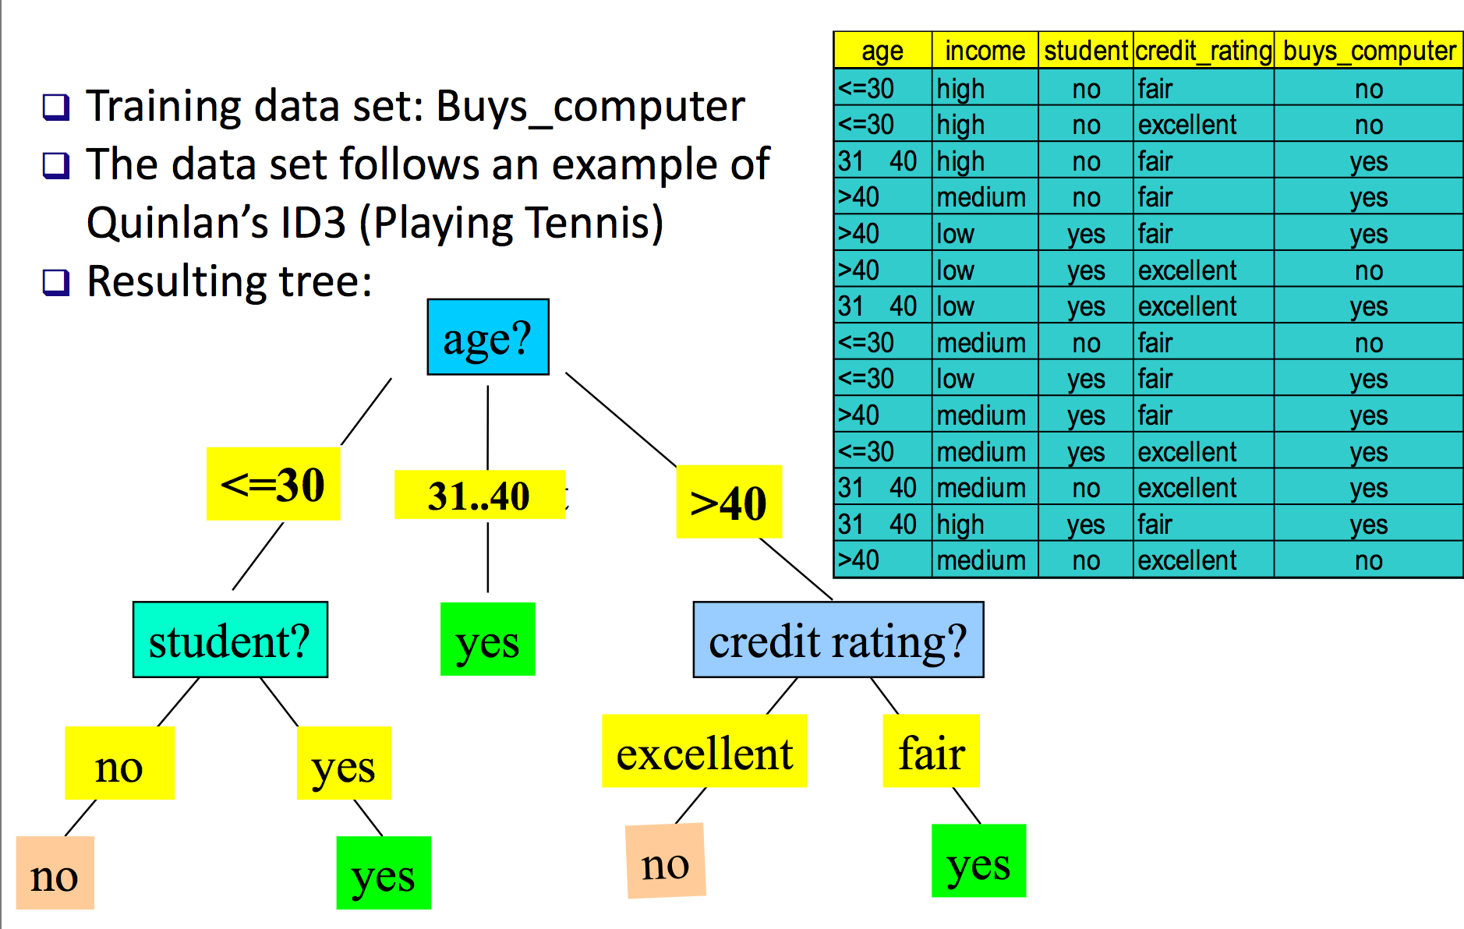
Decision Tree

Slide 8
Sklearn – Python tool
Simple and efficient tools for data mining and data analysis!
Decision tree url : http://scikit-learn.org/stable/modules/tree.html

Slide 9
Homework 1
Registration
Apply a simple algorithm to build the classifier
Use the classifier to predict the sales of each testing data
Submit the result to Kaggle
Deadline: next Thursday (10/29)

Slide 10
Homework 2
Oral report
Deadline: next Thursday (11/5)

Slide 11
Final project
Registration
Try different algorithm to build the best classifier
Use the classifier to predict the sales of each testing data
Submit the result to Kaggle

Slide 12
Final project
Deadline: 11/11 23:59
Submission:
Submit the results to kaggle
Email your project to sydang.ncku@gmail.com
Project file content:
code
prediction result
report

Slide 13
Grading
Homework 1: 20%
Homework 1: 5%
Final Project : 75%
The ranking: 30%
Algorithm and coding : 30%
Report: 15%

Slide 14
XGBoost
General purpose gradient boosting library, including generalized linear model and gradient boosted decision tree
SITE: http://dmlc.ml/

Slide 15
tslm
A linear model with time series components
SITE: http://www.inside-r.org/packages/cran/forecast/docs/tslm

Slide 16
H2o.randomForest
Random Forest (RF) is a powerful classification tool. When given a set of data, RF generates a forest of classification trees, rather than a single classification tree. Each of these trees generates a classification for a given set of attributes. The classification from each H2O tree can be thought of as a vote; the most votes determines the classification.
SITE: http://docs.h2o.ai/h2oclassic/datascience/rf.html

