Slide 1
Kaggle Competition
Titanic: Machine Learning from Disaster

Slide 2
kaggle
What is Kaggle?
A data science competitions :
Upload your predictions.
Scores your solution
Shows your score on the leaderboard

Slide 3
Registration
Site: https://www.kaggle.com/competitions
Account: IKDD1(Group Number)

Slide 4
Titanic
Competition url: https://www.kaggle.com/c/titanic
Data url: https://www.kaggle.com/c/titanic/data
Leaderboard: https://www.kaggle.com/c/titanic/leaderboard

Slide 5
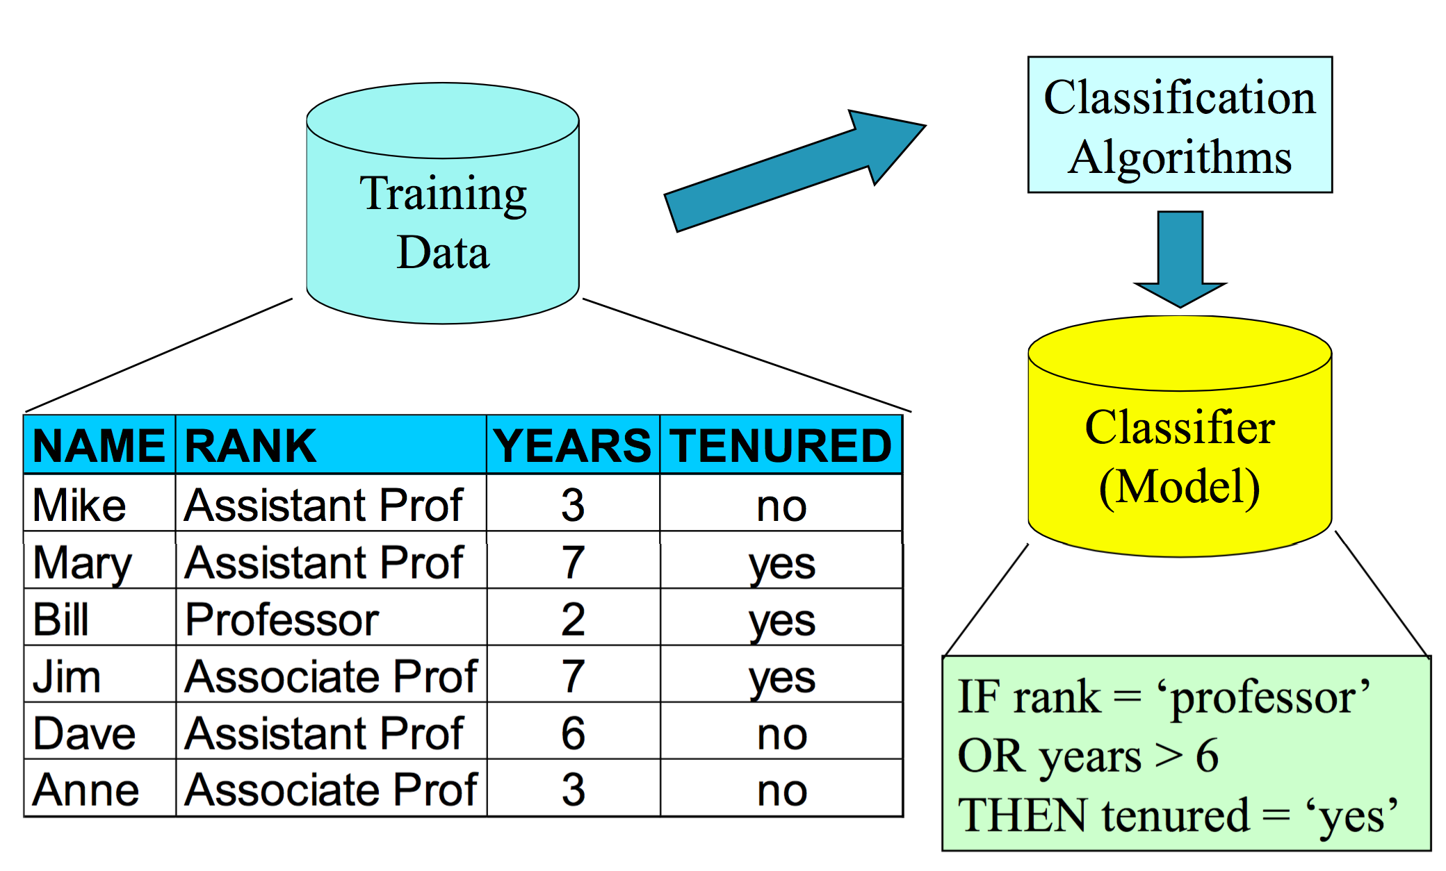
Classification

Slide 6
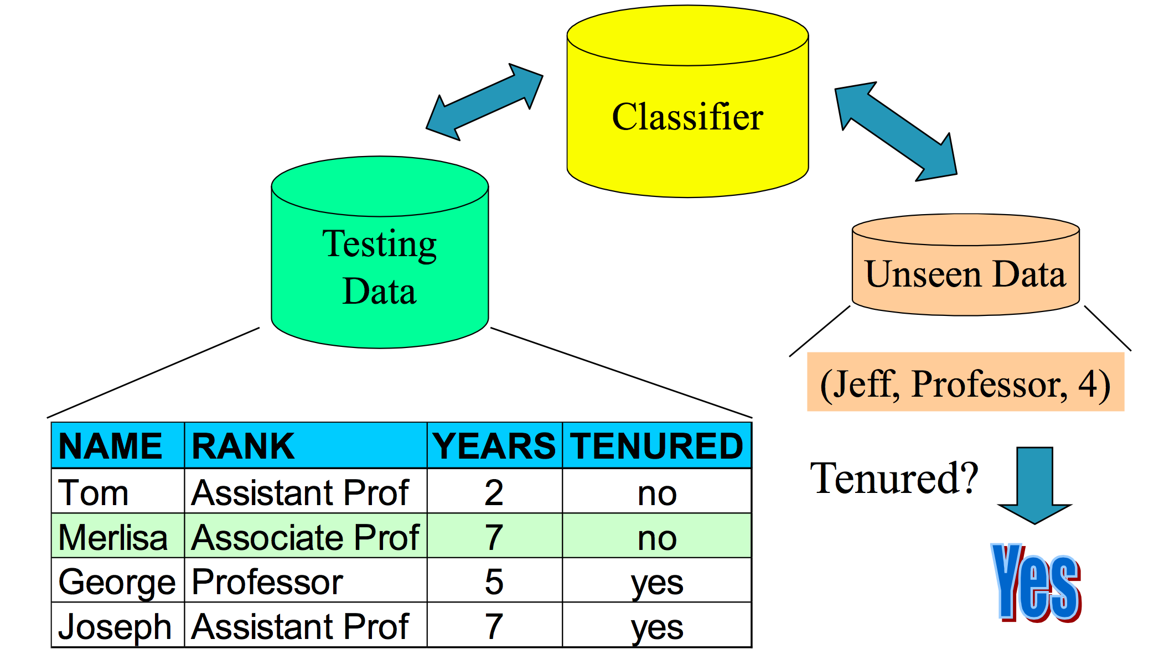
Prediction

Slide 7
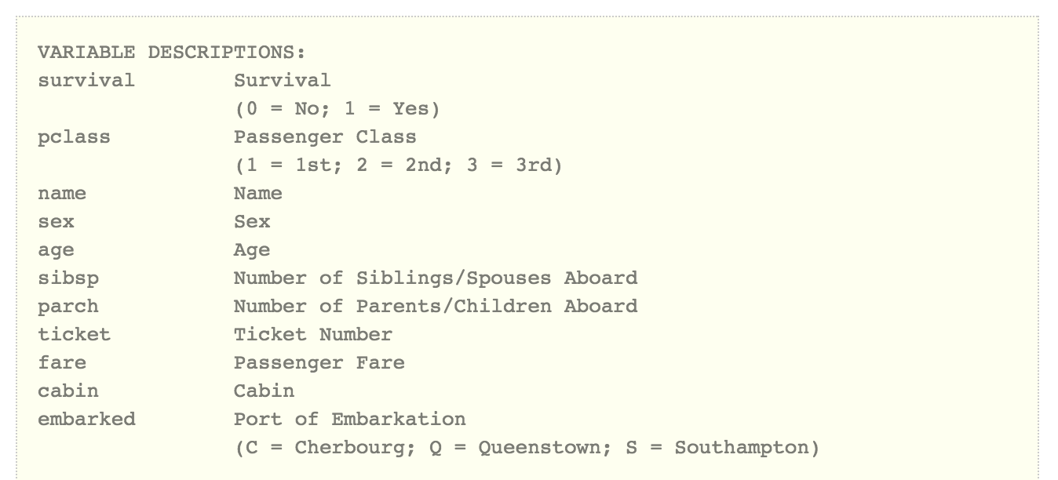
Titanic
Attribute Description:

Slide 8
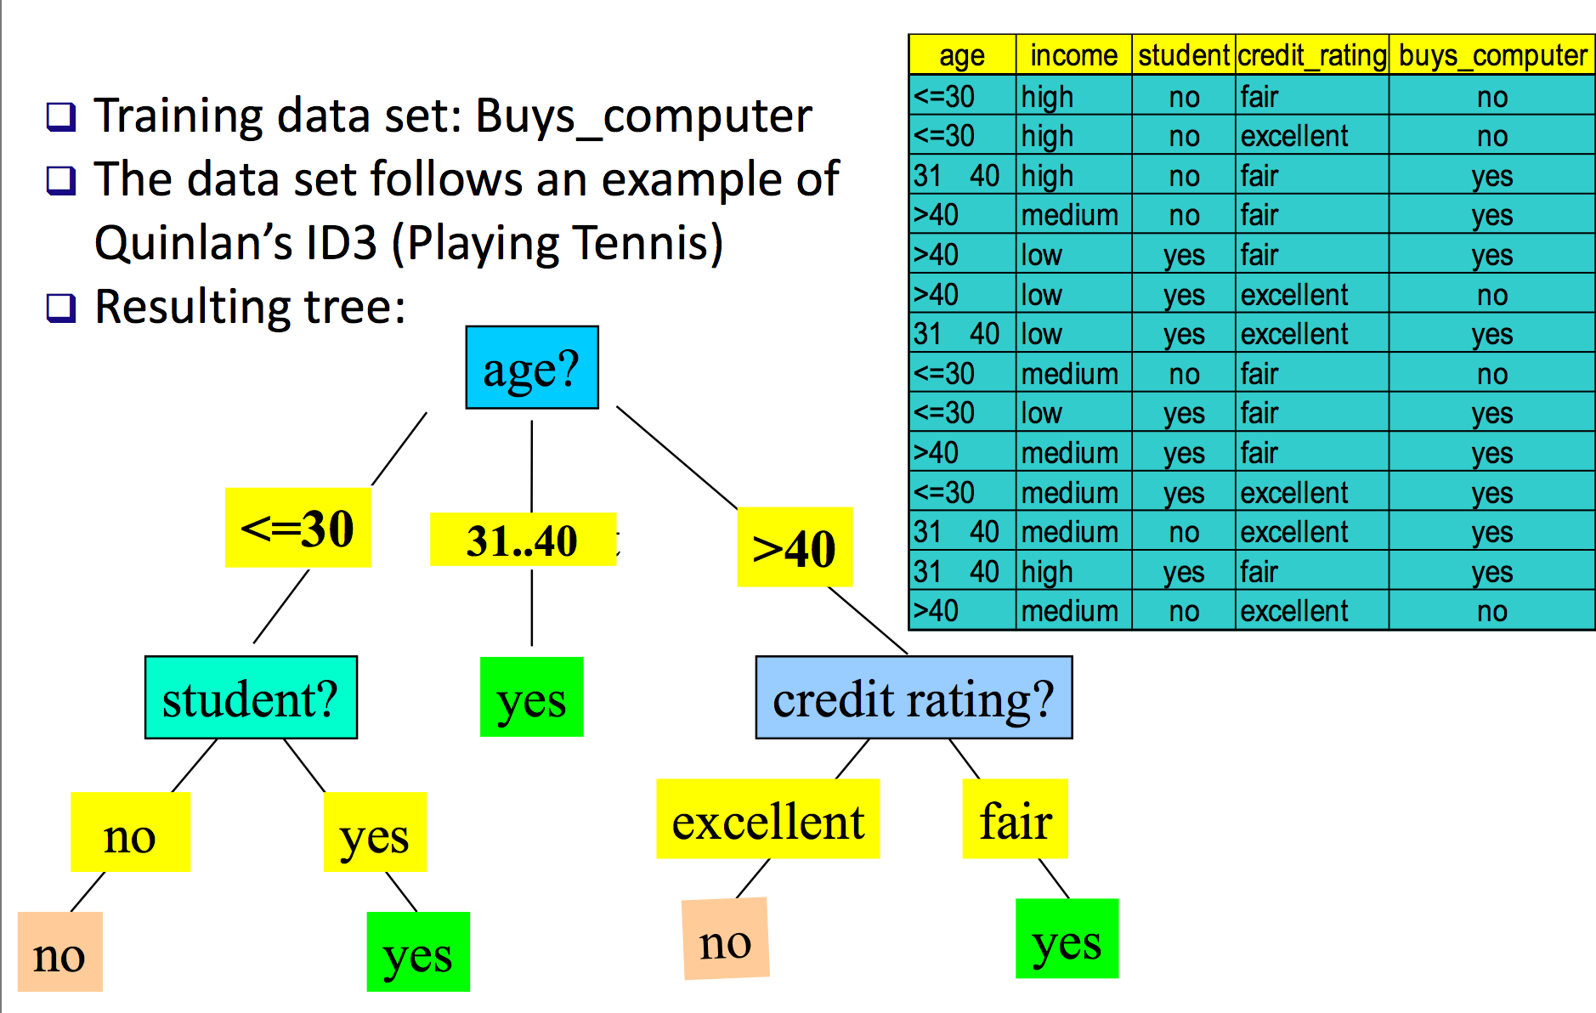
Decision Tree

Slide 9
Sklearn – Python tool
Simple and efficient tools for data mining and data analysis!
Decision tree url : http://scikit-learn.org/stable/modules/tree.html

Slide 10
Provided by Kaggle
gendermodel - python
genderclassmodel - python
myfirstforest - python

Slide 11
Homework 1
Registration
Apply a simple algorithm to build the classifier
Use the classifier to predict the survival passengers
Submit the result to Kaggle
Deadline: next Thursday (11/19)

Slide 12
Homework 2
Oral report
The illustration of x-level decision tree
Deadline: next Thursday (11/26)

Slide 13
Final project
Registration
Try different algorithms to build the best classifier
Use the classifier to predict the survival passengers
Submit the result to Kaggle

Slide 14
Final project
Deadline: 12/2 23:59
Submission:
Submit the results to kaggle
Email your project to sydang.ncku@gmail.com
Project file content:
code
prediction result
report

Slide 15
Grading
Homework 1: 20%
Homework 1: 10%
Final Project : 70%
The ranking: 30%
Algorithm and coding : 30%
Report: 10%

Slide 16
Report
The details of the your best method
The description of the methods that you tried
The important attributes or surprised features you found

Slide 17
XGBoost
General purpose gradient boosting library, including generalized linear model and gradient boosted decision tree
SITE: http://dmlc.ml/

Slide 18
tslm
A linear model with time series components
SITE: http://www.inside-r.org/packages/cran/forecast/docs/tslm

Slide 19
randomForest
Random Forest (RF) is a powerful classification tool. When given a set of data, RF generates a forest of classification trees, rather than a single classification tree. Each of these trees generates a classification for a given set of attributes. The classification from each tree can be thought of as a vote; the most votes determines the classification.
SITE: http://www.r-bloggers.com/a-brief-tour-of-the-trees-and-forests/

Slide 20


Slide 21
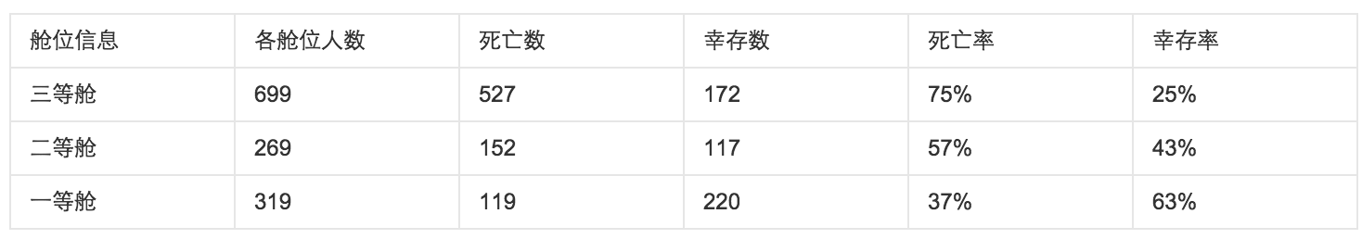
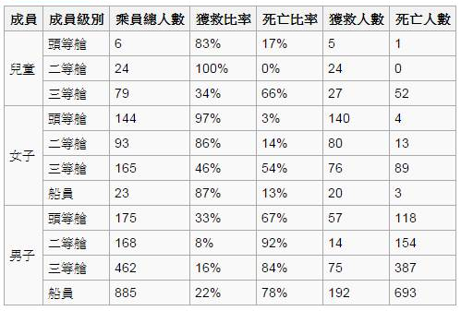

Slide 22
Important attribute
Pclass
Sex
Fare
Embarked

Slide 23
Important attribute
Title ('Capt', 'Don', 'Major', 'Sir’,'Dona', 'Lady', 'the Countess', 'Jonkheer’)
Mother (Sex='female' & Parch>0 & Age>18 & Title!='Miss')
Child (Parch>0 & Age<=18)
FamilyNum (Parch+SibSp+1)
Pclass (Pclass & age & sex)

