Slide 1
θLOS,t
θT
x
θLOS,c
θc
x

Slide 2
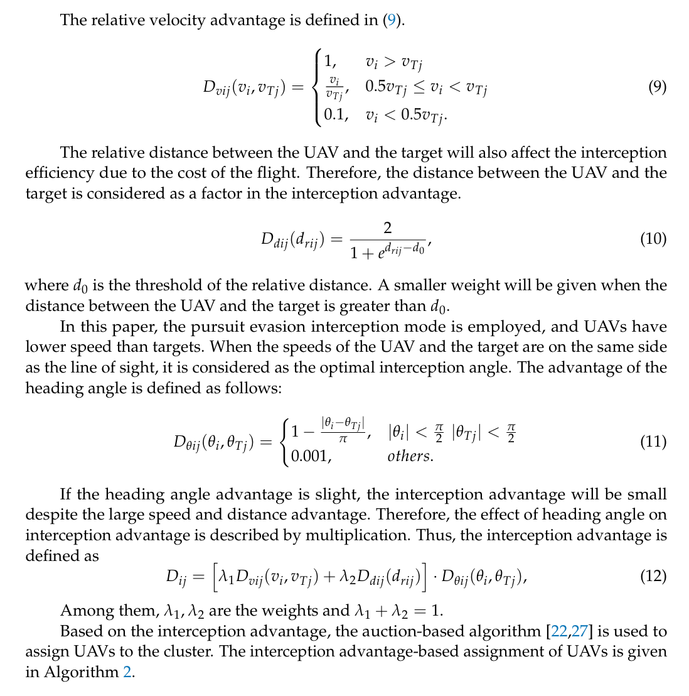
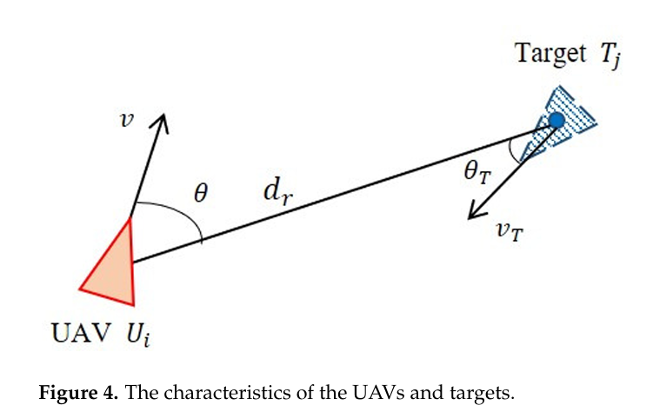
Task Assignment
Notes:
https://www.mdpi.com/2504-446X/7/9/560

