Slide 1
Pagerank with a Clustered Graph Processing Method
Cheng Liu

Slide 2
Clustered Graph Processing Method
Original Graph
New Graph
While(Not Converged){
For v’ in G’{
do v’.pagerank()
}
Update pagerank of G.
}
// CL is the # of vertices in new vertex
v’.pagerank(){
Vertex* v[CL];
for v in v[CL]{
do v.pagerank()
}
}
Clustering
Essentially I am processing
the old graph with batching support
as identified by the new graph.
While(Not Converged){
For v in G{
do v.pagerank()
}
Update pagerank of G.
}

Slide 3
Motivation & Aim of the Clustering
Reduce function call of the page rank computing function.
Potential data reuse within the clustered pagerank computing function.
With compilation support, the clustering can be done transparently to the users. (Basically user provides vertex based user define function such as for pagerank_func(), the compiler produces efficient code based on clustering automatically.)

Slide 4
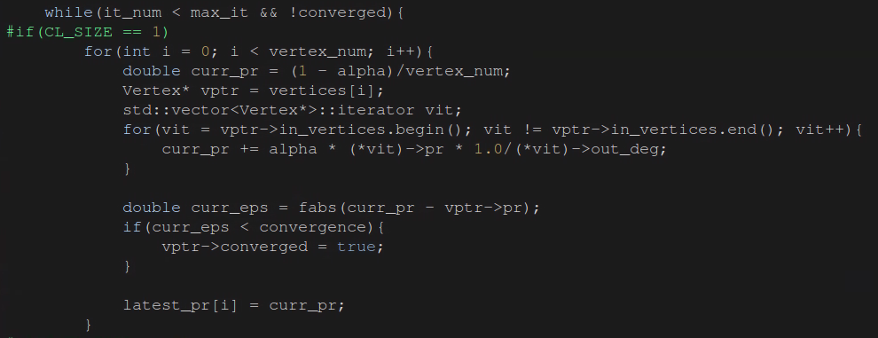
Original code of the pagerank calculation
// Traverse all the vertices in the graph
// Accumulate all the neighbors associated with incoming edges
pagerank_func()
// Keep the ranking result calculated in current iteration. The ranking information will be updated when all the vertices complete the page rank calculation.
The code in the yellow rectangle is put into a single function. It does the page rank calculation of a vertex.

Slide 5
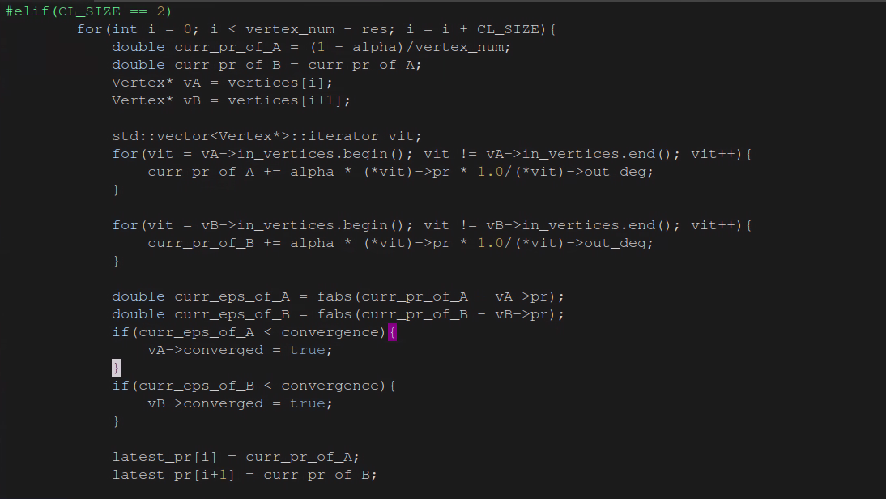
Code of the clustered pagerank calculation
// The vertices in vertices[] are already reordered based on the clustering strategy. This shows the simple combination of the pagerank calculation of vertices in a cluster.
pagerank_func()
When Vertex A and Vertex B share some in_vertices,
in_vertices loading of Vertex B may suffer less cache
because they are just used by Vertex A.

Slide 6
Clustering Strategy
vertex
1
2
3
4
5
6
ID based clustering: Cluster based on vertex ID
cluster
Similarity based clustering without data reorganization
Reorder the vertex based on its in degree
Define similarity by comparing the input vertices. (when
two vertices share the same input vertices, they are considered similar.)
Cluster the vertices based on the similarity. (The vertices with higher
input degree have higher priority to choose vertices to construct a cluster.)
1
2
3
4
5
6
3
2
5
4
1
6
cluster
vertex pointer
Similarity based clustering with data reorganization:
It is similar to strategy 2, the only difference is that
vertices are reorganized based on the clustered order.
3
2
5
4
1
6
cluster

Slide 7
Runtime with Different CL_SIZE
Graph generated using PaRMAT
RMAT1: 100000 vertices and 500000 edges
RMAT2: 100000 vertices and 1000000 edges
RMAT3: 100000 vertices and 2000000 edges
Pagerank runs 100 iterations, each configuration runs five
times and the average runtime is used.
Clustering Based on Vertex ID
Observation:
Reducing the function call has negligible influence on the performance of page rank.
It seems that the clustering even causes slight degradation of the page rank.
The graphs also affect the comparison.

Slide 8
Runtime with Different CL_SIZE
Clustering Based on Incoming Vertex Similarity
Observation:
Similarity based clustering doesn’t help
much with performance improvement. In fact,
it even causes more performance degradation.
Observation:
Similarity based clustering doesn’t help with the performance
improvement as well when the data layout remains unchanged.
Without data replacement, ID based clustering shows
better performance because of the memory access locality.
When the graph layout is updated according to the clustering,
the page rank performance is improved.

