Slide 1
Labeling:
Have the selected data points labeled by an oracle (e.g., a human annotator or a more accurate model).
Model Update:
Add the newly labeled data to the training set.
Retrain the model on the updated training set.
Iteration:
Repeat steps 2-5 until a stopping criterion is met (e.g., a desired accuracy is achieved, a maximum number of iterations is reached, or labeling budget is exhausted).
Steps for Active Learning in Regression:
Initial Training:
Start with a small, labeled dataset.
Train your initial regression model on this dataset.
Select Unlabeled Data:
Choose a pool of unlabeled data that the model can query.
Query Strategy:
Use a query strategy to select the most informative data points from the pool. Common strategies for regression include:
Uncertainty Sampling: Select data points where the model's prediction has the highest uncertainty (e.g., highest variance).
Expected Model Change: Choose points that are expected to cause the greatest change in the model parameters.
Query-by-Committee: Use multiple models to select points where their predictions vary the most.
Variance Reduction: Select points that are expected to reduce the overall output variance of the model.

Slide 2
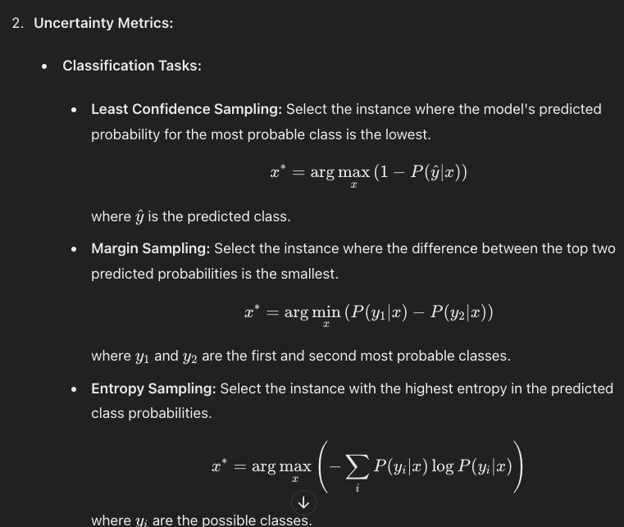
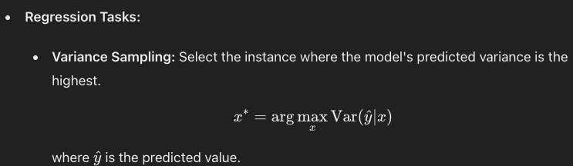

Slide 3
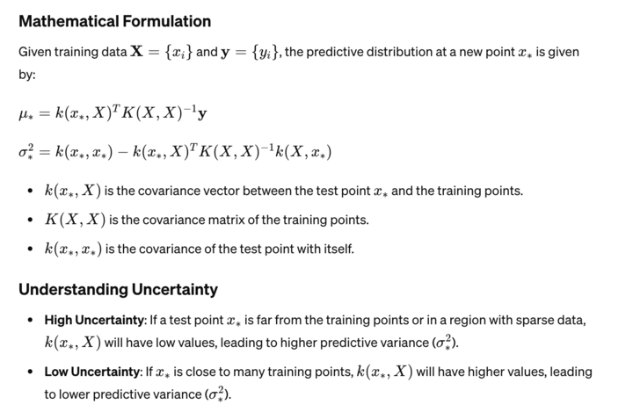
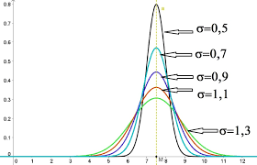
How we get the standard deviation of test point in Gaussian Process Regression

Slide 4
Similar probabilistic model:
Bayesian Ridge Regression: Like GP regression, Bayesian Ridge Regression provides probabilistic predictions and estimates the uncertainty of its predictions. It uses a Bayesian approach and can be computationally more efficient than GPs for large datasets.
Bayesian Neural Networks (BNNs): BNNs are neural networks with Bayesian inference. They can provide uncertainty estimates in predictions by using techniques such as Monte Carlo dropout in inference.
Random Forests: While not inherently probabilistic, Random Forests can estimate prediction uncertainty through techniques such as bootstrapping or by using the standard deviation of predictions from individual trees in the forest.
Gradient Boosting Machines (GBMs): Similar to Random Forests, GBMs are not inherently probabilistic but can estimate uncertainty using techniques such as quantile regression or by using the standard deviation of predictions from ensemble members.
Support Vector Regression (SVR): SVR can provide estimates of prediction uncertainty through techniques such as epsilon-insensitive loss and the use of the support vectors to define the prediction bounds.
Kriging (Gaussian Process Regression in the context of spatial statistics): Kriging is a technique used to interpolate spatial data. It is essentially GP regression applied to spatial data and shares many similarities with GP regression.

Slide 5
difference between a Bayesian neural network (BNN) and a classic convolutional neural network (CNN)
Uncertainty Handling:
BNN: A Bayesian neural network treats weights as probability distributions rather than fixed values. This allows the network to model uncertainty in its predictions. During inference, instead of producing a single output, a BNN produces a distribution of outputs, reflecting its uncertainty about the prediction.
CNN: A classic CNN does not inherently model uncertainty. It produces a single output for each input, representing a point estimate.
Training:
BNN: Training a Bayesian neural network involves learning the parameters of the weight distributions. This can be done using methods like variational inference or Markov Chain Monte Carlo (MCMC) sampling.
CNN: Training a classic CNN involves optimizing the network's weights using techniques like gradient descent.
3.Prediction:
BNN: During prediction, a Bayesian neural network uses techniques like Monte Carlo dropout or MCMC sampling to obtain multiple predictions, reflecting the uncertainty in its output.
CNN: A classic CNN produces a single prediction for each input.
4. Model Size:
BNN: Due to the added complexity of modeling weight distributions, Bayesian neural networks can be more computationally expensive and require more parameters compared to classic CNNs.
CNN: Classic CNNs are generally simpler and have fewer parameters.

Slide 6
1. Variational Autoencoders (VAEs)
VAEs inherently quantify uncertainty through their probabilistic framework. Here’s how to perform uncertainty quantification in VAEs:
Posterior Distribution
Latent Space Sampling: During the training of a VAE, we approximate the posterior distribution 𝑞(𝑧∣𝑥)q(z∣x) using a Gaussian distribution. By sampling multiple latent vectors 𝑧z from this distribution for a given input 𝑥x, we can generate multiple reconstructions of the input. The variance of these reconstructions provides a measure of uncertainty.
Steps:
Train the VAE: Train the VAE on your dataset.
Sample Latent Vectors: For a given input 𝑥x, sample multiple latent vectors 𝑧z from the approximate posterior distribution.
Generate Reconstructions: Use the VAE’s decoder to generate multiple reconstructions from the sampled latent vectors.
Calculate Uncertainty: Calculate the variance or standard deviation of the generated reconstructions.
2. Generative Adversarial Networks (GANs)
GANs do not naturally provide a measure of uncertainty, but there are some techniques to approximate it:
Bayesian GANs
Bayesian GANs: Introduce a Bayesian framework to GANs to estimate uncertainty. This involves placing priors over the GAN parameters and using posterior sampling to estimate uncertainty.
Dropout as Bayesian Approximation
MC Dropout: Apply dropout during both training and inference. By running multiple forward passes with dropout, you can approximate the model’s uncertainty.

Slide 7
3. Diffusion Models
Diffusion models are probabilistic models designed for high-quality sample generation. They inherently involve a stochastic process that allows for uncertainty quantification:
Reverse Diffusion Process
Sampling with Perturbations: During the reverse diffusion process, introduce small perturbations to the noise to generate multiple samples. The variability in these samples can be used to estimate uncertainty.
Steps:
Train the Diffusion Model: Train the diffusion model on your dataset.
Sample with Perturbations: During the reverse diffusion process, introduce small perturbations to generate multiple samples.
Calculate Uncertainty: Compute the variance or standard deviation of the generated samples to quantify uncertainty.
Type of uncertainty:
Epistemic Uncertainty: This arises from model uncertainty due to limited training data. It can be reduced by acquiring more data.
Aleatoric Uncertainty: This arises from noise inherent in the data itself. It is irreducible even with infinite data.

