Slide 1
An Ideal I/O Device Virtualization Framework in DPDK
XIUCHUN LU, CHENBO XIA

Slide 2
Agenda
Way to ideal I/O device virtualization solutions
I/O device virtualization framework in DPDK
Build your emulated device
Current status and next plan

Slide 3
Ideal I/O Device Virtualization Solution
Ideal I/O device virtualization solutions?
VIRTIO?
Yes, then
Can VIRTIO cover all the user scenarios?
Is VIRTIO the only answer to this question?
…

Slide 4
VIRTIO as the Answer
Most likely YES
Platform independent
Unmodified guest
A standardized open interface
A number of open source communities adopted
The performance issue can be addressed by vDPA
What if VIRTIO incompatible devices
High performance
Proprietary accelerators
…

Slide 5
Path to the Ideal I/O Device Virtualization
VIRTIO
IDEAL I/O Device Virtualization
Non-VIRTIO
Lower network B/W
Scaling by core count
C2C MEM movement
Higher TCO
ARBITRATION
Performance
+VDPA
Performance
Performance
VHOST
?
+USER|KERN
+ VFIO
Cloudization
Cloudization
Cloudization
Platform Independent
Unmodified Guest
Live Migrate-able
Pros
Cons

Slide 6
Path to the Ideal I/O Device Virtualization
VIRTIO
IDEAL I/O Device Virtualization
Non-VIRTIO
Lower network B/W
Scaling by core count
C2C MEM movement
Higher TCO
ARBITRATION
Performance
+VDPA
Performance
Performance
VHOST
IOV +
VFIO
+USER|KERN
VFIO-USER +
Cloudization
Cloudization
Cloudization
Platform Independent
Unmodified Guest
Live Migrate-able
Pros
Cons

Slide 7
Platform Independent Composed Device
VNF
VNF
VNF
Driver
Driver
Driver
VMM
VMM
VFIO Obj
VFIO Obj
VFIO Obj
Vfio UAPI Syscall
Vfio-user Client
Vfio-user Client
Vfio-user Server
Vfio-user Server
Emulated Device
Composed Device
SW DP EP
HW DP EP
SW DP EP
SW (vSwitch)
SW (vSwitch)
Physical Device
Physical Device
Physical Device
Physical Device
Hardware (vSwitch)
Hardware Platform
Hardware (vSwitch)
Hardware Platform
MAC
MAC
MAC
MAC
Hardware Device
+
Software BE
=
Composed Device

Slide 8
Agenda
Way to ideal I/O device virtualization solutions
I/O device virtualization framework in DPDK
Build your emulated device
Current status and next plan

Slide 9
I/O Device Emulation Framework Overview
vfio-user protocol: Unix domain socket messages based on VFIO device definition (i.e., Region/IRQ/DMA/…)
Syscall (ioctl/pread/pwrite/…) in kernel vfio -> Socket messages
Client-Server model
VFIO Dev : Device Emulation : DP Provider = 1 : 1 : 1
rte_vfio_user lib and rte_emudev lib enable DPDK to be an alternative I/O device emulation library

Slide 10
How to Build Your Emulated Device
device emulation uses rte_vfio_user lib and rte_emudev lib
rte_vfio_user lib
act as vfio_user server in this case
provide client implementation for container usage
rte_emudev lib
abstracted as emudev device

Slide 11
Emudev Device: Objects
Regions
Queue
Queue
Queue
…
Queue
…
Memory table
Emudev Device
Emudev device objects
Regions: device layout
Queues: address/size + doorbell + interrupt
Memory table: DMA mapping table

Slide 12
Emudev Device: Ops
For application
Lifecycle management
Region info config and set
Register notify callback
For data path provider
Register notify callback
Region channel setup and read/write
Queue and queue notify scheme setup
DMA table setup
struct emu_dev_ops {
int (*dev_start)(…);
void (*dev_stop)(…);
int (*dev_configure)(…);
int (*dev_close)(…);
Lifecycle
int (*subscribe_event)(…);
int (*unsubscribe_event)(…);
Notify
int (*region_map)(…);
int (*get_attr)(…);
int (*set_attr)(…);
Region
int (*get_queue_info)(…);
int (*get_irq_info)(…);
int (*get_db_info)(…);
Queue
int (*get_mem_table)(…);
DMA
};

Slide 13
How to Build Your Emulated Device
Data path provider could be a virtual device (vdev) or PCI device driver
Could be Ethdev
Emudev APIs + Ops provided by device emulation

Slide 14
Build up for SW/HW Data Path Provider
Query device info
Similar for SW/HW
Set up regions/queues
SW: set up all regions/queues
HW: only set up Control Plane (CP) regions/queues
Set up DMA
SW: maintain the whole DMA table
HW: maintain part of DMA table in software (for CP), rest used to set up HW IOMMU
Register event callback

Slide 15
Hands on Composed Device
Device follows Intel Adaptive Virtual Function (IAVF) specification

Slide 16
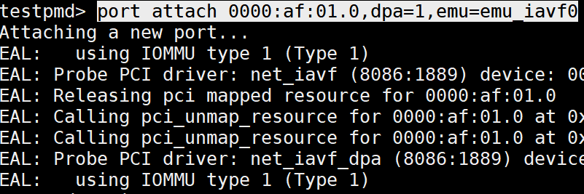
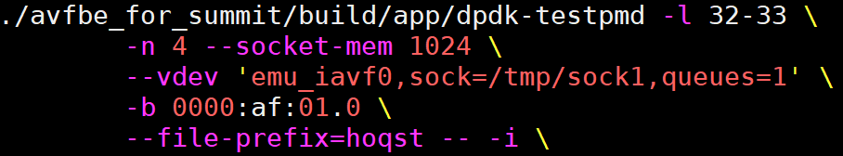
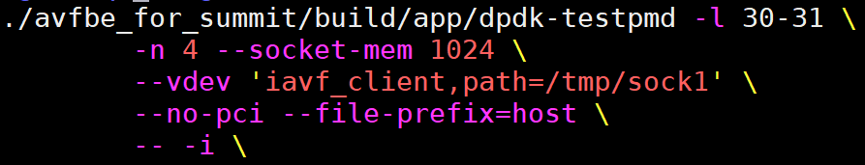
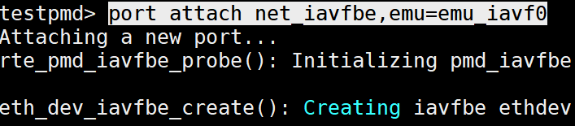
Hands on Composed Device
Server attaches HW Data Plane:
(Provided by Intel E810 NIC)
Server:
Client:
Server attaches SW Data Plane:

Slide 17
Agenda
Way to ideal I/O device virtualization solutions
I/O device virtualization framework in DPDK
Build your emulated device
Current status and next plan

Slide 18
Status & Plan
vfio-user Protocol patch (v7)
https://patchew.org/QEMU/20201130161229.23164-1-thanos.makatos@nutanix.com/
DPDK patch
rte_vfio_user lib: http://patchwork.dpdk.org/project/dpdk/list/?series=14711
rte_emudev lib + iavf emudev driver: http://patchwork.dpdk.org/project/dpdk/list/?series=14712
iavf back-end driver: http://patchwork.dpdk.org/project/dpdk/list/?series=14570&state=*
iavf client driver: http://patchwork.dpdk.org/project/dpdk/list/?series=14576&state=*
DPDK sub-tree
http://git.dpdk.org/draft/dpdk-draft-emudev/
Contact
XIUCHUN LU (xiuchun.lu AT intel.com) / CHENBO XIA (chenbo.xia AT intel.com)

