Slide 1
Efficient Federated Learning System for Large Language Models Fine-tuning
(Final Presentation)
Student Name:
Student ID:
Supervisor:
Co-Examiner:
2nd Assessor:
Date:
LIU Qianli
20080796D
Dr ZHANG Zhaorui
Dr ZHOU Kai
Dr LUO Wei
2024 April 20

Slide 2
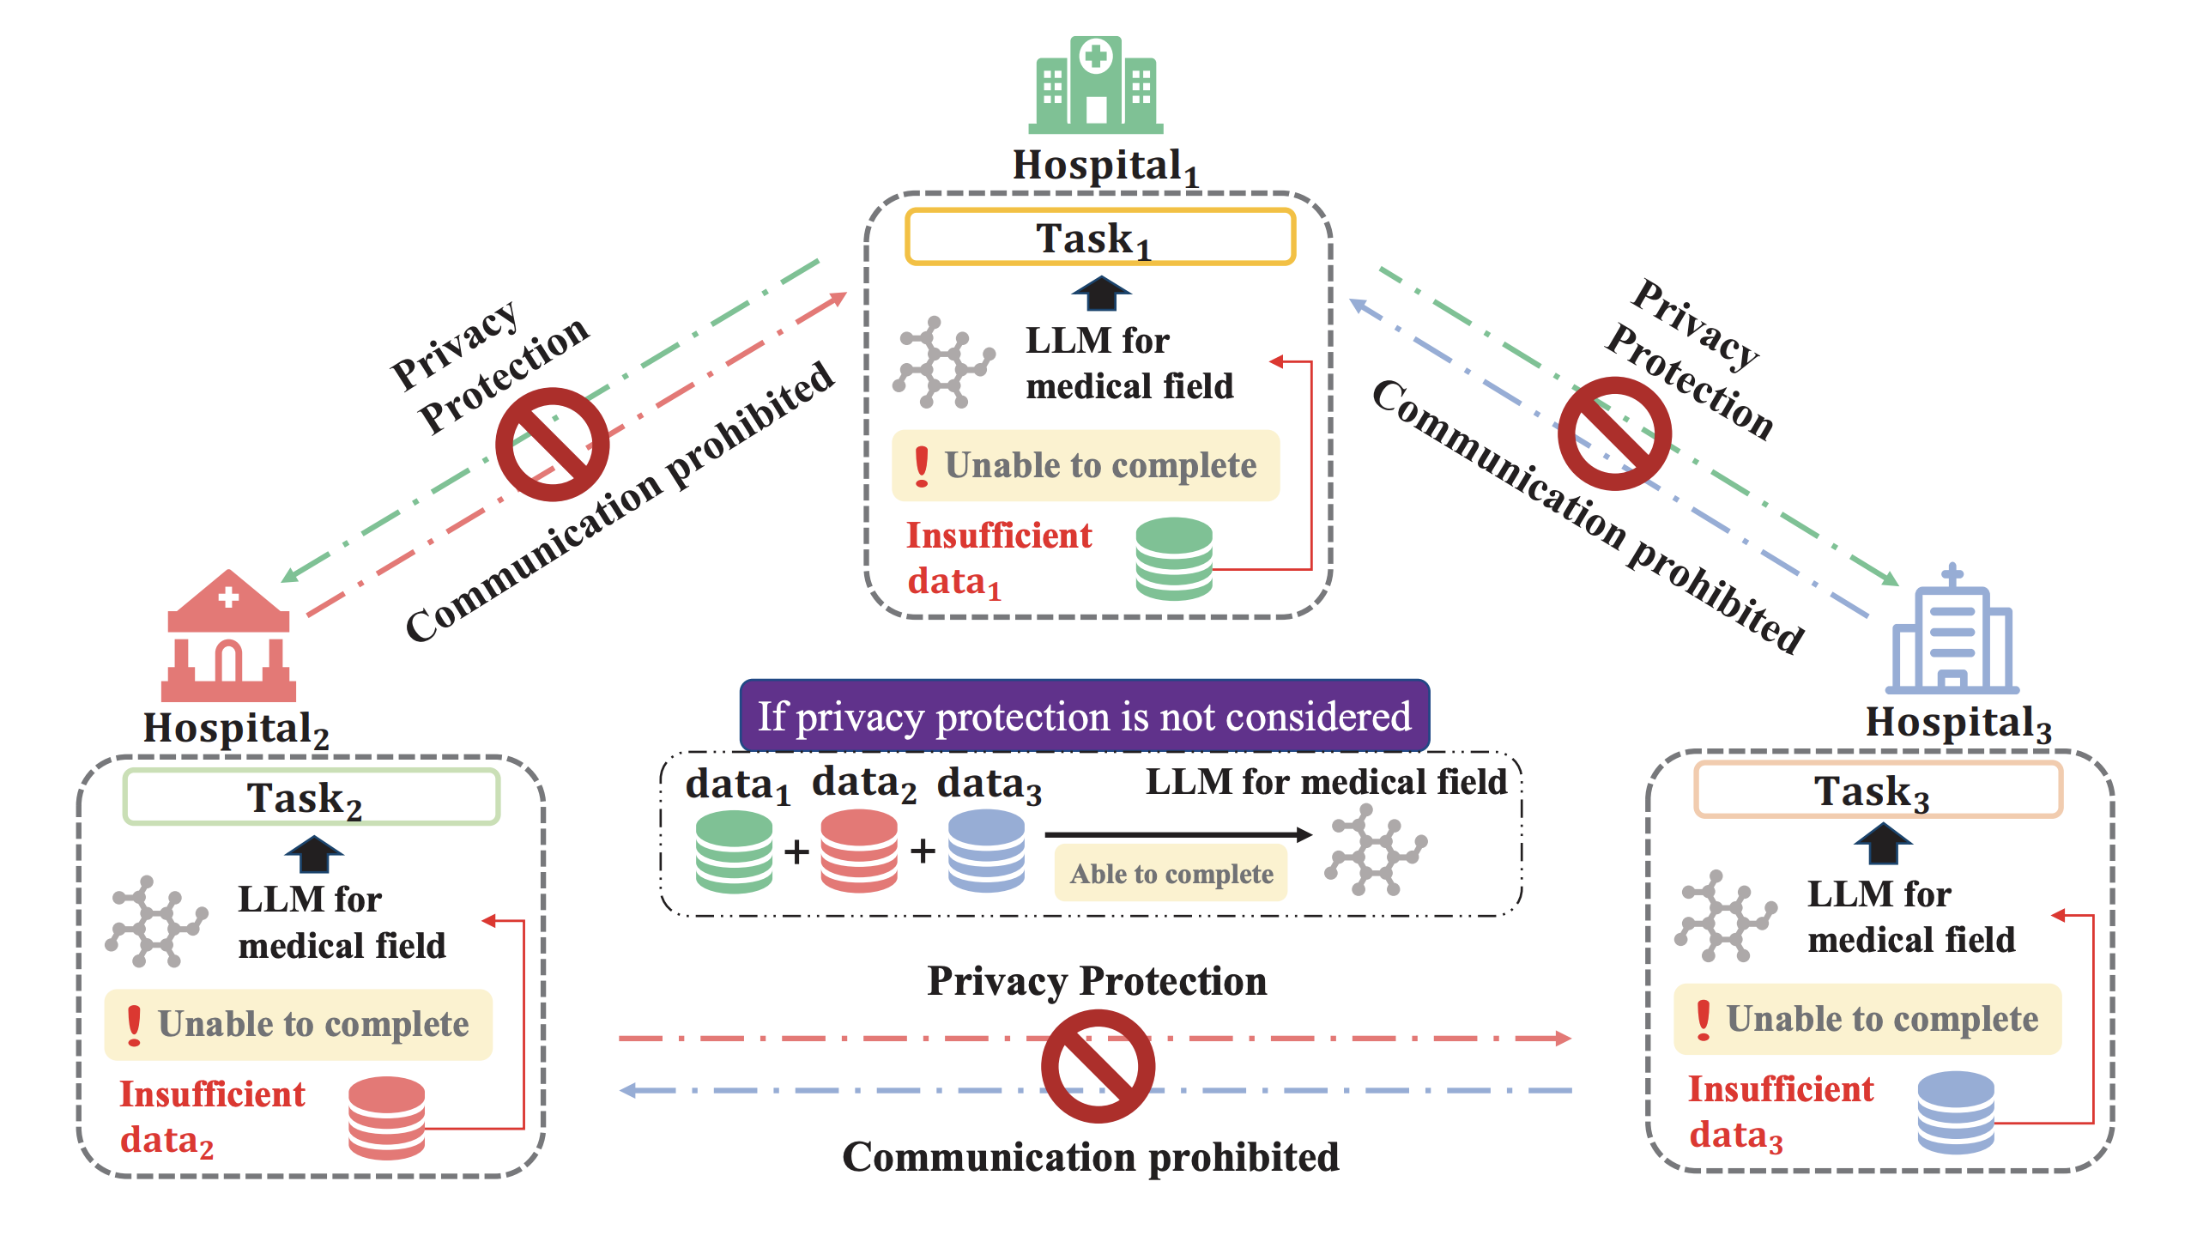
1. Background
The Age of LLM
Large Language Model (LLM), like ChatGPT, Claude and LLaMa, have significantly succeeded.
Their success hinges on the large model sizes and large training datasets​​.
Fine-tuning Data Dilemma
Public domain data does not always provide more knowledge for pre-trained LLMs
Private sectors have rich data but are restricted due to privacy concerns and competition.
Notes:
Imagine there are three hospitals, each with their own valuable medical data, but none of them have enough on their own to really make a difference. They want to use this data to improve a large language model (LLM) specifically for medical purposes. If they could somehow combine their data, it would be a game-changer for training medical LLMs. But here's the catch: strict data privacy laws make it really hard for them to share this information. This situation highlights a big problem: they're stuck between not having enough data and needing to keep patient information private.

Slide 3
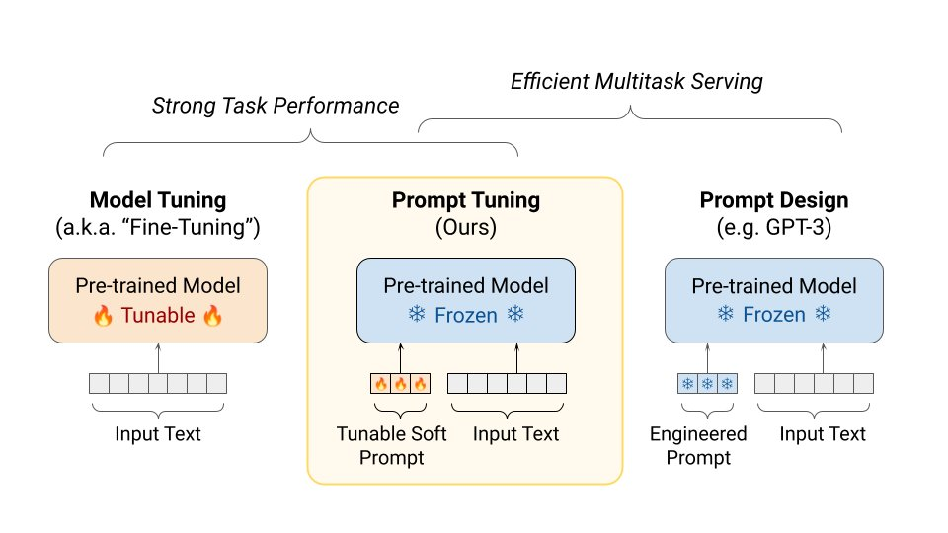
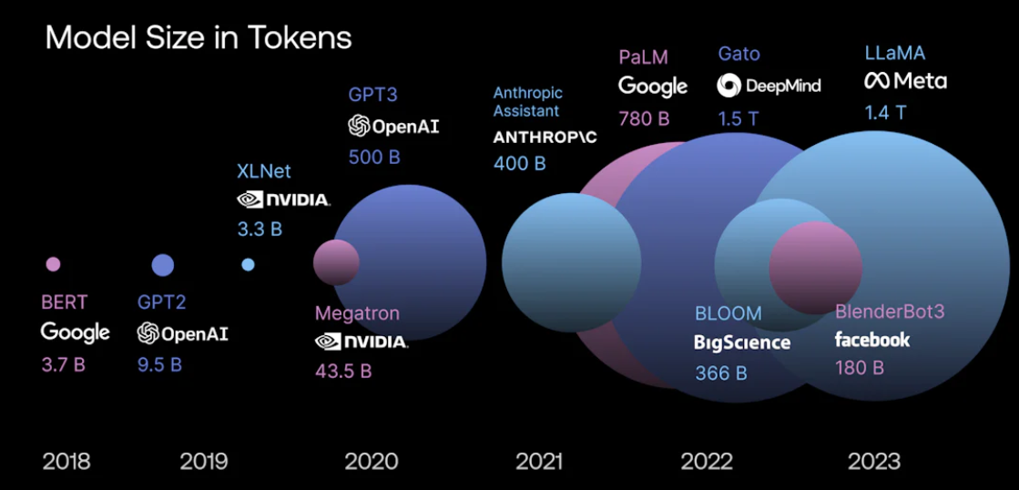
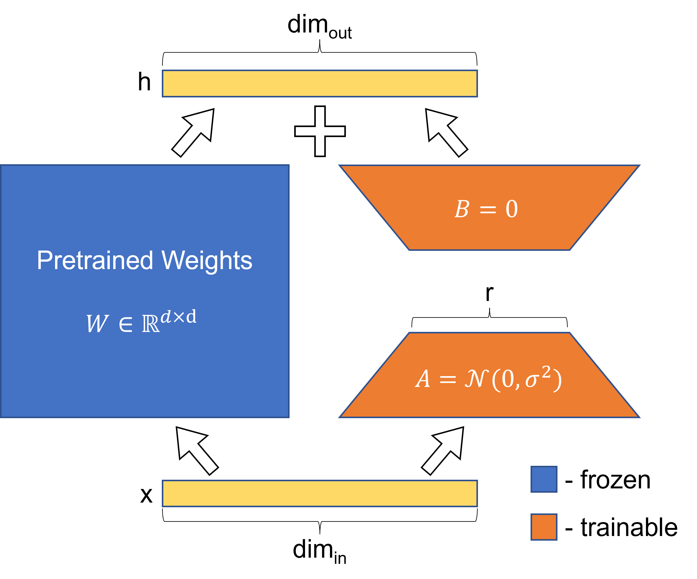
PEFT: Parameter Efficient Fine Tuning
Challenge:
LLM size grows rapidly and model fine-tuning consumes a costly amount of resources
E.g. The 7B version of LLaMa 2 requires more than 28G of GPU memory for inference (not even fine-tuning), and a fine-tuning takes time measured in days!
Solution:
Introduce a minimal number of additional trainable parameters to enhance model performance while maintaining pre-trained parameters that are frozen.
LoRA: Low-rank Adaption (SOTA)
Prompt Tuning

Slide 4

PEFT: Parameter Efficient Fine Tuning
LoRA: Low-rank Adaption (SOTA)
Prompt Tuning
LoRA (Low-Rank Adaptation) enhances pre-trained models by introducing trainable low-rank matrices that adapt the existing layers.
Prompt Tuning extend the model by appending trainable dimensions to the inputs and hidden layers, thereby modifying the initial conditions or processing pathways of the network.
$$W′=W_{0}+ΔW=W_{0}+BA$$

Slide 5
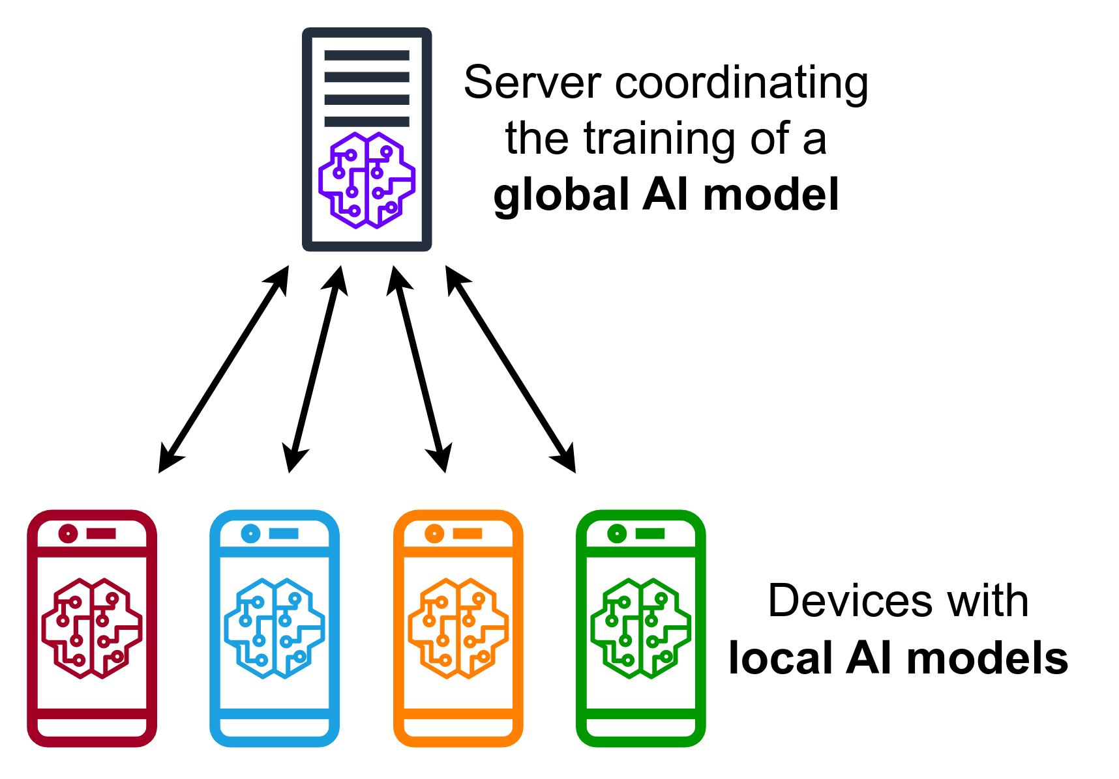
Federated Learning
Why Federated Learning
Decentralized devices or servers collaborate to train a model without sharing their actual data.
Allows participants to contribute to a shared model while maintaining the privacy and security of their own datasets.
Challenge in Federated Fine-tuning
Heterogeneity of data exists between different clients, and the effectiveness of the global model is affected by the distribution of client data.
The communication cost of transmitting LLM weights for large language models is unaffordable since LLM parameter size is very large.
Notes:
Fine-tuned large language models (LLMs) have increasingly become integral to applications across various domains, though the fine-tuning process often relies on large-scale, domain-specific datasets. Typically, these datasets are distributed among multiple stakeholders, each possessing only a fraction of the data required for effective model training, and direct data sharing is frequently restricted due to privacy concerns.

Slide 6
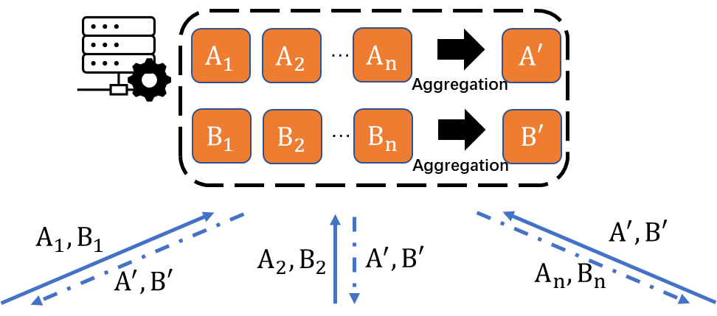
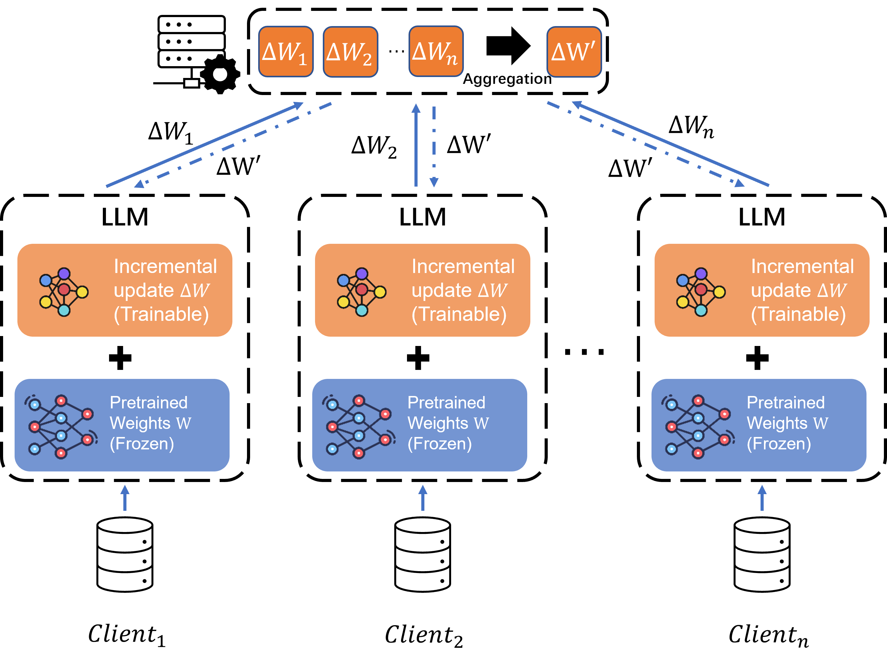
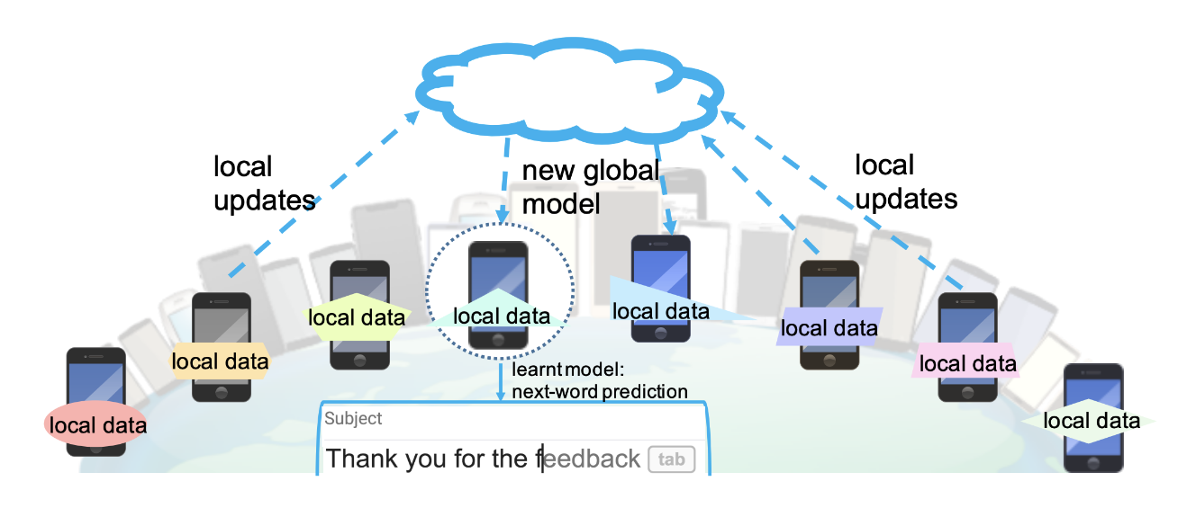



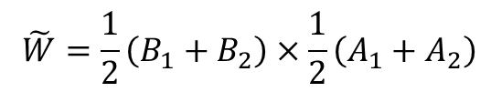
Federated LoRA: Naïve Implementation
Step 1: Local Fine-tuning
Step 3: Global Aggregation
$$\tilde{W}=\frac{1}{2}\left(B_{1}+B_{2}\right)×\frac{1}{2}\left(A_{1}+A_{2}\right)$$
$$W′=W_{0}+ΔW=W_{0}+BA$$
Step 2: Uploading Low Rank Matrix
Step 4: Client update
Sent $B_{i},A_{i}$ to Server
$$B_{k}=B^{′}, A_{k}=A′$$
Notes:
Fine-tuned large language models (LLMs) have increasingly become integral to applications across various domains, though the fine-tuning process often relies on large-scale, domain-specific datasets. Typically, these datasets are distributed among multiple stakeholders, each possessing only a fraction of the data required for effective model training, and direct data sharing is frequently restricted due to privacy concerns.

Slide 7
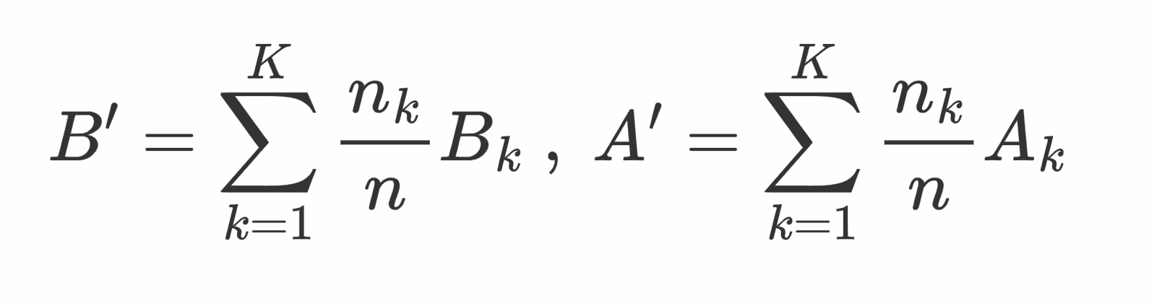
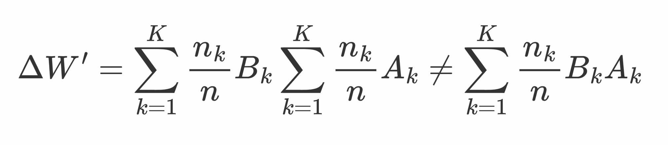
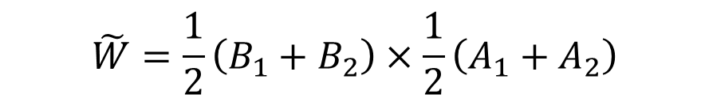
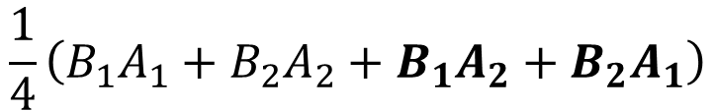
Limitation of Naïve Implementation
1. Introducing Inconsistency
Act as decoder
Act as encoder
$$\tilde{W}=\frac{1}{2}\left(B_{1}+B_{2}\right)×\frac{1}{2}\left(A_{1}+A_{2}\right)$$
$$\frac{1}{4}\left(B_{1}A_{1}+B_{2}A_{2}+B_{1}A_{2}+B_{2}A_{1}\right)$$

Slide 8
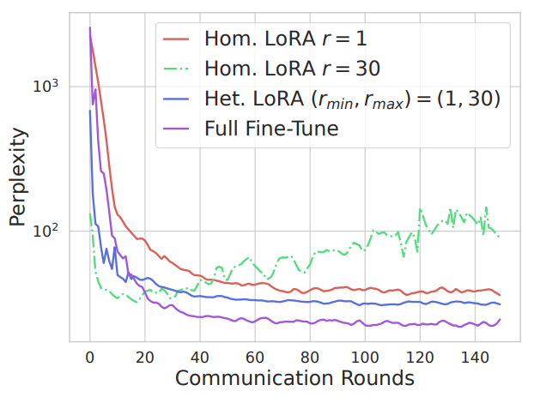
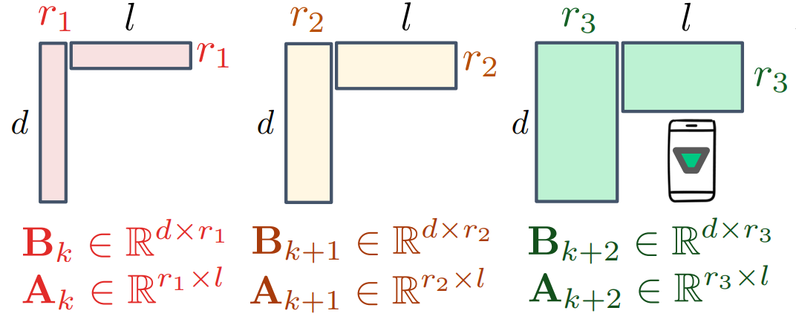
Limitation of Naïve Implementation
2. Cannot handle Heterogenous rank
Unable to aggregate heterogeneous rank
LoRA is rank-sensitive

Slide 9
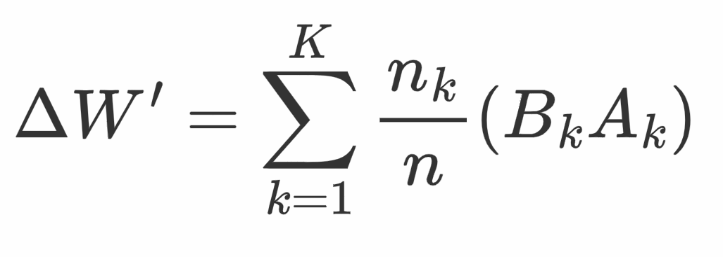
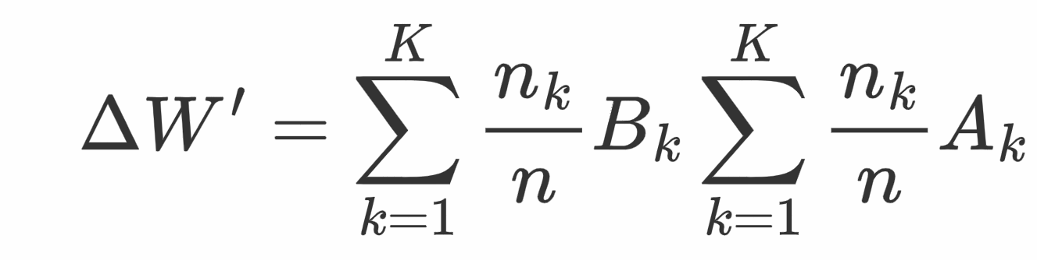
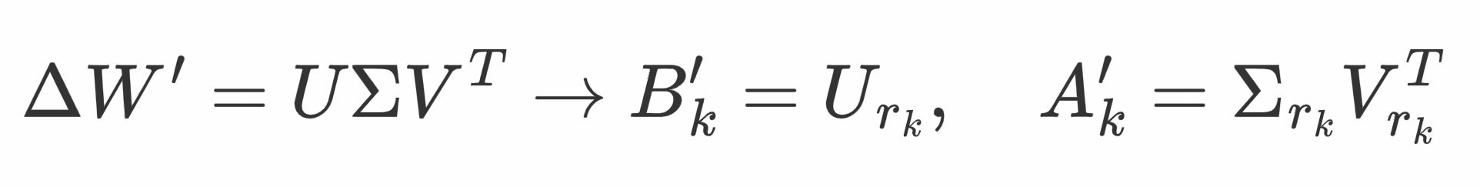
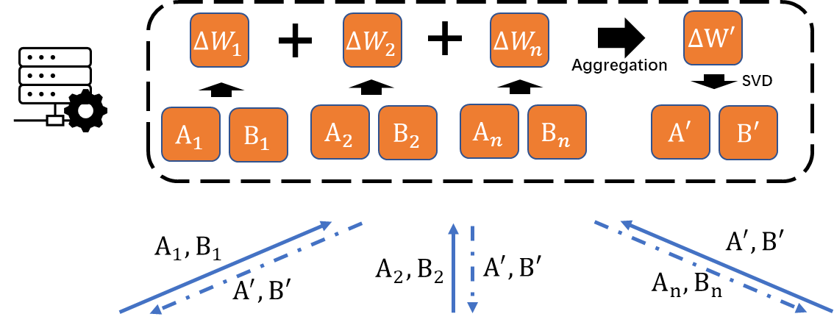
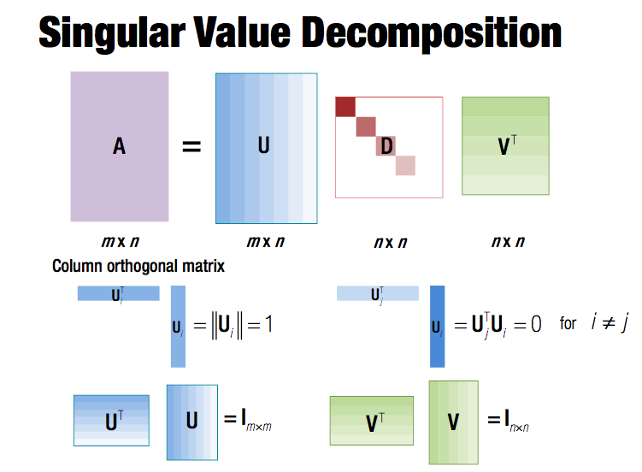
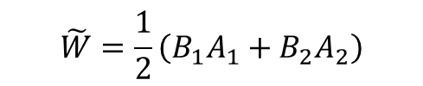
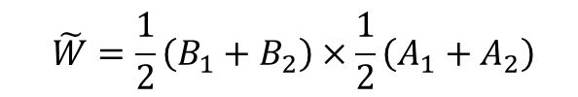
Proposed Method: Federated Reconstruct LoRA
Step 1: Reconstruction and Aggregate
Current Solution
Naïve Implementation
Ensures each client’s adaptors contribute as unified entities, preserving the inconsistency
$$\tilde{W}=\frac{1}{2}\left(B_{1}+B_{2}\right)×\frac{1}{2}\left(A_{1}+A_{2}\right)$$
Step 2: Decomposition and Assign the Ranks
Our Design
SVD decomposition to obtain the result of matrix decomposition
Obtain a low-rank matrix of specified rank by intercepting the singular value matrix
$$\tilde{W}=\frac{1}{2}\left(B_{1}A_{1}+B_{2}A_{2}\right)$$
Notes:
Fine-tuned large language models (LLMs) have increasingly become integral to applications across various domains, though the fine-tuning process often relies on large-scale, domain-specific datasets. Typically, these datasets are distributed among multiple stakeholders, each possessing only a fraction of the data required for effective model training, and direct data sharing is frequently restricted due to privacy concerns.

Slide 10
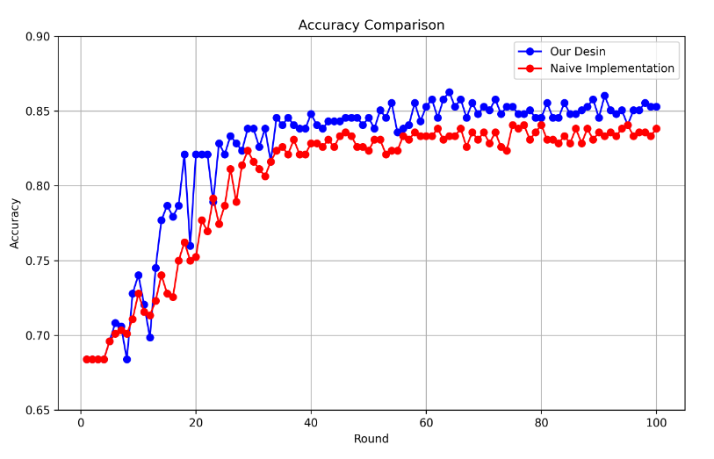
Experiments
Experiment Setting
Experiment Result 1
Environment: NVIDIA 4090 * 6
Model: RoBERTa-large (335M)
Dataset: GLUE benchmark (MRPC task)
FL setting： 100 Client, 20 per round
Optimizer: SGD(lr = 0.01)
Other:
Total 100 communication rounds
Data is non-iid and follow Dirichlet distribution
Federated Reconstruct LoRA & Naïve implementation
Achieved 103.79% performance compared to baseline
Notes:
shows the convergence speed and final performance of the naive implementation

Slide 11
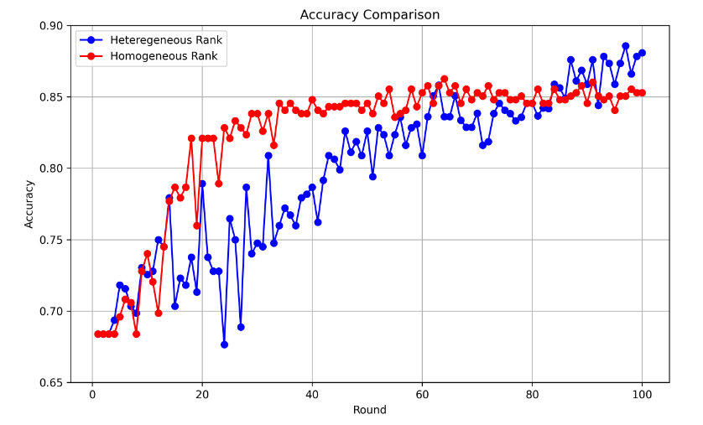
Experiments
Experiment Setting
Experiment Result 2
Environment: NVIDIA 4090 * 6
Model: RoBERTa-large (335M)
Dataset: GLUE benchmark (MRPC task)
FL setting： 100 Client, 20 per round
Optimizer: SGD(lr = 0.01)
Other:
Total 100 communication rounds
Data is non-iid and follow Dirichlet distribution
Heterogeneous Rank
VS
Homogeneous Rank
Slower converge
But avoid overfitting

Slide 12
Conclusion
Future Work
We explore the inconsistencies that arise from the direct application of LoRA in FL and explain the potential reasons for performance degradation.
We propose an innovative FL system that aggregates different rank LoRA modules from heterogeneous setting
We conducted a series of tests and evaluations to confirm that our approach is more effective than current solution.
Whether there are optimal rank assignments between different clients in the federated learning setting
Whether there are optimal rank assignments at different stages of model training.
Notes:
During the experiment, it was found that when the data is heterogeneous, different clients randomly assigned different ranks will make the global model perform better.Next, we will explore whether there are optimal rank assignments between different clients in the federated learning setting, or whether there are optimal rank assignments at different stages of model training.

