Slide 1
Privacy-Preserving Recommendation of User Abnormal Behavior using Multilayer Network Analysis
Based on Tianchi: OneID Dataset

Slide 2
Machine Learning (ML) Dilemma
Need Enough Features to train: Security operators must construct enough features that characterize user behavior. But such features may require ``peeking'' at detailed user information such as IP addresses, cookies, and locations, which generally violates user privacy agreements.
Hard to collect enough Features: In addition, standard machine learning models require a multitude of features to build a well-trained model, but it is difficult to work with or collect such large amounts of data. Insufficient amounts of data can lead to over-fitting in resultant models.

Slide 3
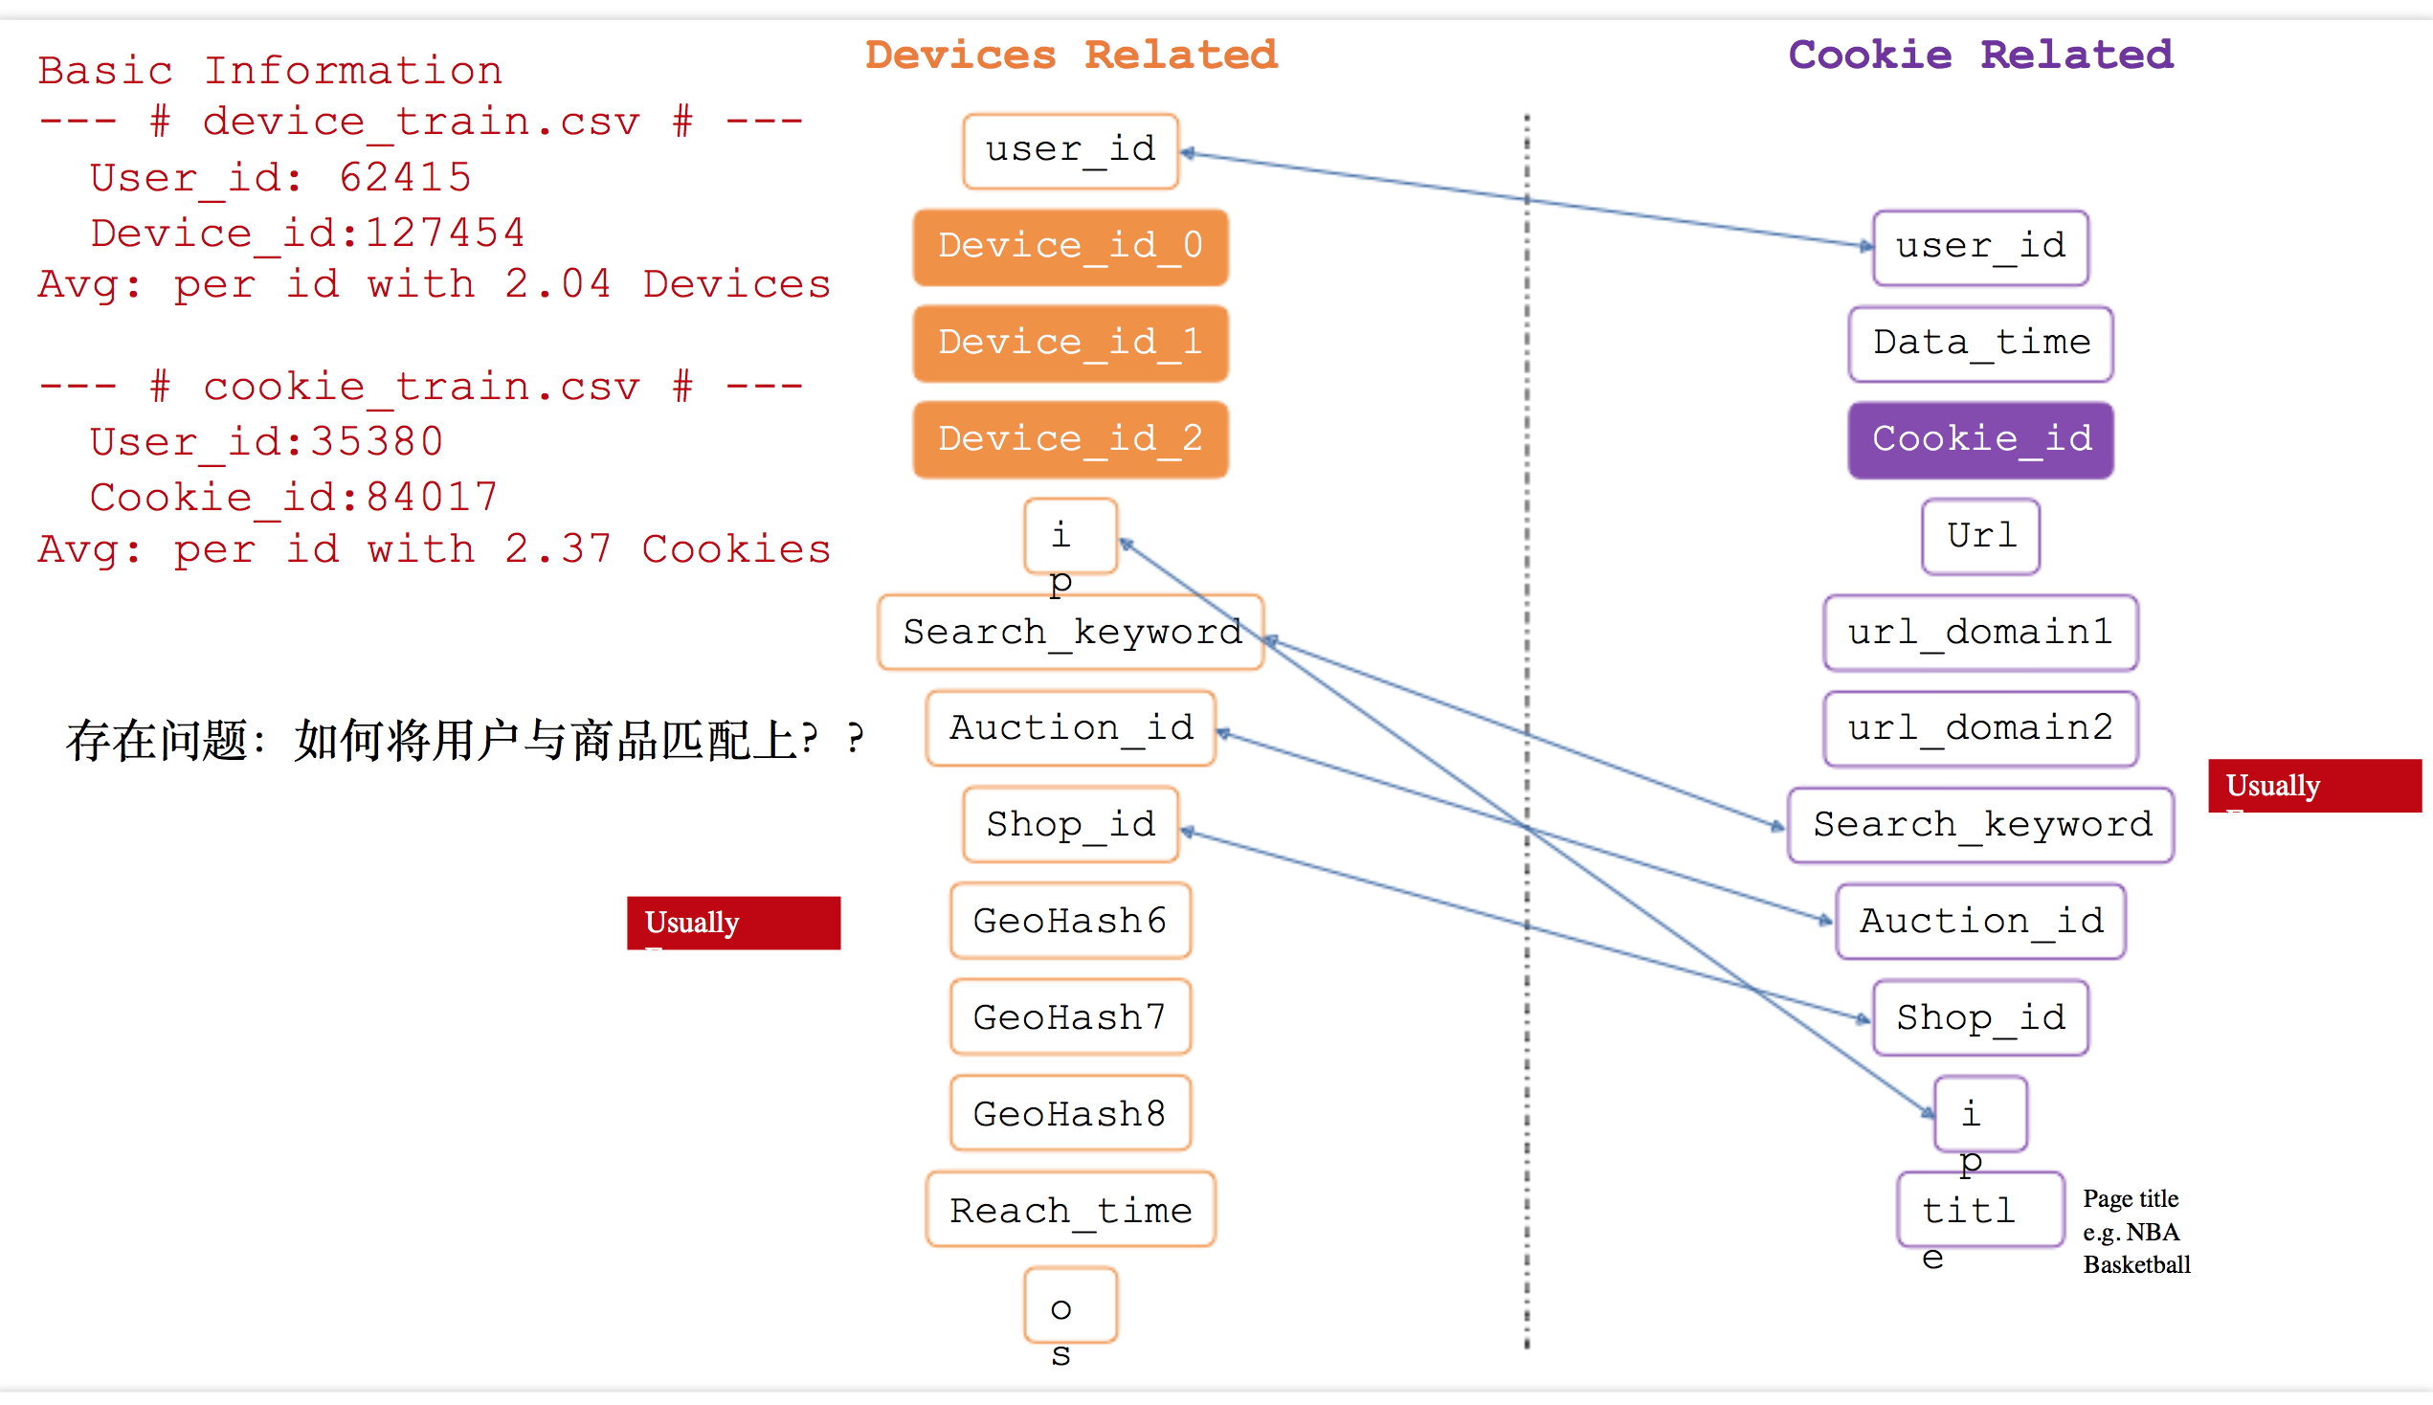
(PER User Useful Features) User_ID Based :
IP
Device (at most 3 devices!)
Device_id_0
Device_id_1
Device_id_2
Reach_Time/Data_Time
--infer--> Different Time Duration per item
Cookies_id
Privacy Logs for User: A Toy Example from TianChi:OneID Dataset

Slide 4
Things for Paper

Slide 5
Private-Preserving System
Real User
User
Information
Login Account
Deny!
Imposter

Slide 6
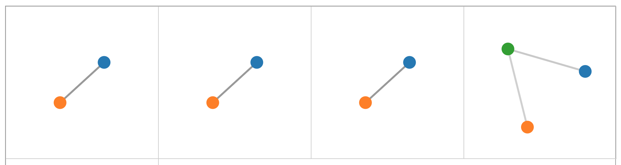





User
Database
Majority Cluster
Outliers
Outlier(s)
Recommendation
Multilayer Network Embedding
Alg: Outliers Recommendation
Data
Cleaning
…
Alg: node2vec on Multilayer Network
$$t_{1}$$
$$t_{2}$$
$$t_{3}$$
$$t_{4}$$
$$t$$
Visualization
Time-Based Behaviors Grouping
Multilayer Network Based
User Behavior Representation
Majority Community
Outliers
Multilayer Network Community Detection
Alg: Mean △T Grouping
Alg: Multilayer Network Construction
Alg: Weighted Multilayer Network Community Detection
Multilayer Network Construction Module
Multilayer Network Analysis Module
Recommendation System Module

Slide 7
Construct User ID -> Multilayer Network
User Logs
Multilayer Network
User ID: A0001
Devices: d1, d2
Login Time: 2017-10-02 08:01:00
Logged Behavior: XXX
d1
d2
User ID: A0001
Devices: d1, d2, d3
Login Time: 2017-10-02 08:01:20
Logged Behavior: XXX
d1
d3
d2
User ID: A0001
Devices: d2, d3
Login Time: 2017-10-02 08:01:40
Logged Behavior: XXX
d2
d3

Slide 8
Viz System

Slide 9
Viz Architecture
Multilayer Network Visualization
If has abnormal:
Mark Abnormal
User
Database
User Statistics Extraction
Abnormal Recommendation
Total Nodes
Time Groups
Time Intervals
Score Groups
Analysis Results
Security Score
Reasoning

Slide 10
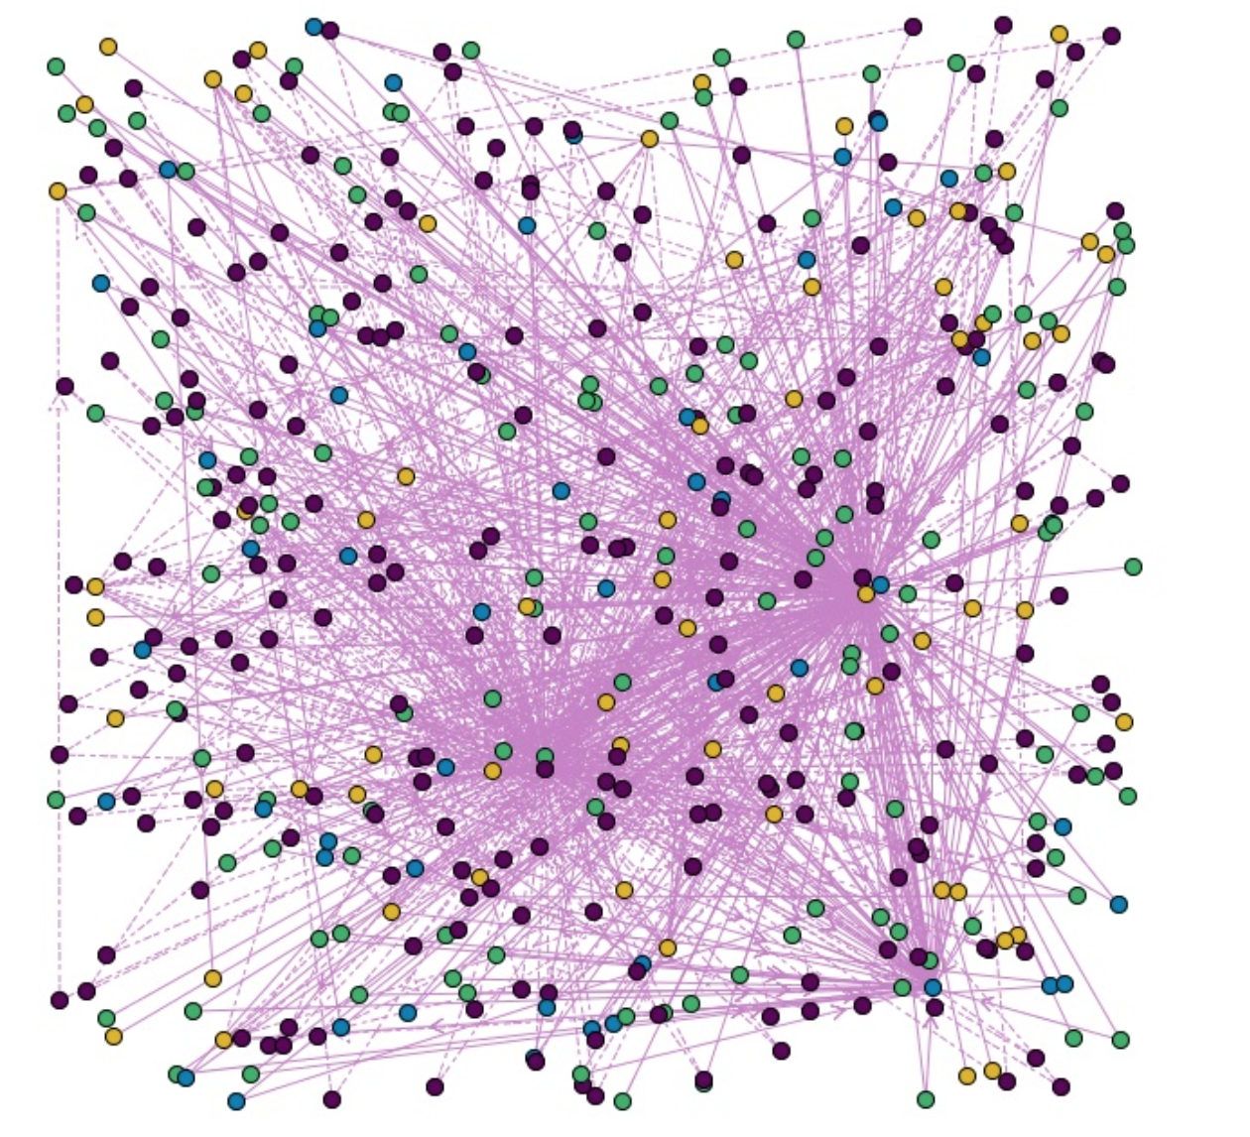
Scenario 1: Log-in System For ALL USER
输入ID方框
可以直接输入User ID
可以通过下拉菜单选择User
Please Input User ID:
所有节点的Network网络图
每一种颜色代表一个User
这个图应该是随机布局的。目的是为了展示“混乱”程度。
图上的点是可以点击的。点击效果和上面输入Id方框的效果是一样的。
p.s.如果节点太多，就随机展示100个左右就OK了

Slide 11
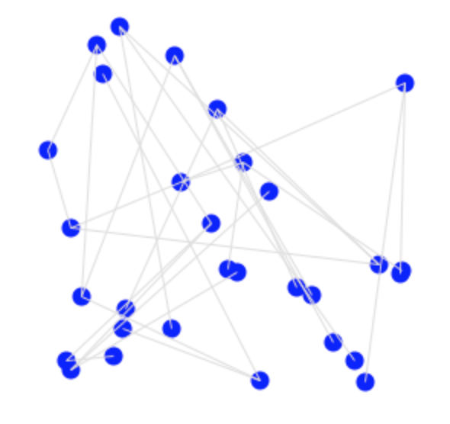
Scenario 2: Log-in System For ONE USER
当前user的ID号
点击按钮直接跳到Scenario2，展示网络图像
XXXXXXX
User Behavior Construction
All Encrypted Features:
Search keyWord …
IP: …
只展示一个User。。。
当前一个User在所有时间下的Devices之间的随机布局。每一种颜色代表一个Devices。
Show每一个Encrypted Feature！！
Search_KeyWord: asdfi***
IP: asdfwqerqwe***
All Related Information are encrypted!

Slide 12

Scenario 3: User Behavior Demonstration
p.s. 如果能做延时效果更棒！
每一个Layer之后都sleep比如说5s
Current User ID: XXXXX
device3_t4
device2_t1
device2_t2
device2_t3
Weight=1
Weight=1
Weight=1
Weight=1
device2_t4
Weight=0.3
device1_t1
device1_t2
device1_t3
device1_t4
t1
t2
t3
t4
Current User Statistics:
Total Devices: 3
Time Groups: 4
Time Interval: 899s
User Behavior Analysis
通过下拉菜单展示每种颜色的Device ID号

Slide 13
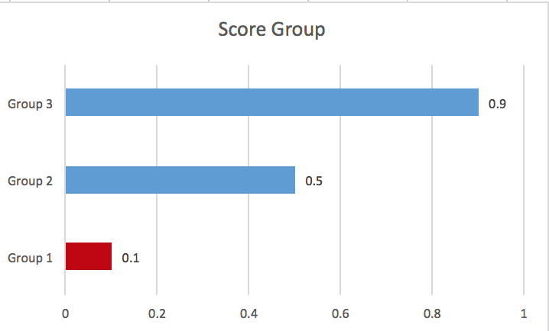
Scenario 4: Abnormal User Demonstration
Current User ID: XXXXX
device3_t4
device2_t1
device2_t2
device2_t3
Weight=1
Weight=1
Weight=1
Weight=1
device2_t4
Weight=0.3
device1_t1
device1_t2
device1_t3
device1_t4
t1
t2
t3
t4
Score Group Details
Analysis Results
Group 1
1. User Security Score
Group 2
Group 3
2. Reasoning
Different Devices Behavior.

Slide 14
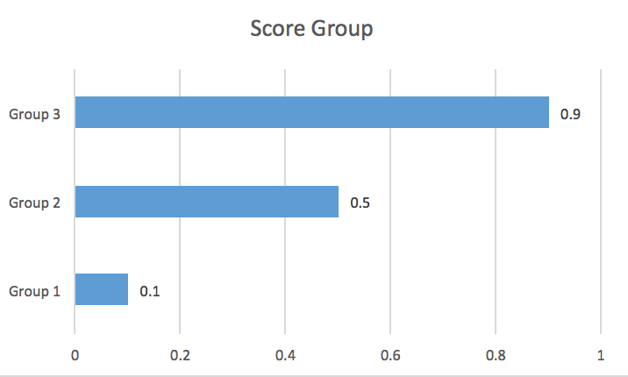
Scenario 5: Normal User Demonstration
Current User ID: XXXXX
device3_t4
device2_t1
device2_t2
device2_t3
Weight=1
Weight=1
Weight=1
Weight=1
device2_t4
Weight=0.3
device1_t1
device1_t2
device1_t3
device1_t4
t1
t2
t3
t4
Score Group Details
Analysis Results
Group 1
1. User Security Score
Group 2
Group 3
2. Reasoning
Normal User

