Slide 1
Tianchi: OneID

Slide 2
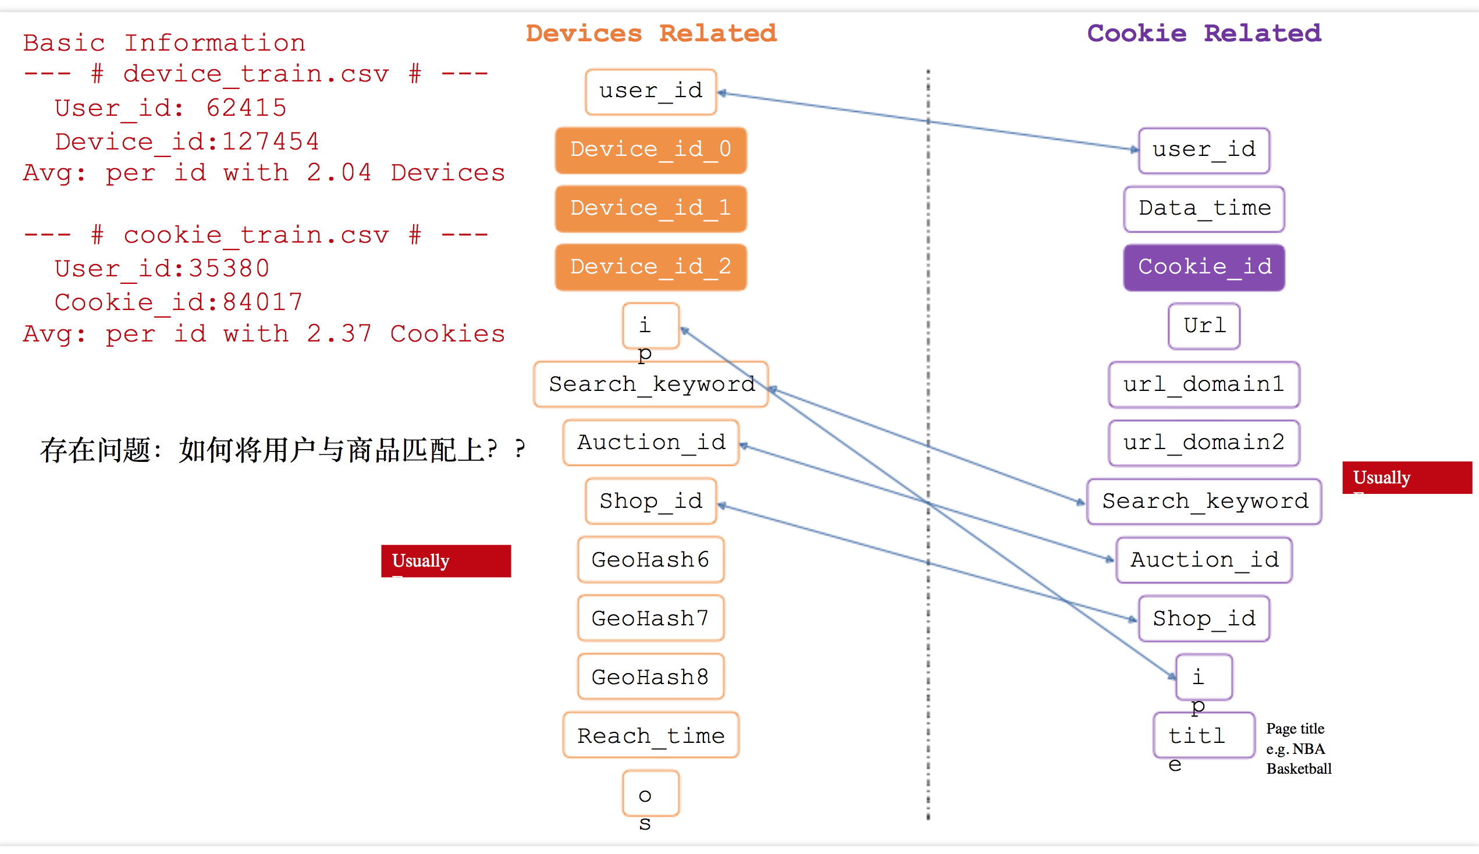

Slide 3
Data Statistics
(PER User Useful Features) User_ID Based :
IP
Device (at most 3 devices!)
Device_id_0
Device_id_1
Device_id_2
Reach_Time/Data_Time
--infer--> Different Time Duration per item
Cookies_id

Slide 4





Outlier in Vector Space
Multilayer Network Embedding
…
Alg: node2vec on Multilayer Network
Outlier(s)
Recommendation
User
Database
Data
Cleaning
Time-Based Behaviors Grouping
$$t$$
$$t_{1}$$
$$t_{2}$$
$$t_{3}$$
$$t_{4}$$
Alg: Median △T Grouping
Multilayer Network Based
User Behavior Representation
Outlier in Graph Topology
Graph Analysis
Alg: Feature-based Jaccard Similarity
Alg: Weighted Multilayer Network Community Detection

