Slide 1
WORKSHOP 2 · 30 SEPTEMBER · 90 MINUTES
Visual & Physical Data
Levels 3, 4 and 5. Images, multi-step reasoning, and data you collect yourself.
Chatbot Challenge 2026 · Open lab for 30 minutes afterwards
Notes:
TIMING: Before start / 1 min
Facilitator note: Three of the five blocks are labs. Teams should have their own bots running. If a team has nothing working, put them with a mentor in block 1 rather than letting them watch.
Okay, let's get started. Welcome back.
Two weeks ago, in Workshop 1, we built the basic loop: scrape, chunk, embed, retrieve, answer, then score it against the fifteen dev questions. The homework for the 23rd was your own scraper on both websites and a bot scoring above zero on Levels 1 and 2. Most of you should be there now.
Today is about the three levels that loop can't do on its own. Level 3 is answers that only exist inside images. Level 4 is questions where the answer isn't written down anywhere, so your bot has to put it together. Level 5 is data that isn't online at all. You collect it yourselves, in this building.
Same format as last time. Five blocks, ninety minutes, and three of the blocks are labs, so keep your laptops open and your bot ready to run. If your team has nothing running right now, put your hand up and a mentor will sit with you. The labs assume you can run your bot and get a score. After this there's a thirty-minute open lab, same as last time.

Slide 2
Today's Session
Lv3
Visual retrieval
40% of the preliminary round
Block 2 and 3
Lv4
Reasoning
About 30% of the final
Block 4
Lv5
Physical world
About 40% of the final
Your own time
A bot that handles only Levels 1 and 2 covers 60% of the preliminary round and none of the final round.
This session covers the remaining three levels.
02
Notes:
TIMING: 2 min
Here's why today matters for your score.
[Point at each column.] Level 3, visual retrieval, is 40% of the preliminary round. That's blocks 2 and 3. Level 4, reasoning, is about 30% of the final. That's block 4. Level 5, the physical world, is about 40% of the final. Most of that happens in your own time. We'll just set it up in block 5.
Look at the line at the bottom. If your bot only handles Levels 1 and 2, which is roughly where Workshop 1 left you, you're capped at 60% of the preliminary and you get nothing in the final. So what you built last time is the base. It isn't enough by itself. Today covers the other three levels.

Slide 3
1
BLOCK 1
Sharing
Three teams report on the image-data homework. Everyone posts a per-level score.
15 MIN
03
Notes:
TIMING: BLOCK 1: 15 min total
Block 1. Fifteen minutes, and it's mostly you talking.
The homework due today was to get your bot answering questions where the answer is only in an image. We gave you no method and said we didn't expect it to work. So this block is about what you tried and where it broke.
First, everyone posts a score for each level. Then three teams report back.
[Share the scoreboard link or sheet. Give teams about 3 minutes to fill in their row.]

Slide 4
Where Everyone Is
Team Lv1 Lv2 Lv3 Lv4 Lv5 Total
.... 3/3 2/3 0/3 0/3 0/3 5/15
.... 3/3 3/3 0/3 1/3 0/3 7/15
.... 2/3 2/3 1/3 0/3 0/3 5/15
Zero on Lv3 is expected
The homework asked you to try something we had not taught. Most teams will have scored nothing, and that is the intended starting point for block 2.
Three teams, two minutes each
What approach did you take to image data?
Where exactly did it break?
What did the score do?
Describe what you tried and what happened, rather than what you planned to build.
04
Notes:
TIMING: ~12 min
Facilitator note: Pick the three teams during the break beforehand, not on the spot. Choose one that got something working and two that failed differently.
[The dotted rows are placeholders. Replace them with the real sheet, or show the live sheet instead.]
Take two or three minutes. If you haven't run the dev set today, run it now and fill in your row, one score per level.
[When most rows are in:] Look at the Level 3 column. Mostly zeros. That's what we expected. The homework asked you to try something we hadn't taught, so zero here doesn't mean you did anything wrong. It's where block 2 starts.
Now three teams, two minutes each. [Call the three teams you picked.] I want three things from you. What approach did you take with the images? Where exactly did it break? And what did the score do? Tell us what you actually tried and what happened, not what you were planning to build. The point where it broke is the useful part.
[After each team, sum it up in one line and write it on the board, e.g. "so the scraper never saved the images", or "you had the URLs but nothing turned them into text". You'll map these onto the three columns on slide 7.]
Thanks, all three of you. Keep those failure points in mind, because we're about to sort everyone's into three kinds.

Slide 5
2
BLOCK 2 · LAB
Diagnosing Image Failures
Work out why your bot failed, then look at the two methods that fix it.
LV3
25 MIN
05
Notes:
TIMING: BLOCK 2: 25 min total
Block 2, twenty-five minutes. Diagnosing image failures.
We just heard three ways it breaks. First, one slide on what a vision model actually does, because it explains a couple of the failures. Then you'll go through your own wrong Level 3 answers and work out why each one failed. After that we look at the two fixes: collecting the images properly, and describing them.

Slide 6
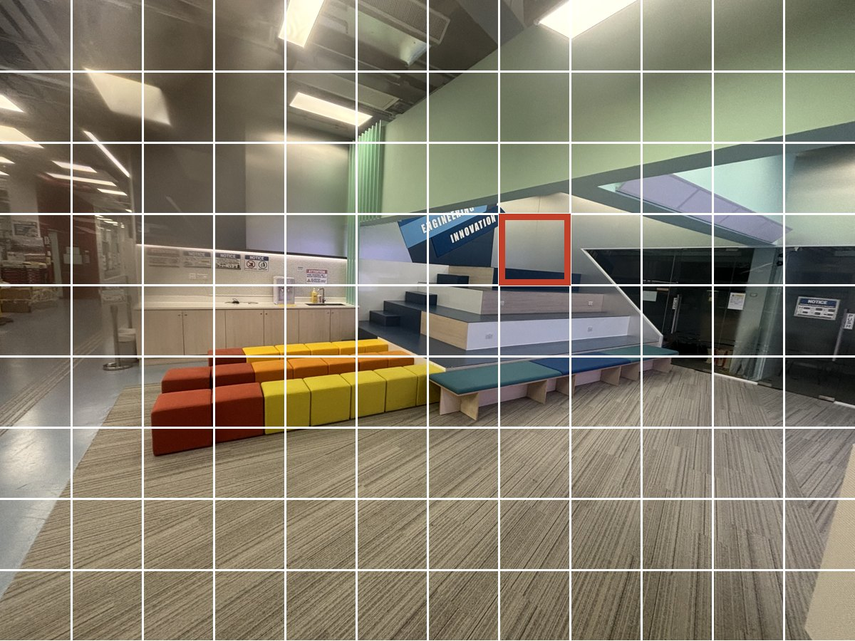
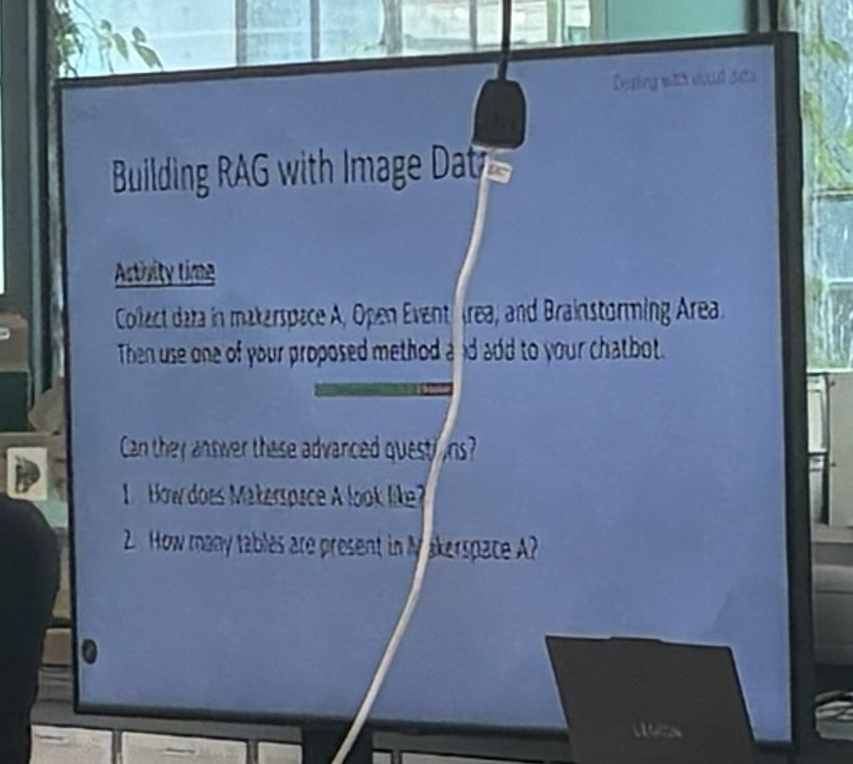

THEORY
How Vision Models Work
LV3
Same
transformer
as for text
"A modern indoor
collaborative space with
colorful modular cube
seats ... tiered wooden
seating steps labeled
ENGINEERING INNOVATION"
⋮
1. Cut into patches
12 × 9 here; one patch outlined
2. One vector per patch
108 patches, 108 vectors
3. Patches as tokens
no separate text reader
4. Generate text, word by word
real gpt-5-mini output for this photo
Consequence 1: the description is a prediction
Generated text, with everything from Workshop 1: it can paraphrase, approximate and invent. In our test run the model read a screen titled "Building RAG with Image Data" as "Building PAG".
Consequence 2
Text smaller than a patch cannot be read. Shrink a screen or poster to fit and the small print is gone before the model sees it.
the camera
after downscaling
Dosovitskiy et al. (2021), An Image is Worth 16x16 Words: arxiv.org/abs/2010.11929
06
Notes:
TIMING: 2 min, keep it short
Facilitator note: Keep this to a gloss. It exists so the verbatim instruction in block 3 and the OCR suggestion both make sense rather than sounding arbitrary.
Quick bit of theory. Last time we said a language model predicts the next token. A vision model is the same thing with one step added at the front.
[Walk left to right.] One: the photo is cut into a grid of patches. This is the brainstorming area, cut 12 by 9, and the red square is one patch. Two: every patch becomes a vector, so this photo is 108 vectors. Three: those vectors go through the same transformer that handles text, treated like tokens. There is no separate part that reads text. Four: it generates text word by word. What you see on the right is what gpt-5-mini actually wrote about this photo.
Two consequences. [Left card.] The description is a prediction, with everything we said about hallucination in Workshop 1. In our own test run it read a screen that says Building RAG with Image Data as Building PAG.
[Right card.] And anything smaller than a patch can't be read. Left is what the camera saw. Right is roughly what's left once the image is shrunk to fit. The slide title survives, the small print doesn't. That's why tiling comes up later.

Slide 7
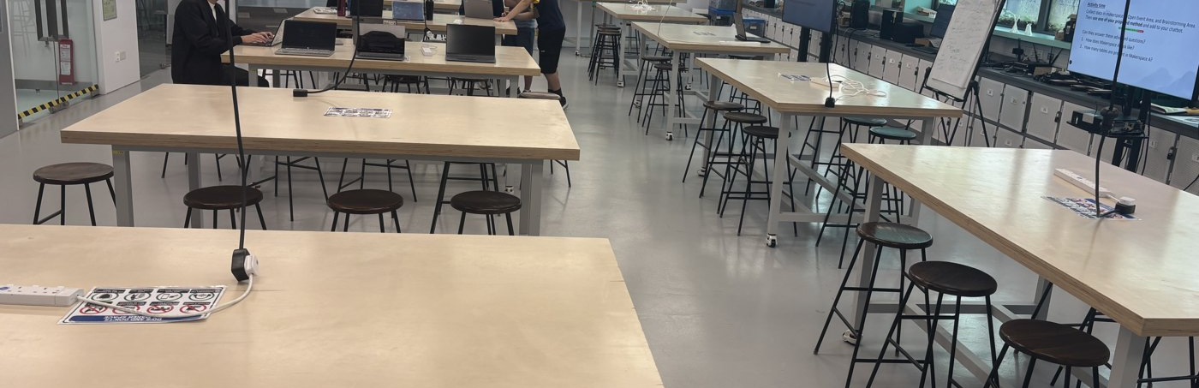
TROUBLESHOOTING
Why Lv3 Fails
LV3
Three different causes, three different fixes. Sort every failing Lv3 question into one column.
A Never collected
B Never described
C Described badly
<h2>Pitch New Tech
Ideas 2025</h2>
<img src="winners.jpg">
soup.get_text() ->
"Pitch New Tech Ideas
2025" no image
data/images.json
{"src": ".../01.-Design-
Build-and-Fly-Team-2023-
Poster-723x1024-1.png",
"alt": "",
"page": ".../innowing1/"}
embed() sees a URL,
not a poster
"Large open lab with wooden worktables and stools, several people using laptops..."
real gpt-5-mini output
The scraper kept the page text and dropped the img tag. The winners are only on the poster.
illustrative page
A real record from lab 3. The URL is stored, but nothing turned the poster into text.
How many tables are in Makerspace A? The description never counted them.
Lab 3: put each failing Lv3 question in a column. Fix in order A, B, C. Most teams have all three.
07
Notes:
TIMING: 3 min + lab
So why did Level 3 score zero, not just low? Because when the answer is only in an image, nothing from Workshop 1 reaches it. It breaks in one of three places, and each needs a different fix.
[Column A.] Never collected. Here's a page: a heading and an img tag with the winners. Run get_text on it and you get the heading. The image is gone, and the winners' names with it.
[Column B.] Never described. This is a real record from lab 3's scraper, a poster from the Inno Wing page. We have the URL, and the alt text is empty. A URL means nothing to the embedding model, so there's nothing for a question to match.
[Column C.] Described badly. This is the makerspace, and this is what the model wrote: large open lab, wooden worktables, people on laptops. Reads fine. Now ask how many tables are in Makerspace A. It never counted them.
[Lab transition.] That's the lab. Take every Level 3 question your bot gets wrong and put it in a column. Check it the same way as the retrieval lab: retrieve, print the chunks, look. Is the image in your data? Is there a description? Does it contain the answer? Fix in order A, B, C, because a better description is useless for an image you never collected.
[Before sending them off, show slide 8. It takes two minutes and gives them something concrete to compare against.]

Slide 8
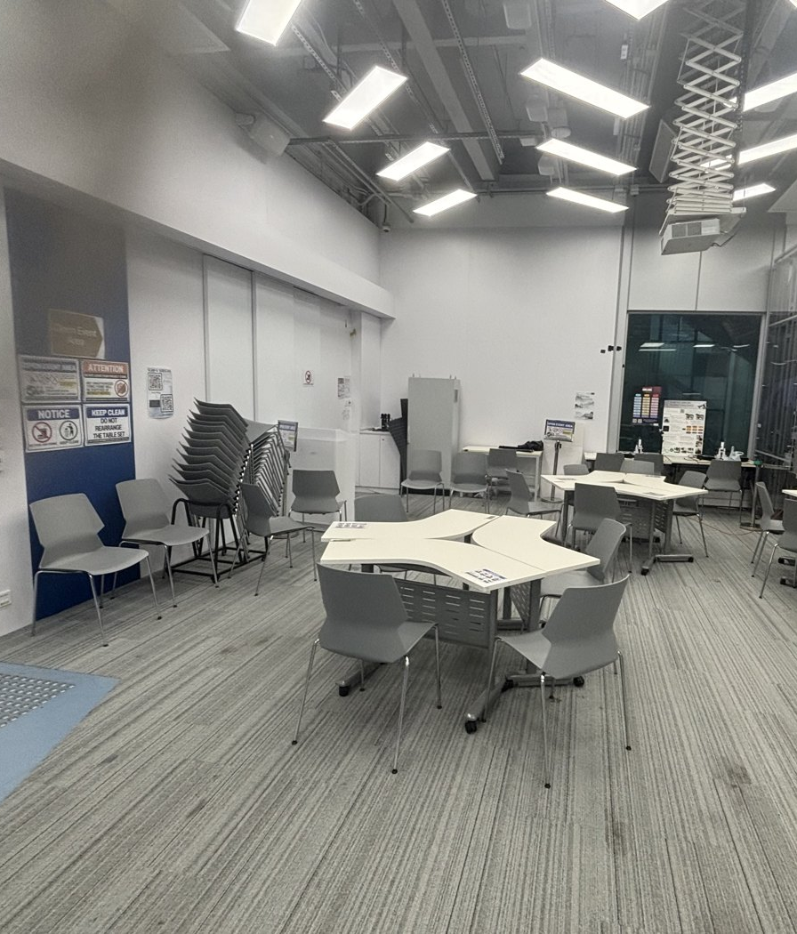
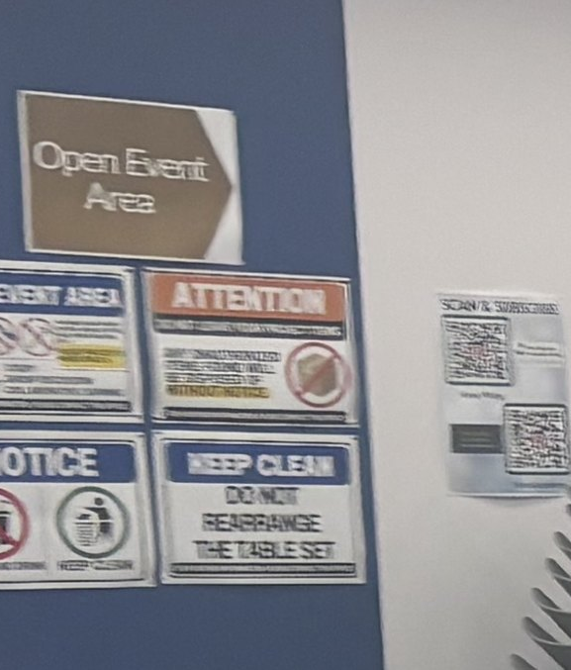
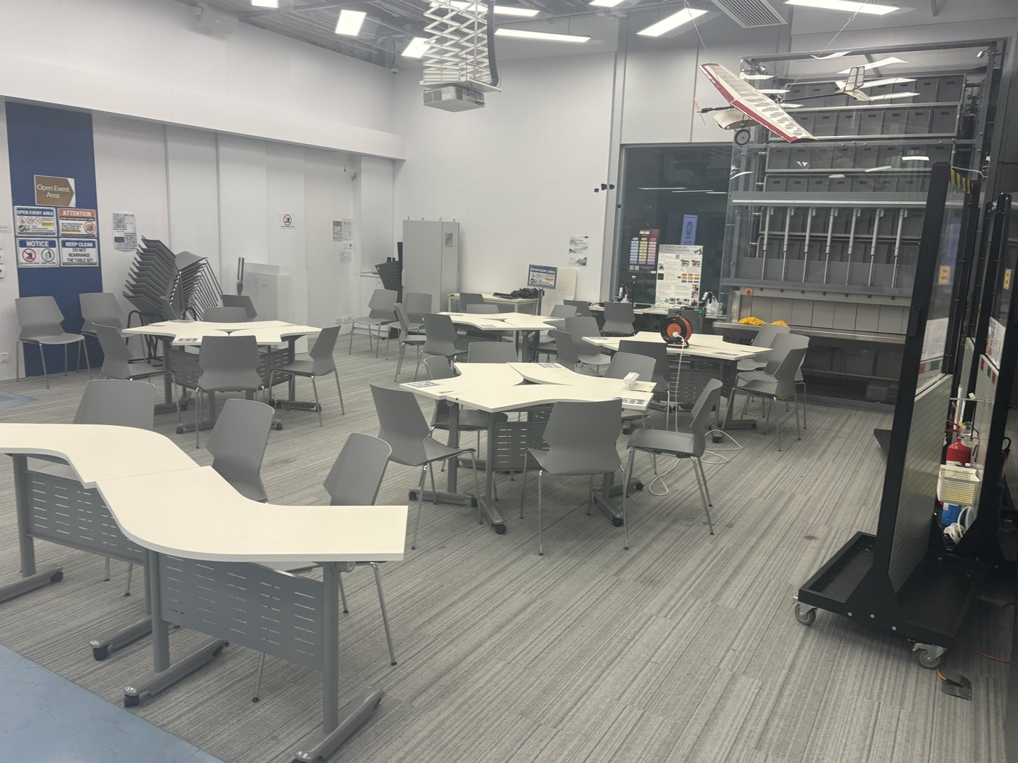
FOR SHARING
Bad Examples From a Real Run
LV3
Every quote below came back from gpt-5-mini in our own test run of lab 4, while DESCRIPTION_PROMPT was still the TODO placeholder. All of it would have gone into the index.
Misread the text
a slide titled "Building PAG with Image Data"
On screen: Building RAG with Image Data
One wrong letter. It then offered four made-up bullet points for the slide.
Named the wrong room
"Quiet study space ready for group work and late-night brainstorming."
On the wall: Open Event Area
The signage names the room. Nothing asked the model to read it.
Paraphrased a sign
"Please keep this area tidy... return them to their original configuration."
On the sign: KEEP CLEAN. DO NOT REARRANGE THE TABLE SET
Close in meaning, useless for a question that wants the exact words.
Answered the prompt, not the photo
"Here are a few ready-to-use text options you can drop in where it says TODO: write yours here."
Prompt: still the TODO placeholder
So it wrote alt text, tweets and signs. Check the prompt before anything else.
08
Notes:
TIMING: 2 min, before the lab
Before you start, look at what bad output actually looks like. None of this is made up. These came back from gpt-5-mini when we ran lab 4 ourselves and forgot to fill in the prompt.
[Top left.] Misread the text. The screen says Building RAG with Image Data. The model wrote PAG. One letter, and a question that wants the exact title scores zero. It then offered four bullet points for the slide that it made up.
[Top right.] Named the wrong room. It called this a quiet study space for late-night brainstorming. The sign on the wall says Open Event Area. The answer was in the photo, and nobody asked the model to read it.
[Bottom left.] Paraphrased a sign. The sign says KEEP CLEAN, DO NOT REARRANGE THE TABLE SET. The model gave us please keep this area tidy, return them to their original configuration. Same meaning, useless for a question that wants the words.
[Bottom right.] Answered the prompt, not the photo. The prompt was still the TODO placeholder, so the model wrote alt text, tweets and signs for us. If your descriptions look like this, check the prompt before anything else.
The point for sharing: every one of these would have gone into the index and looked fine until a question needed the fact. [Ask the room:] which of these have you already got in yours?
[Lab transition.] Okay, go. Mentors will come round. [Timing: block 2 is 25 minutes. Call time at about 14 so slides 9 and 10 still fit.]
[Calling time:] Stop there. Show of hands: mostly A? B? C? Good. The next two slides fix A and B.

Slide 9
THEORY
Collecting Images
LV3
submission_repo/build/scrape.py · extract()
What it returned for one real page
images = []
for img in soup.select("img"):
src = img.get("src")
if not src:
continue
fig = img.find_parent("figure")
images.append({
"src": urljoin(url, src), # absolute
"alt": img.get("alt", ""),
"caption": ..., # figcaption text
"page": url, # trace answers back
})
innowings.engg.hku.hk/innowing1/ · lab 3, Step 2
7 images -> data/images.json
alt "Innovation Wing" header logo
alt "" Design-Build-and-Fly
alt "" Peter-Cobb-Armenia
alt "" HKUR5.jpg
alt "" Robocon-2023-5.jpg
alt "" InnoWing-Logo.jpg
alt "" thtamBanner30-1.jpg
6 of 7 have no alt text. A vision model is the only way to their content.
—
Resolve src with urljoin, or relative links will not load later.
—
Collect images in the same pass as the text, or crawl both sites twice.
09
Notes:
TIMING: 2 min
Column A: collecting. This is the actual code from build/scrape.py in your repo, the extract function. For every img tag it keeps four things: the full src, the alt text, the figcaption, and the page it came from.
The two comments in red are the ones people get wrong. urljoin makes a relative path absolute, otherwise the link won't load later. And page lets you trace a wrong answer back to the image it came from.
[Right side.] This is what it returned when we ran it on one real Inno Wing page in lab 3. Seven images. One has alt text, and it's the logo. The other six have nothing. So on this site you can't lean on alt text. A vision model is the only way into those images.
And do it in the same pass as the text. Otherwise you crawl both sites twice.

Slide 10

THEORY
Describe, Then Index
LV3
One route, and it reuses everything you already built. No image path at query time.
describe_image(
path,
DESCRIPTION_PROMPT)
build/images.py, at build time, once per image
Brainstorming area. Wall sign reads ENGINEERING INNOVATION. Low bench with 3 cushions in front of the tiered seating. Glass doors to the right.
document
"Brainstorming
area. Wall..."
kind "image"
url page
image src
1. The collected image
src, alt, caption, page
2. Vision model
cached by image URL
3. The description
an ordinary text chunk
4. Same store as text
retrieved by the same query
Why this works
The description is embedded like any scraped chunk, so your retriever does not need to know an image was involved.
Where it happens
At ingestion, never while answering. A few hundred images take under an hour once; one call at query time can blow the 30 second limit.
10
Notes:
TIMING: 2 min
Columns B and C: describing. One route, and it reuses everything you already built.
[Walk left to right.] One: the collected image. Two: describe_image with your DESCRIPTION_PROMPT, in build/images.py, once per image, at build time. Three: what comes back is plain text. Four: that text goes into the same store as your scraped chunks, tagged kind image, with the page and the image URL.
Why it works: it's embedded like any other chunk, so the retriever doesn't care that a picture was involved. Where it happens matters: at build time, never while answering. One vision call at query time can blow the 30 seconds by itself.
What goes in box three, and the metadata in box four, is the next block.

Slide 11
3
BLOCK 3 · LAB
Descriptions & Metadata
Turning each image into searchable text, and tagging it with metadata you can filter on later.
LV3
LV5
20 MIN
11
Notes:
TIMING: BLOCK 3: 20 min total
Block 3, twenty minutes. Descriptions and metadata.
Two parts. First, making the description contain the facts questions actually ask about. Second, tagging each description with metadata so you can filter on it, which block 4 depends on.
This covers Level 5 as well. Your own photos go through exactly the same step later.

Slide 12
THEORY
Good Description vs Bad Description
LV3
BAD · REAL MODEL OUTPUT
"Bright, flexible seating for engineering innovation."
GOOD · SPECIFIC, SEARCHABLE FACTS
"Brainstorming area. Wall sign above the tiered seating reads ENGINEERING INNOVATION. Long low bench in front of the seating with 3 cushions (teal, blue, teal). Rows of red, orange and yellow cube stools to the left. Glass doors directly to the right, with a NOTICE sign."
Question
BAD
GOOD
How many cushions are on the long low bench?
✗
✓ 3
images/Brainstorming aerial.JPG · lab 4
What is directly to the right of the tiered seating?
✗
✓ glass doors
What words are on the wall?
by luck
✓ exact
Whatever the description does not mention cannot be retrieved. The first two questions come from lab 4; the wall question is Lv5 in the dev set.
12
Notes:
TIMING: 2 min
Here's the brainstorming area again, and two descriptions of it.
[Top.] Bad, and this one's real model output: bright, flexible seating for engineering innovation. Nice caption.
[Pink box.] Good: the area, the exact wall sign, three cushions on the low bench, the cube stools, and glass doors directly to the right with a NOTICE sign. Every one of those facts is checkable in the photo.
[Table.] Now the questions. How many cushions on the bench? Bad can't say. Good says 3. What's to the right of the tiered seating? Bad can't say. Good says glass doors. These two are the actual test questions in lab 4.
The wall one is interesting. The bad caption does contain the words engineering innovation, but as marketing, not as the sign. A string match might even call it a hit. That's luck, and you can't build on luck.
The rule: whatever the description doesn't mention can't be retrieved. The prompt sets the ceiling for Level 3 and Level 5.

Slide 13
THEORY
The Description Schema
LV3
LV5
1
Location, as the sign names it
Open Event Area
4
2
Objects, with counts
"twelve chairs", never "some chairs"
1
3
3
Visible text, word for word
KEEP CLEAN. DO NOT REARRANGE THE TABLE SET
2
4
Spatial relations
model aircraft above the storage rack, on the right
5
5
Colours and materials
white tables, grey chairs: only when it tells rooms apart
Anything you do not ask for will not be in the description. Say "copy text exactly" and "write [unreadable] rather than guess".
images/Open event.JPG · numbers match the fields on the right
13
Notes:
TIMING: 2 min
So what do you ask for? Five fields, by name. The numbers on the photo match the list.
[1.] Location, as the sign names it. The sign on that blue wall says Open Event Area. That's the name to use, not study room or classroom. Remember, the model called this a study space.
[2.] Objects with counts. Twelve chairs, never some chairs. Counting questions come up a lot.
[3, the one in red.] Visible text, word for word. KEEP CLEAN. DO NOT REARRANGE THE TABLE SET. Exactly as written. This is the field people lose.
[4.] Spatial relations. The model aircraft hangs above the storage rack on the right. Questions ask what's behind or next to what.
[5.] Colours and materials, only when they tell rooms apart.
[Pink box.] Anything you don't ask for won't be in the description. Tell it to copy text exactly and to write [unreadable] rather than guess.

Slide 14
LAB
20 MINUTES
Lab: Writing Image Descriptions
LV3
20 minutes. Five Inno Wing photographs and three questions about them are in the workshop folder.
01
Write the description instructions in DESCRIPTION_PROMPT
Use the five fields as a checklist. Give instructions, not a request.
02
Generate descriptions for the five images
Before indexing: can you answer the three questions from the descriptions alone?
03
Revise the instructions and regenerate
Most teams need two or three attempts. The first descriptions are almost always too general.
04
Index the descriptions, re-score Lv3
Ordinary text chunks in your existing store, with metadata attached. No new pipeline.
05
Swap descriptions with the team next to you
Which questions do their descriptions answer that yours miss?
14
Notes:
TIMING: ~13 min lab
Facilitator note: Step 2 is the one to enforce. Teams want to index immediately and then wonder why the score did not move.
[Lab transition.] Lab time. In the workshop folder there are five Inno Wing photos and three questions about them.
Step one. Write your instructions in DESCRIPTION_PROMPT in build/images.py. Use the five fields as a checklist. Write it as instructions, like "List every object with its count". Not a polite request like "Could you describe this image?"
Step two, and this is the one I'll be checking. Generate descriptions for the five images. Before you index anything, read them and try to answer the three questions from the descriptions alone. If you can't answer it by reading, the retriever can't either. It takes two minutes and saves you rebuilding the index again and again.
Step three. Revise the instructions and regenerate. Most teams need two or three goes. The first descriptions are nearly always too general.
Step four. Index them as ordinary text chunks in your existing store, with metadata, then re-score Level 3. I'll show the metadata part when most of you get there.
Step five. Swap with the team next to you and run their instructions on your images. Which questions do theirs answer that yours miss?
Go ahead.
[Walk round. Ask every team: "Can you answer the three questions from these descriptions?" before they index. When most teams reach step 4, around 8 to 10 minutes in, get everyone's attention and go to slide 15 for about 90 seconds.]

Slide 15
THEORY
Store Metadata With Every Description
LV3
LV5
The description lets a question find an image by meaning. Metadata lets you find it by fact: which page, what type, which year, which zone.
submission_repo/build/images.py · index_descriptions()
ONE STORED RECORD · EXAMPLE
metas.append({
"url": im.get("page", src),
"image": src,
"kind": "image",
# add what a question could filter on
"type": "poster",
"year": "2025",
"zone": "Open Event Area",
})
"Workshop poster: Design, Build and Fly Team 2023. ..."
url
.../innowing1/
image
...Fly-Team-2023-Poster.png
kind
image
type
poster
year
2023
zone
- (website image)
The template stores url, image and kind. The red lines are yours to add.
Why now, not later
Block 4 filters on these fields to count exactly. A field you skip now means rebuilding the index.
15
Notes:
TIMING: 90 sec, mid-lab
Quick interrupt, eyes up for a minute. This matters for step four.
[Left.] This is index_descriptions in build/images.py, straight from your repo. The template stores three fields: url, image and kind. The red lines are yours to add: type, year, and for your own photos, zone.
[Right.] Here's what one stored record looks like with them. The description text on top, then the fields. It's an example, not real output. The description finds the image by meaning; the fields find it by fact.
[If asked about re-running: Chroma won't overwrite an id that already exists. Lab 4 deletes the old image chunks first. In your own build, rebuild into an empty data/chroma when you change the prompt.]
Why now: block 4 filters on exactly these fields to count things. A field you skip now means rebuilding the index later. Okay, carry on.

Slide 16
FROM EXPERIENCE
Tips From Last Year
LV3
Patterns we noticed, not rules. Your corpus may reward something different, which is why you compare descriptions with the team next to you.
Tended not to
Tended to help
"Describe this image."
Asking for a summary or a caption.
Not mentioning text at all.
Leaving the model to decide what mattered.
Asking for counts in so many words.
Saying "copy the text exactly".
Naming the room or area.
Saying what to do when something is unreadable.
The pattern underneath: the model writes about whatever you name, and skips whatever you do not. That much has held every time. The specific wording is yours to find.
Swap instructions with the team next to you and run theirs on your five images. Which questions do their descriptions answer that yours miss?
16
Notes:
TIMING: 1 min, during step 5
[Put this up while teams are on step 5.]
Some patterns from last year. They're not rules.
What tended to help: asking for counts in so many words, saying "copy the text exactly", naming the room or area, and saying what to do when something's unreadable.
What tended not to: just "Describe this image", asking for a summary or a caption, not mentioning text at all, and leaving the model to decide what mattered.
The pattern underneath is that the model writes about whatever you name and skips whatever you don't. That's held every time. The exact wording is yours to work out, which is why you're swapping with the team next to you.

Slide 17
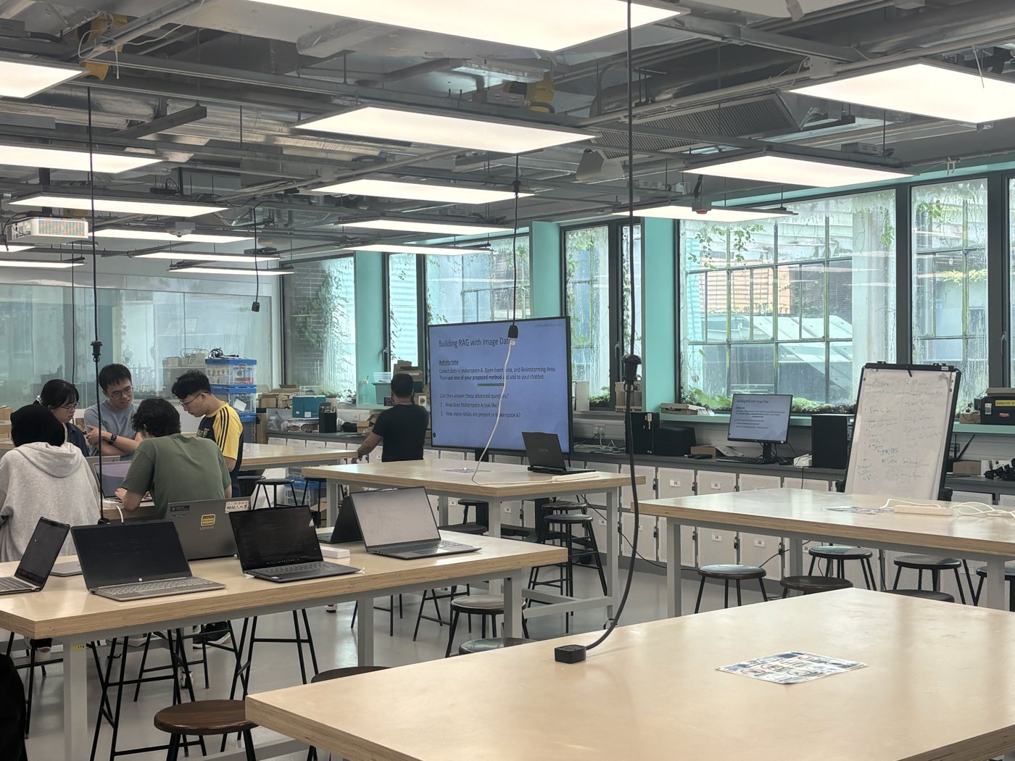
THEORY
Advanced Description Techniques
LV3
Not needed to score on Lv3. Worth trying once your basic prompt works.
Two prompts per image
Split large images
Cache the results
prompt: objects and layout
3 cushions on the bench; glass doors to the right
build/images.py describe_all()
for im in images:
src = im["src"]
if src in cache:
continue
cache[src] = describe_image(
tmp, DESCRIPTION_PROMPT)
prompt: text only
ENGINEERING INNOVATION / NOTICE
Two focused passes beat one that asks for everything. The model attends to what the prompt emphasises.
A big screen or poster loses its small print when shrunk. Cut the photo into overlapping tiles and describe each one.
Key the cache by image URL. Change the prompt, clear the cache; change anything else, keep it.
17
Notes:
TIMING: 1 min, optional
[Overlaps with slide 18. If time is tight, show this one and skip 18.]
None of this is needed to score on Level 3. It's for once your basic prompt works.
[Left.] Two prompts per image. One asks for objects and layout, one asks only for text. You get two focused answers instead of one that tries to do everything.
[Middle.] Split large images. This is the makerspace screen photo cut into four overlapping tiles. Each tile goes to the model separately, so small text is still big enough to read. Same reason as slide 6.
[Right.] Cache. This is describe_all from build/images.py. If the URL is already in the cache, skip it. So you pay for each image once. If you change the prompt, clear the cache; if you change anything else, keep it.

Slide 18
FROM EXPERIENCE
Notes on Image Data
LV3
Describe the same image twice
Run OCR alongside
Once asking for objects and layout, once asking only for text. The model gives more attention to whatever the prompt emphasises, so two focused passes usually beat one that asks for everything.
A vision model paraphrases text; an OCR engine transcribes it character by character. For dense signage that difference is the answer. Tesseract or PaddleOCR, both local, both permitted.
Index alt text regardless
Describe once, cache forever
Alt attributes and captions are already text and cost nothing to index. Occasionally they contain the answer with no vision model involved at all.
Key the cache by image URL. Without it you re-describe every image each time you change something downstream, and experimenting becomes slow enough that you stop.
18
Notes:
TIMING: 1 min, end of block 3
Last notes on images.
Run OCR alongside. A vision model paraphrases text. An OCR engine like Tesseract or PaddleOCR copies it character by character. For dense signage, that difference is the answer. Both run locally and both are allowed.
Index the alt text regardless. It's free, and sometimes the answer is in it.
Describe once, cache forever. Key the cache by image URL. Without it, every time you change chunking or anything else downstream, you re-describe every image. Experimenting gets slow enough that you stop doing it, and the experiment log from last time only works if runs are cheap.
[Transition.] Okay, wrap up where you are. If you didn't get to re-scoring, do that first in the open lab. Let's move to Level 4.

Slide 19
4
BLOCK 4 · LAB
Reasoning & Synthesis
Questions whose answer is not written down anywhere. You find every matching item and count it yourself.
LV4
25 MIN
19
Notes:
TIMING: BLOCK 4: 25 min total
Block 4, twenty-five minutes. Reasoning and synthesis.
The Level 4 questions you'll see are mostly counts. How many posters, how many workshops, how many of something. The answer isn't written on any page. Your bot has to find every matching item and count them itself.
Three short slides on why the normal pipeline can't do that and what can, then a lab in lab 5.

Slide 20
THEORY
Counting Questions
LV4
How many workshop posters are on the Innovation Academy website for 2025?
Answer: 31
31 posters for 2025 on the website
—
No chunk anywhere contains the number 31. It is not written down.
—
You have to find every matching poster and count them.
—
Vector search returns the k nearest chunks. With k = 5, the model sees 5 posters at most.
k sets a ceiling on the answer. A better embedding model does not change this.
the 5 chunks your bot retrieves with k = 5. It answers 5, not 31.
20
Notes:
TIMING: 1.5 min
Facilitator note: let this land before offering the fix. It reframes Lv4 from a hard retrieval problem into a different kind of question.
Here's the question we'll use for the whole block. How many workshop posters are on the Innovation Academy website for 2025? The answer is 31.
[Right.] Here are the 31. No chunk anywhere contains the number 31. Nobody wrote it down. You have to find all of them and count.
Now remember what vector search does. It returns the k nearest. With k equals 5, your bot sees these five red ones, and nothing else. It will say 5, or it will guess.
[Pause.] So k is a ceiling. A better embedding model doesn't fix it. A better prompt doesn't fix it. It's a different kind of question, and it needs a different tool.

Slide 21
THEORY
Search vs Filter
LV4
Semantic search the k closest
Metadata filter every exact match
Returns the 5 nearest, ranked, posters or not. Always returns something, never everything.
Returns all 22 items with year 2025 and type poster. Exact, so the count can be trusted.
query(store, q, k=5)
query(store, q, k=200,
where={"year": "2025", "type": "poster"})
2025 poster
other chunk
Most Level 4 questions need both: filter to the right subset, then search or count inside it.
21
Notes:
TIMING: 2 min
Here's the tool. Same dots in both panels. Red dots are 2025 posters, grey dots are everything else.
[Left.] Semantic search. The star is the question. It returns the five nearest, the dashed circle, posters or not. Always returns something, never tells you it found everything.
[Right.] Metadata filter. Year 2025 and type poster. It returns every red dot and nothing else. Exact, so you can count it.
[Code.] Same query function, with a where argument and a big k. If all you need is the number, Chroma's get with the same where filter returns every match without a k at all.
And this only works on fields you stored when you built the index. That's the whole reason we kept going on about metadata in block 3.

Slide 22
THEORY
Counting, Step by Step
LV4
Q "How many workshop posters are on the Innovation Academy website for 2025?"
1 Spot the count
2 Filter, do not search
3 List the evidence
4 Count the list
route(q)
-> "4" count
where={"year": "2025",
"type": "poster"}
1. poster: <title>, 2025
2. poster: <title>, 2025
...
31. poster: <title>, 2025
31
"How many" sends it down the counting path, not the normal one.
Every chunk tagged year 2025 and type poster. All of them, not the nearest 5.
The model writes out each item it was given before it answers.
The number comes last, from a list you can check.
Labs/lab5_query_decomposition.ipynb · Step 4
Why list first
When the count is wrong you can see which poster was missed or counted twice.
k is still a ceiling
k=200 here. Keep it above any answer you expect, or you are back to counting 5.
def answer_by_counting(question, where, k=200):
chunks = query(store, question, k=k, where=where)
listing = "\n".join(f"- {c['text'][:120]}" for c in chunks)
return chat([{"role": "system", "content":
"Count the items listed. List what you counted, "
"then give the number on its own final line."}, ...])
22
Notes:
TIMING: 2 min
So here's the full path for our poster question, four steps.
[1.] Spot the count. The question says how many, so it goes down the counting path. In lab 5 that's route(), one cheap call that says level 4.
[2, in pink.] Filter, don't search. Year 2025, type poster. Every one of them, not the nearest five.
[3.] List the evidence. The model writes out each item it was given before it answers.
[4.] Count the list. 31, and you can check it against the list.
[Code.] This is answer_by_counting from lab 5, step 4. Query with the filter and k=200, list the items, and the system prompt in red: count the items, list what you counted, number on the last line.
Two things on the right. Listing first means when the count is wrong you can see which poster was missed or counted twice. And k is still a ceiling. It's 200 here. Keep it above any answer you expect.

Slide 23
THEORY
When Metadata Is Not Enough
LV4
A poster that was never tagged with year and type is invisible to the filter. Fall back to retrieving wide and letting the model judge each item.
query(store, q, k=50) no filter, illustrative results
1
Retrieve wide
k=30 to 50, no filter. The posters are somewhere in there.
✓
Workshop poster: 3D printing basics, Oct 2025
✗
News: Inno Show 2024 highlights
2
Judge each item
One call: "For each item, yes or no: is this a 2025 workshop poster?"
✓
Workshop poster: Arduino for beginners, 2025
✗
Venue page: Makerspace A booking rules
3
Drop duplicates
The same poster can appear on two pages. Dedupe by image URL.
dup
Workshop poster: 3D printing basics (second page)
✓
Workshop poster: Laser cutting safety, 2025
4
Count the yeses
In code, not in the model's head.
✗
Workshop poster: Robotics bootcamp, 2024
... 43 more
Still capped by k: 50 wide cannot count 60. It also costs one long call, so time it.
The better fix is to store year and type at build time.
23
Notes:
TIMING: 1.5 min
What if you never tagged the posters with a year? The filter can't see them. Here's the fallback.
[Left.] Retrieve wide: k of 30 to 50, no filter. This is what comes back, illustrative. Some are 2025 posters, some are news pages, some are 2024 posters, and one is the same poster showing up on a second page.
[Right.] So: one, retrieve wide. Two, one call that marks every item yes or no: is this a 2025 workshop poster? Three, drop duplicates by image URL. Four, count the yeses, in code, not in the model's head.
[Pink box.] It's still capped by k. Fifty wide can't count sixty. And it's one long call, so time it. The real fix is to store year and type when you build the index.

Slide 24
THEORY
Four Ways to Answer a Count
LV4
List, then count
Give the model the whole filtered set. It lists every item, then gives the number. Mistakes become visible.
Filter by metadata
When the question names a year or a type. Exact and cheap, no extra model call. Only works on fields you stored at build time.
2
1
Retrieve wide, then judge
When the metadata is missing. Fetch 30 to 50, have the model mark each item yes or no, dedupe, count the yeses.
3
Split the count
When the count has two parts, like 2025 against 2024. Count each part separately, then combine in code.
4
Try them in this order. 1 and 2 together answer most counting questions. 3 is the fallback when a field is missing; 4 only when the question counts two things.
24
Notes:
TIMING: 1 min
Four ways to answer a count, in the order to try them.
One, filter by metadata. Cheap, exact, no extra model call, but only on fields you stored. Two, list then count, which is the answer_by_counting pattern. One and two together answer most counting questions.
Three, retrieve wide then judge, the fallback when a field is missing. Four, split the count, only when the question counts two things. That's the slide after the lab.
[Lab transition.] Right, lab.

Slide 25
LAB
20 MINUTES
Lab: Counting Questions
LV4
20 minutes. Labs/lab5_query_decomposition.ipynb, with the image chunks you indexed in lab 4.
01
Baseline a Lv4 counting question
Step 1: answer_simple. Record the answer and the seconds. You are comparing against both.
02
Count with a filter
Step 4: answer_by_counting with where={"kind": "image"}. It should list and count your five images.
03
Break it on purpose
Drop the filter and set k=3. Watch the count fall to what it was shown. That is the ceiling.
04
Design the filter for posters
Which fields would "2025 workshop posters" need? Check your build/images.py stores them.
05
Route, then time it
Steps 5 and 6: counting costs time. route() sends only the counts down this path.
25
Notes:
TIMING: ~15 min lab
[Lab transition.] Lab 5, about fifteen minutes. You need the image chunks you added in lab 4.
Step one. Run the baseline, answer_simple, on the Level 4 counting question. Write down the answer and the seconds.
Step two. Go to Step 4 in the notebook, answer_by_counting with where kind equals image. It should list your five images and say 5. If it says 0, you skipped lab 4's indexing step.
Step three. Break it on purpose. Drop the filter and set k to 3. The count falls to whatever it was shown. That's the ceiling from the start of the block, and now you've seen it happen.
Step four. For your own bot: what fields would 2025 workshop posters need? Open your build/images.py and check you actually store them.
Step five. Counting costs time. Run steps 5 and 6 in the notebook. route() is how you send only the counts down this path.
[Notebook steps 2 and 3, the splitting ones, are for counts with two parts. Teams that finish early can do them with slide 26 up.]
[Walk round. Most common problem: 0 items matched, because lab 4's image chunks were never indexed.]

Slide 26
THEORY
When a Count Has Two Parts
LV4
Q "How many more workshop posters were there in 2025 than in 2024?"
split_question() 1 call
1 How many workshop posters in 2025?
2 How many workshop posters in 2024?
answer_by_counting(q,
where={"year": "2025",
"type": "poster"})
31
answer_by_counting(q,
where={"year": "2024",
"type": "poster"})
N
31 - N computed in code
Do the arithmetic in Python: models slip on subtraction. Only split when the count really has two parts; each part costs another filtered call.
26
Notes:
TIMING: Show during or after the lab
Last case. How many more workshop posters were there in 2025 than in 2024? That's two counts.
[Walk top to bottom.] split_question makes one call and gives two questions, one per year. Each goes through answer_by_counting with its own year in the filter. 31 for 2025, N for 2024.
Then subtract, in Python, not in the model. Models slip on arithmetic.
And only split when the count really has two parts. Each part is another filtered call, and that adds up against the thirty seconds.

Slide 27
FROM EXPERIENCE
Notes on Reasoning
LV4
Route before you reason
Make it list evidence first
One cheap call classifying the question level, then dispatch. Most questions are not counts, and a filter-and-list pass on all twenty wastes your time budget.
Instruct the model to write out the items it found before stating the answer. Counting accuracy improves, and when it is wrong you can see why.
Deduplicate before you count
Watch the clock, not the score
The same poster often appears on a listing page and its own page. Key on the image URL, or 31 becomes 40.
Listing every item costs tokens and seconds, and splitting a count doubles it. Thirty seconds is a hard limit; a timed-out question scores zero.
27
Notes:
TIMING: 2 min, end of block 4
[Calling time.] Okay, stop where you are. Four notes before we move on.
Route before you reason. One cheap call classifies the question, then dispatch. Most questions aren't counts, so don't pay for a filter-and-list pass on all twenty.
Make it list evidence first. That's how you can check a count.
Deduplicate before you count. The same poster turns up on a listing page and on its own page. Key on the image URL, or 31 becomes 40.
Watch the clock. Listing costs tokens and seconds, and splitting a count doubles it. Thirty seconds is a hard limit.
[Transition.] One last short block, then open lab.

Slide 28
5
BLOCK 5
Deadlines & Collection
Zone assignments and the written kit. The method is yours to work out.
LV5
5 MIN
28
Notes:
TIMING: BLOCK 5: 5 min total
Block 5, five minutes, and there's no lab. This is Level 5, the physical data.
I'll cover what's in scope and the dates. How you collect is up to you, and the details are in the written kit.

Slide 29
THEORY
Level 5: Physical Data
LV5
This data is not on any website and cannot be scraped. Every team starts from nothing, and it is around 40% of the final round.
In scope
Same pipeline as Level 3
The gallery outside the office, posters, venues excluding the machine workshop and event hall, and equipment.
Your assigned zones are in the kit.
Your photographs go through the same description prompt you wrote in block 3 and into the same index. Nothing new is required in the code.
Teams do not share collected data. The collection log records only which zones you have covered, so that two teams do not walk the same route.
29
Notes:
TIMING: 1.5 min
Level 5 data isn't on any website, so it can't be scraped. Every team starts from zero, and it's about 40% of the final round. That makes it the biggest part of the score you haven't started on yet.
In scope: the gallery outside the office, posters, the venues except the machine workshop and the event hall, and equipment. Your assigned zones are in the kit.
The good news is it's the same pipeline as Level 3. Your photos go through the description prompt you wrote in block 3 and into the same index, with metadata, including the zone. No new code.
Teams don't share collected data. The collection log only records which zones you've covered, so two teams don't walk the same route.

Slide 30
FROM EXPERIENCE
Planning Your Collection
LV5
You cannot photograph everything. What would you need to have captured, and captured well enough to transcribe, for a question you have not seen yet to be answerable?
Decide your answer to this before the first visit. Details of the zone assignments and the file naming convention are in the written collection kit.
30
Notes:
TIMING: 1 min
One question to answer as a team before your first visit. [Let them read it.]
You can't photograph everything. So what would you need to have captured, clearly enough to transcribe, for a question you haven't seen yet to be answerable?
Think about the five description fields. Names on the signage, counts, exact text, what's next to what. Your photos have to show those clearly, or the description can't contain them.
Zone assignments and the file naming convention are in the kit.

Slide 31
Key Dates
7 Oct
Collection log entry for your assigned zones
14 Oct
Image descriptions indexed, scoring above zero on Lv3
21 Oct
Preliminary submission: code and vector database
28 Oct
Final, live in Inno Wing
Plan a second visit
After indexing your first batch, write your own Lv5 questions and run them. Note which ones fail, then go back for exactly those. The building is open and the data does not change.
31
Notes:
TIMING: 1 min
Dates.
7 October: a collection log entry for your assigned zones.
14 October: image descriptions indexed, and scoring above zero on Level 3.
21 October: preliminary submission, code and vector database.
28 October: the final, live in the Inno Wing.
Plan a second visit. After you've indexed the first batch, write your own Level 5 questions and run them. Note which ones fail, then go back and photograph exactly those things. The building is open and the data doesn't change.

Slide 32
THEORY
The Complete Pipeline
Built once, in advance
Crawl
→
Extract
→
Describe
→
Photograph
→
Chunk & embed
Both sites
Text and image URLs
Vision model, cached
Your zones
Metadata attached
Run once per question, inside 30 seconds
Classify
→
Decompose
→
Filter and search
→
Assemble
→
Answer
Which level is this
If it needs it
Metadata plus vectors
Context and question
Directly, and always
Scraped text, website image descriptions and your own photographs all go into one index and are retrieved by the same query. Levels 3 and 5 do not need separate systems.
32
Notes:
TIMING: 1 min
So here's the whole pipeline, with everything from both workshops.
[Top row.] Built once, in advance: crawl both sites, extract the text and the image URLs, describe the images with a vision model and cache them, add your own photographs, then chunk and embed everything with metadata attached.
[Bottom row.] Run once per question, inside thirty seconds: classify which level it is, decompose if it needs it, filter and search, assemble the context with the question, and answer. Directly, and always. Same rule as Workshop 1: never "I don't know", because a guess can score and a refusal can't.
The main point is at the bottom. Scraped text, website image descriptions and your own photos all go into one index and get retrieved by the same query. Levels 3 and 5 aren't separate systems. It's one bot.

Slide 33
Open Lab
Thirty minutes, immediately after this session. Mentors stay in the room, and the collection zones are in the building around you.
Finish the block 3 or block 4 lab if you did not complete it.
Start photographing your assigned zones while mentors are available.
Ask about OCR, tiling or routing if you want to try any of them.
33
Notes:
TIMING: Close
That's the taught part. Open lab for thirty minutes, and the mentors are staying.
Three things you could do. Finish the block 3 or block 4 lab if you didn't get through it. Start photographing your zones while mentors are around to answer questions, since the zones are in the building around you. Or if you want to try OCR, tiling or routing, grab one of us.
Thanks, everyone.

