Slide 1


Learning Effective Embeddings From Crowdsourced Labels:
An Educational Case Study
Guowei Xu, Wenbiao Ding, TAL AI LAB
Jiliang Tang, Michigan State University
Songfan Yang, Gale Yan Huang, Zitao Liu, TAL AI LAB
ICDE 2019, Macau, China
April 2019
www.ailab.100tal.com

Slide 2
Introduction
Learning representation is important!
Existing approaches rely on:
Massive data
Accurate labels
Industry reality:
Limited data
Noisy labels

Slide 3
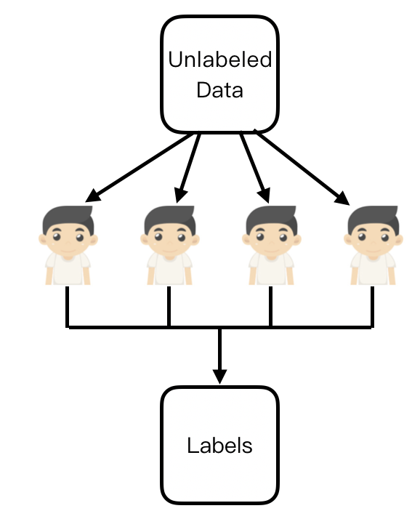
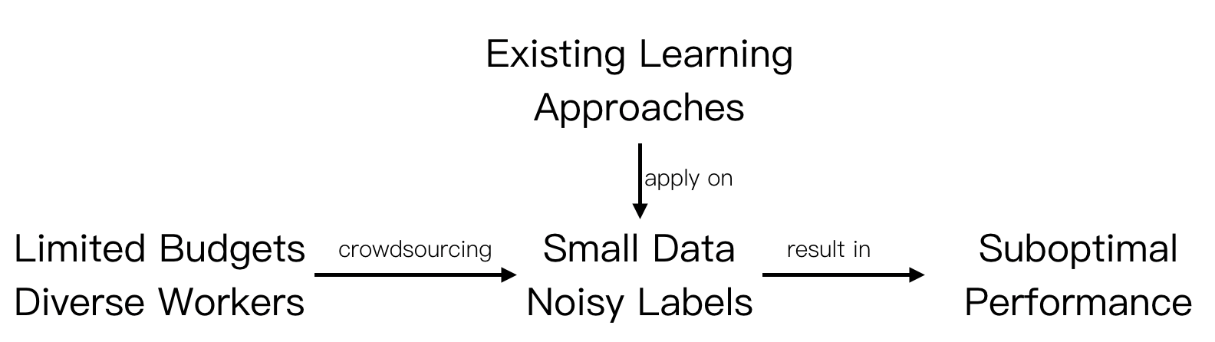
Introduction
How to obtain labeled data? Crowdsourcing

Slide 4
Our Method
?
Limited data + Noisy crowdsourced labels Robust representation
RLL: An unified framework to learn robust representation
from small data and inconsistent labels

Slide 5
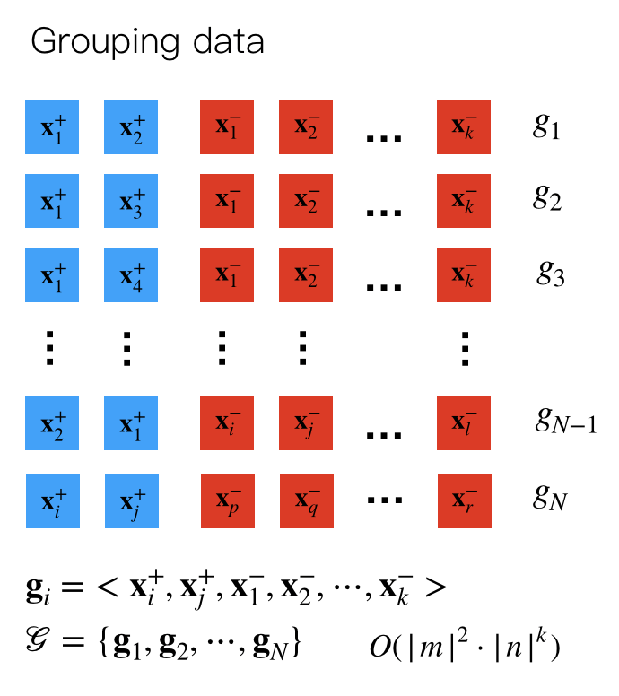





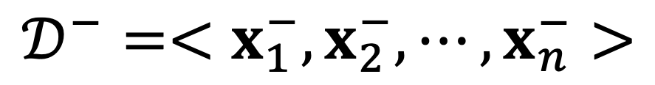

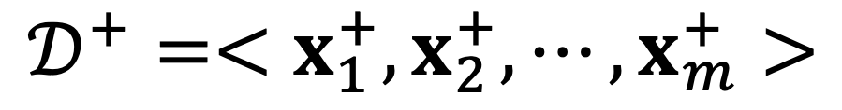

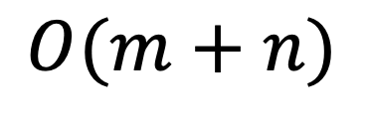
Grouping Based Architecture
Original data
$$𝒟^{+}=<x_{1}^{+},x_{2}^{+},⋯,x_{m}^{+}>$$
$$𝒟^{−}=<x_{1}^{−},x_{2}^{−},⋯,x_{n}^{−}>$$
…
Substantially
more data!
$$x_{1}^{+}$$
$$x_{2}^{+}$$
$$x_{m}^{+}$$
$$x_{1}^{−}$$
$$x_{2}^{−}$$
…
$$x_{n}^{−}$$
Positive
Negative
Data size:
$$O(m+n)$$

Slide 6
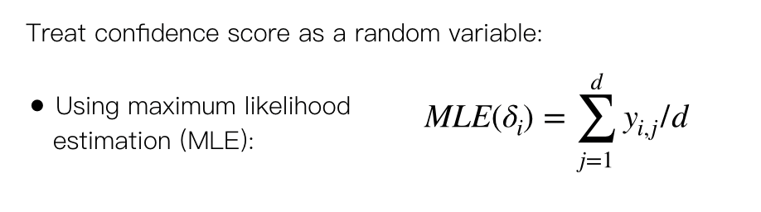
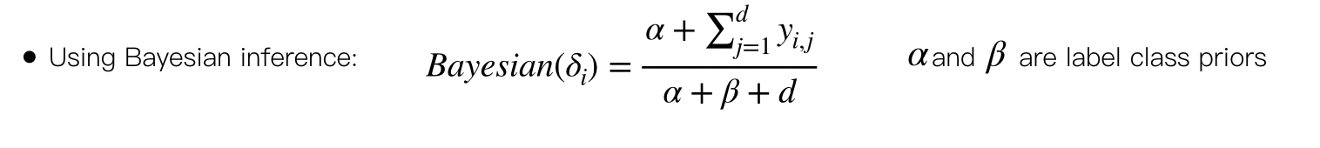
Confidence Score Estimator
Example A
Example B
5 workers label examples
A case where labels are inconsistent
Positive
Negative

Slide 7
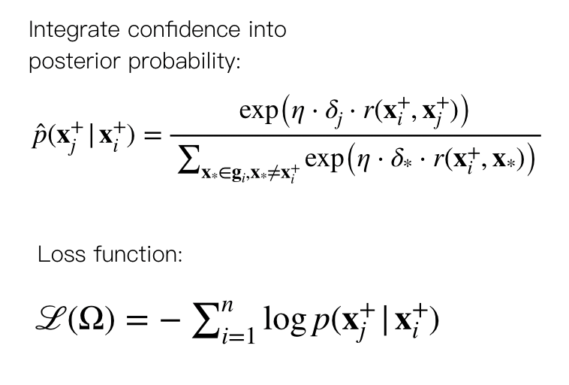
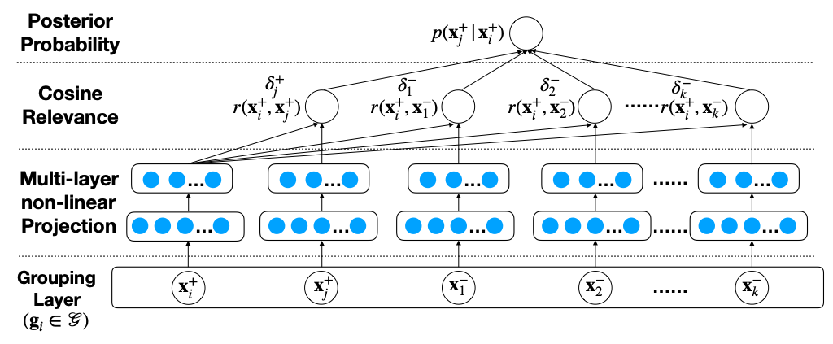
Model Summary
RLL
=
Grouping based
strategy
+
Confidence
estimator
+
Model
learning
The overview of RLL framework

Slide 8
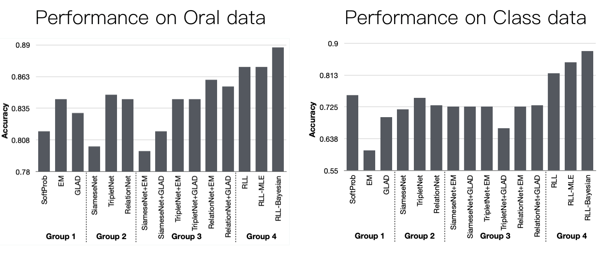
Experiment
Dataset:
Oral: 880 audios, label: fluent/disfluent
Class: 472 videos, label: good/bad
RLL-Bayesian demonstrates
the best performance on
both datasets!

Slide 9
Conclusion
RLL framework outperforms all the baseline groups
Bayesian estimator works better with small number of crowd workers
It is necessary to solve the limited and inconsistent label problems jointly
Future Work
Incorporate individual crowd worker information in the model

Slide 10

Thanks！
Thanks！

