Slide 1

DiDi-Columbia Capstone Project
DiDi AI Labs

Slide 2
Background
This project is about analyzing the relationship between work behavior of drivers on a ride-hailing platform and their in-service hours. The in-serice hours of a driver is the accumulated length of time within which the driver is serving an order. It is closely related to his/her income, thus an important metric to monitor.
On a ride-hailing platform, drivers are free to choose when to get online, how long to stay online, and where they go when they are not assigned an order, typically based on their habits and preferences. On the other hand, it is apparent that even for drivers working over similar length of time, their in-serivce hours could show significant differences. This project tries to tackle the problem of understanding the relationship between driver in-service hours disparity and their work patterns, if any. The insights obtained from this task would be very useful to the platform to better serve the drivers’ need as well as to improve the efficiency of the platform.
The approach to this problem is OPEN.

Slide 3
Research Questions
Goal
Investigate the factors (as indicated by the trip and trajectory data) contribute to the differences in driver in-service times
Questions
What differentiates an experienced driver on a ride-hailing platform from novices?
Are there any particular work habits that lead to gaps in driver in-service times? If so, what are they?

Slide 4
Suggested Reading List
Inverse Reinforcement Learning
Abbeel, P. and Ng, A.Y., 2004, July. Apprenticeship learning via inverse reinforcement learning. In Proceedings of the twenty-first international conference on Machine learning (p. 1). ACM.
Ng, A.Y. and Russell, S.J., 2000, June. Algorithms for inverse reinforcement learning. In Icml (Vol. 1, p. 2).
Levine, S., Popovic, Z. and Koltun, V., 2010. Feature construction for inverse reinforcement learning. In Advances in Neural Information Processing Systems (pp. 1342-1350).
Liu, S., Araujo, M., Brunskill, E., Rossetti, R., Barros, J. and Krishnan, R., 2013, June. Understanding sequential decisions via inverse reinforcement learning. In 2013 IEEE 14th International Conference on Mobile Data Management (Vol. 1, pp. 177-186). IEEE.
Trip Analysis
Dong, Y., Wang, S., Li, L. and Zhang, Z., 2018. An empirical study on travel patterns of internet based ride-sharing. Transportation research part C: emerging technologies, 86, pp.1-22.
Zhou, Z., Dou, W., Jia, G., Hu, C., Xu, X., Wu, X. and Pan, J., 2016. A method for real-time trajectory monitoring to improve taxi service using GPS big data. Information & Management, 53(8), pp.964-977.

Slide 5
Other Tools
Exploratory factor analysis
Software tools
Scikit-learn, pandas
Tensorflow, Keras
Data
GAIA data sets

Slide 6
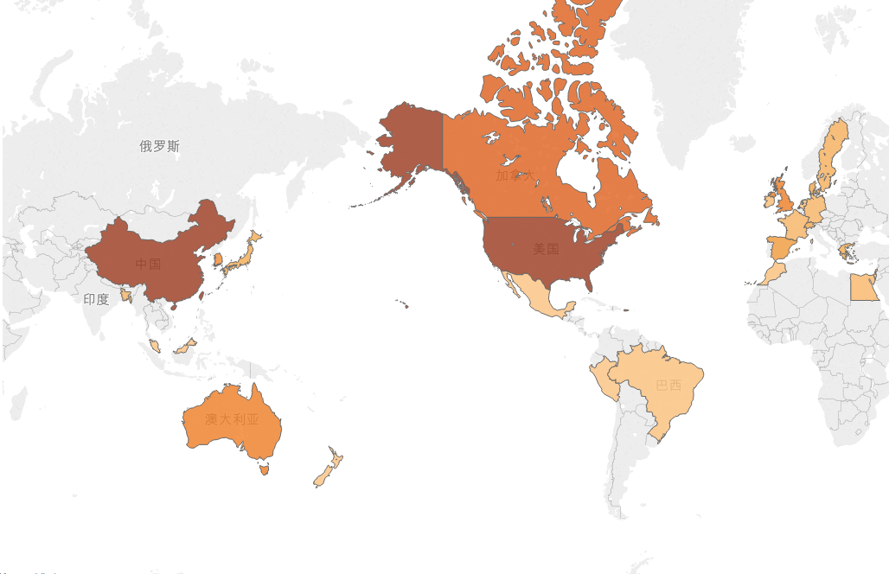
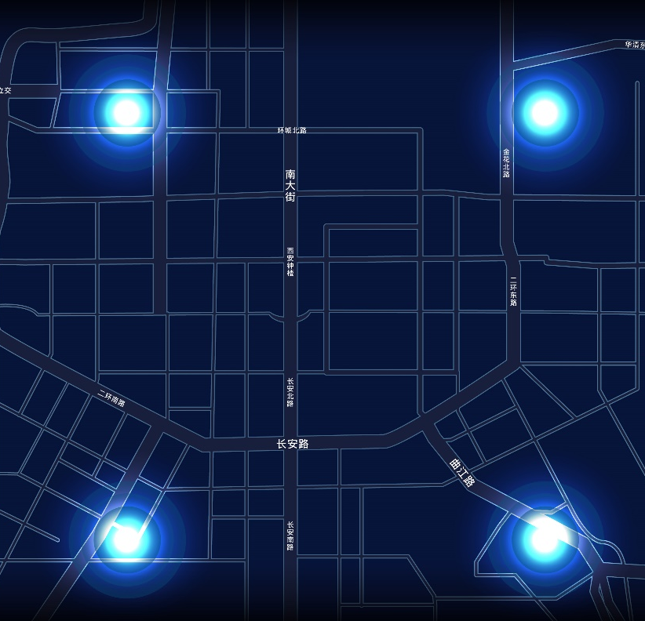

GAIA Open Dataset
China：200+ Research Organizations，1300+ Domestic applicants
Beyond China：140+ Research Organization from 20+ Countries， 500+ Overseas Applicants
* Data counts from 2016 - 2018
Visit GAIA Initiative website:
GAIA.didichuxing.com/en
Share anonymized data to foster open and collaborative data-driven research in transportation
Vehicle Trajectory Data
Chengdu and Xi’an, China

Slide 7

THANK YOU
www.didichuxing.com

