Slide 1

Telco Customer Churn Analysis
Academic Year 2022-2023
Liu Chang

Slide 2
Introduction
Telco Customer Churn Predictor is a tool that allow the manager of a telecommunication company to prevent a possible churn from customers by letting the manager to know in advance and have a time to implement a market strategy to prevent the churn from customers

Slide 3
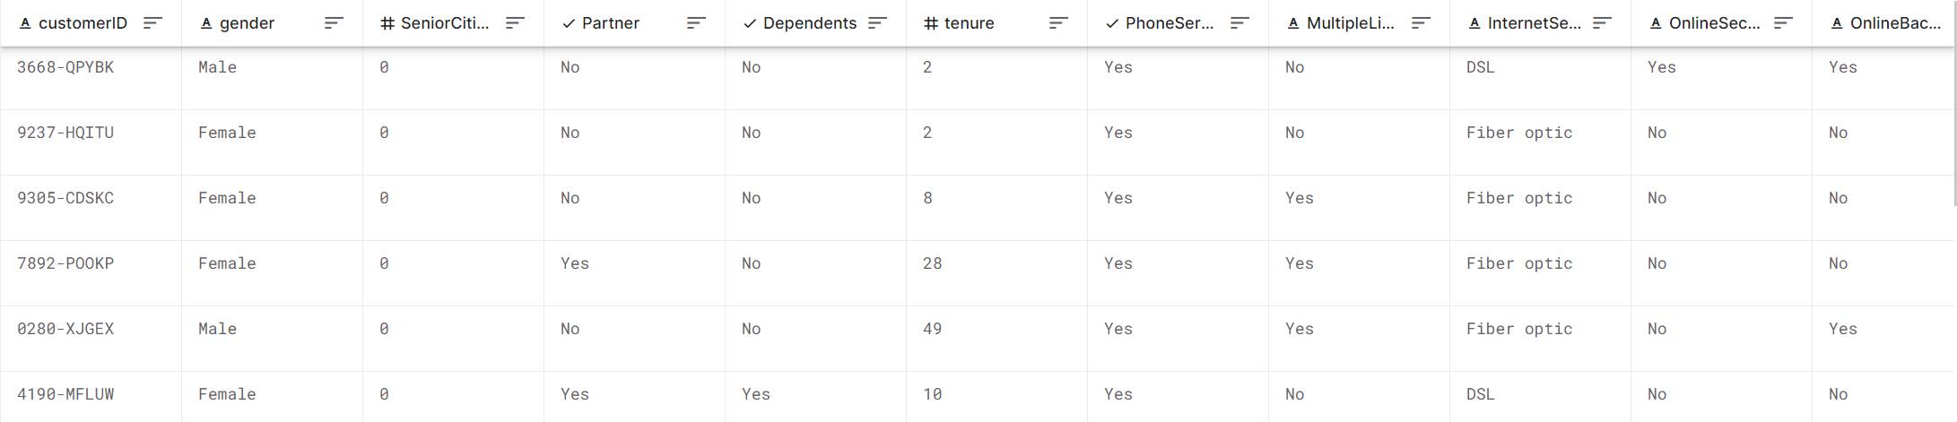
Dataset

Slide 4
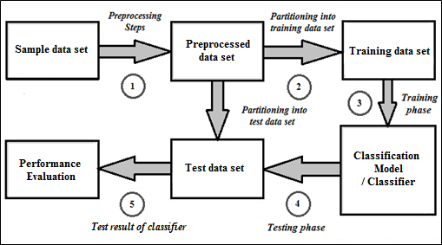
Analysis

Slide 5
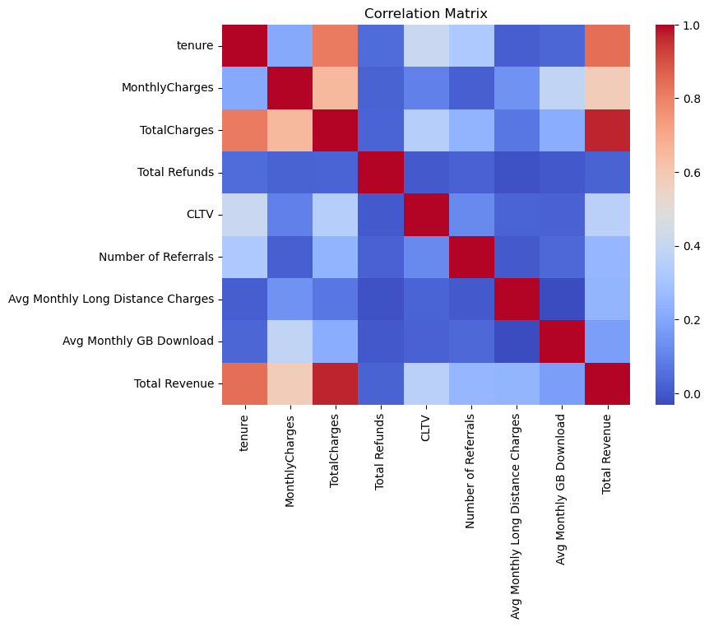
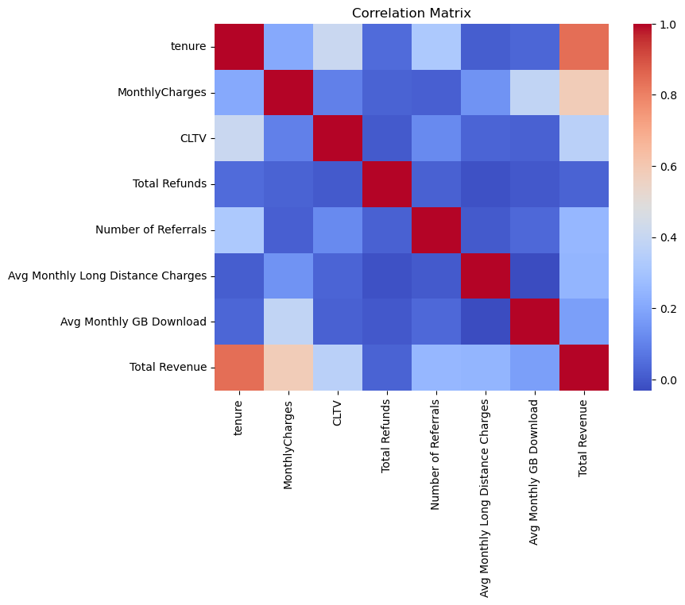
Correlation matrix pre
Correlation matrix after

Slide 6
Pre-processing
Categorical data : yes →1 , no →0, no phone service→0 , no internet service→0
Partner Dependents PhoneService MultipleLines Online Security Online Backup StreamingTV StreamingMovie DeviceProtection Tech Support PaperlessBilling Streaming Music Under30 Maried Referred a Friend Unlimited Data and Premium Tech Support
Drop by math long distance charge=Avg charge*tenure , Married and Partner by equality
Drop feature that have equal value like count, or irrelevant like customerID and abitation (all things about it)
Remove tuples where churn is caused by major forces(decease, moved) and joined now
Map gender to 0 and 1
Dummy cells for InternetService, Offer, PaymentMethod and Contract

Slide 7
X & Y Features
X feature based on the gender of the person, the age, the type of services subscribed such as type of line and online services, or if they have tech support, the type of contract, payment method and if they requested an addition service like if they charged extra GB
Y feature : churned or stayed

Slide 8
Classifiers
Random Forest Classifier
Naïve Bayes
SVC
K-Neighbors
Ada Boost
Pipeline: MinMaxScaler,SelectKBest → Classifier

Slide 9
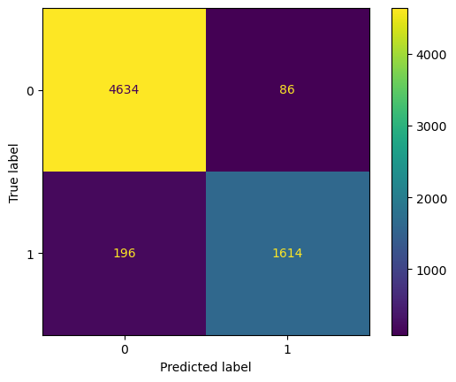
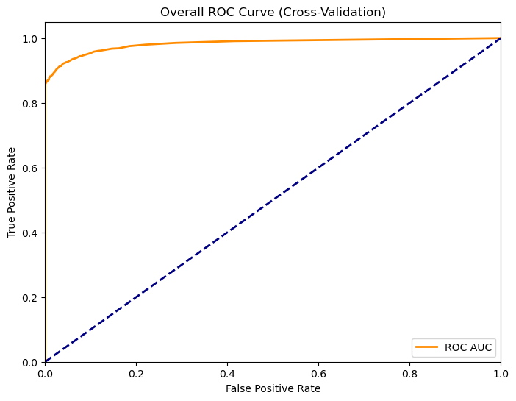
Random Forest

Slide 10
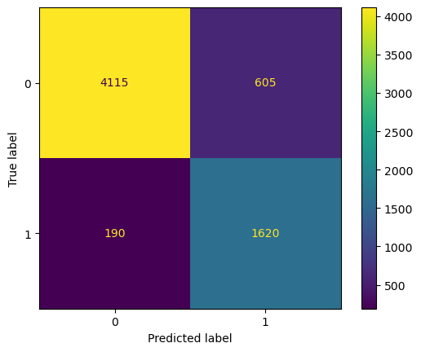
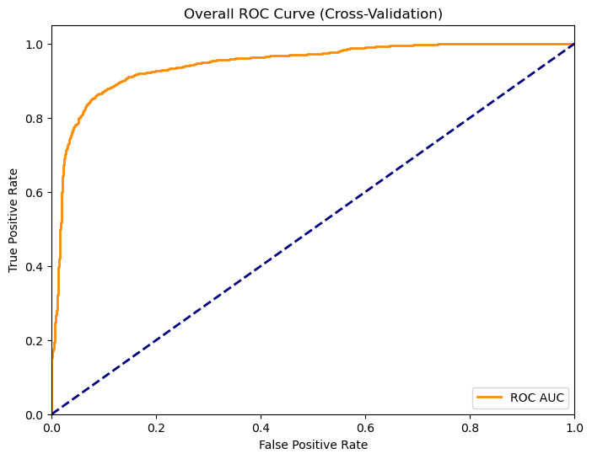
Naïve Bayes

Slide 11

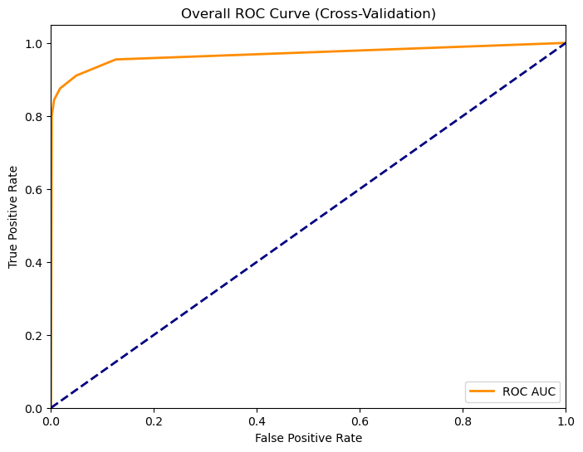
K-Neighbors

Slide 12


SVC

Slide 13


Ada Boost

Slide 14
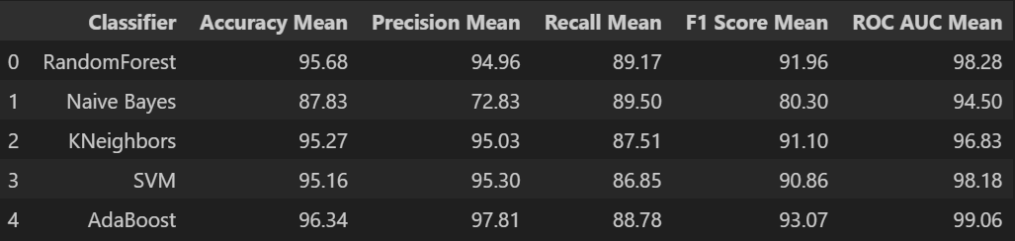
Result with 10-fold Cross validation

Slide 15
Wilcoxon Statical Test (Threshold=5% f1)
Classifier Comparison | P-value
AdaBoost-SVM | 0.001953125
Random Forest-AdaBoost | 0.010862224
Random Forest-SVC | 0.048828125
AdaBoost-KNN | 0.001953125
KNN-SVC | 0.625
Random Forest-KNN | 0.009765625

Slide 16
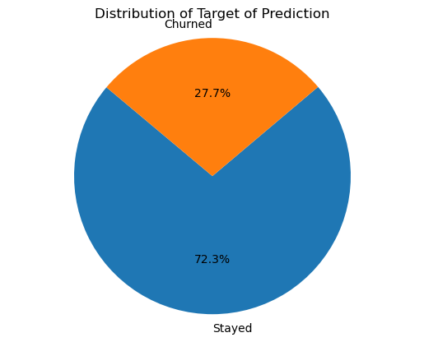
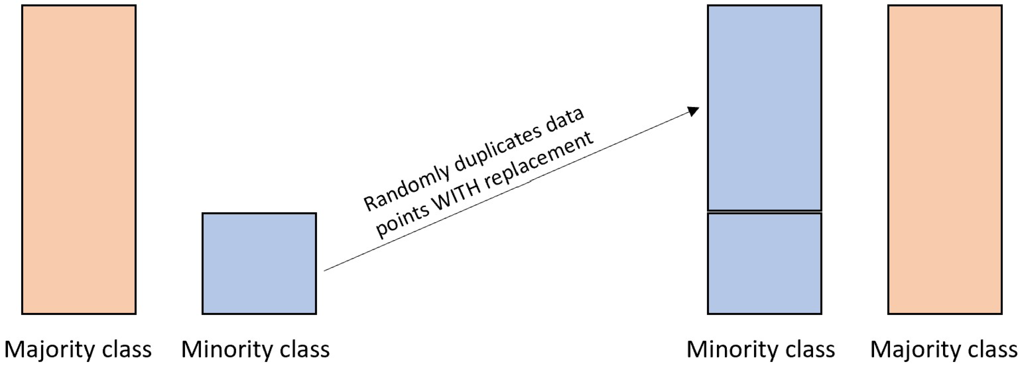
SMOTE Oversampling
Pipeline: SMOTE,MinMaxScaler,SelectKbest→Classifier

Slide 17
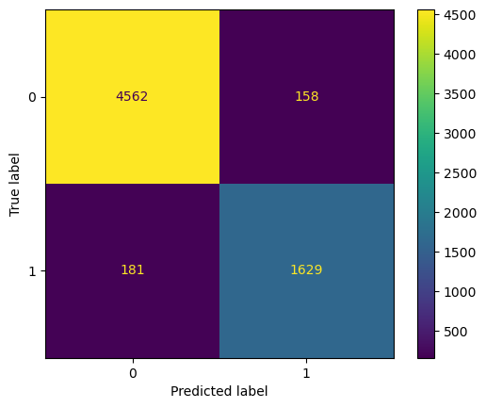

Random Forest

Slide 18

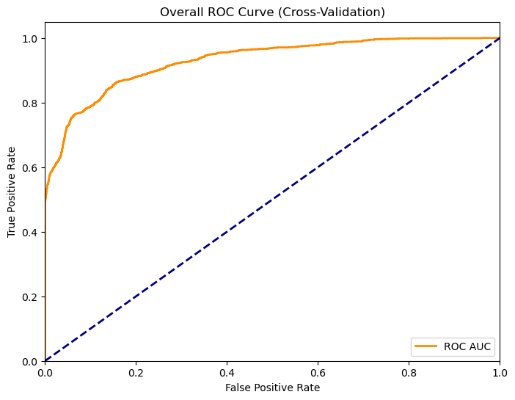
Naïve Bayes

Slide 19
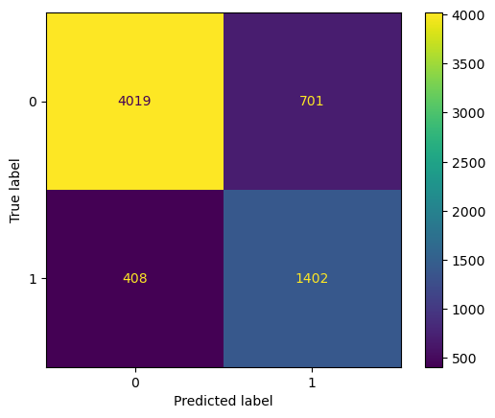
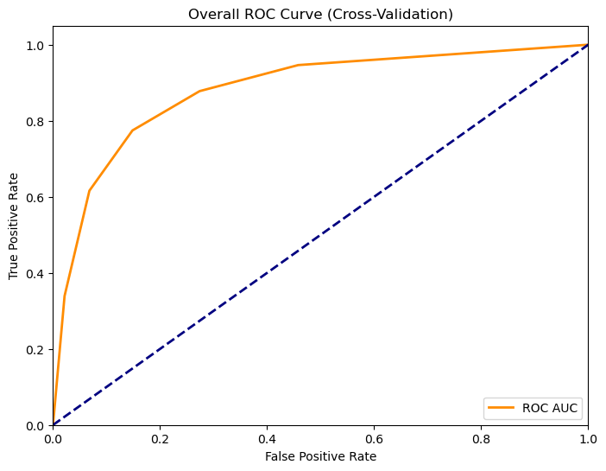
K-Neighbors

Slide 20


SVC

Slide 21


Ada Boost

Slide 22
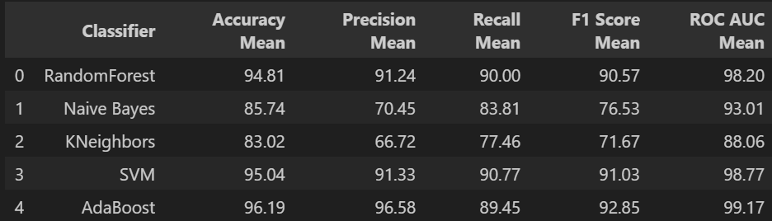
Result with 10-fold Cross validation

Slide 23
Wilcoxon Statical Test (Threshold=5% f1)
Classifier Comparison | P-value
AdaBoost-SVM | 0.001953125
Random Forest-AdaBoost | 0.001953125
Random Forest-SVM | 0.375

Slide 24
Wilcoxon Statical Test (Threshold=5% f1) Before and After Resampling
Classifier | P-value
Random Forest | 0.005859375
Naïve Bayes | 0.845703125
SVC | 0.275390625
KNN | 0.001953125
AdaBoost | 0.001953125

Slide 25
Conclusion
Best Classifier is Random Forest in the case without sampling, with SMOTE there are Random Forest and SVC because we can’t reject the null hypothesis
Only AdaBoost reject the null hypothesis for before after resampling, we can choose the version with SMOTE with improvement of 0.2% in f1
The operation of SMOTE deteriorate the performance of almost all classifiers in term of f1 score, even if for Adaboost there are only 0.2% of improvement, so the cost of SMOTE is not justified so the simplest pipeline should be chosen

