Slide 1
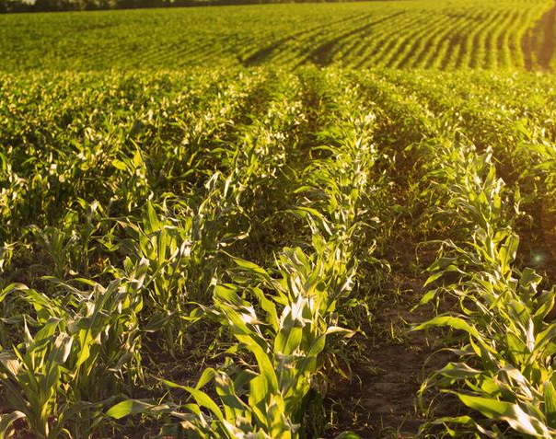
Smart Agriculture
LIU CHANG

Slide 2
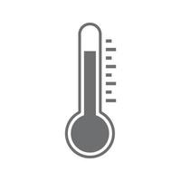


Introduction

Slide 3
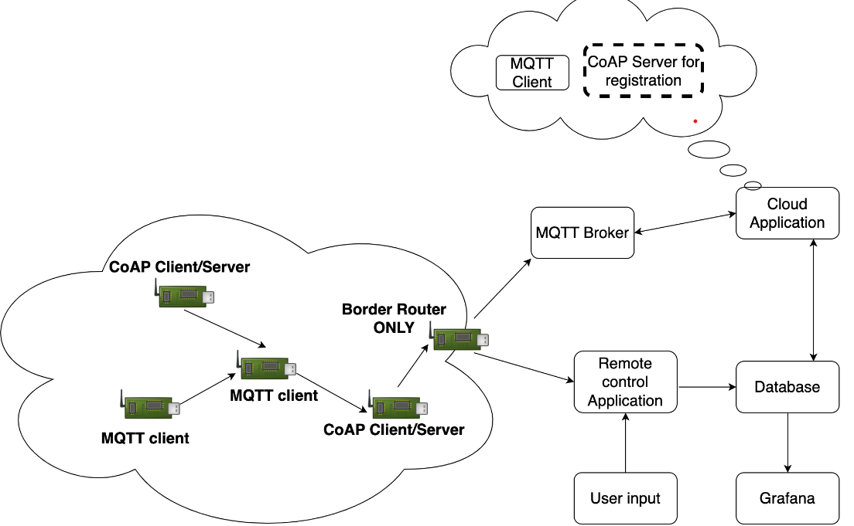
System Architecture
A network with two type of Protocols:
MQTT
Humidity Sensors
Temperature Sensors
CoAP
Sprinklers Actuators
A Java Collector that:
Receives data from sensors
Executes control logic
Writes to a MySQL database
Exposes a CLI
A Web interface Using Grafana

Slide 4
MQTT
Temperature(pub=device, sub=controller):
Publish temperature(C) measurements periodically
Humidity(pub=device, sub=controller):
Publish humidity(%) measurements periodically

Slide 5
CoAP
WaterSpurt
PUT mode=on/off : turns on or off the sprinkler

Slide 6
Data Encoding
{
“node”:”NodeID”
“temperature”:”temperature”
}
{
“node”:”NodeID”
“humidity”:”humidityLevel”
}
All sensors return the data they have collected in JSON format.
JSON is more flexible and less verbose than XML
The application does not process a critical data

