Slide 1




2015 Summer School (East Ontario) on High Performance Computing Queen's University, July 27-31
Combination of MPI and OpenMP
Gang Liu and Hartmut Schmider
{gang.liu, hartmut.schmider}@queensu.ca
Notes:
2015 Ontario Summer School on High Performance Computing Western University, London, Ontario, May 25-29 University of Toronto, Toronto, Ontario, July 13-17 Queen's University, Kingston, Ontario, July 27-31

Slide 2
MPI and OpenMP are completely different parallelisms. MPI is for distributed memory, while OpenMP is for shared memory system. However, they can be combined.

Slide 3
A typical cluster
is made of many independent nodes.
CPUs of any node can not access
memory of any other nodes.

Slide 4
A typical cluster
is made of many independent nodes.
CPUs of any node can not access
memory of any other nodes.
Many cores/CPUs
with shared memory
in each node

Slide 5
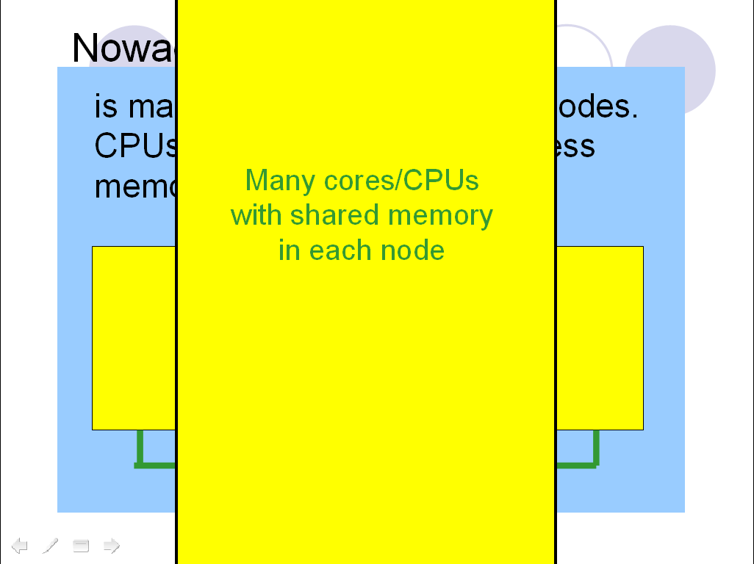

Slide 6
This feature of the physical system can be very well described by a mixture of MPI and OpenMP parallelisms. MPI can perform the parallelism across nodes/processes, while OpenMP does those inside each node/process.

Slide 7
A framework of mixture of MPI and OpenMP
Parallelize the whole code with MPI as an outer layer parallelism.
Then regard each MPI process as a regular serial code/run, and parallelize it with OpenMP as an inner layer parallelism.

Slide 8
A Challenge
Can MPI communications be done
in OpenMP parallel region ?
If yes, how to do them safely,
since all threads of a fixed
process share the same
MPI rank number ?

Slide 9
The Challenge
is an MPI thread-safe problem.
Some MPI implementations claim so,
while most not.
Let us consider no thread-safe only.
Then we suggest:

Slide 10
A basic rule
MPI is only allowed between different processes, with only one thread per process involved at a given time (placed into an OpenMP critical region)
Notes:
In other words, MPI is isolated from the combination essentially.

Slide 11
A simple example of mixture of MPI and OpenMP
Notes:
In other words, MPI is isolated from the combination essentially.

Slide 12
The square-root example with two processes
for(i=0;i<=M;i++)
DO I=0,M,1

Slide 13
The square-root example with two processes
for(i=myid;i<=M;i=i+2)
DO I=MYID,M,2

Slide 14
The square-root example with two processes
for(i=myid;i<=M;i=i+2)
DO I=MYID,M,2

Slide 15
The square-root example with two processes
for(i=myid;i<=M;i=i+2)
DO I=MYID,M,2
…
…

Slide 16
The square-root example with two processes
for(i=myid;i<=M;i=i+2)
DO I=MYID,M,2
…
…
Click here for mixed example in C
in F90

Slide 17
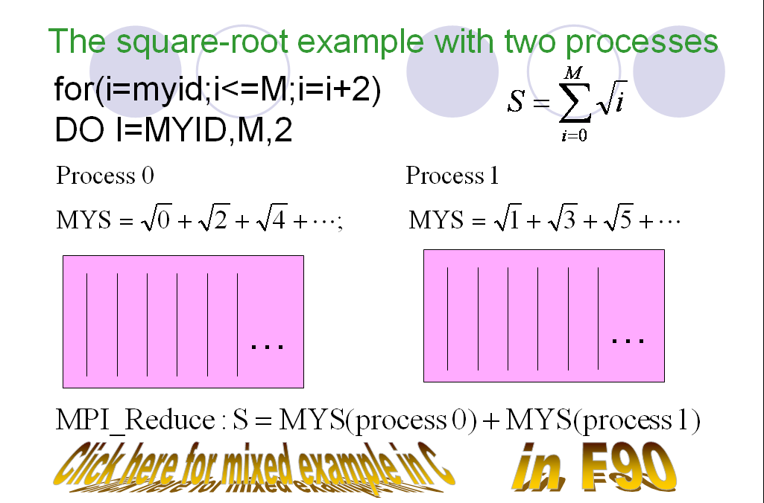
Click here for mixed example in C
in F90

Slide 18
Lab Work I: Mixed/C(F90)/mixed
C compiling:
mpiicc –o mixed.exe –O3 –fopenmp mixed.c
F90 compiling:
mpiifort –o mixed.exe –O3 –fopenmp mixed.f90
Run:
cat mixed.in
OMP_NUM_THREADS=2 timex mpirun –np 2 ./miexed.exe < mixed.in

Slide 19
From now no, we will focus on Double-layer Master-Slave Model
A good example of MPI and OpenMP mixed
Already converted into a library with open source code
Distributes independent jobs dynamically, then useful for many researchers

Slide 20
From now no, we will focus on Double-layer Master-Slave Model
A combination of
MPI master-slave model and
OpenMP all-slave model

Slide 21
MPI Master-slave parallel model
Jobs

Slide 22
Master-slave parallel model
Slaves (Other ranks):
Master
(Rank 0)
only
assigns
jobs to
Slaves.
(I am idle)
(Do this job)
Click here for an example code f21.f
cpp21.cpp
c21.c

Slide 23
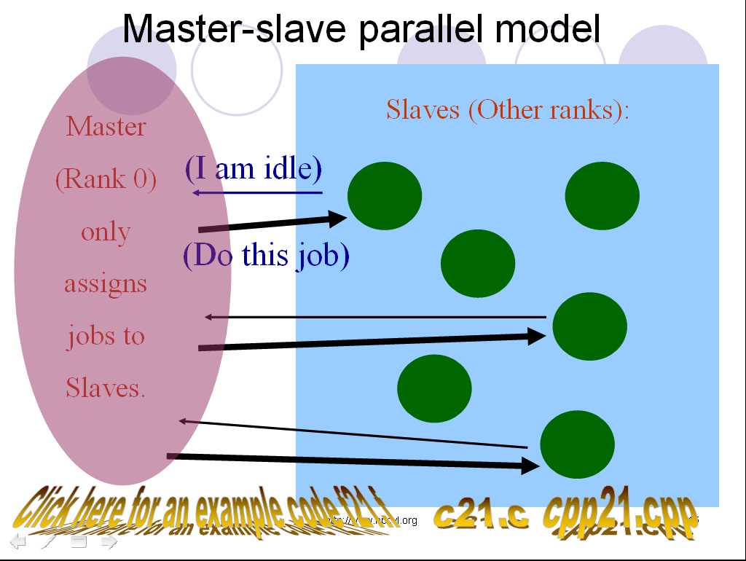
Click here for an example code f21.f
cpp21.cpp
c21.c

Slide 24
As you see, in this MPI master-slave model, there must be a process to maintain the job number/counter. Since it is in the process local (distributed) memory, the process has to maintain it dedicatedly and send it to any other process who needs it, then the process becomes the master.

Slide 25
In OpenMP, if the job number/counter is defined as a shared variable, then every thread can access it, and no master is needed.

Slide 26
OpenMP All-slave Model where whenever any thread becomes idle, he checks the shared job number/counter (of course, in a critical region). If any job left, he updates job number/counter, takes and completes the next job.
Click here for an example in FORTRAN
in C

Slide 27
Double-layer Master-Slave Model

Slide 28
Double-layer Master-Slave Model
Jobs

Slide 29
Double-layer Master-Slave Model
Jobs grouped

Slide 30
Double-layer Master-Slave Model
Job groups sent to nodes via
MPI master-slave model

Slide 31
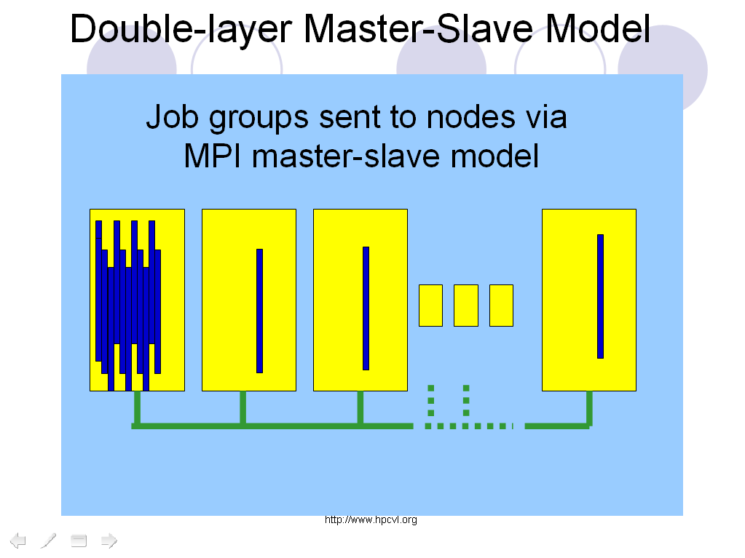

Slide 32
Slave nodes
Master
node

Slide 33
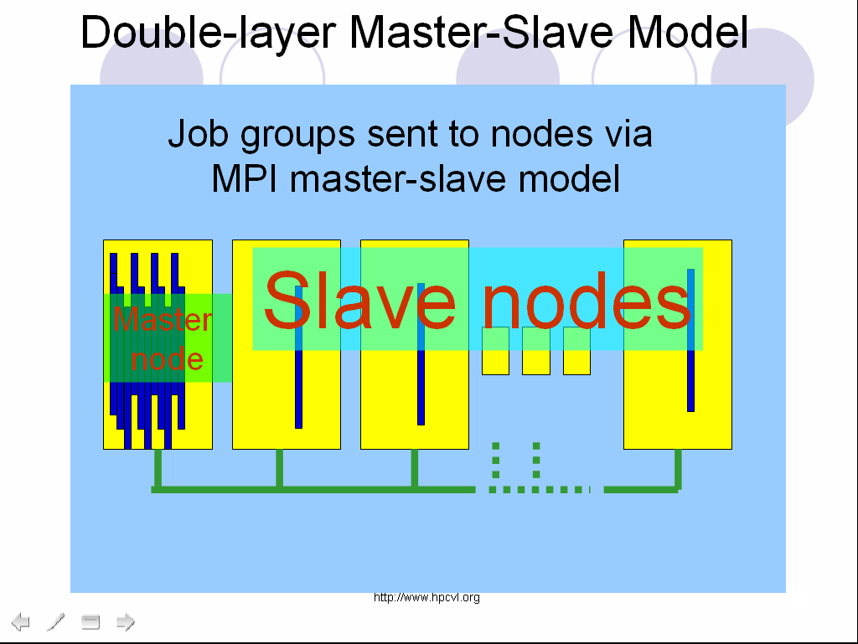

Slide 34
Double-layer Master-Slave Model
Jobs in a group executed
in the node by threads via
an OpenMP all-slave model
Job groups sent to nodes via
MPI master-slave model

Slide 35
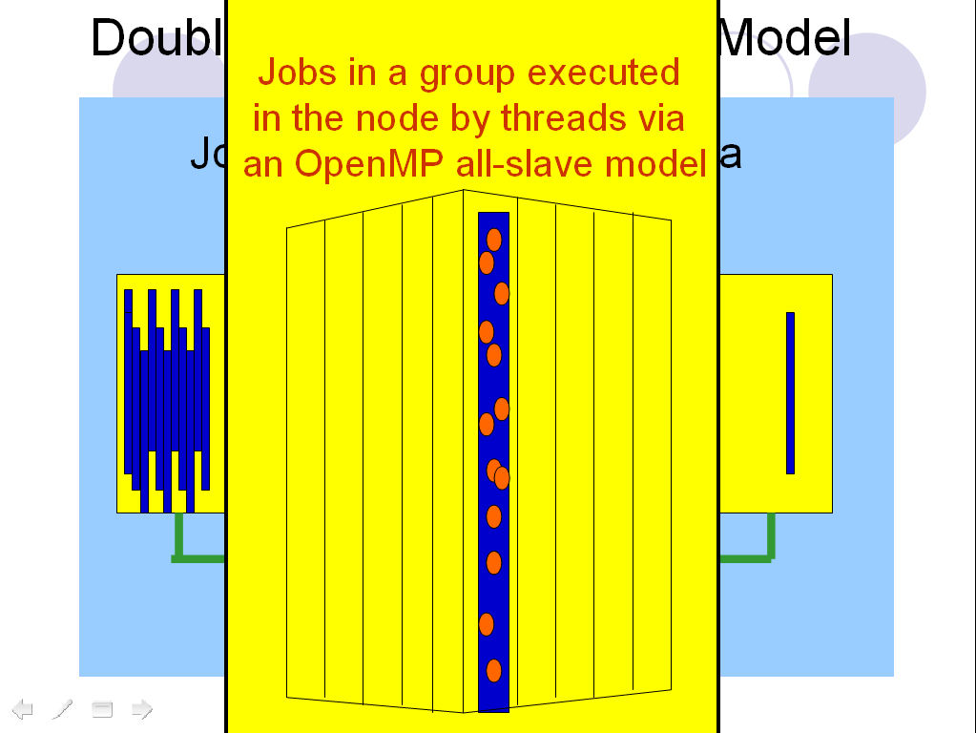

Slide 36
Double-layer Master-Slave Model
HPCVL supplies the DMSM library
with source code for free.

Slide 37
A basic rule
MPI is only allowed between different processes, with only one thread per process involved at a given time (placed into an OpenMP critical region)
Notes:
In other words, MPI is isolated from the combination essentially.

Slide 38
Double-layer Master-Slave Model
For levels of reliability and efficiency,
any combination of the following
three modes of the master node and
three modes of the slave nodes are
supplied in the library, although all of
them have been tested in the HPCVL
clusters with a success.

Slide 39
Double-layer Master-Slave Model
Master node
no OpenMP.
Master Mode 1
To initialize interafce

Slide 40
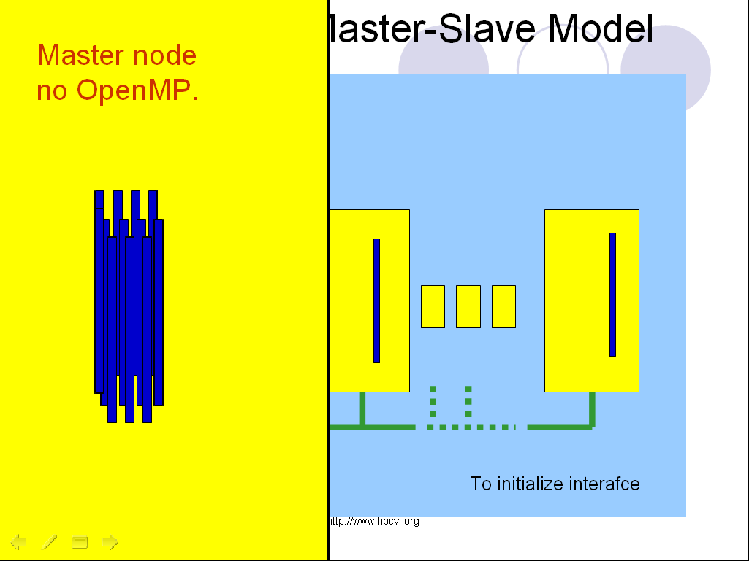

Slide 41
Double-layer Master-Slave Model
In the master node,
main thread is the
master, others do
pre-allocated jobs.
Master Mode 2: always in OpenMP

Slide 42
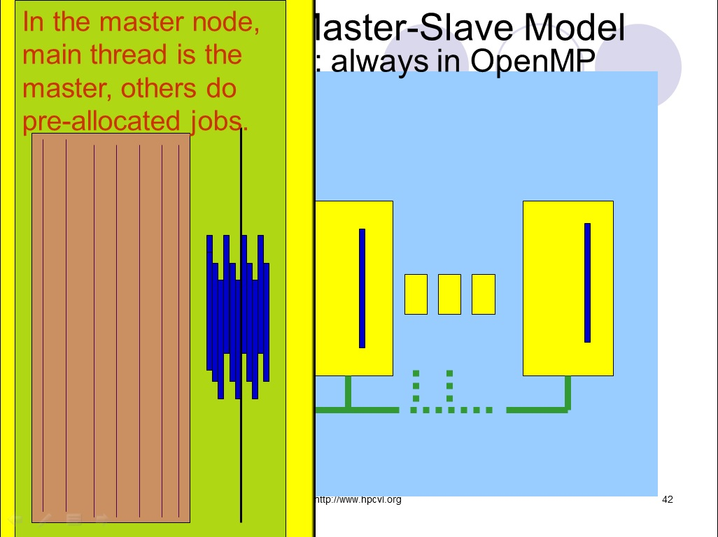

Slide 43
Double-layer Master-Slave Model
In the master node,
main thread is the master, any other
will get job groups
inside the node in a critical region and do the jobs based on all-slave model
Master Mode 3: always in OpenMP
v

Slide 44
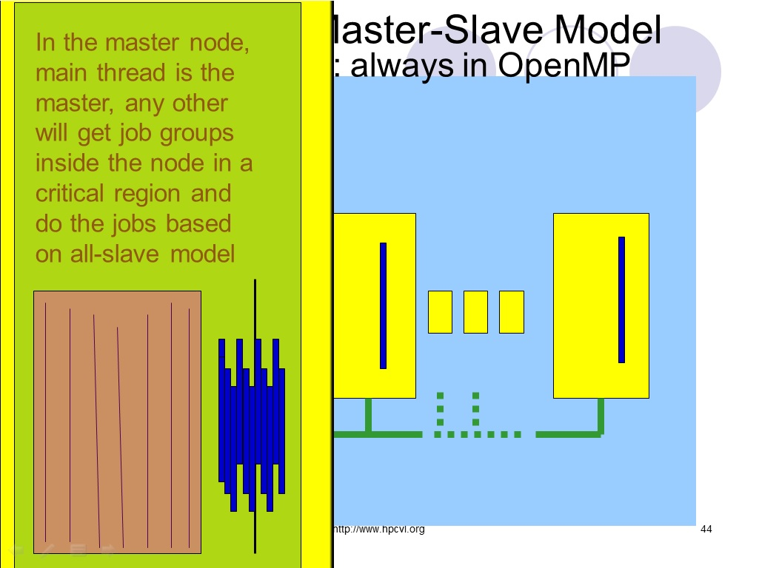

Slide 45
Double-layer Master-Slave Model
MPI outside of
OpenMP
Slave Mode 1
To initialize interafce

Slide 46
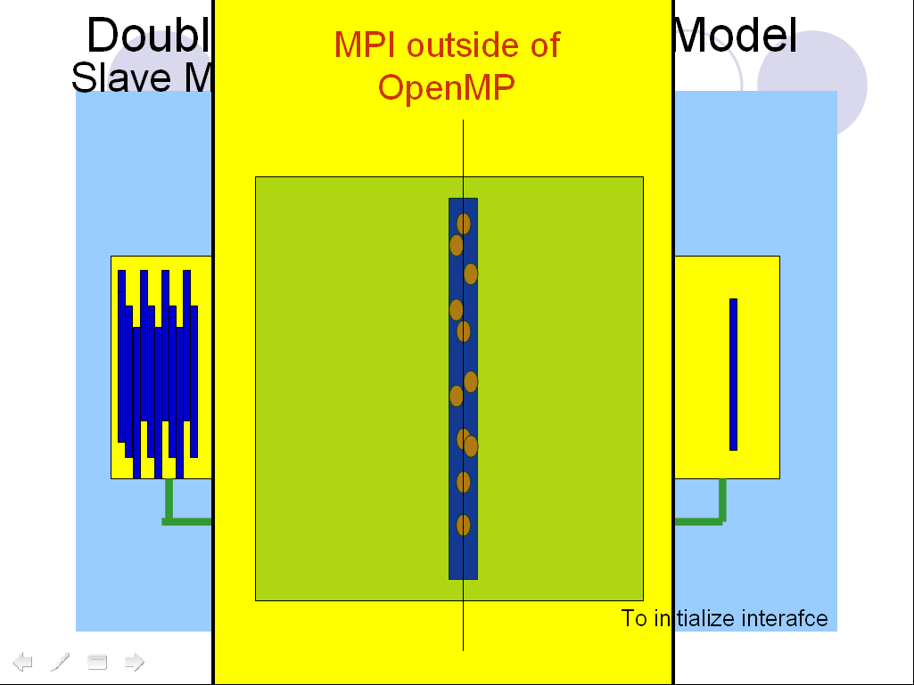

Slide 47
Double-layer Master-Slave Model
Always in OpenMP,
only main thread
asks groups from
the master.
Slave Mode 2: anywhere is in OpenMP

Slide 48
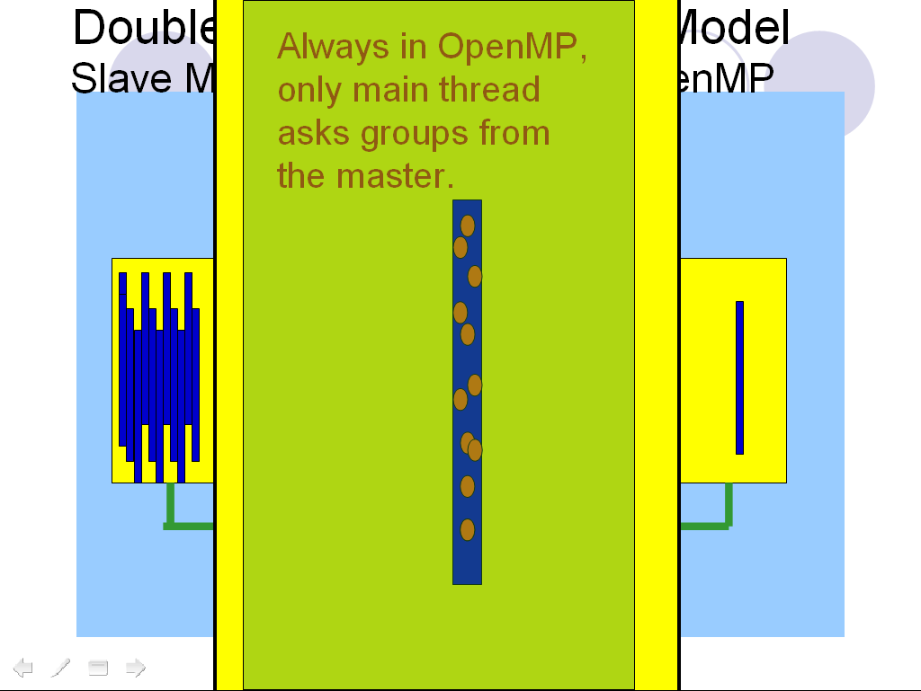

Slide 49
Double-layer Master-Slave Model
Slave Mode 3: anywhere is in OpenMP
Any thread asks
groups from the
master.

Slide 50
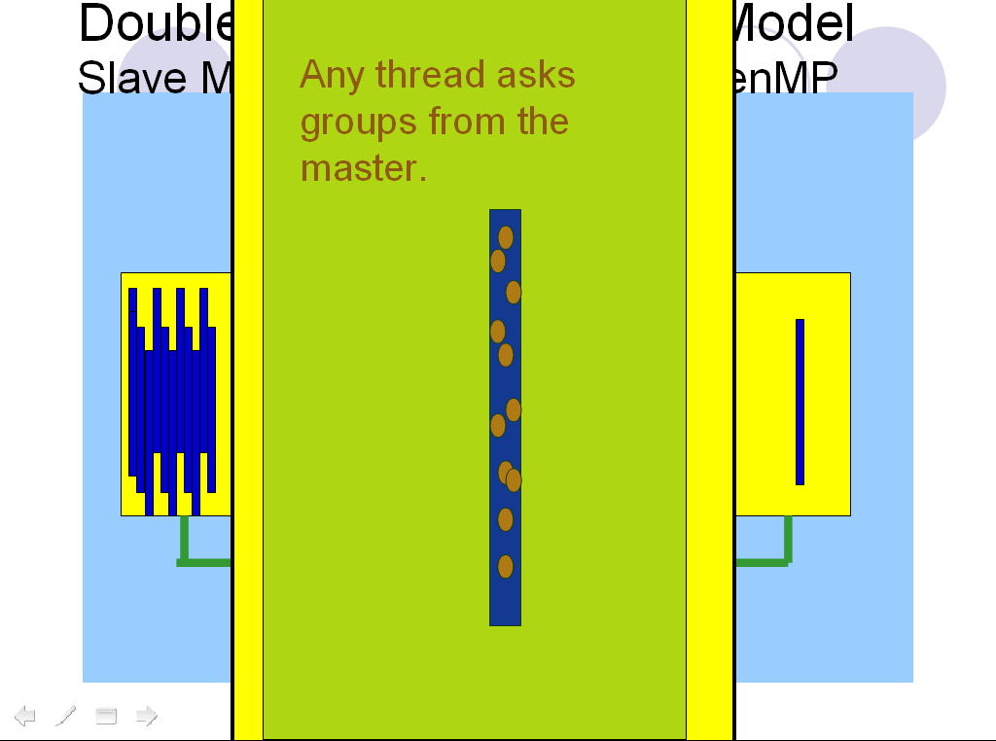

Slide 51
Double-layer Master-Slave Model
Normally, mode 3 for both Master
and Slave nodes are suggested,
for efficiency.

Slide 52
Double-layer Master-Slave Model
To use the DMSM library, users only
need to code their own routines for
data initialization, computing a job,
calling this library, and managing
the calculated results (including
outputs).

Slide 53
Double-layer Master-Slave Model
Job (grouped) distributions and all
kinds of communications associated
with them are done by the library.
The library also takes down how each
job was done including CPU-time,
checks and reports whether these
operations were done normally at
the end.

Slide 54
Double-layer Master-Slave Model
The DMSM library adopts
a naming convention:
inside the library, all names of
constants, variables, routines,
and files generated by the
library begin with DMSM_
prefix.

Slide 55
Double-layer Master-Slave Model
The DMSM library files:
C/C++:
dmsm.c and dmsm.h
FORTRAN 90:
dmsm.f90 and dmsm.ctimer.c

Slide 56
Double-layer Master-Slave Model
The interface of a simple usage
of DMSM library in Fortran 90
USE DMSM_MODULE
then call the following routines in sequence:
CALL DMSM_INITIALIZE(…)
CALL DMSM_WORKING(…)
CALL DMSM_JOB_DISTRIBUTION_CHECKUP()
CALL DMSM_FINALIZE()
where the last two take no arguments.

Slide 57
The four integer arguments of DMSM_INITIALIZE in Fortran 90
THREADS_PER_PROCESS, &
JOB_DISTRIBUTION_PLAN, &
TOTAL_JOBS, &
NUM_OF_JOBS_PER_GROUP
where the JOB_DISTRIBUTION_PLAN is
master_mode*10+
slave_mode.

Slide 58
The four arguments of DMSM_WORKING in Fortran 90
DO_THE_JOB(), &
JOB_GROUP_PREPARATION(), &
RESULT_COLLECTION(), &
RESULT_COLLECTION_ENABLED
where the first three are user supplied subroutines and the last is a logic variable.

Slide 59
The first argument of DMSM_WORKING in Fortran 90
DO_THE_JOB()
is, mandatory, to do user’s specific jobs.
It takes JOB_SEQUENCIAL_NUMBER
(from 1) as the only one argument.

Slide 60
The second argument of DMSM_WORKING in Fortran 90
JOB_GROUP_PREPARATION()
is, optional, to prepare the initial data for a job group, when the job group is assigned from the master to anybody.
It takes from_job, to_job, my_MPI_rank, and the_receiver_MPI_rank as the only four integer arguments.
Race condition addressed later.

Slide 61
The third argument of DMSM_WORKING in Fortran 90
RESULT_COLLECTION()
is, optional, to collect available calculated results to the master from anybody when they communicate. The fourth logic RESULT_COLLECTION_ENABLED must follow. If it is .TRUE., the collection happens during computation, otherwise only when all computation is done, inside our lib.

Slide 62
The third argument of DMSM_WORKING in Fortran 90
RESULT_COLLECTION()
takes MY_MPI_RANK, and MPI_RANK_OF_RESULT_FROM
as the only two integer arguments.
Race condition addressed later.

Slide 63
DMSM_WORKING in Fortran 90
is overloaded.

Slide 64
Double-layer Master-Slave Model
The F90 interface of DMSM library
A wrapper for
CALL DMSM_INITIALIZE()
CALL DMSM_WORKING()
CALL DMSM_JOB_DISTRIBUTION_CHECKUP()
CALL DMSM_FINALIZE()
in sequence is also supplied as
SUBROUTINE DMSM_ALL()
with the combined arguments of
DMSM_INITIALIZE ()
and
DMSM_WORKING() in order.

Slide 65
Interface of DMSM_ALL() in F90
SUBROUTINE DMSM_ALL(
THREADS_PER_PROCESS, &
JOB_DISTRIBUTION_PLAN, &
TOTAL_JOBS, &
NUM_OF_JOBS_PER_GROUP, &
DO_THE_JOB(), &
JOB_GROUP_PREPARATION(), &
RESULT_COLLECTION(), &
RESULT_COLLECTION_ENABLED )
which is also overloaded.

Slide 66
Double-layer Master-Slave Model
The C interface of a simple usage
of the DMSM library
#include "dmsm.h"
void DMSM_Initialize()
void DMSM_Working()
void DMSM_Job_Distribution_Checkup()
void DMSM_Finalize()
and the corresponding wrapper
void DMSM_All()

Slide 67
Double-layer Master-Slave Model
The C interface of DMSM library
void DMSM_Initialize(
int Total_Number_Of_Threads_Per_Process,
int Job_Distribution_Plan,
int Total_Num_Of_Jobs,
int Num_Of_Jobs_Per_Group
);

Slide 68
Double-layer Master-Slave Model
The C interface of DMSM library
void DMSM_Working(
void (*Do_The_Job) (int),
void (*Job_Group_Preparation) (int,int,int,int),
void (*Result_Collection) (int,int),
int Result_Collection_Enabled
);
If no Job_Group_Preparation or Result_Collection,
pass NULL, as C does not allow overloading.

Slide 69
Double-layer Master-Slave Model
The C interface of DMSM library
void DMSM_All(
int Total_Number_Of_Threads_Per_Process,
int Job_Distribution_Plan,
int Total_Num_Of_Jobs,
int Num_Of_Jobs_Per_Group
void (*Do_The_Job) (int),
void (*Job_Group_Preparation) (int,int,int,int),
void (*Result_Collection) (int,int),
int Result_Collection_Enabled
);

Slide 70
Double-layer Master-Slave Model
The C interface of DMSM library
void DMSM_Working or DMSM_ALL(
…
void (*Do_The_Job) (int),
void (*Job_Group_Preparation) (int,int,int,int),
…
);
Job (sequential) numbers as arguments start from 0.

Slide 71
Double-layer Master-Slave Model
In all the following examples, the computational tasks/jobs are the same:
Although the summation with the maximum upper limit includes all the rest, we regard
all of the summation jobs as independent ones for demonstration purpose.

Slide 72
Double-layer Master-Slave Model
Example 1:
As all initial data is made available to any thread
in any node beforehand, and all the calculated
results is collected afterwards by the user, only
the routine DO_THE_JOB() is supplied
when the lib is called.
Click here for example 1 in C
in F90

Slide 73
Lab Work II: Mixed/C(F90)/dmsm
Check example source code: dmsm.example1.c or dmsm.example1.f90
C compiling: mpiicc –O3 –fopenmp dmsm.c dmsm.example1.c
F90 compiling: mpiicc –c –O3 –fopenmp dmsm.ctimer.c
mpiifort –cpp -O3 -fopenmp dmsm.f90 dmsm.example1.f90 dmsm.ctimer.o
Run: cat in.dat
cat integers.dat
echo 2 TotalNumberOfOpenMPThreadsPerProcess
OMP_NUM_THREADS=2 mpirun –np 4 ./a.out
more DMSM_journal.txt
hh1 1 1
more DMSM_journal.txt
simpler

Slide 74
Double-layer Master-Slave Model
Example 2:
Suppose the user wants to prepare initial data
for any job group only when the job group is
assigned to a node dynamically, for any reason.
Then a user’s routine
JOB_GROUP_PREPARATION(…)
to do so, should also be passed into the library.

Slide 75
Double-layer Master-Slave Model
Example 2:
However there is an OpenMP race condition here.
When one thread received a new job group and is
trying to update the initial data for it, another
thread of the same node may need the initial
data for a job of the old job group. To avoid this
problem, the DMSM library supplies two more
routines, which should be called in the routines
JOB_GROUP_PREPARATION() and
DO_THE_JOB() respectively.

Slide 76
Double-layer Master-Slave Model
The F90 interface of DMSM library
SUBROUTINE DMSM_WAIT_FOR_INITIAL_LOCKS()
(should be called in the user’s routine
JOB_GROUP_PREPARATION()
before updating any initial data of a job group)
SUBROUTINE DMSM_UNSET_AN_INITIAL_LOCK()
(should be called in the user’s routine
DO_THE_JOB()
as soon as the initial data of a job is no
longer needed, e.g. saved somewhere else.)

Slide 77
Double-layer Master-Slave Model
The C interface of DMSM library
void DMSM_Wait_For_Initial_Locks();
(should be called in the user’s routine
JOB_GROUP_PREPARATION()
before updating any initial data of a job group)
void DMSM_Unset_An_Initial_Lock();
(should be called in the user’s routine
DO_THE_JOB()
as soon as the initial data of a job is no
longer needed, e.g. saved somewhere else.)

Slide 78
Double-layer Master-Slave Model
In fighting against this
OpenMP race condition
with OpenMP locks or any other mechanism
employed, the DMSM library does all the rest
jobs, including initialization, setting, and finalization.
Click here for example 2 in C
in F90
simpler

Slide 79
Lab Work III: Mixed/C(F90)/dmsm
Check example source code: dmsm.example2.c or dmsm.example2.f90
C compiling: mpiicc –O3 –fopenmp dmsm.c dmsm.example2.c
F90 compiling: mpiicc –c –O3 –fopenmp dmsm.ctimer.c
mpiifort –cpp -O3 -fopenmp dmsm.f90 dmsm.example2.f90 dmsm.ctimer.o
Run: cat in.dat
cat integers.dat
echo 2 TotalNumberOfOpenMPThreadsPerProcess
OMP_NUM_THREADS=2 mpirun –np 4 ./a.out
more DMSM_journal.txt
hh2 1 1
more DMSM_journal.txt
simpler

Slide 80
Double-layer Master-Slave Model
Since this situation of OpenMP race condition is not very straightforward, where different threads update/access the same shared data structure but in different areas of the code, we removed all MPI stuff from example 2 and cut it into a much shorter race example and a corresponding norace example, for OpenMP users.

Slide 81
An OpenMP Race Condition Example
Many independent jobs will be performed group by group, and inside each group, the all-slave model is used to distribute the jobs. When one thread wants to update the initial data for a new group assigned, another thread may still need the initial data for the old job group, then the race condition.
Click here for race example in C
in F90

Slide 82
An OpenMP Race Condition Example
We will use OpenMP locks to remove this race condition. When a job is assigned to a thread, a lock identified by the thread number is set. Later the lock is unset by the thread when he decides the initial data for his specific job is no longer needed (e.g. saved somewhere else). Then any thread can update the initial data for a whole new job group safely, only if all locks are confirmed unset.
Click here for norace example in C
in F90

Slide 83
The four arguments of DMSM_WORKING in Fortran 90
DO_THE_JOB(), &
JOB_GROUP_PREPARATION(), &
RESULT_COLLECTION(), &
RESULT_COLLECTION_ENABLED
where the first three are user supplied subroutines and the last is a logic variable.

Slide 84
Double-layer Master-Slave Model
Suppose the user wants to further collect computed
results when a new job group is assigned to a node
dynamically, then another user’s routine
Collect_Results(…)
to do so, should also be passed into the library.
For this purpose, let us assume in each node
computed results are placed into its own temporary data structure T_structure, and later all of them are collected into a shared data structure F_structure
but only in the master node.

Slide 85
Double-layer Master-Slave Model
Since the library is coded in such a way where Collect_Results(…) is always called by the library from a critical region if meaningful, the race condition on the F_structure is avoided, if it is accessible through Collect_Results(…) only.
Then let us consider if race condition on
T_structure.

Slide 86
Double-layer Master-Slave Model
Example 3:
If T_structure is THREADPRIVATE,
no race condition on T_structure either.
Click here for example 3 in C
in F90
simpler

Slide 87
Double-layer Master-Slave Model
However, if T_structure is SHARED,
OpenMP race condition on it would happen.
Reason 1, many threads may update it at the
same time in the computation.
Reason 2, when one thread, in the
Collect_Results(…) routine, is sending it to the
master and deleting it when the sending is
finished, another thread may be trying to update
it in computation. Again, many threads may
update the same data structure at the same time
but in different areas of the code.

Slide 88
Double-layer Master-Slave Model
In order to avoid the OpenMP race condition on
the SHARED T_structure, the library declares,
initializes, and finalizes an additional lock, and
users are expected to
CALL DMSM_SET_NODE_RESULT_LOCK()
(void DMSM_Set_Node_Result_Lock(); in C)
before updating any T_structure and
CALL DMSM_UNSET_NODE_RESULT_LOCK()
(void DMSM_Unset_Node_Result_Lock(); inC)
after the updating.

Slide 89
Double-layer Master-Slave Model
Example 4:
CALL DMSM_SET_NODE_RESULT_LOCK()
(void DMSM_Set_Node_Result_Lock(); in C)
before updating any T_structure and
CALL DMSM_UNSET_NODE_RESULT_LOCK()
(void DMSM_Unset_Node_Result_Lock(); inC)
after the updating
to avoid race condition in result collection dynamically.
Click here for example 4 in C
in F90
simpler

Slide 90
Double-layer Master-Slave Model
Commands to test in F90
For compiling
use studio12u3
mpif90 -dalign -fast -xopenmp -C \
dmsm.f90 User_source_files.f90 -lm
To run
echo THREADS > \
TotalNumberOfOpenMPThreadsPerProcess
mpirun -np PROCESSES x THREADS ./a.out
or
hi PROCESSES THREADS (for example i=1,2,3,4)

Slide 91
Double-layer Master-Slave Model
Commands to test in C
For compiling
use studio12u3
mpicc -dalign -fast -xopenmp \
dmsm.c User_source_files.c –lm
To run
echo THREADS > \
TotalNumberOfOpenMPThreadsPerProcess
mpirun -np PROCESSES x THREADS ./a.out
or
hi PROCESSES THREADS (for example i=1,2,3,4)

Slide 92
Lab Work IV: Mixed/C(F90)/dmsm
Check example source code: dmsm.exampleX.c or dmsm.exampleX.f90
C compiling: mpiicc –O3 –fopenmp dmsm.c dmsm.exampleX.c
F90 compiling: mpiicc –c –O3 –fopenmp dmsm.ctimer.c
mpiifort –cpp -O3 -fopenmp dmsm.f90 dmsm.exampleX.f90 dmsm.ctimer.o
Run: cat in.dat
cat integers.dat
echo 2 TotalNumberOfOpenMPThreadsPerProcess
OMP_NUM_THREADS=2 mpirun –np 4 ./a.out
more DMSM_journal.txt
hhX PROCESSES THREADS (for example X=1,2,3,4)
more DMSM_journal.txt
simpler

Slide 93
Double-layer Master-Slave Model
Three special cases in the DMSM lib
I, Total_processes=1 & Total_threads_per_node=1,
then serial;
II, Total_processes=1 & Total_threads_per_node>1,
then pure OpenMP all-slave model;
III, Total_processes>1 & Total_threads_per_node=1,
then pure MPI Master-Slave model.

Slide 94
Double-layer Master-Slave Model
Extended usage of the DMSM lib
based on the special case III
Total_processes>1 & Total_threads_per_node=1,
then pure MPI Master-Slave model.

Slide 95
Double-layer Master-Slave Model
Job groups sent to nodes via
MPI master-slave model

Slide 97
Double-layer Master-Slave Model
Jobs in a group executed
in the node by threads via
an OpenMP all-slave model
Job groups sent to nodes via
MPI master-slave model

Slide 99
Double-layer Master-Slave Model
Now each job is
executed by all threads
of the node, in parallel.
Job groups sent to nodes via
MPI master-slave model

Slide 100
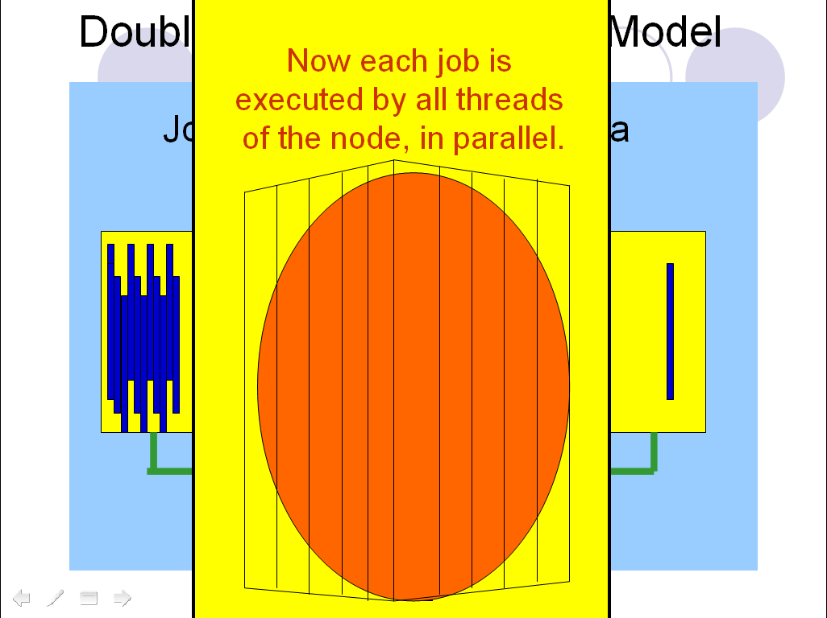

Slide 101
Double-layer Master-Slave Model
Key points for OpenMP parallelized jobs
1, Total_threads_per_node is set as 1, when the lib is called, although not true in reality;
2, All OpenMP parallelization is done inside the user’s DO_THE_JOB() routine.

Slide 102
Double-layer Master-Slave Model
OpenMP job example:
still square root summation
Click here for the example in C
in F90

Slide 103
Double-layer Master-Slave Model
Use script file to test it in F90 and C
hho PROCESSES THREADS

Slide 104
Double-layer Master-Slave Model
Then a normal existing OpenMP parallel code for a certain job can be converted into a user’s DO_THE_JOB() routine, then call the DMSM lib of special case III to get an additional outer layer parallelism to submit many OpenMP parallel jobs together.

Slide 105
Double-layer Master-Slave Model
Now each job is
executed by some MPI
processes in parallel.
Job groups sent to nodes via
MPI master-slave model

Slide 106
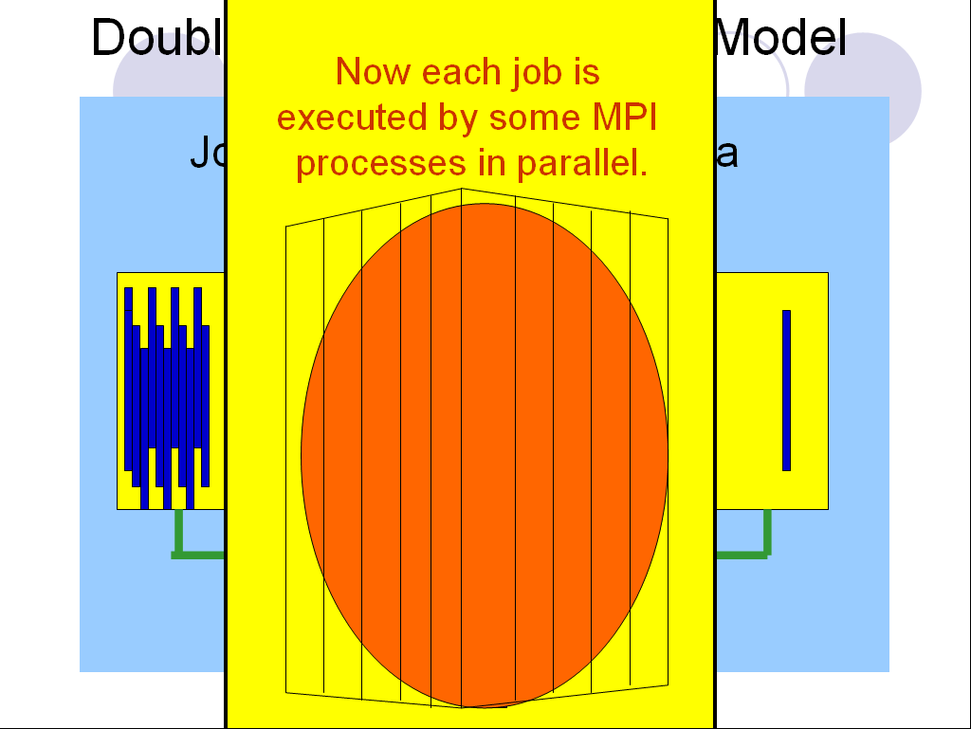

Slide 107
Double-layer Master-Slave Model
An example for MPI parallelized jobs of DMSM lib
Total 81 processes:
1 process is the master to assign job groups to the rest processes;
every 10 of the rest 80 processes do a job together in MPI parallelism.

Slide 108
Double-layer Master-Slave Model
In such a situation, job communicators of processes performing every jobs in parallel
are needed.

Slide 109
Double-layer Master-Slave Model
Additionally, a “dist communicator” of all processes with rank 0 from all job communicators for job (group) distribution is also necessary.

Slide 110
Double-layer Master-Slave Model
Extended interfaces for MPI parallelized jobs of DMSM lib in F90
CALL DMSM_GEN_COMM_MPI_ALL( &
Job_processes_expected, &
All_comm, All_rank, All_processes, &
Job_comm, Job_rank, Job_processes, &
Dist_comm, Dist_rank, Dist_processes )
…
CALL DMSM_MPI_ALL( Total_jobs, &
Num_of_jobs_per_group, &
Do_my_job, &
Prepare_for_a_job_group, &
Collect_results, Enable_it_or_not)

Slide 111
Double-layer Master-Slave Model
Extended interfaces for MPI parallelized jobs of DMSM lib in C
void DMSM_Gen_Comm_MPI_All( int Toal_Processes_For_a_Job,
MPI_Comm All_Comm, int *All_Rank, int *All_Processes,
MPI_Comm *Job_Comm, int *Job_Rank, int *Job_Processes,
MPI_Comm *Dist_Comm, int *Dist_Rank, int *Dist_Processes);
…
void DMSM_MPI_All( int Total_Num_Of_Jobs,
int Num_Of_Jobs_Per_Group,
void (*Do_The_Job) (int),
void (*Job_Group_Preparation) (int,int,int,int),
void (*Result_Collection) (int,int),
int Result_Collection_Enabled);

Slide 112
Double-layer Master-Slave Model
MPI example:
still square root summation
Click here for the example in C
in F90

Slide 113
Double-layer Master-Slave Model
Use script file to test it in F90 and C
hhm Total_processes processes_per_job

Slide 114
Double-layer Master-Slave Model
Then a normal existing MPI parallel code for a certain job can be converted into a user’s DO_THE_JOB() routine, then call the DMSM lib of special case III to get an additional outer layer parallelism to submit many MPI parallel jobs together.

Slide 115
Double-layer Master-Slave Model
The examples and the library
are made public available at:
http://www.hpcvl.org/misc/dmsm/dmsm.html

Slide 116
Thank you very much for your attention!
HAVE A NICE DAY!

