Slide 1

M
V
C/P

Slide 2
App
App/空壳
微信
联系人
发现
我
App/Library
App/Library
App/Library
App/Library
BaseModule
Library

Slide 3
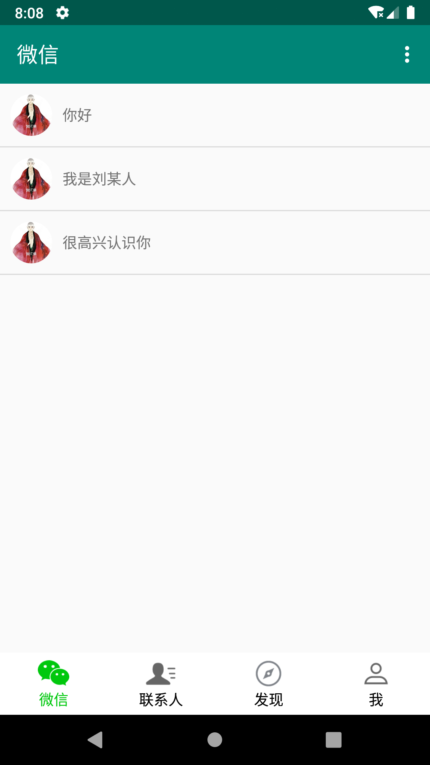
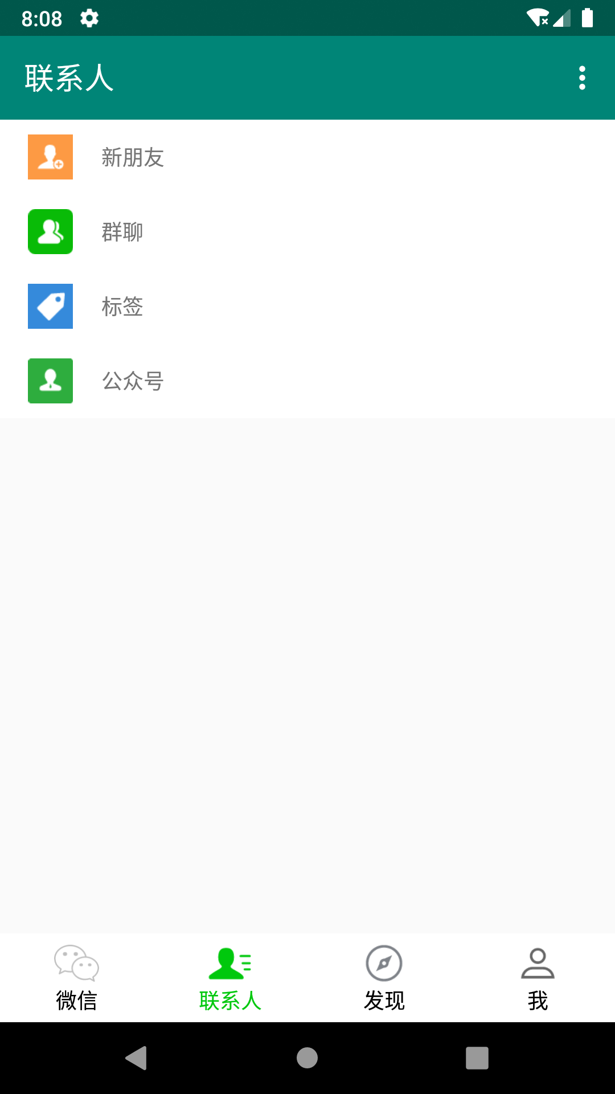
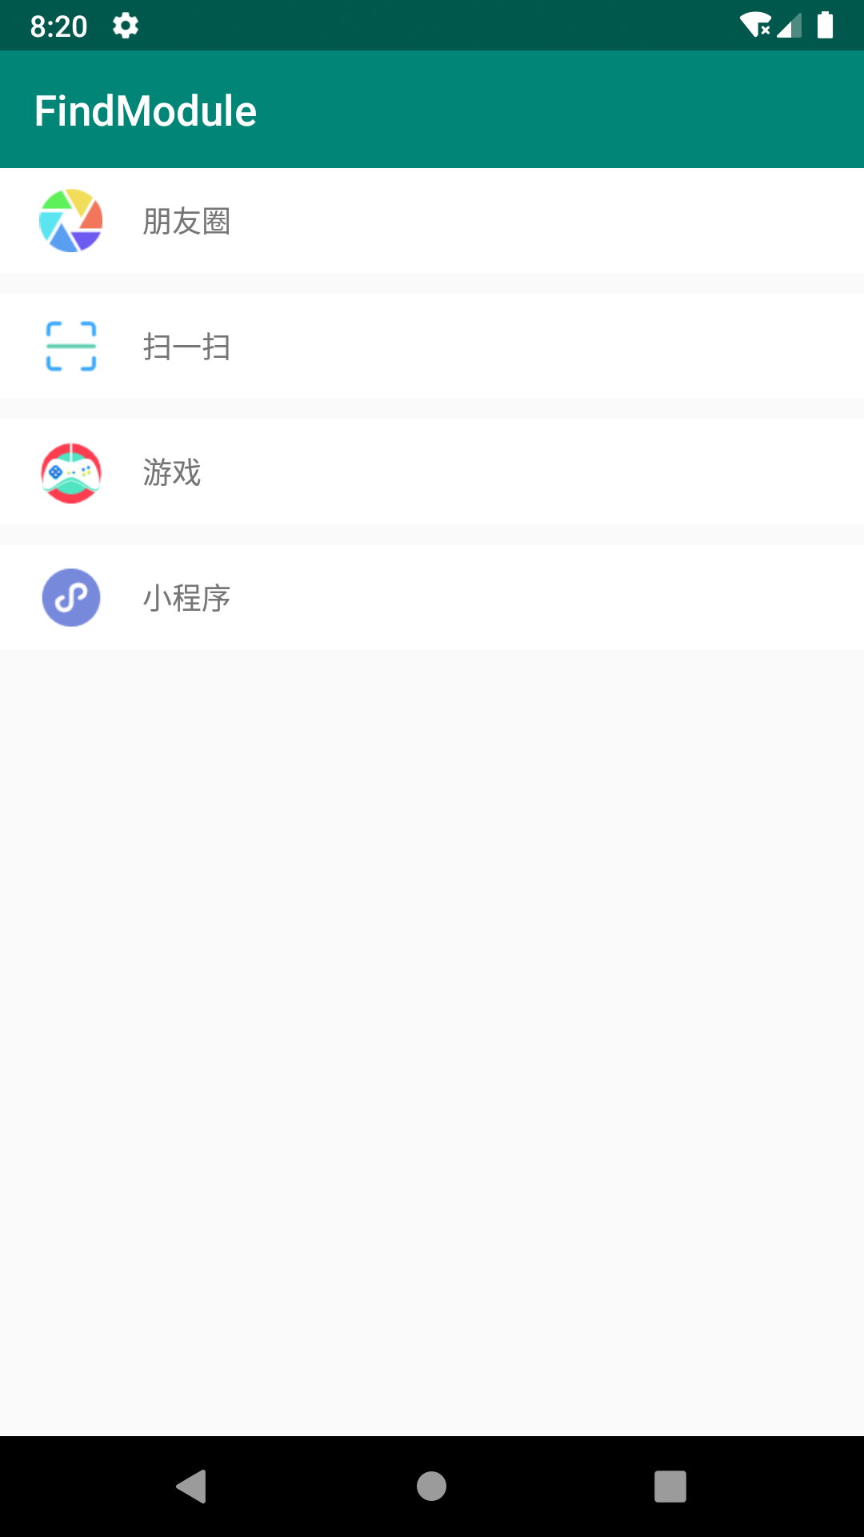
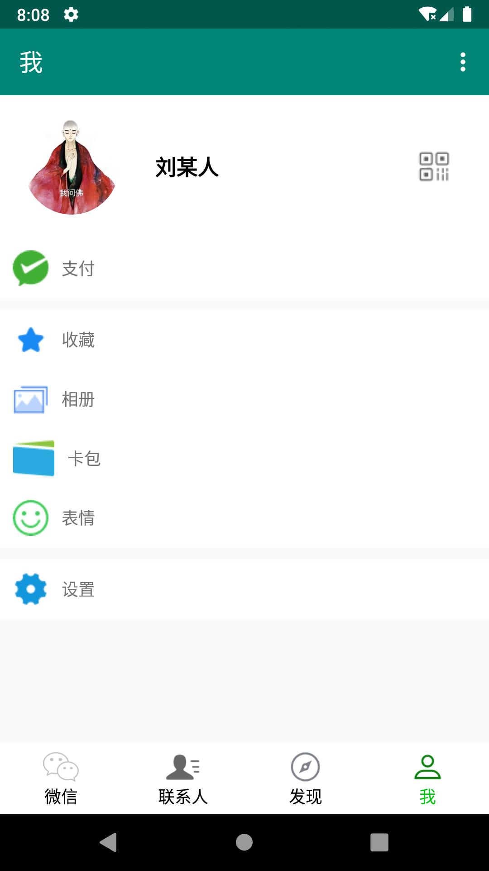

Slide 4
