Slide 1
Convolutional Deep Belief Networks
for Scalable Unsupervised Learning of Hierarchical Representation
Honglak Lee, Roger Grosse, Rajesh Raganath, and Andrew Y. Ng

Slide 2
Convolutional Deep Belief Networks
for Scalable Unsupervised Learning of Hierarchical Representation
Honglak Lee, Roger Grosse, Rajesh Raganath, and Andrew Y. Ng

Slide 3
Motivation
DBN's don't scale well to realistically sized images:
  Images are high dimensional
  Objects can appear anywhere in an image
Both of these problems can be addressed by introducing a degree of translation invariance

Slide 4
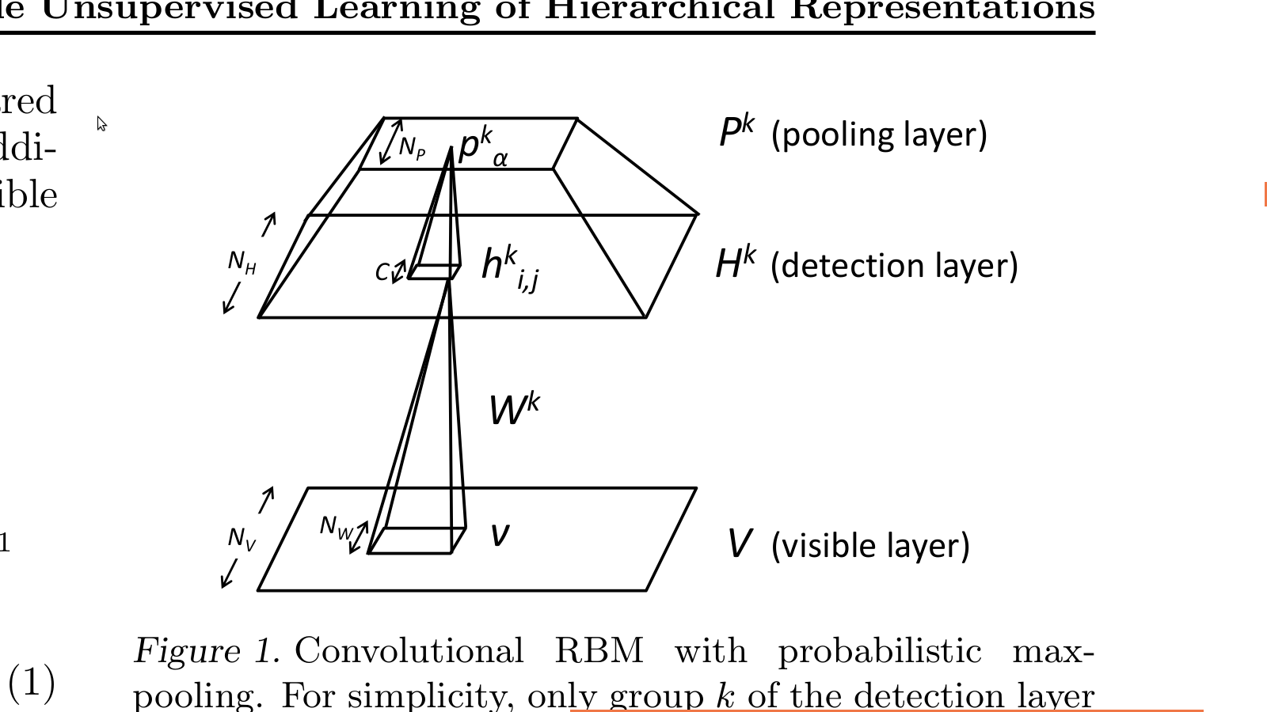
Convolutional RBM (CRBM)
Two layers:
  Input layer V
    NV X NV array of real-valued units
  Hidden layer H
    K “groups”
      NH X NH arrays of real-valued units

Slide 5
Convolutional RBM (CRBM)
Like DBNs, stack several max-pooling CRBM on top of each other
Train with efficient greedy, layer-wise algorithm

Slide 6
Probabilistic Max-Pooling
In general, each layer requires progressively larger inputs
Add a third layer to reduce complexity shrinking representation, without sacrificing significant features
Feed forward only the “best match” by adding the constraint that only one unit in each C X C block is activated

Slide 7
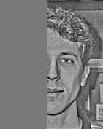
Hierarchical probabilistic inference
Lee and Mumford proposed that visual cortex performs hierarchical Bayesian inference
  Use posterior computed at each layer to improve feature detection (especially disambiguation) in lower layers
  This extends to feature inference
e.g, from an observation of half of a face, we can infer the rest of the face by combining observation with prior knowledge of faces

Slide 8
Experiment
Learning hierarchical representations from natural images
Self-taught learning for object recognition
Handwritten digit classification
Unsupervised learning of object parts
Hierarchical probabilistic inference

Slide 9
Experiment
Learning hierarchical representations from natural images
Self-taught learning for object recognition
Handwritten digit classification
Unsupervised learning of object parts
Hierarchical probabilistic inference

Slide 10
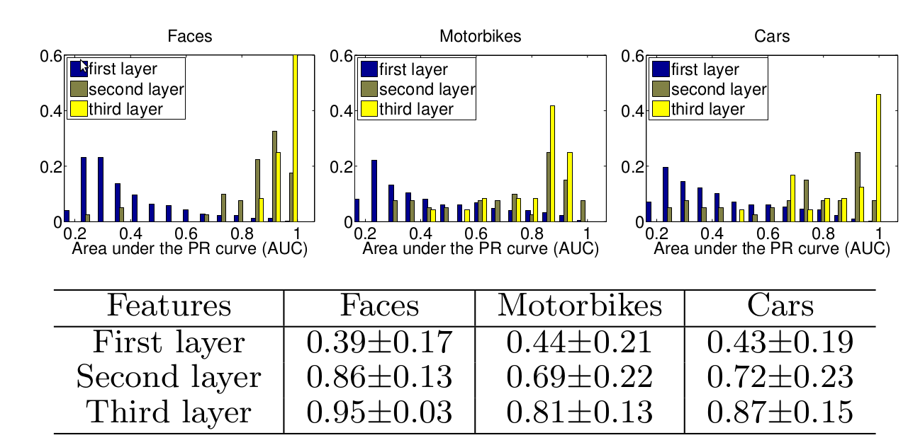
Unsupervised learning of object parts

Slide 11
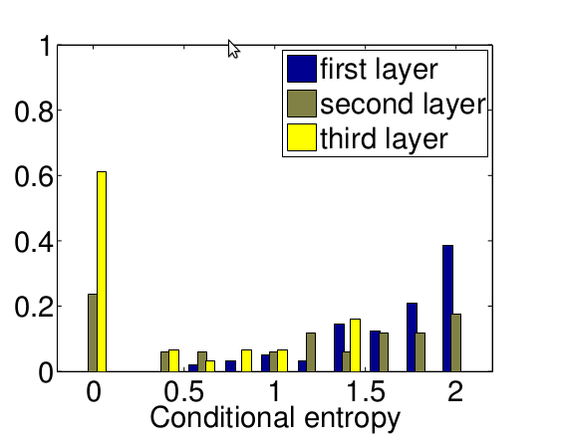
Unsupervised learning of object parts

Slide 12
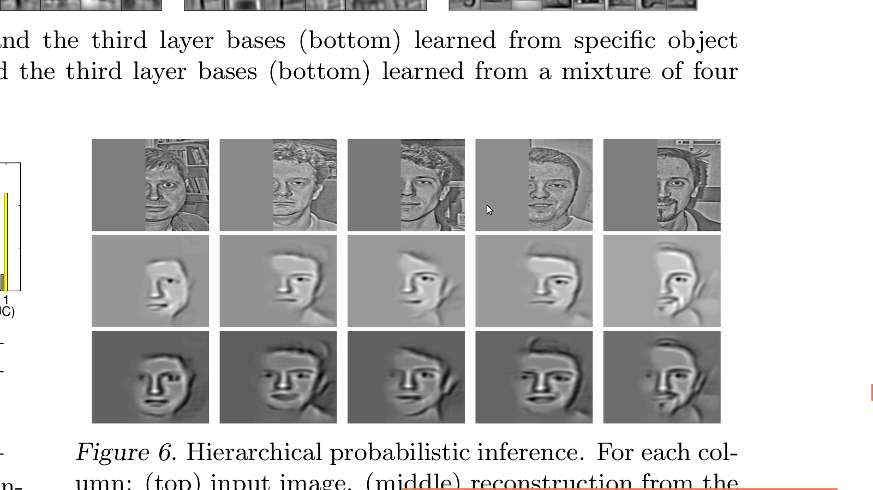
Hierarchical probabilistic inference
Original image
Control
(bottom-up)
Top-down and
Bottom-up

Slide 13
Conclusions
Probabilistic Max-Pooling significantly reduces computational overhead
Incorporating top-down information flow reduces stimulus ambiguity and allows inference of unobserved stimulus
  Similar to hierarchical Bayesian inference

