Slide 1
Spontaneous Events Outline
the Realm of Possible Sensory Responses
in Neocortical Populations
Artur Luczak, Peter Bartho, Kenneth D. Harris

Slide 2
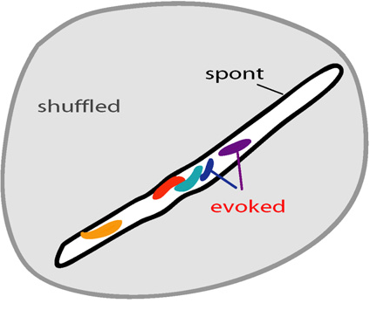
Set of Neuronal Responses
response matrix:

Slide 3
Set of Neuronal Responses
Constrained vocabulary of spike patters expressible by cortical circuit
Spontaneous events widely sample this vocabulary

Slide 4
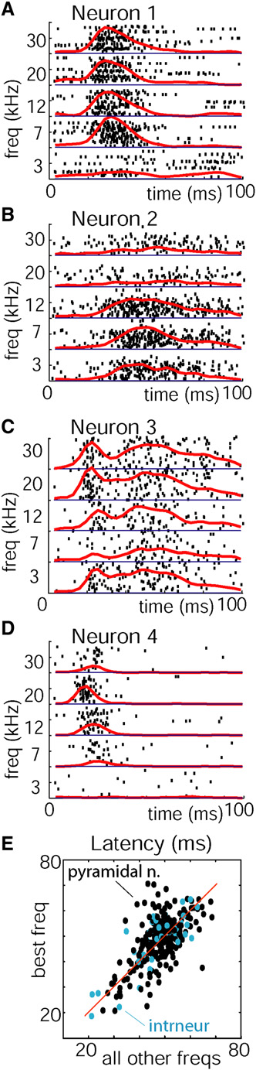
Consistent PSTH structure
temporal structure conserved across stimuli
varied widely between neurons

Slide 5
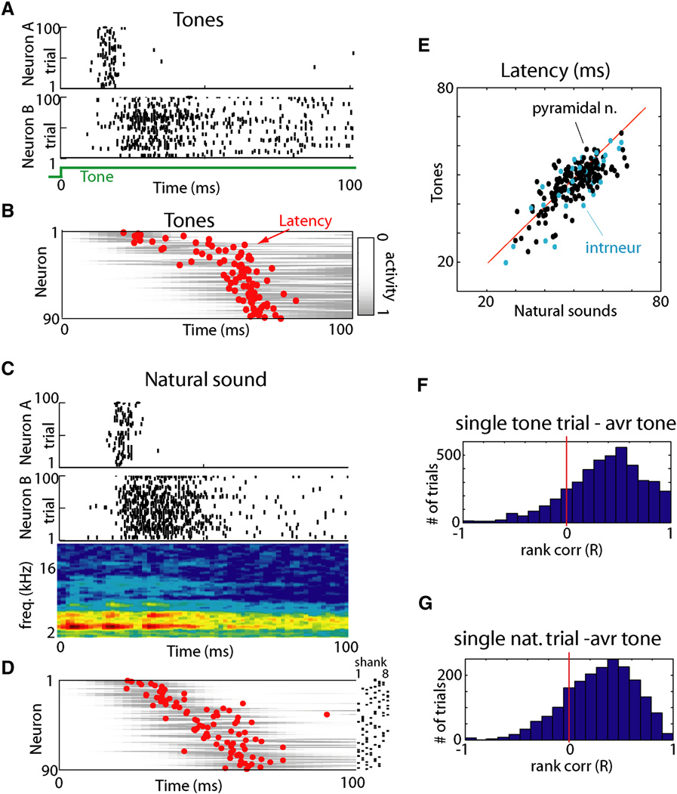
Consistent PSTH structure
High average correlation of PSTH with mean PSTH (0.72 ± 0.24)

Slide 6
Population Level
Stereotyped spike latency translates into sequential population response
Natural sounds

Slide 7
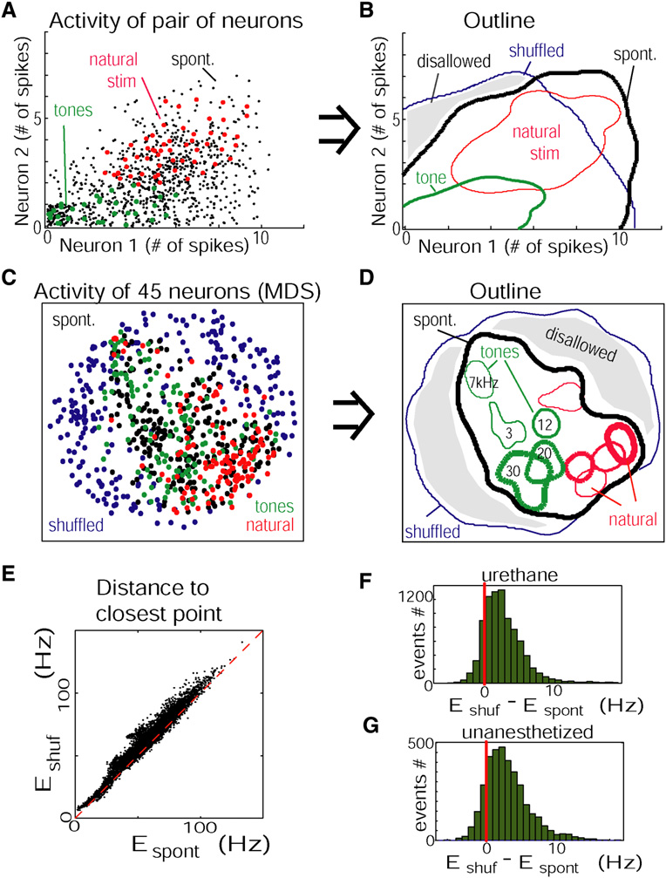
Visualizing Response Constraints
Reduced dimensionality with multidimensional scaling (MDS)
MDS is roughly isometric (w.r.t. Euclidean metric)

Slide 8
Visualizing Response Constraints

Slide 9
Quantifying Response Constraints
Relative volume of region satisfying constraint was estimated as absolute value of determinant of cell-by-cell spike count covariance matrix
Normalized by determinant shuffled covariance matrix
Does this make sense? Shouldn't constraints reduce this volume? On the other hand, constraints increase covariances, which in turn increases this volume?

Slide 10
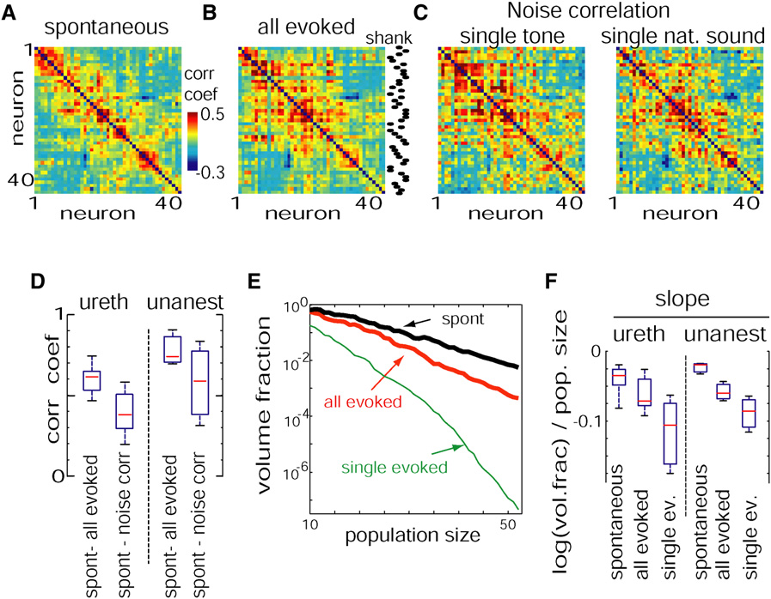
Quantifying Response Constraints
    Paper claims that volume decreases monotonically with number of cells, and suggests this implies that each cell further constrains the population response.
    Shouldn't this occur when covariances are small, so that neurons don't constrain much?

Slide 11
Geometry of Response Constraints
    Similarity of signal/noise correlation matrices to spontaneous correlation matrix suggests similar orientation in population response space

Slide 12
Possible mechanisms of constraint
Temporal response profile of individual neurons partially determined by gated ion channel thresholds
Strong reciprocal neuronal connectivity occurs more often than expected by chance
  This constrains activation to subsets of neurons
More likely, correlations just represent larger-scale network interactions (data not shown)

Slide 13
Relation to memory replay studies
A number of studies have suggested that spontaneous activity in resting or sleep replays firing patterns seen during prior behavior.
In this study, rat had never heard the tone stimuli presented prior to spontaneous activity recording
Similarity in firing pattern may arise from constraints
Also, firing rates may be as useful as temporal order/correlation in characterizing replay

Slide 14
Significance for Information Encoding
Constraints reduce vocabulary of a neuronal ensemble
Potentially inefficient
Redundancy may increase neural code's robustness

Slide 15
Other curiosities...
Paper claimed that each tetrode yielded 5-15 well-isolated units
  So 1-4 units per electrode.
    Likely some double-counting?
  Correlation analysis dependent on sorting
Upstate detected by transition from <1 spike per 30 ms to >15 spikes per 60 ms

