Slide 1
Decoding V1 Neuronal Activity using Particle Filtering with Volterra Kernels
Ryan Kelly and Tai Sing Lee

Slide 2
Motivation
Use Volterra Kernels to predict neuronal response at next time step from response history by predicting the scene variable.

Slide 3
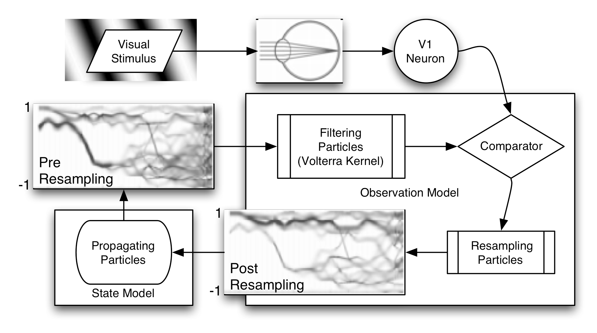
Hypothesis Particle
History of the scene variable as hypothesized from neuronal activity.
Filter particles to find the most likely.

Slide 4
Paradigm

Slide 5
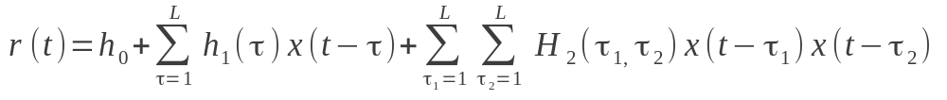

Particle Filtering
Generate a prediction of the neuronal response by filtering the hypothesis with the Volterra Kernels
Kernel learned by:

Slide 6
Comparator
For each hypothesis particle, compare neuronal response to predicted response to yield likelihood measure.
Proportional to how close the particle's predicted response is to observed response.

Slide 7
Particle Resampling
Resample (with replacement) the posterior distribution based on this likelihood.
Particles predicting a response similar to the observed neural response will have higher likelihoods will repeat with high probability.

Slide 8
Particle Propagation
Combine likelihood with prior on how scene variable tends to vary

Slide 9

Experiment
Used phase of sine-wave grating as scene variable.

Slide 10
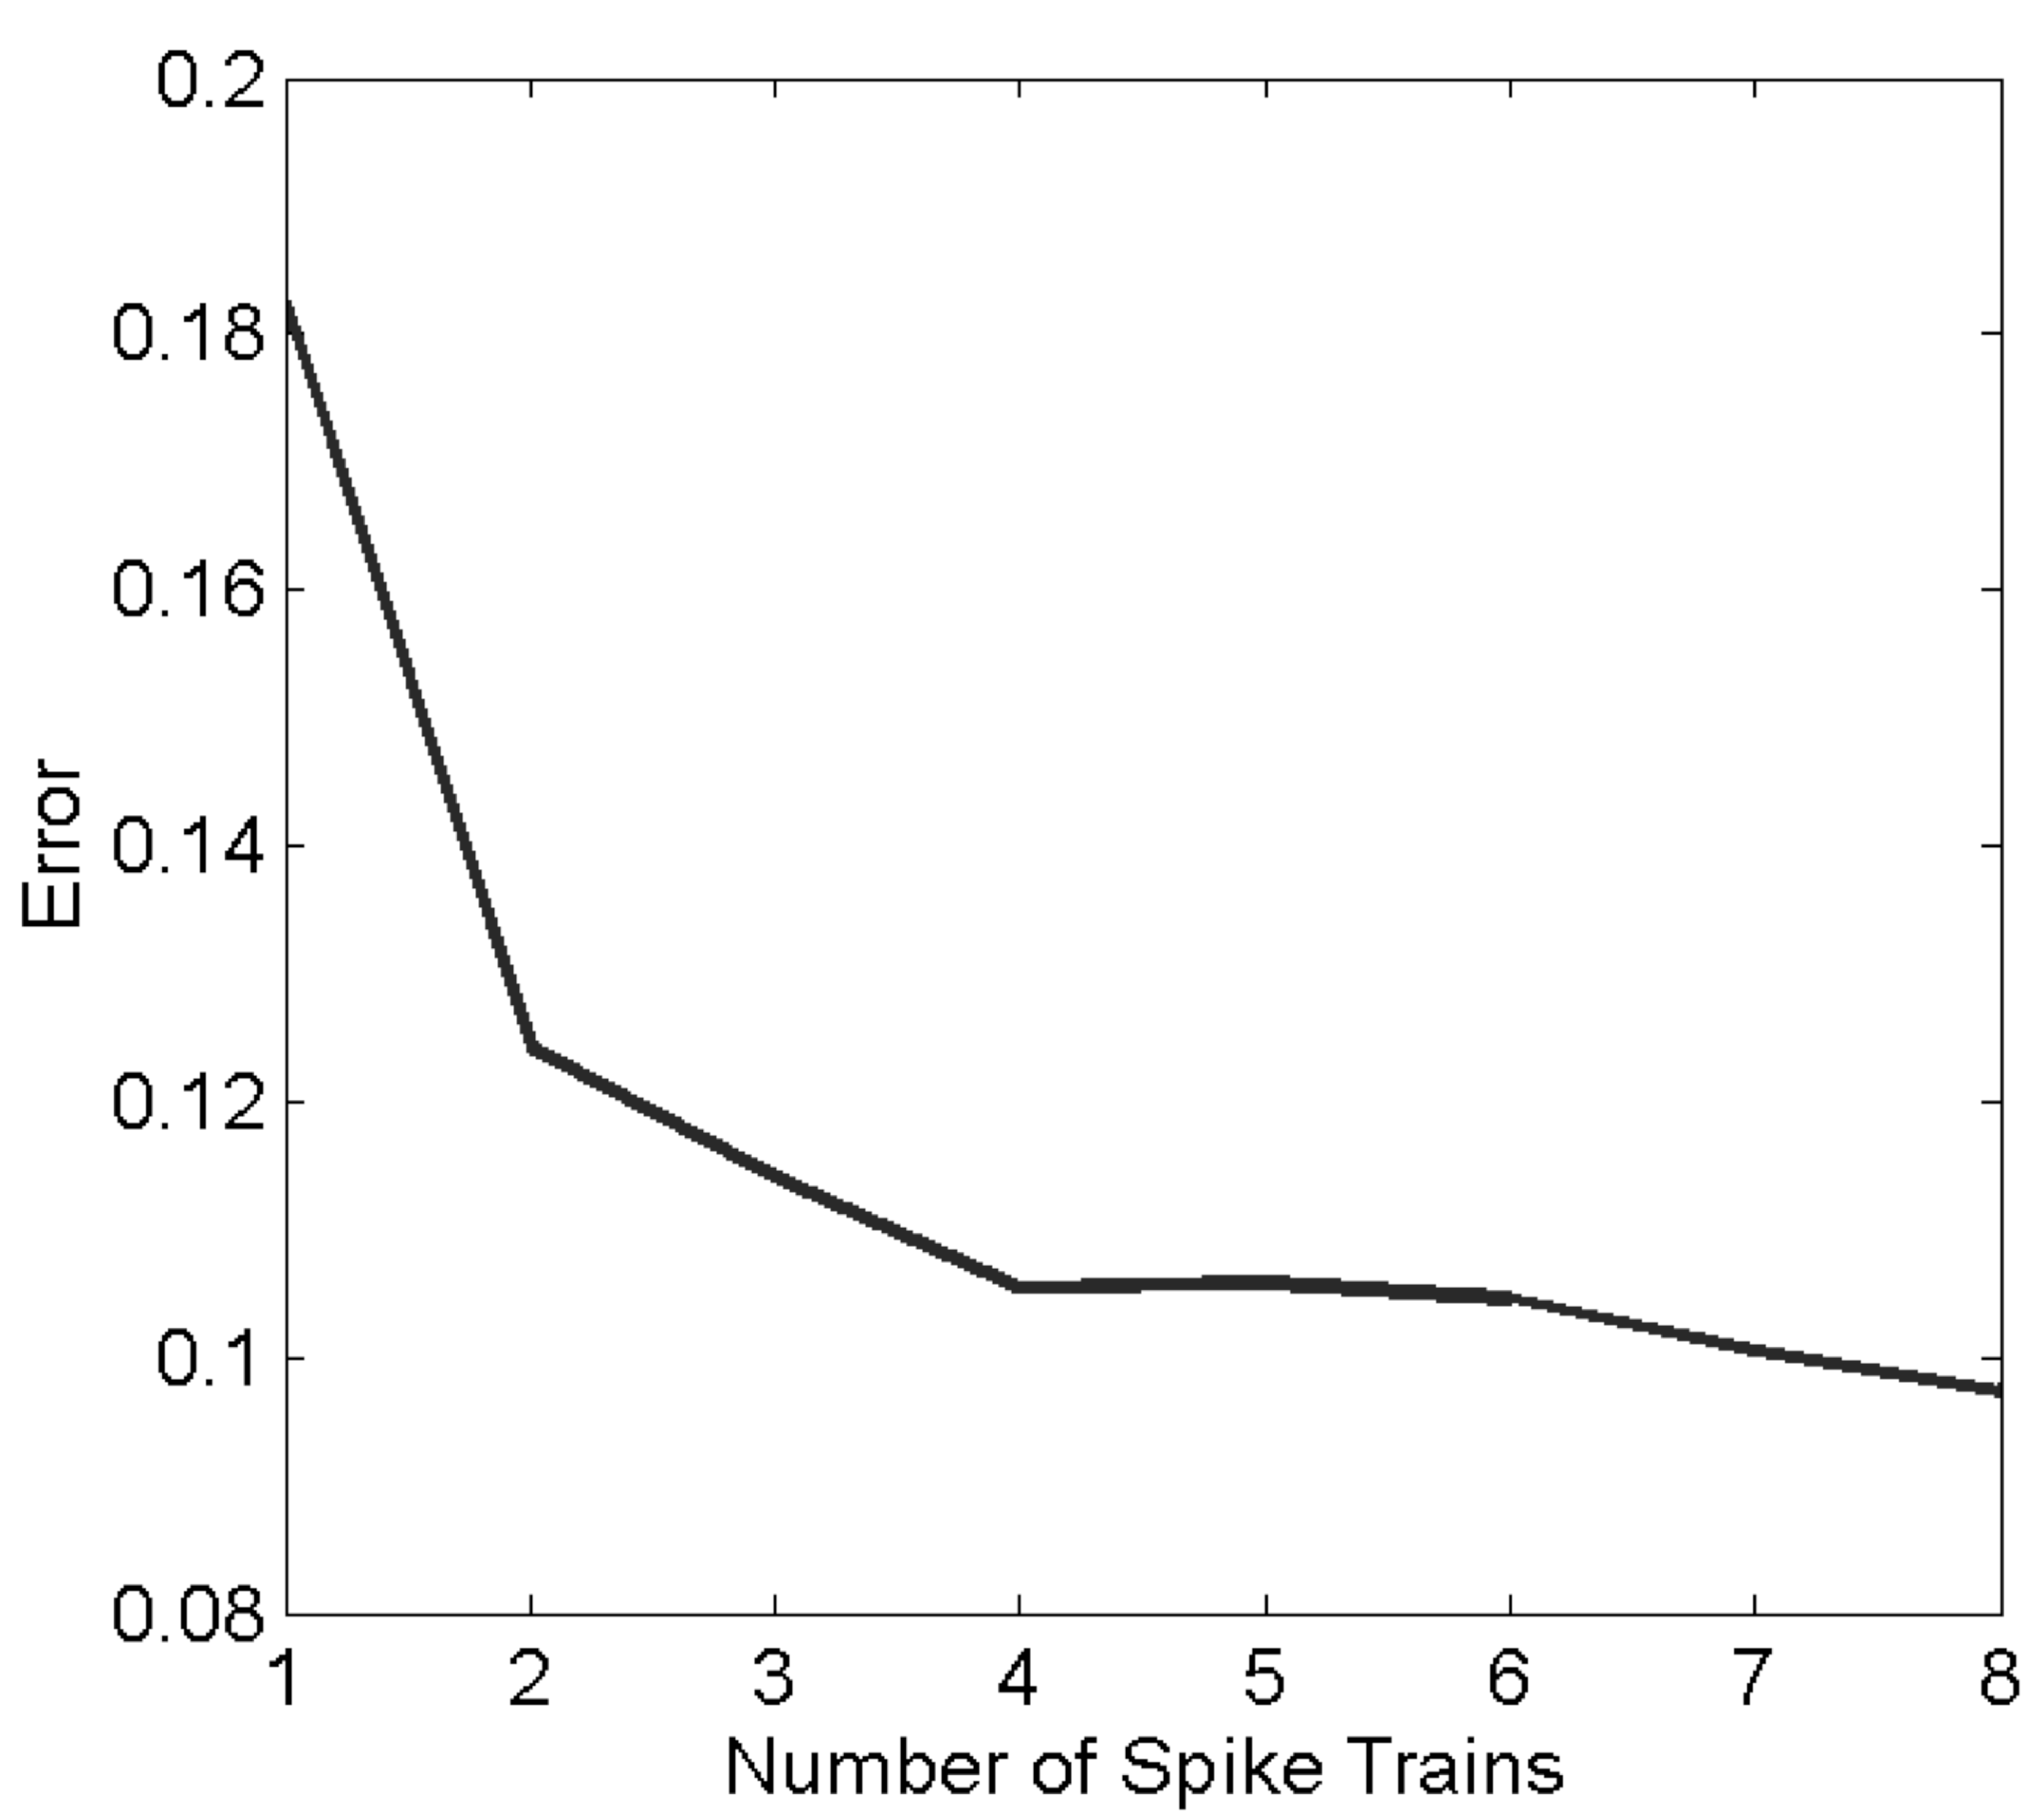
Results
Sampling from 10 independent neurons is sufficient to reconstruct scene variable with 90% accuracy

Slide 11
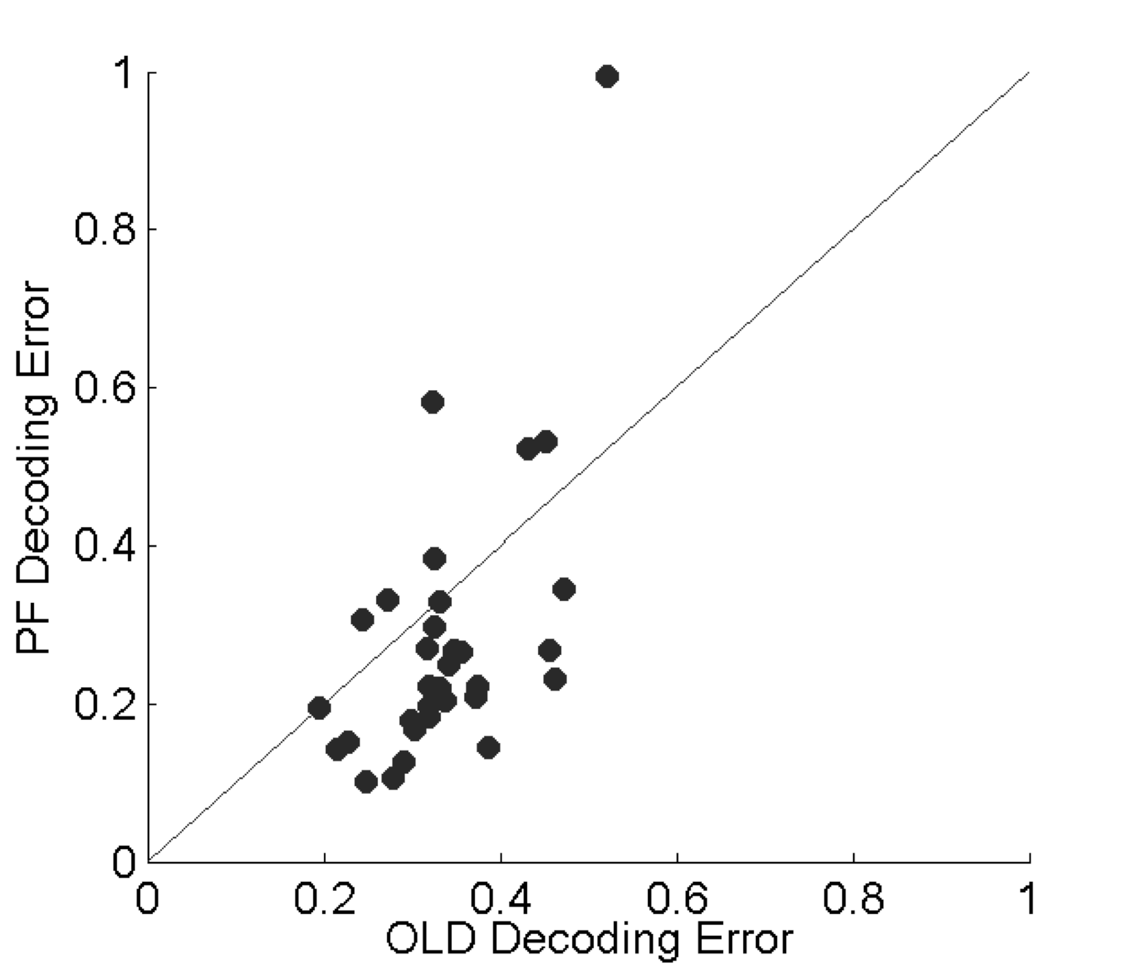
Results
General improvement over optimal linear decoding (OLD).
OLD keeps only one hypothesis at a given time step.

Slide 12
Conclusions
Nonlinearities are significant when modeling neurons – using second order Volterra Kernels improves decoding accuracy.
Particle filtering allows an efficient approximation of relevant areas of the hypothesis space, while tracking several very different hypotheses.
Keeping a prior on how the scene variables tends to change allows pruning of the hypothesis space.

