Slide 1
From GitHub Copilot to Cursor
Why We Need a Project-Level AI
Improving engineering productivity beyond code completion

Slide 2
What Cursor
Cursor is an AI-native code editor built by Anysphere that forked VS Code to gain architectural control impossible through extensions.
Unlike GitHub Copilot (which operates as a plugin), Cursor can rewrite the editor itself—enabling features like Shadow Workspace verification, inline diffs, and multi-file edits that extensions cannot replicate. It reached $1B ARR in 24 months at a $29B valuation, making it the fastest-growing SaaS company in history.
Notes:
https://www.mmntm.net/articles/cursor-deep-dive?utm_source=chatgpt.com

Slide 3
Current Situation of Github and Cursor
Cost breakdown
Cursor Pro: $20 monthly but you only get 500 premium requests, then extra fees kick in
GitHub Copilot Pro: $10 monthly with unlimited usage under fair use terms
I’ve seen people mention bills over $40 with Cursor when they go over limits
Features they both have
Code auto-completion
AI chat for help with coding
Automated coding agents
Understanding your entire project

Slide 4
Current Situation of Github and Cursor
Cost breakdown
Cursor Pro: $20 monthly but you only get 500 premium requests, then extra fees kick in
GitHub Copilot Pro: $10 monthly with unlimited usage under fair use terms
I’ve seen people mention bills over $40 with Cursor when they go over limits
Features they both have
Code auto-completion
AI chat for help with coding
Automated coding agents
Understanding your entire project

Slide 5
GitHub Copilot: A Great Code-Level Assistant
Intelligent inline code completion
Helps write functions and boilerplate faster
Useful for API usage, syntax, and patterns
Low learning curve, easy to adopt
✅ Copilot significantly speeds up writing code

Slide 6
Copilot’s Ceiling in Real Engineering Work
Limited project-wide understanding
Multi-file changes are mostly manual
Refactoring still requires developers to:
Search files
Open files
Decide what to change
AI mostly reacts to developer actions
⚠️ Copilot helps how fast we type,
but not who does the engineering work

Slide 7
Why Copilot Has Limits — An Architectural View
GitHub Copilot --Plugin-based assistant
Developer
↓
IDE (VS Code)
↓
Copilot Extension
Runs as an IDE plugin
Context is provided by the IDE
No autonomous project traversal
👉 AI assists the developer
Cursor --AI-native editor
Developer Goal
↓
AI Agent
↓
Project Files
AI built into editor core
Project-level file access
Can plan and execute multi-step changes
👉 AI acts as an engineer
The difference is not the AI model — it’s the architecture.

Slide 8
Why Copilot Has Limits — An Architectural View
GitHub Copilot --Plugin-based assistant
Positioning: VS Code plugin → AI code completion assistant
Key Points:
Reads only open files + workspace index
Cannot proactively edit multiple files
AI is passive, triggered only by user input
Limitation: Restricted by VS Code APIs, no project-level awareness
Cursor --AI-native editor
Developer Goal
↓
AI Agent
↓
Project Files
AI built into editor core
Project-level file access
Can plan and execute multi-step changes
👉 AI acts as an engineer
The difference is not the AI model — it’s the architecture.

Slide 9
Copilot vs Cursor: Capability Comparison
Capability | GitHub Copilot | Cursor
Inline completion | ✅ | ✅
Single-file edits | ✅ | ✅
Project-wide understanding | ⚠️ Limited | ✅
Multi-file refactoring | ⚠️ Assisted | ✅ Autonomous
File search & traversal | ❌ | ✅
Create / modify many files | ❌ | ✅
Engineering task execution | ❌ | ✅
Copilot is code-level. Cursor is project-level.

Slide 10
Why Cursor Is Worth Introducing
Best-fit scenarios
Large or legacy codebases
Cross-file refactoring
Logging / error handling standardization
Onboarding to unfamiliar projects
Increasing senior engineers’ leverage
Adoption strategy（现实、不激进）
✅ Cursor is not a replacement for Copilot
✅ Copilot → daily coding
✅ Cursor → engineering-level tasks

Slide 11
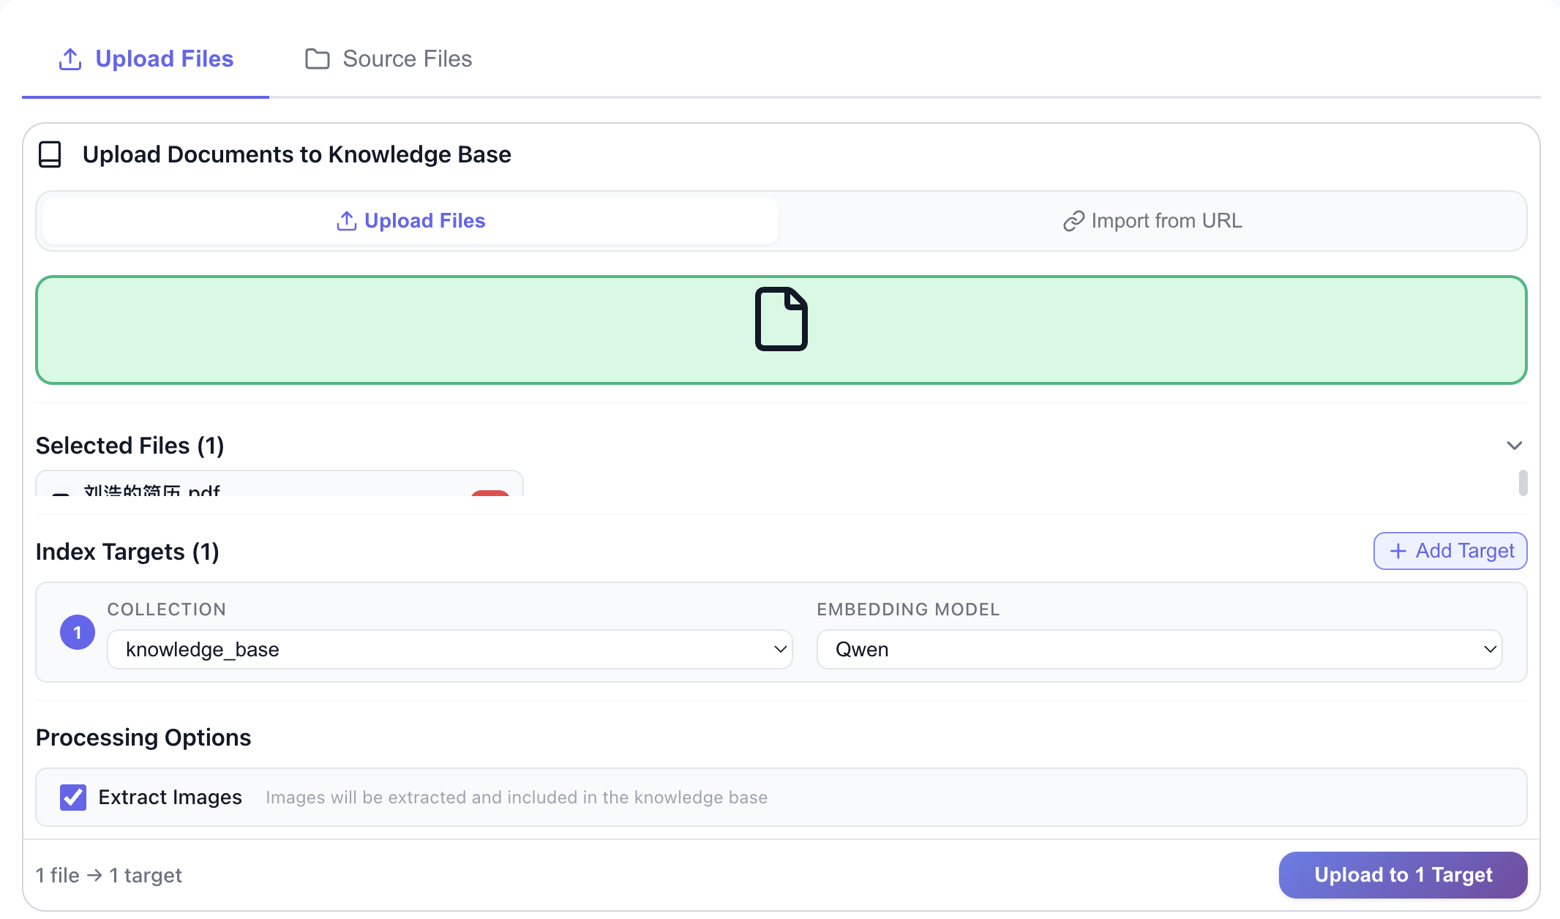
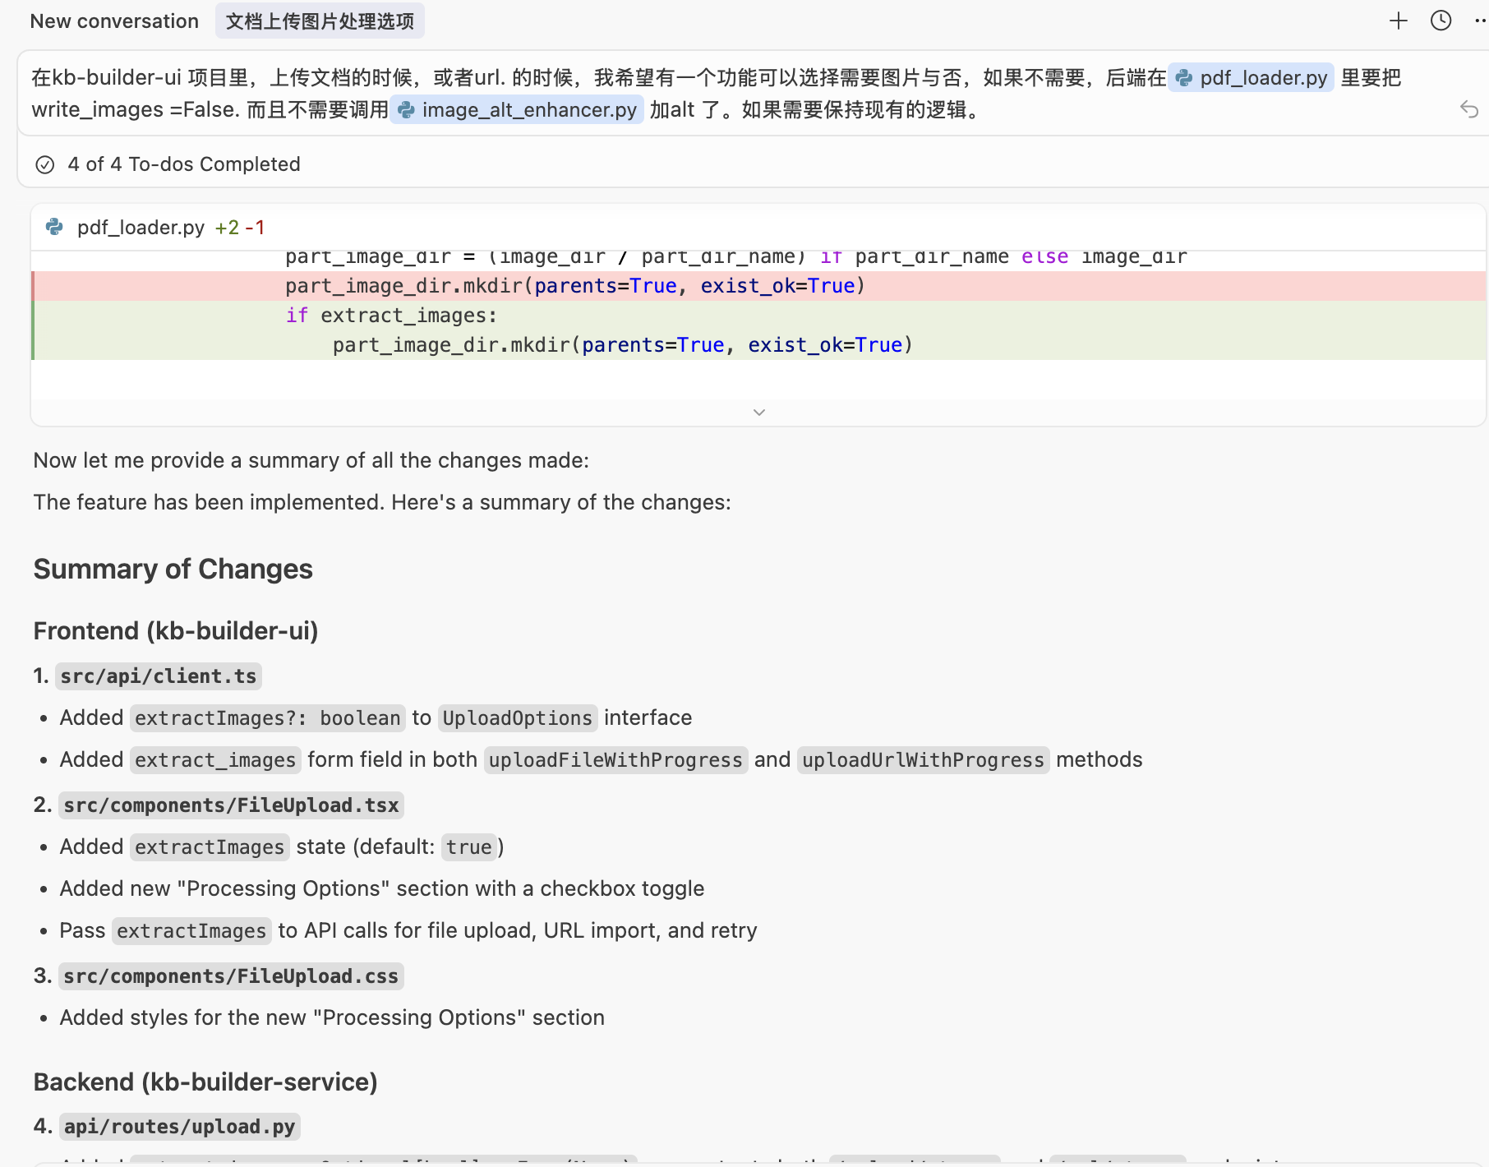
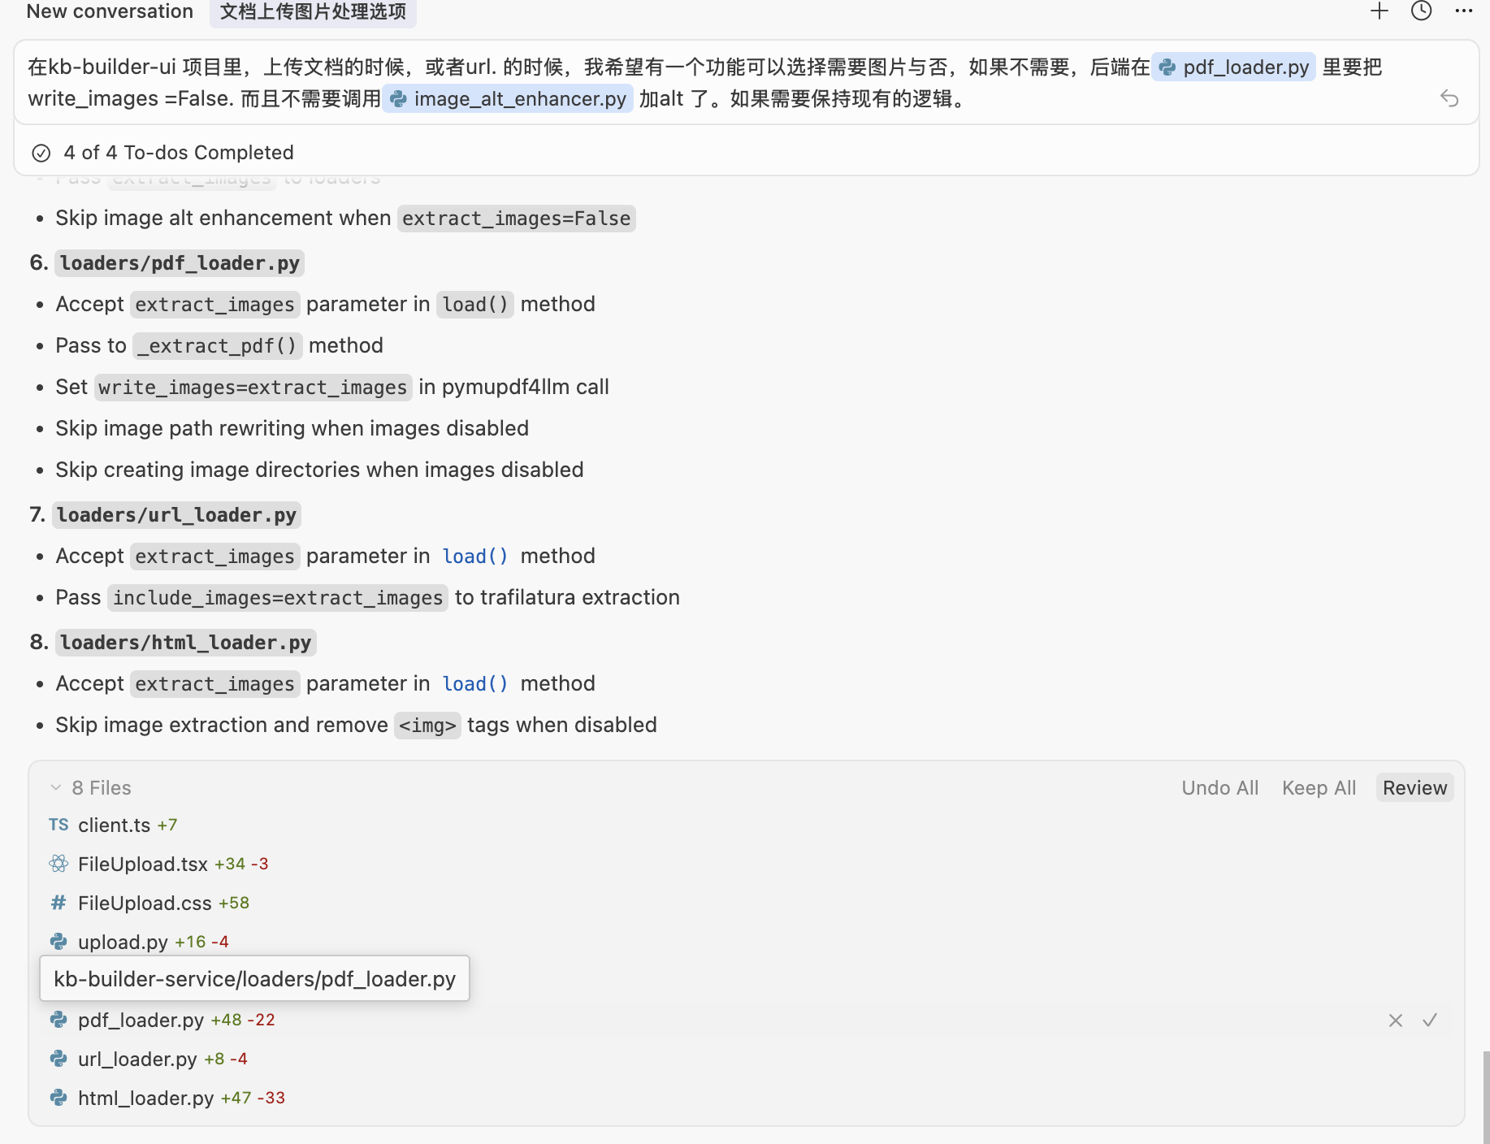
Demo-add new feature for comparison

Slide 12
Demo-add new feature for comparison

Slide 13
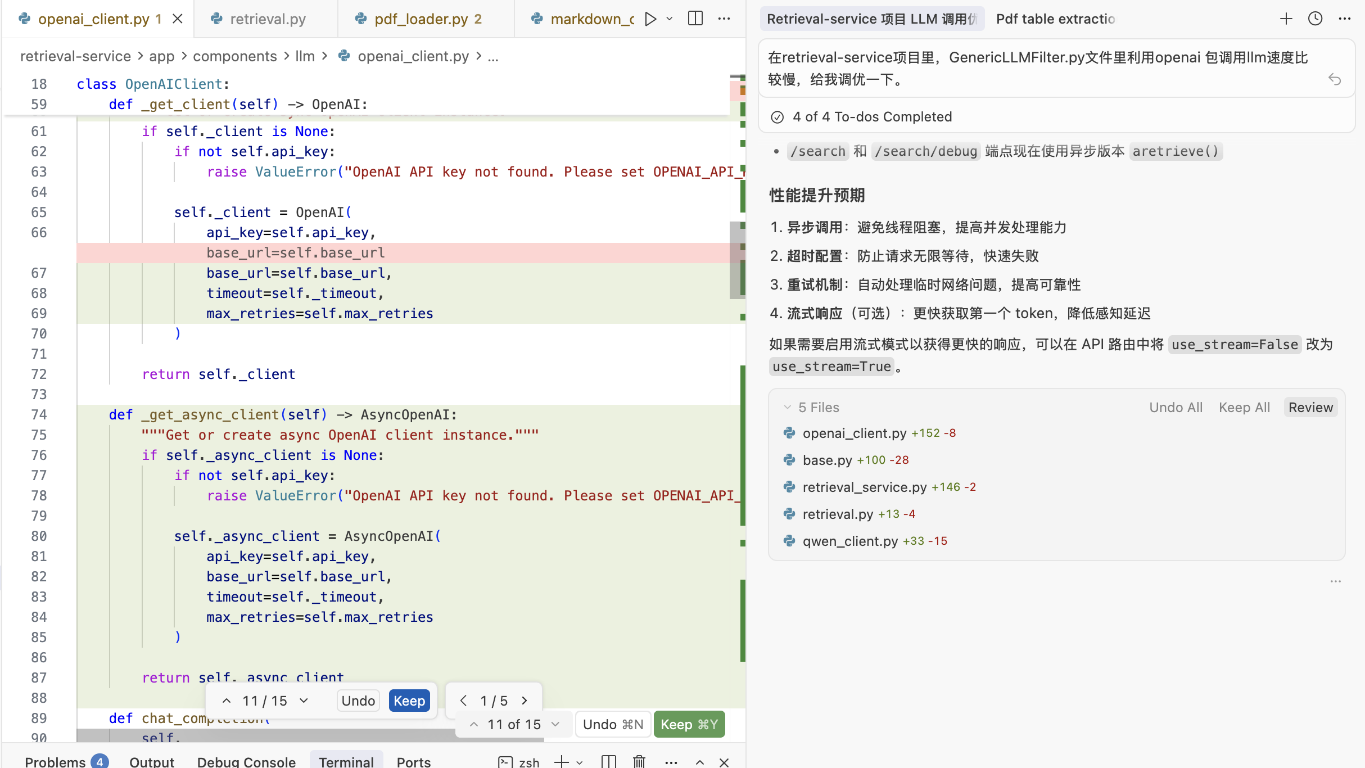

Slide 14
Codebase Indexing: Cursor vs VS Code + Copilot
Cursor
Builds a project-wide semantic index by default
Scans and understands the entire repository when a project is opened
Automatically identifies related files, call chains, and dependencies
Enables AI to:
  Answer questions across the whole codebase
  Plan and apply multi-file changes
  Perform large-scale refactors with consistent context
Treats the entire codebase as the default unit of context
VS Code + GitHub Copilot
Context is on-demand and ephemeral
Uses:
  Open files
  Selected code
  Manually attached files in Copilot Chat
No explicit step to scan or index the entire repository
Cross-file reasoning depends heavily on what the developer provides
Well suited for local edits, code completion, and guided refactors
Key Difference
Copilot reasons over the context you give it.
Cursor reasons over the context it already understands.

Slide 15
