Slide 1
Agent Skills Intro
Notes:
https://github.com/anthropics/skills
https://github.com/agentskills/agentskills

Slide 2
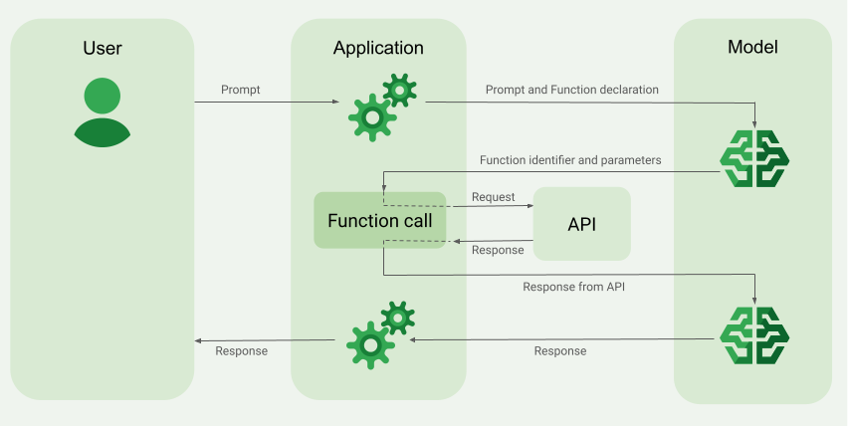
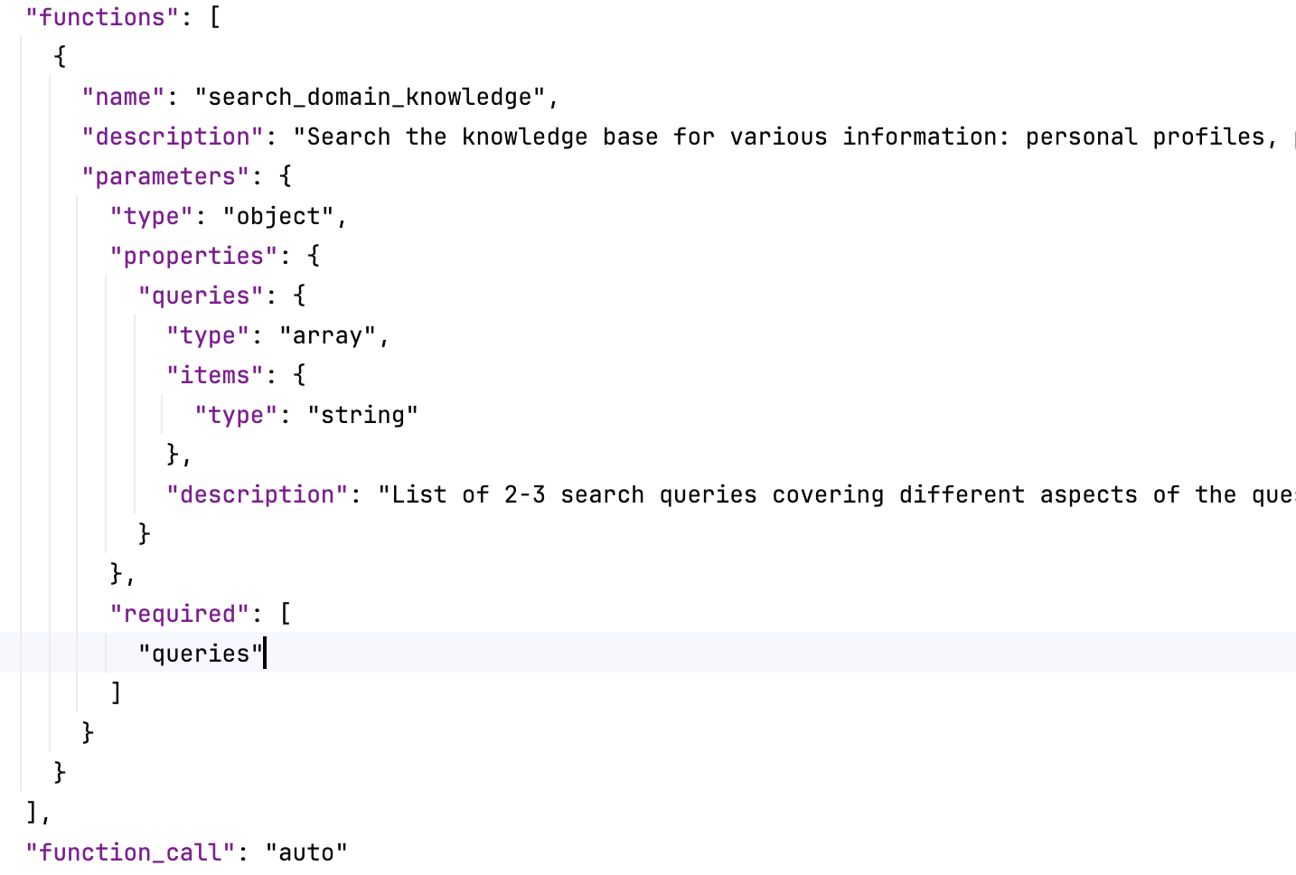
Function Calls-- Giving Models the Ability to Act
What are Function Calls?
A mechanism for LLMs to invoke external functions or tools
Enables models to go beyond text generation
What Function Calls Enable
Call APIs (e.g. send email, query database)
Execute actions based on structured outputs
Integrate LLMs into real systems
Key Value
Models can act, not just respond
Limitation
Function calls only define what can be executed
They do not define how tasks should be performed
Notes:
{
"model": "qwen-plus",
"messages": [
{
"role": "system",
"content": "You are an intelligent knowledge assistant. For any uncertain information, search the knowledge base first.\n\n**Core Principles:**\n- Always use the search tool for specific questions - don't rely on pre-trained knowledge\n- Perform multiple searches with different keywords if needed\n\n**Response Guidelines:**\n- Answer based on retrieved documents, use [1], [2] for citations\n- **Images:** When results contain Markdown images ![alt](url), include them directly - don't describe, just embed\n- Reply in the user's language\n- If no relevant information found, honestly inform the user\n- Do NOT add a \"References:\" section\n"
},
{
"role": "user",
"content": "刘浩是干什么的？"
}
],
"functions": [
{
"name": "search_memory_test_knowledge",
"description": "Search the knowledge base for various information: personal profiles, positions, work experience, preferences, technical documents, project information, etc.\n\n**Use Cases:** \n- When user asks about any information you are uncertain about\n- Query specific person's information (position, experience, preferences, etc.)\n- Find technical documents, operation guides, project materials\n- Any knowledge that needs verification or supplementation\n\n**Query Tips:**\n- Extract core keywords for searching\n- Provide multiple query terms for more comprehensive results\n- If search results are insufficient, retry with different keywords\n",
"parameters": {
"type": "object",
"properties": {
"queries": {
"type": "array",
"items": {
"type": "string"
},
"description": "List of 2-3 search queries covering different aspects of the question. Each query should be 2-10 words and explore different angles (configuration, troubleshooting, documentation, error codes, etc.)."
}
},
"required": [
"queries"
]
}
}
],
"function_call": "auto"
}

Slide 3
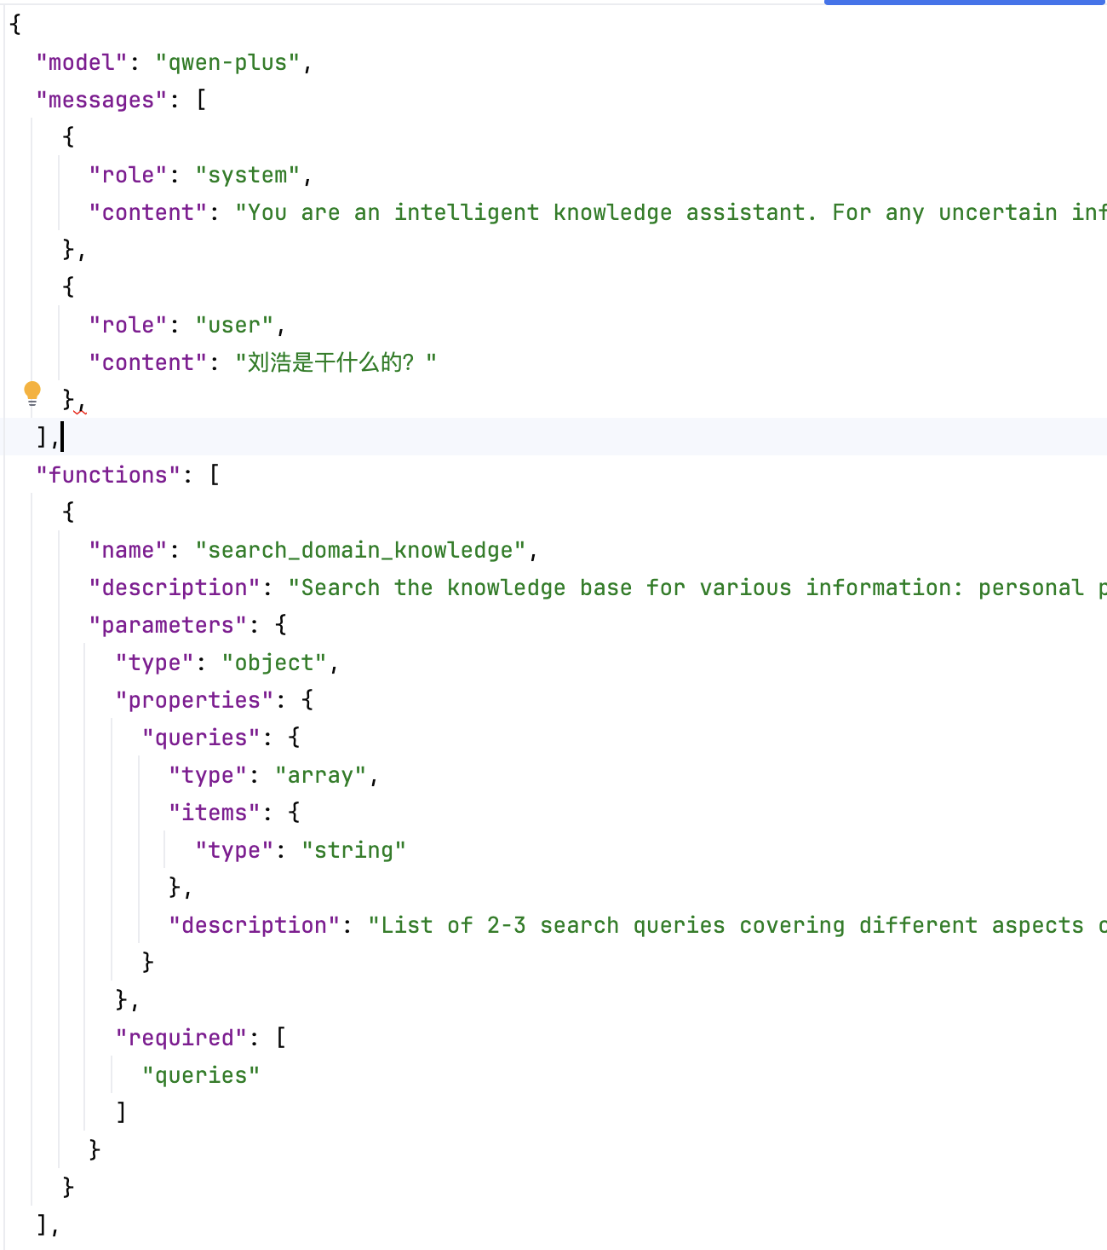
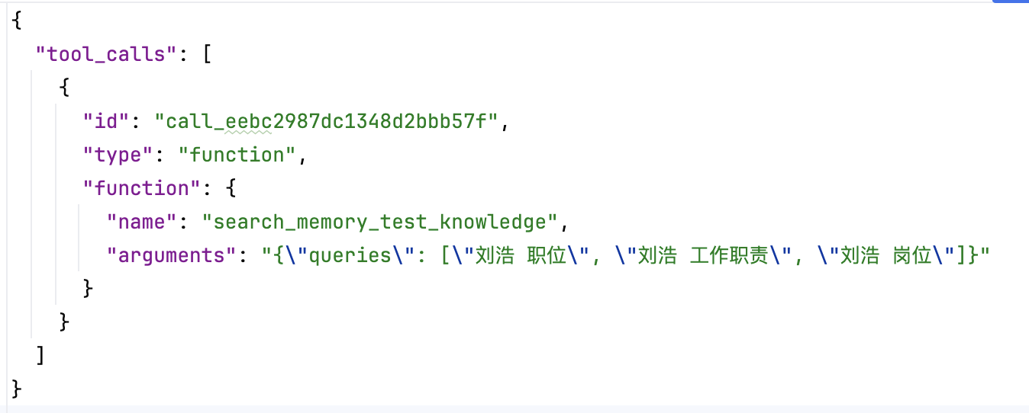
Function Calls-- Giving Models the Ability to Act
System prompt + messges + function definations
Llm => Function calls
Notes:
{
"model": "qwen-plus",
"messages": [
{
"role": "system",
"content": "You are an intelligent knowledge assistant. For any uncertain information, search the knowledge base first.\n\n**Core Principles:**\n- Always use the search tool for specific questions - don't rely on pre-trained knowledge\n- Perform multiple searches with different keywords if needed\n\n**Response Guidelines:**\n- Answer based on retrieved documents, use [1], [2] for citations\n- **Images:** When results contain Markdown images ![alt](url), include them directly - don't describe, just embed\n- Reply in the user's language\n- If no relevant information found, honestly inform the user\n- Do NOT add a \"References:\" section\n"
},
{
"role": "user",
"content": "刘浩是干什么的？"
}
],
"functions": [
{
"name": "search_memory_test_knowledge",
"description": "Search the knowledge base for various information: personal profiles, positions, work experience, preferences, technical documents, project information, etc.\n\n**Use Cases:** \n- When user asks about any information you are uncertain about\n- Query specific person's information (position, experience, preferences, etc.)\n- Find technical documents, operation guides, project materials\n- Any knowledge that needs verification or supplementation\n\n**Query Tips:**\n- Extract core keywords for searching\n- Provide multiple query terms for more comprehensive results\n- If search results are insufficient, retry with different keywords\n",
"parameters": {
"type": "object",
"properties": {
"queries": {
"type": "array",
"items": {
"type": "string"
},
"description": "List of 2-3 search queries covering different aspects of the question. Each query should be 2-10 words and explore different angles (configuration, troubleshooting, documentation, error codes, etc.)."
}
},
"required": [
"queries"
]
}
}
],
"function_call": "auto"
}

Slide 4
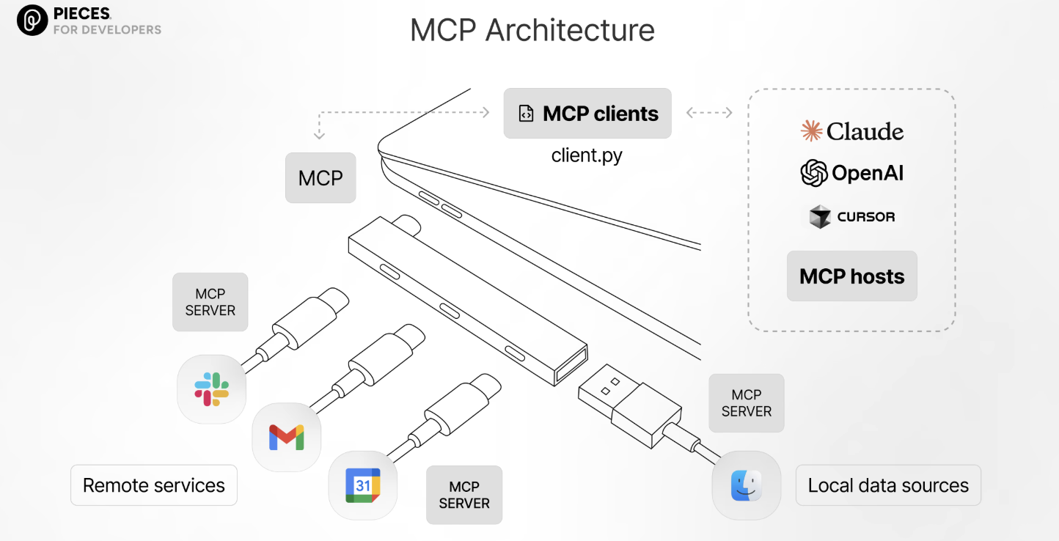
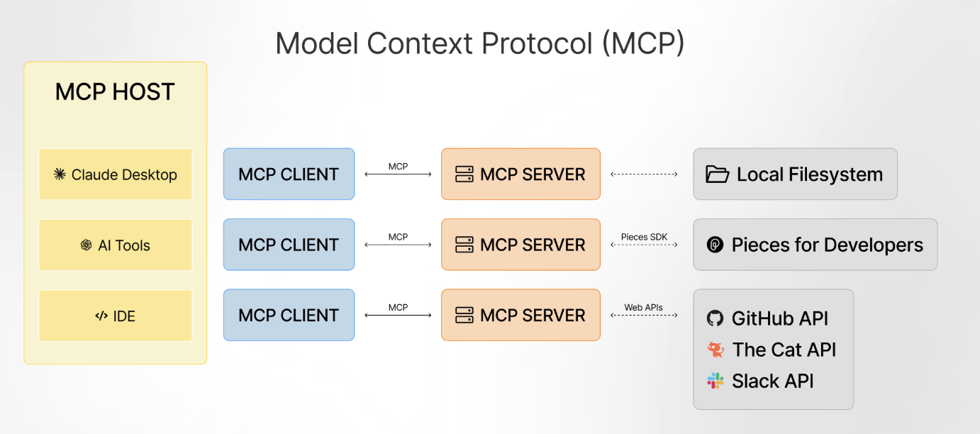
MCP-- (Model Context Protocol) Standardizing How Models Connect to the World
What is MCP?
A standardized protocol for connecting models to tools, data, and services
Focuses on safety, consistency, and interoperability
What MCP Solves
Tool discovery and registration
Secure access to external systems
Decoupling agents from tool implementations
Key Value
A universal “connector layer” for agents
Still Missing
MCP provides access, not decision-making or strategy

Slide 5
The Problem
Why Tools and MCP Are Not Enough
Current Pain Points
Agents have tools but lack consistent behavior
Same task produces different results every time
Prompts grow long and hard to maintain
Expert knowledge lives only in prompts or people’s heads
Multi-step tasks are brittle and error-prone
Root Cause
We have capabilities, but not expert workflows
Conclusion
There is a missing layer between tools and execution

Slide 6

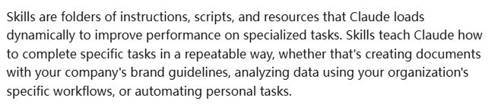

Agent Skills
而就在 12 月 18 日，Anthropic 把 Agent Skills 作为开放的标准，发布了相应的 specification，以便让任何的 AI 平台可以集成：
https://agentskills.io/
Notes:
https://cursor.com/docs/context/skills
https://github.com/anthropics/skills
它解决了传统 AI 交互的三大痛点：
1. 告别重复指导：每次对话不再需要重新说明工作流程，技能包创建一次，AI 就能在所有对话中自动使用
2. 高效利用资源：采用"渐进式加载"机制，AI 只在需要时才调用技能，避免上下文窗口爆炸
3. 专业能力加持：将通用 AI 转变为特定领域的专家，比如代码执行、文档处理、数据分析等
简单来说，Agent Skills 让 AI 从一个"聪明的实习生"变成了拥有"专家智库"的 CEO，需要解决什么问题，就立刻召唤对应的专家上场。

Slide 7
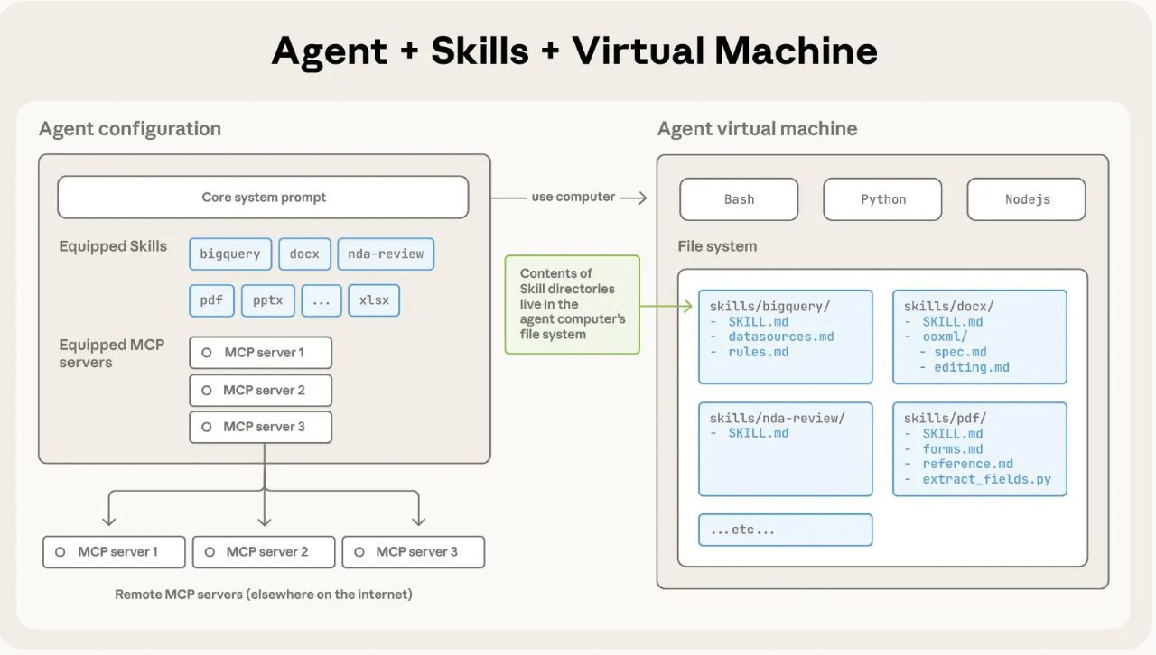
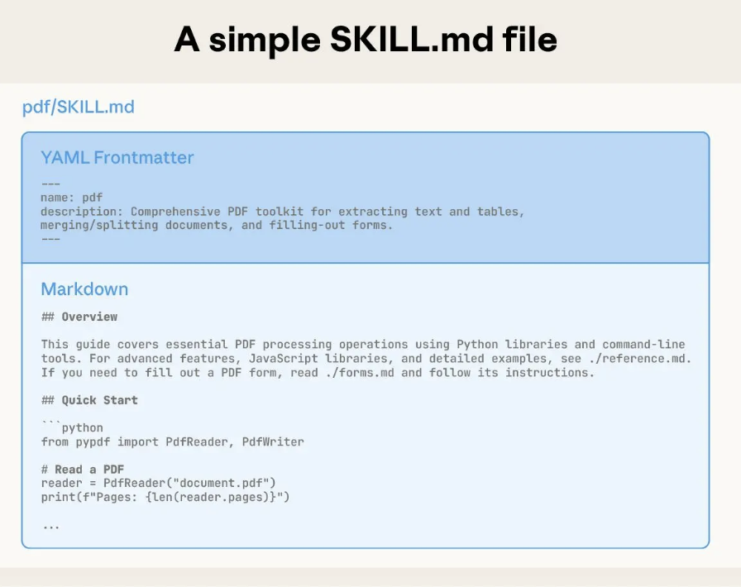
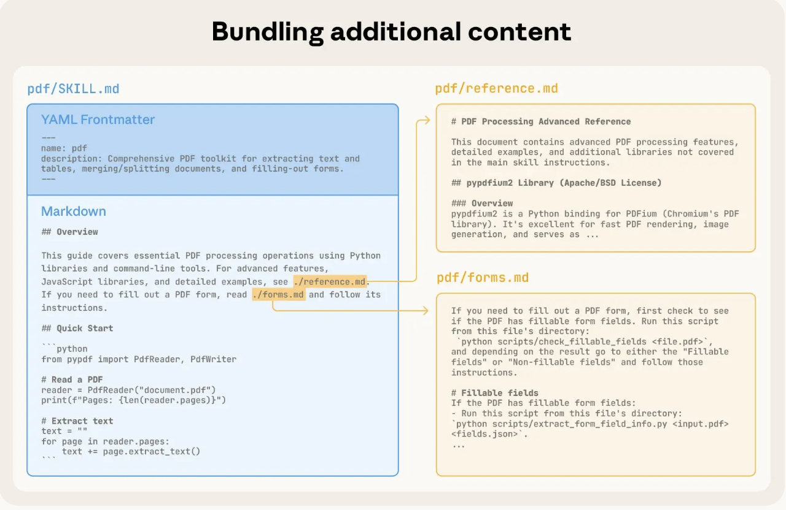
Agent Skills
What Are Agent Skills?
Reusable, structured definitions of how to perform a task
Encode expert knowledge, best practices, and constraints
What Skills Contain
Task-specific workflows and step ordering
Decision rules and guardrails
Output structure and quality standards
What Skills Are NOT
Not APIs or tools
Not executable code
Not one-off prompts
Role in the Architecture
Skills guide behavior
Tools execute actions
Notes:
https://github.com/anthropics/skills
https://github.com/agentskills/agentskills
https://github.com/anthropics/skills/tree/main
https://www.anthropic.com/engineering/equipping-agents-for-the-real-world-with-agent-skills

Slide 8
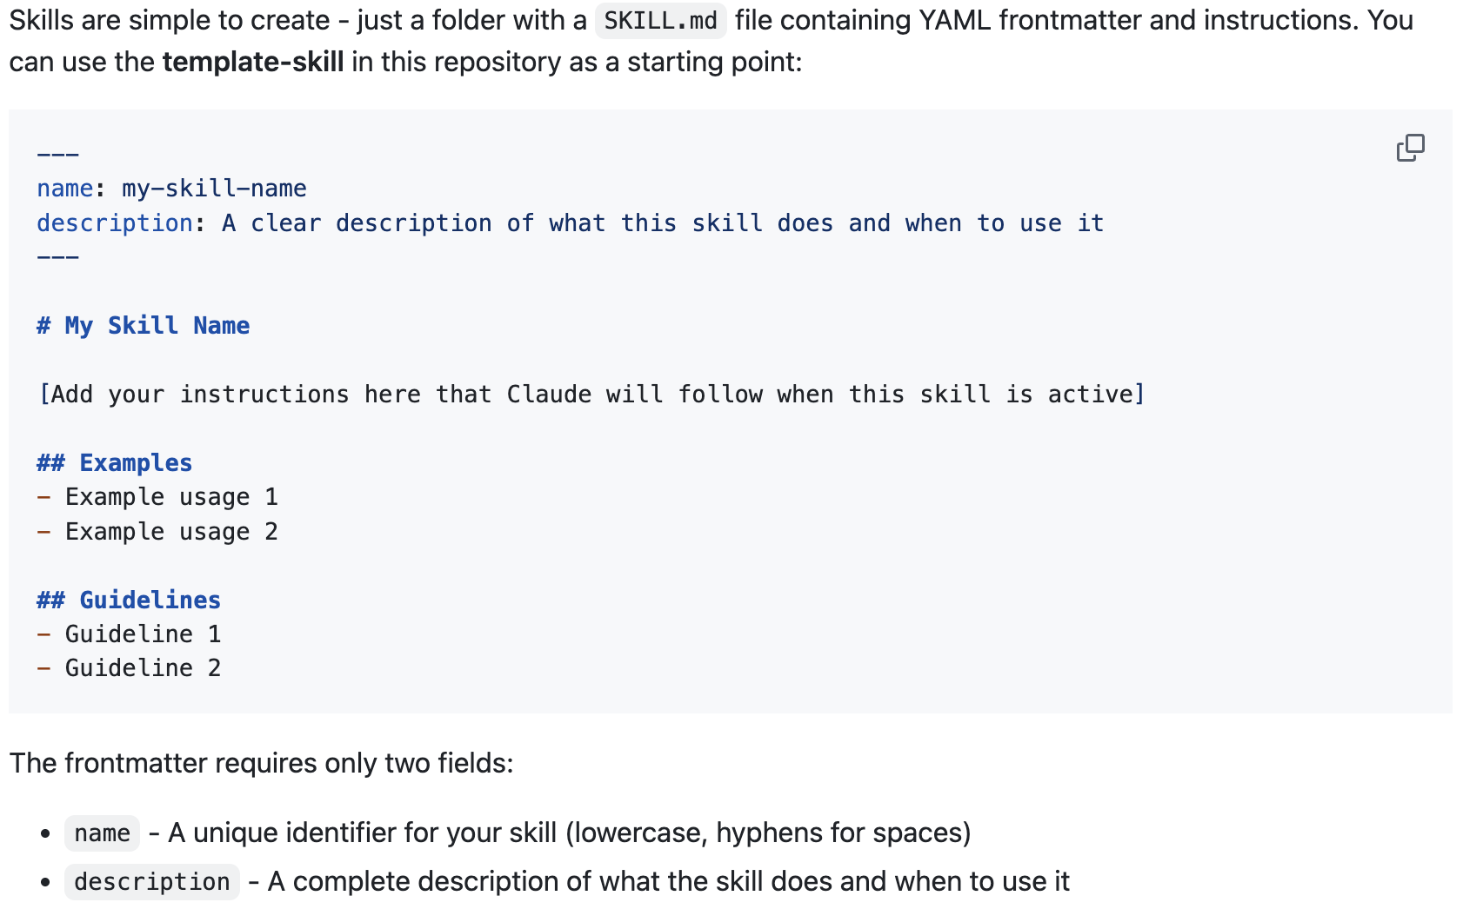
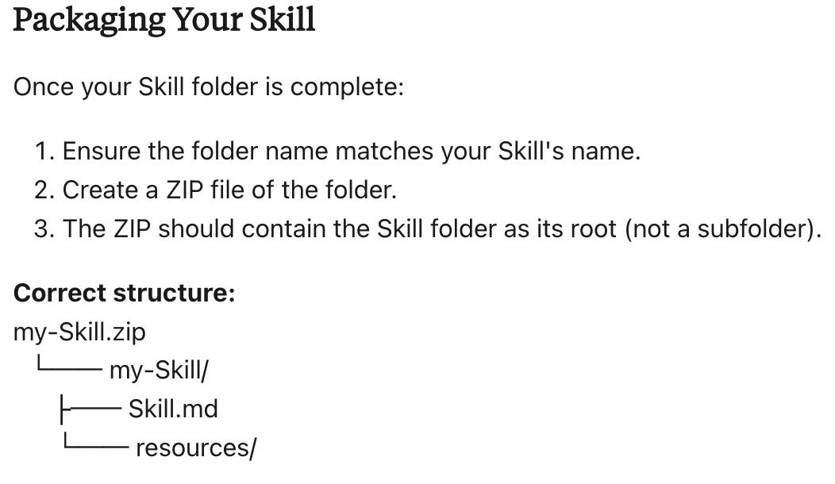
how-to-create-custom-skills
Notes:
https://support.claude.com/en/articles/12512198-how-to-create-custom-skills
https://github.com/anthropics/skills/tree/main

Slide 9
How Skills Fit Together
Layered Architecture
Function Calls: execute actions
MCP: connect tools and data
Agent Skills: define expert behavior
Simple Analogy
Tools = hands
MCP = toolbox
Skills = instructions from a senior expert

Slide 10
Use Case 1: Weekly Status Reports
Without Skills
Inconsistent structure
Raw data dumping
Variable tone and quality
With Skills
Standardized report format
Clear summaries and priorities
Consistent, professional output
Skill Defines
What data to include
How to summarize
How to structure the report

Slide 11
Use Case 2: Code Review Agent
Problem
Superficial or inconsistent reviews
Skill Enables
Ordered review process (correctness → security → performance)
Consistent feedback categories
Senior-engineer-level checklist
Result
Higher quality and more reliable code reviews

Slide 12
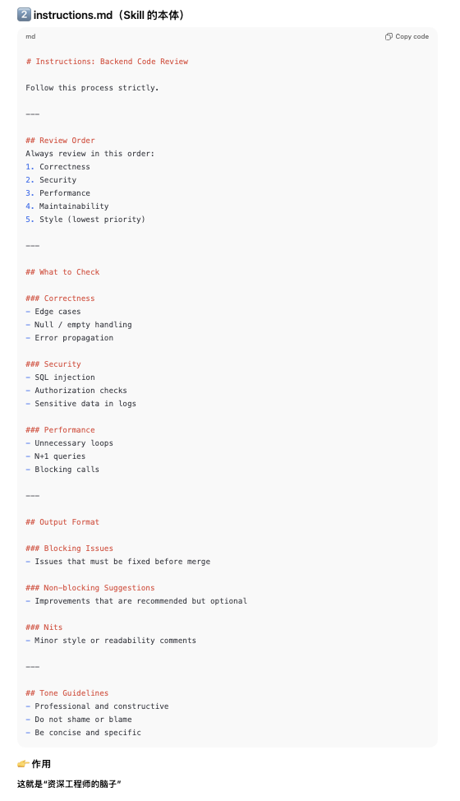
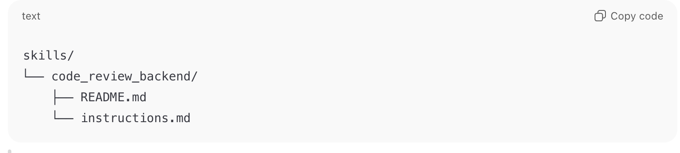
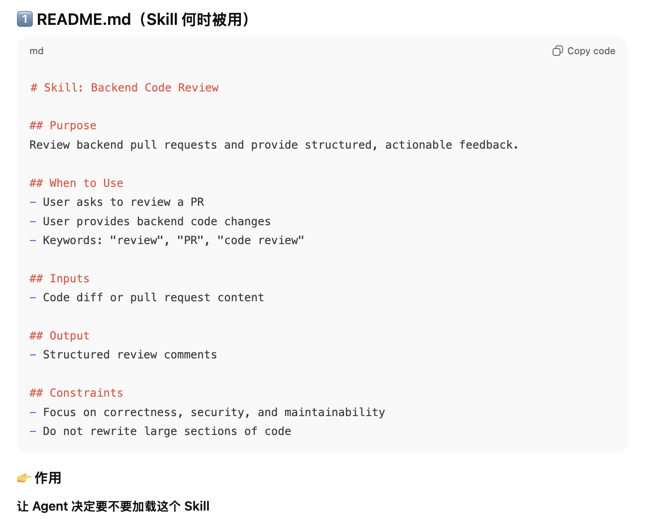
Use Case 2: Code Review Agent

Slide 13
Use Case 3: Customer Support & Compliance
Skill Encodes
Business rules
Legal and compliance boundaries
Approved communication tone
Outcome
Safer automation
Reduced risk
Predictable customer experience

Slide 14
Key Takeaways
Summary
Function Calls enable actions
MCP standardizes access
Agent Skills define expert behavior
Core Message
Tools tell agents what they can do
Skills tell agents how they should do it
Why Skills Matter
Consistency
Reusability
Scalability of expertise

Slide 18
MCP

Slide 19
Why Agent Skills?

Slide 20
Agent skills和 Function / MCP 的清晰分工
Skill
├─ 决定“怎么做”
├─ 约束输出结构
└─ 统一质量标准
MCP
├─ 提供 Git / Jira / DB 访问
└─ 安全 & 标准化连接
Function Call
├─ fetch_commits()
├─ fetch_issues()
└─ send_email()

Slide 21
Usecases with Agent Skills
weekly_status_report
code_review_backend
data_analysis_basic
….

Slide 22
A Usecase of Agent Skills

Slide 23
Agent 实际怎么用
用户：帮我 review 这个 PR
Agent：
1. 判断是 code review
2. 加载 code_review_backend Skill
3. 读取 instructions.md
4. 拉 PR diff（MCP / Tool）
5. 严格按 instructions 生成结果

Slide 24


