Slide 1












偷盗
自行车
判刑
多久
h1
*${ w}_{11 }$ +
h2
*${ w}_{12 }$ +
h3
*${ w}_{13 }$ +
h4
*${ w}_{14 }$ =
c1
盗窃财物罪
h1
*${ w}_{21 }$ +
h2
*${ w}_{22 }$ +
h3
*${ w}_{23 }$ +
h4
*${ w}_{24 }$ =
c2
量刑标准
h1
*${ w}_{31 }$ +
h2
*${ w}_{32 }$ +
h3
*${ w}_{33 }$ +
h4
*${ w}_{34 }$ =
c3
stop

Slide 2




h1
h2
h3
h4
$${ w}_{14 }$$
$${ w}_{13 }$$
$${ w}_{12 }$$
$${ w}_{11 }$$
c1
c2
c3

Slide 3
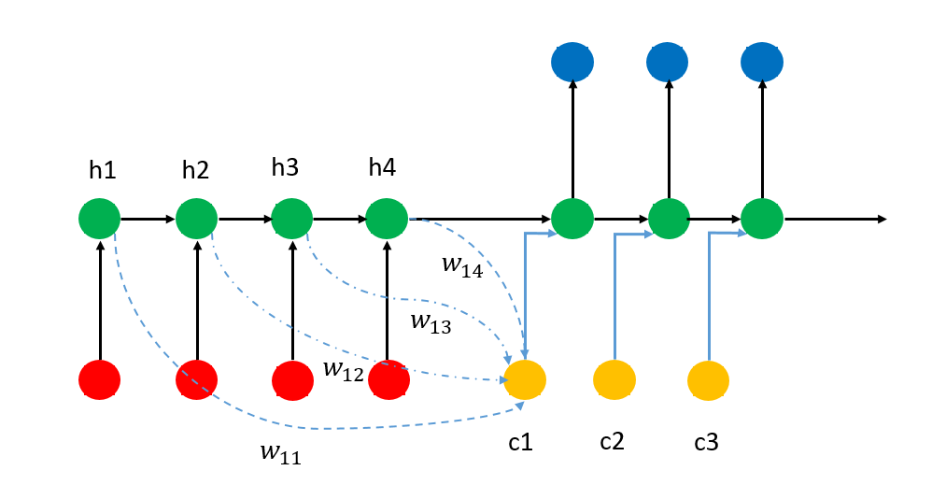
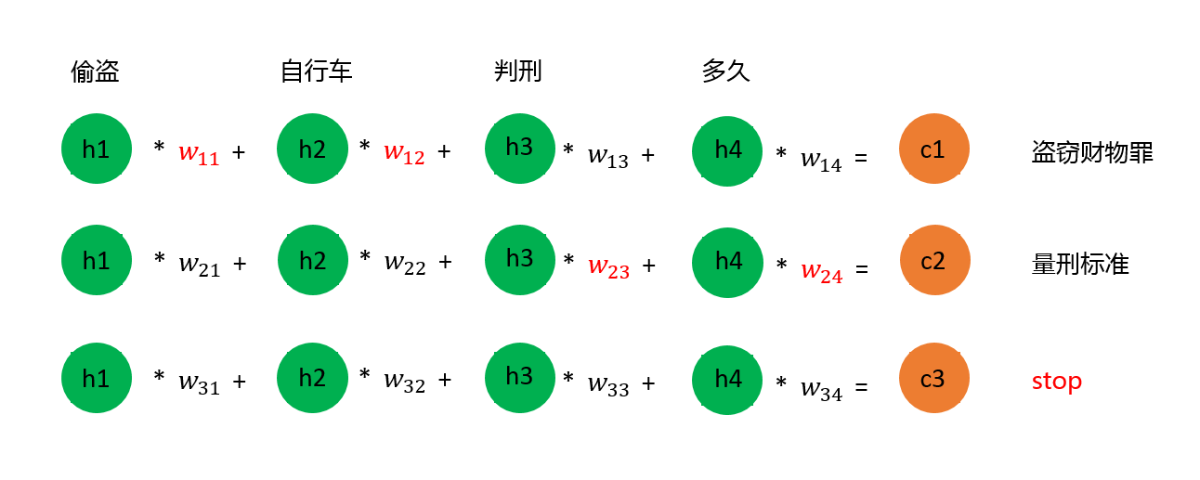

Slide 4
输入
x₁
输出
w₁
神经细胞
x₂
w₂
∑
f
y
w₃
x₃
w₄
x₄
聚合
激励函数
输入层

Slide 5
f
Output Gate
h
Forget Gate
cell
f
f
Input Gate
g

Slide 6

C_{t-1}
C_{t}
o_{t}
f_{t}
i_{t}
h_{t-1}
_{遗}
_{忘}
_{门}
_{输}
_{入}
_{门}
_{记}
_{忆}
_{单}
_{元}
_{输}
_{出}
_{门}

