Slide 1
25-MINUTE CONFERENCE TALK
Opaque Selling on a
Opaque Selling on a Bipartite Graph
Bipartite Graph
Structural Conditions for Inventory Pooling
Structural Conditions for Inventory Pooling
Jie Liu · Hailun Zhang · Zhenghua Long · Jiheng Zhang
Presenter: Jie Liu · Department of IEDA, HKUST
POMS-CHINA · XI’AN · 2026/07/19
Jie Liu · Hailun Zhang · Zhenghua Long · Jiheng Zhang
Presenter: Jie Liu · Department of IEDA, HKUST
[Conference Name] · [City] · [Date]
MENU STRUCTURE
INVENTORY ALLOCATION
LOAD-BALANCED FULFILLMENT
MENU STRUCTURE
INVENTORY ALLOCATION
LOAD-BALANCED FULFILLMENT

Slide 2
Opaque selling pools imbalanced variant demand
TRADITIONAL SELLING
OPAQUE SELLING
The customer selects the exact variant.
The secondary attribute is revealed after purchase.
REMAINING STOCK AT FIRST STOCKOUT
REMAINING STOCK AT FIRST STOCKOUT
item 1
item 1
item 2
item 2
item 3
item 3
item 4
item 4
item 5
item 5
popular variant stocks out while slow movers remain
flexible orders absorb slow stock and align depletion
Pooling delays the first stockout, lengthens the cycle, and reduces leftover inventory.
02

Slide 3

Opaque selling is a practical pooling mechanism
OBSERVED PRACTICE
WHAT CHANGES OPERATIONALLY
1
The customer accepts a set of variants.
2
The secondary attribute is disclosed after purchase.
3
The retailer chooses an eligible variant at fulfillment.
The opaque order consolidates variant-level demand into a flexible customer type.
Background challenge: variant demand is skewed and shifts with seasons, promotions, and observed customer features.
03

Slide 4
Pooling depends on three coupled decisions
Asymmetric and shifting demand meets a doubly exponential menu space.
1 · OPACITY DESIGN A
1 · OPACITY DESIGN
2 · INVENTORY ALLOCATION C
2 · INVENTORY ALLOCATION
3 · FULFILLMENT POLICY Π
3 · FULFILLMENT POLICY
Which variants enter each opaque product—and how do products overlap?
How is the common total stock S distributed across underlying items?
Which eligible item serves each opaque arrival after its type is observed?
Failure mode
Failure mode
Failure mode
Disjoint or fragile menus cannot move demand across the whole assortment.
A connected menu can fail when its reachable items receive too little stock.
Myopic routing can deplete an item faster than its planned inventory share.
Operational problem
Build a scheme whose induced demand flow, reachable supply, and online depletion remain aligned throughout the cycle.
04

Slide 5
Existing theory covers a symmetric benchmark
PRIOR BENCHMARK · EYZ
THIS PAPER'S OPERATING REGIME
01
Symmetric item demand
01
Asymmetric and shifting demand
02
Uniform item inventory
02
General or design-aware allocation
03
Menu treated as given
03
Arbitrary overlapping opaque products
04
Raw-load / balls-into-bins view
04
Load deviations relative to planned stock
ε-expansion condition
05
Subset-expansion condition
05
Slack on the induced item–customer graph
Under asymmetry, the bottleneck is reachable inventory minus effective demand—not subset size alone.
05

Slide 6
What makes sparse opacity work?
RESEARCH QUESTION
ANSWER
What structural property of an opacity design and its inventory allocation supports near-optimal pooling under asymmetric and time-varying demand?
1 Encode feasible fulfillment as a bipartite graph.
2 Measure the weakest supply slack with GCG.
3 Align stock, then route by load deviation.
4 Obtain Ω(S⁻¹ᐟ²) savings—the same asymptotic order as full flexibility.
4 Obtain the full-flexibility savings order.
Talk roadmap: model → structural certificate → quantitative guarantees → design diagnostics → numerical evidence
06

Slide 7
The model separates offline design and online fulfillment
OFFLINE PRIMITIVES AND CHOICES
Menu A
Opacity menu
Demand (p,q)
Demand
Stock c
Inventory shares
Fulfillment π
Fulfillment policy
1
2
3
4
offer arbitrary, possibly overlapping opaque products I ⊆ [N]
base item choice and transfer into opaque customer types
allocate fixed total stock S through Sᵢ = cᵢS
after type is observed, choose one eligible item online
offer arbitrary, possibly overlapping opaque products
base item choice and transfer into customer types
allocate fixed total stock across underlying items
after type is observed, choose one eligible item online
Opaque selling scheme
Opaque selling scheme
(c, q, A) induces the graph, effective type demand, and inventory vector; π operates the scheme.
The offline choices induce effective demand, the fulfillment graph, and the inventory vector.
Base analysis: stationary demand. Robustness section: general fixed c and three specified time-varying regimes.
Base analysis: stationary demand. Robustness: general fixed allocations and three specified time-varying regimes.
07

Slide 8



Demand origin differs from fulfillment eligibility
ITEMS
OPAQUE PRODUCTS
DEMAND TRANSFER
[N] = {1,…,N}
I ⊆ [N]
qᵢ,ᴵ
Horizontally differentiated by a secondary attribute such as color or style.
A buyer accepts any one item in I; the retailer selects the realized variant.
Probability that a customer who would have bought i instead buys opaque product I.
Traditional type i chooses item i with base probability pᵢ.
The offered collection A is the opacity design.
q records demand response; it need not follow membership in I.
Traditional customers choose a specific item.
The offered collection is the opacity design.
Transfers record demand response, not eligibility.
Critical distinction
Critical distinction
qᵢ,ᴵ describes where demand originates; I describes which items can fulfill it. A base-i customer may transfer to an opaque product that does not contain i.
The transfer matrix describes where demand originates; the opaque-product set describes which items can fulfill it. Origin and eligibility need not coincide.
08

Slide 9
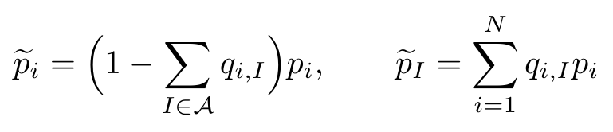

Transfers create regular and opaque demand
EFFECTIVE DEMAND PROBABILITIES
CHOICE VERSUS FULFILLMENT
the summation for p̃ᴵ runs over all base items i
Demand origin
aggregates demand from every base item
Supply eligibility
Supply eligibility
qₘᵢₙ = minᵢ,ᴵ qᵢ,ᴵ
only items belonging to I may fulfill type I
only eligible items may fulfill an opaque type
Regular demand retained at item i
Opaque demand pooled into product I
This separation creates the allocation challenge.
Special cases: q = 0 → traditional selling · q = 1 and A = {[N]} → full flexibility
Traditional selling has no transfers; full flexibility offers one all-item opaque product.
09

Slide 10
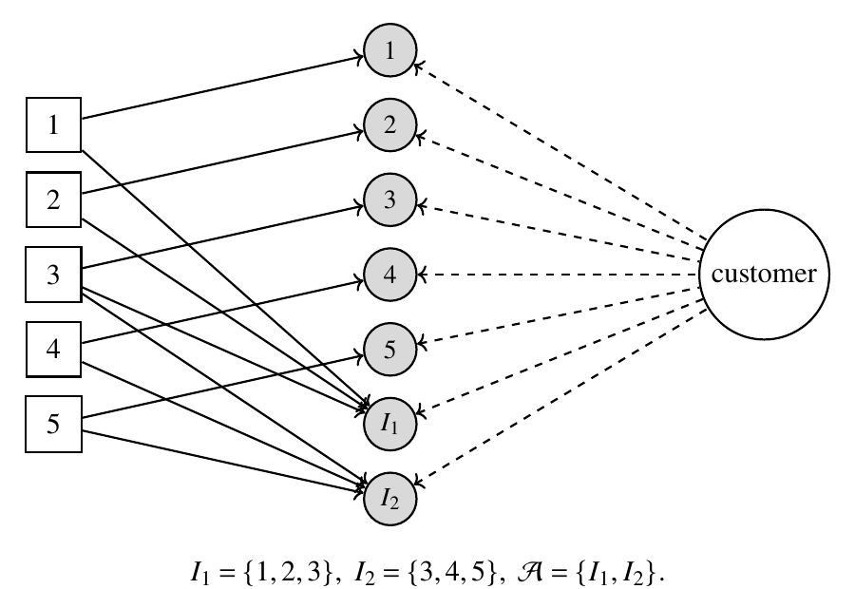

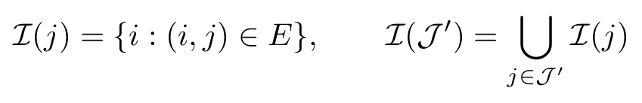
A bipartite graph records feasible fulfillment
ITEMS · SUPPLY NODES
REGULAR CUSTOMER TYPES
OPAQUE CUSTOMER TYPES
INDUCED GRAPH
1
1
An arc exists exactly when an item can fulfill the corresponding customer type.
I₁
2
2
3
3
REACHABLE SUPPLY
4
4
I₂
5
5
The graph separates demand origin from fulfillment eligibility.
one dedicated arc i → i
membership arcs i → I
Example from Figure 2: I₁={1,2,3}, I₂={3,4,5}, A={I₁,I₂}. An arc (i,j) exists iff item i can fulfill type j.
10

Slide 11


The cycle ends at the first item stockout
CYCLE STATE
sequential arrivals
Initial stock
0
R
(c₁S, …, c_NS)
R(c,q,𝒜)
S is fixed and common across all strategies.
units served before the first stockout
units served before the first stockout
Why R is the performance proxy
Larger E[R] means a longer cycle, fewer orders per unit sold, and less residual inventory held at replenishment.
11

Slide 12
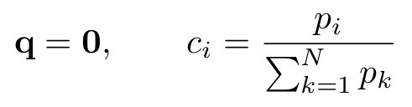


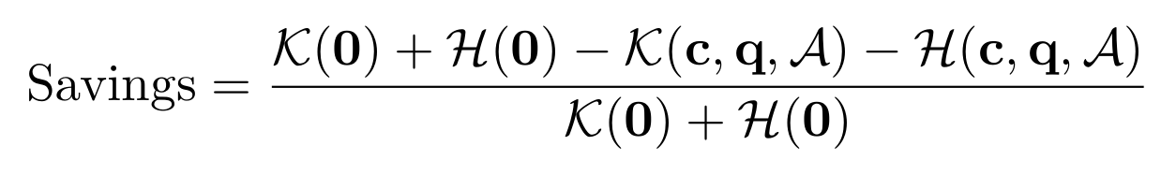
Cycle consumption drives inventory cost
COST PER UNIT SOLD
TRADITIONAL BENCHMARK
q = 0
cᵢ = pᵢ / Σₖpₖ
leftover θ₀ = Ω(√S)
FULL-FLEXIBILITY BENCHMARK
Larger E[R] lowers ordering cost and the holding-cost upper bound.
A = {[N]}, q = 1
R = S − N + 1 a.s.
COMPARISON METRIC: RELATIVE SAVINGS AGAINST Q = 0
Analytical comparison holds total demand and total stock S fixed; pricing enters the numerical profit model.
12

Slide 13
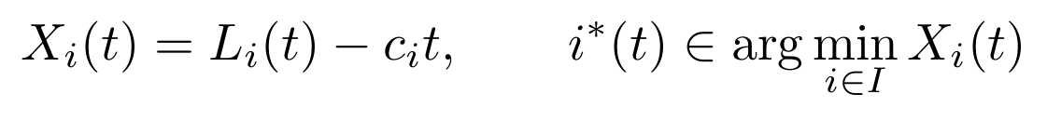



Load balancing aligns depletion with stock
STATE VARIABLE
OPAQUE TYPE I = {1,2,3}
X₁(t)
X₂(t)
Lᵢ(t) is cumulative depletion; cᵢt is the target depletion implied by the inventory share.
The first term is cumulative depletion; the second is target depletion implied by the planned inventory share.
X₃(t)
choose item 2
Policy
select the lowest Xᵢ(t)
For an opaque order, fulfill with an eligible item having the lowest load deviation; break ties arbitrarily.
choose the smallest load deviation
The rule is allocation-aware and avoids solving the intractable optimal dynamic policy.
13

Slide 14
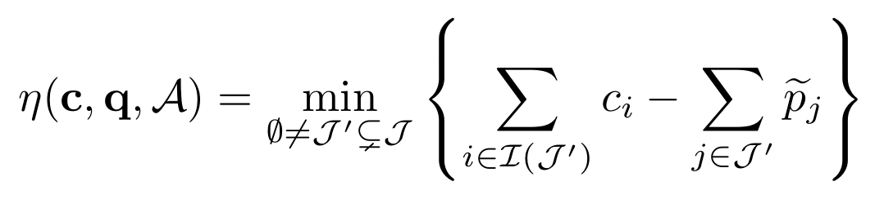
GCG is the weakest capacity–demand cut
DEFINITION: GENERALIZED CHAINING GAP
J = [N] ∪ A; I(J′) = items capable of serving at least one customer type in J′
For any customer-type subset, collect every item that can serve at least one type in that subset.
η > 0
Every nontrivial customer subset has strictly more eligible inventory than effective demand.
η ≤ 0
The minimizing subset identifies a supply bottleneck that no routing elsewhere can repair.
A scheme (c,q,𝒜) is a GCG design exactly when η > 0.
A scheme is a GCG design exactly when its minimum capacity–demand cut has positive slack.
14

Slide 15
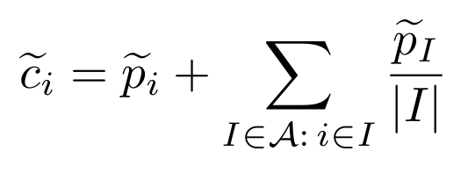
Connectivity determines whether positive GCG is achievable
If 𝒢𝒜 is disconnected, no inventory allocation can produce η > 0.
Disconnected graph: no allocation can produce positive GCG.
If 𝒢𝒜 is connected, a positive-GCG allocation exists.
Connected graph: an allocation with positive GCG exists.
DISCONNECTED
CONNECTED
1
I₁
1
I1
2
I2
2
I₂
3
ONE CONSTRUCTIVE CERTIFICATE: DESIGN-AWARE EVEN ALLOCATION
Exact scope
Connectivity is sufficient for existence—not for an arbitrary fixed stock vector.
15

Slide 16

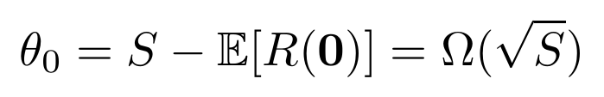
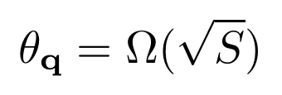
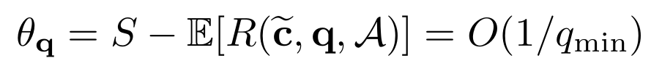
Positive GCG converts flexibility into an O(1/qₘᵢₙ) leftover bound
Positive GCG sharply reduces leftover inventory
θ = S − E[R]
expected inventory remaining when the cycle ends
expected inventory remaining when the cycle ends
TRADITIONAL SELLING
CONNECTED + ALIGNED
DISCONNECTED DESIGN
No cross-item pooling
even allocation + load balancing
Pooling remains local
cycle length stays within O(1/qₘᵢₙ) of total stock
central-limit-scale stranded stock
leftover falls sharply below the central-limit scale
system-wide order improvement disappears
The proof uses the GCG/load-deviation argument against the actual demand and allocation—not exchangeable bins.
16

Slide 17
Sparse GCG designs match the full-flexibility order
THEOREM 1 · PREREQUISITES
CONCLUSION
1
N and the opacity design A are fixed as S → ∞.
Items and the opacity design remain fixed as total stock grows.
2
The connected design uses the even allocation.
3
Opaque orders are fulfilled by load balancing.
4
The minimum transfer obeys the stated scaling.
Relative savings = Ω(S⁻¹ᐟ²)
Same asymptotic savings order as full flexibility
COROLLARIES
Same asymptotic order as full flexibility
Same asymptotic order as the optimal fulfillment policy
Order comparison only: the theorem does not claim equal finite-system savings.
17

Slide 18
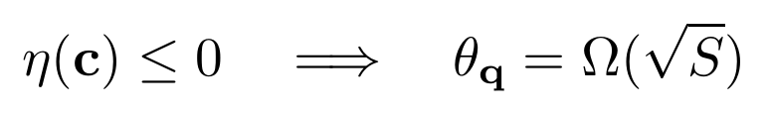
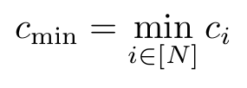
Under fixed stock, GCG—not connectivity—governs success
PROPOSITION: GENERAL INVENTORY ALLOCATION
PROPOSITION · GENERAL ALLOCATION
Fix 𝒜 and c under the same qₘᵢₙ scaling as the main theorem.
Fix the menu and inventory allocation under the transfer-rate scaling used in Theorem 1.
cₘᵢₙ = minᵢ cᵢ
η(c) = worst subset slack under the fixed allocation
GCG is the worst subset slack under the fixed allocation.
Why connectivity alone can fail
A connected menu can route too much opaque demand into a subset whose eligible items receive too little stock. The minimizing GCG cut identifies that understocked region.
Even allocation is one construction; quantitative GCG slack is the performance invariant.
18

Slide 19
One connected graph can fail or succeed
FORMAL CONDITION
MANUSCRIPT COUNTEREXAMPLE: CONNECTED THREE-ITEM PATH
Uniform allocation
Even allocation
c = (1/3, 1/3, 1/3)
c̃ = (5/48, 23/48, 20/48)
bottleneck slack η ≤ −1/6
full check gives η = 1/16 > 0
The same connected graph changes from failure to success when inventory follows the induced demand flow.
19

Slide 20
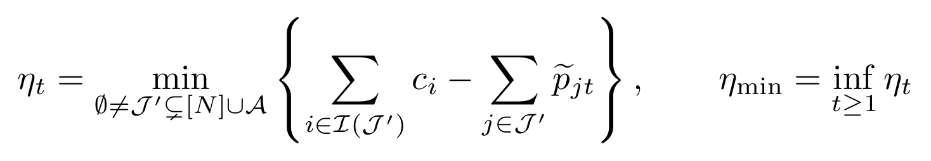
Worst-period GCG yields the unified guarantee
TIME-VARYING DEMAND
At arrival t, customer features fₜ induce effective probabilities p̃ⱼₜ.
At each arrival, observed customer features determine the effective type-demand vector.
THEOREM 2
Economic meaning: GCG—not even allocation, symmetry, or stationarity—is the invariant governing inventory efficiency.
20

Slide 21
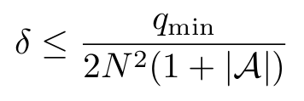

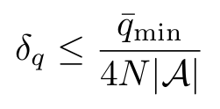
One allocation covers three time-varying regimes
1 · BASE-DEMAND DRIFT
2 · FINITE SEGMENTS
3 · TRANSFER DRIFT
pᵢₜ fluctuates around a known mean p̄ᵢ.
Base demand fluctuates around a known mean profile.
Demand takes one of M observed segment profiles.
Demand takes one of finitely many observed segment profiles.
Promotions vary qᵢ,ᴵ,ₜ around mean q̄ᵢ,ᴵ.
Promotions perturb transfers around their mean values.
Condition
Condition
Condition
δ ≤ qₘᵢₙ / [2N²(1+|A|)]
robust cut LP returns η* > 0
δq ≤ q̄ₘᵢₙ / [4N|A|]
Use the even allocation computed from mean demand.
Use one allocation c* that preserves slack across every segment.
Use one allocation that preserves slack across every segment.
Use the even allocation computed from mean transfers.
Scope: these are the manuscript's verified regimes—not unrestricted non-stationarity.
21

Slide 22
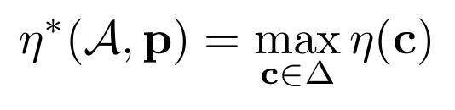
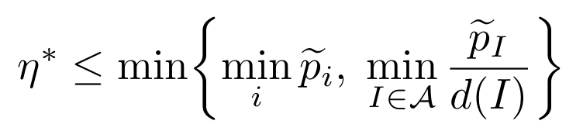
Optimized GCG separates retention and connectivity
PROPOSITION: OPTIMIZED GCG
Δ = {c ≥ 0 : Σᵢcᵢ = 1}
Feasible allocations distribute one unit of total stock.
d(I) = components after removing opaque type I
Component count: connected pieces left after removing an opaque type
Exactness
The two-term ceiling equals η* when the induced graph has at most one cycle.
Diagnostic
The two-term ceiling is exact when the induced graph has at most one cycle.
Network term binds
Allocation rule
redesign the menu
If d(I)=|I|, the even allocation is optimal; the circle is verified separately. With multiple cycles, the expression is only a ceiling—solve the cut LP for η*.
When removing each opaque node creates one component per eligible item, the even allocation is optimal; the circle is verified separately. With multiple cycles, use the cut LP.
Retention term binds
moderate conversion / discount
22

Slide 23
Close bridges and strengthen the weakest link
TREE / PATH · N−1 PRODUCTS
CIRCLE · N PRODUCTS
1
5
2
1
2
3
4
5
4
3
Every opaque product is a bridge: d(I)=2
Every opaque product is a bridge: removal creates two components
Removing any one product leaves the network connected: d(I)=1
Removing any one product leaves the network connected
ASYMMETRIC-DEMAND IMPLICATION
When transfer rates are comparable, all circle links have d(I)=1; the binding numerator is the smallest effective opaque-type demand.
When transfer rates are comparable, every circle link is non-bridging; the binding numerator is the smallest effective opaque-type demand.
Interleave popular and unpopular items to raise the weakest opaque-product demand.
Design lens—not a global menu-ranking theorem.
Interleave popular and unpopular items to raise the weakest opaque-product demand.
Design lens—not a global menu-ranking theorem.
23

Slide 24
The circle leads reported profit in 23 of 27 cells
WINNER COUNT
23 / 27
Circle is numerically highest
OPTIMIZED DISCOUNT RANGE
Circle
2.03–3.45%
Categorical
4.26–6.63%
N-opaque
6.27–8.63%
Exceptions: categorical leads 3 cells; N-opaque leads 1 cell by 0.04 pp.
Reported simulation point estimates; no standard errors or confidence intervals are reported.
24

Slide 25
Balanced composition leads all 18 Logistic comparisons
18 / 18
MAGNITUDE
+0.14 to +2.07 pp
Logistic calibration comparisons
Interleaved circle and categorical variants have higher reported profit than their naive counterparts in every tested cell.
WHAT THE EVIDENCE SUPPORTS
Profit improves in all 18 comparisons.
WHAT IT DOES NOT SUPPORT
Not every intermediate metric improves; the result is numerical evidence for the design lens, not a theorem.
Mechanism predicted by the bound: strengthen the weakest opaque-type demand while every link remains non-bridging.
Mechanism predicted by the bound: raise the weakest opaque-type demand while d(I)=1.
Reported simulation point estimates; no standard errors or confidence intervals are reported.
25

Slide 26
Design-aware stock lifts categorical savings to about 10%
SAME TOTAL STOCK
Only c changes
Only stock shares change
Uniform
2.38% → 10.04%
Normal
2.44% → 9.80%
Logistic
2.87% → 9.54%
Traditional demand-proportional allocation → design-aware even allocation
Reported simulation point estimates; no standard errors or confidence intervals are reported.
26

Slide 27
Positive GCG is the unifying certificate
ESTIMATE
ESTIMATE
CONNECT
CONNECT
ALIGN
ALIGN
BALANCE
BALANCE
1
2
3
4
1
2
3
4
demand profiles
p and q
screen menus
screen 𝒜
verify worst-period GCG
verify η(c)=Ω(qₘᵢₙ)
route by load deviation
minimize Xᵢ(t)
Unified theorem · Theorem 2
Main theorem
Under the theorem's qₘᵢₙ scaling, quantitative GCG slack plus load balancing achieves the full-flexibility savings order.
Quantitative worst-period GCG plus load balancing achieves the full-flexibility savings order.
Guardrails: allocation-qualified connectivity · specified time-varying regimes · circle is a sparse benchmark, not a universal optimum
Guardrails: allocation-qualified connectivity · specified time-varying regimes · circle is a sparse benchmark, not a universal optimum
27

