Slide 1
6
数值微分

Slide 2
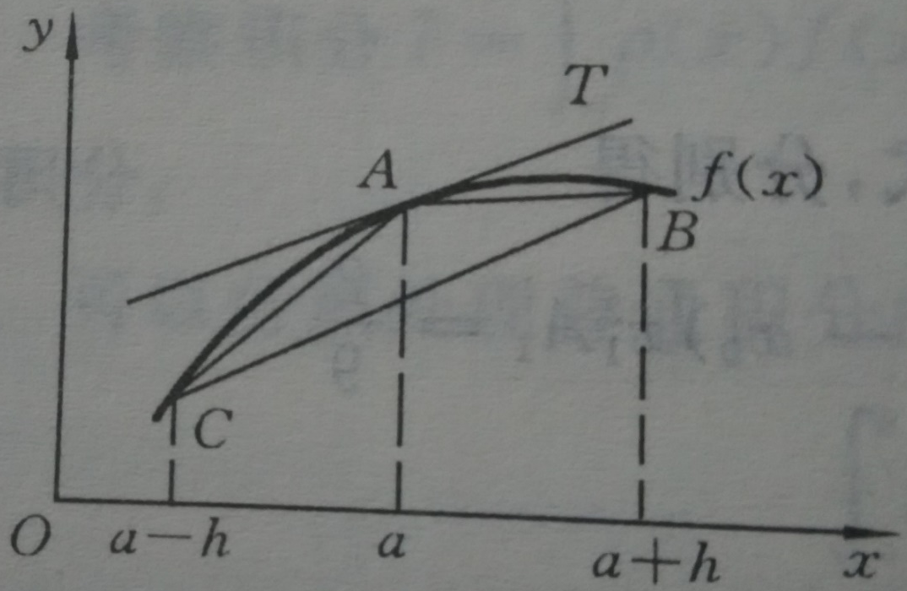




1
中点方法与误差分析
数值微分就是用函数值的线性组合近似函数在某点的导数值。
按导数定义，可以简单地用差商近似导数：
$$f^{′}\left(a\right)≈\frac{f\left(a+h\right)−f\left(a\right)}{h}$$
$$f^{′}\left(a\right)≈\frac{f\left(a\right)−f\left(a−h\right)}{h}$$
$$f^{′}\left(a\right)≈\frac{f\left(a+h\right)−f\left(a−h\right)}{2h}$$
中点方法
$h$称为步长。

Slide 3






1
中点方法与误差分析
$$f\left(a±h\right)=f\left(a\right)±hf^{′}\left(a\right)+\frac{h^{2}}{2!}f^{′′}\left(a\right)±\frac{h^{3}}{3!}f^{′′′}\left(ξ_{±}\right)$$
$$G\left(h\right)=\frac{f\left(a+h\right)−f\left(a−h\right)}{2h}$$
$$=f^{′}\left(a\right)+\frac{h^{2}}{12}\left(f^{′′′}\left(ξ_{+}\right)+f^{′′′}\left(ξ_{−}\right)\right)$$
$$=f^{′}\left(a\right)+\frac{h^{2}}{6}f^{′′′}\left(ξ\right)$$
$$\left|G\left(h\right)−f^{′}\left(a\right)\right|=\frac{h^{2}}{6}\left|f^{′′′}\left(ξ\right)\right|≤\frac{h^{2}}{6}M$$
$$M=\max_{\left|x−a\right|≤h}\left|f^{′′′}\left(x\right)\right|$$
表面上看，$h$越小越好。
但当$h$很小时，$f\left(a+h\right)$与$f\left(a−h\right)$很接近，直接
相减会造成有效数字的严重损失。

Slide 4


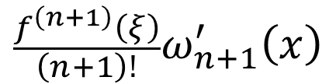




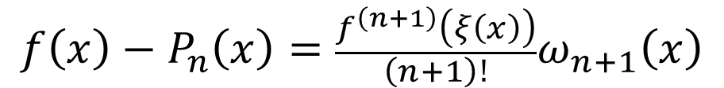

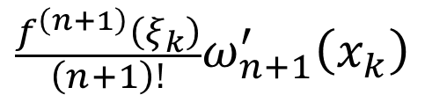




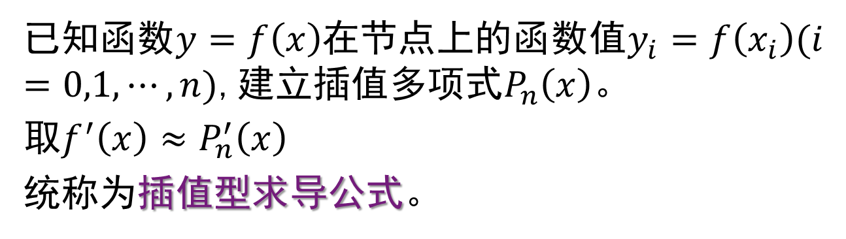
2
插值型的求导公式
已知函数$y=f\left(x\right)$在节点上的函数值$y_{i}=f\left(x_{i}\right)(i$
$=0,1,⋯,n)$,建立插值多项式$P_{n}\left(x\right)$。
取$f^{′}\left(x\right)≈P_{n}^{′}\left(x\right)$
统称为插值型求导公式。
$$f\left(x\right)−P_{n}\left(x\right)=\frac{f^{\left(n+1\right)}\left(ξ\left(x\right)\right)}{\left(n+1\right)!}ω_{n+1}\left(x\right)$$
$$P_{n}^{′}\left(x\right)$$
$$=$$
$$\frac{f^{\left(n+1\right)}\left(ξ\right)}{\left(n+1\right)!}ω_{n+1}^{′}\left(x\right)$$
$$\frac{ω_{n+1}\left(x\right)}{\left(n+1\right)!}\frac{d}{dx}f^{\left(n+1\right)}\left(ξ\right)$$
$$f^{′}\left(x\right)$$
$$−$$
$$+$$
$$f^{′}\left(x_{k}\right)$$
$$−$$
$$P_{n}^{′}\left(x_{k}\right)$$
$$=$$
$$\frac{f^{\left(n+1\right)}\left(ξ_{k}\right)}{\left(n+1\right)!}ω_{n+1}^{′}\left(x_{k}\right)$$
$$\left(8.4\right)$$

Slide 5



2
插值型的求导公式
下面考虑在等距节点上的导数值。
$1.$两点公式
$$P_{1}\left(x\right)=\frac{x−x_{1}}{x_{0}−x_{1}}f\left(x_{0}\right)+\frac{x−x_{0}}{x_{1}−x_{0}}f\left(x_{1}\right)$$
$$P_{1}^{′}\left(x\right)=\frac{f\left(x_{1}\right)−f\left(x_{0}\right)}{x_{1}−x_{0}}=\frac{1}{h}\left[f\left(x_{1}\right)−f\left(x_{0}\right)\right]$$
$$P_{1}^{′}\left(x_{0}\right)=\frac{1}{h}\left[f\left(x_{1}\right)−f\left(x_{0}\right)\right]=P_{1}^{′}\left(x_{1}\right)$$
由余项公式$\left(8.4\right)$可知
$$f^{′}\left(x_{0}\right)=\frac{1}{h}\left[f\left(x_{1}\right)−f\left(x_{0}\right)\right]−\frac{h}{2}f^{′′}\left(ξ_{0}\right)$$
$$f^{′}\left(x_{1}\right)=\frac{1}{h}\left[f\left(x_{1}\right)−f\left(x_{0}\right)\right]+\frac{h}{2}f^{′′}\left(ξ_{1}\right)$$

Slide 6

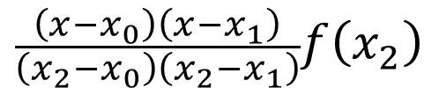

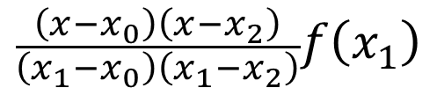




















2
插值型的求导公式
$3.$三点公式
$$\frac{\left(x−x_{1}\right)\left(x−x_{2}\right)}{\left(x_{0}−x_{1}\right)\left(x_{0}−x_{2}\right)}f\left(x_{0}\right)$$
$$\frac{\left(x−x_{0}\right)\left(x−x_{2}\right)}{\left(x_{1}−x_{0}\right)\left(x_{1}−x_{2}\right)}f\left(x_{1}\right)$$
$$P_{2}\left(x\right)$$
$$=$$
$$+$$
$$+$$
$$\frac{\left(x−x_{0}\right)\left(x−x_{1}\right)}{\left(x_{2}−x_{0}\right)\left(x_{2}−x_{1}\right)}f\left(x_{2}\right)$$
$$P_{2}\left(x_{0}+th\right)$$
$$=$$
$$\frac{1}{2}\left(t−1\right)\left(t−2\right)f\left(x_{0}\right)$$
$$t\left(t−2\right)f\left(x_{1}\right)$$
$$−$$
$$+$$
$$\frac{1}{2}t\left(t−1\right)f\left(x_{2}\right)$$
$$\frac{1}{2h}$$
$$−$$
$$+$$
$$P_{2}^{′}\left(x_{0}+th\right)$$
$$=$$
$$[\left(2t−3\right)f\left(x_{0}\right)$$
$$\left(4t−4\right)f\left(x_{1}\right)$$
$$+\left(2t−1\right)f\left(x_{2}\right)]$$
$$\left(8.5\right)$$
取$t=0,1,2$,得

Slide 7






























2
插值型的求导公式
$$P_{2}^{′}\left(x_{0}\right)=\frac{1}{2h}\left[−3f\left(x_{0}\right)+4f\left(x_{1}\right)−f\left(x_{2}\right)\right]$$
$$P_{2}^{′}\left(x_{1}\right)=\frac{1}{2h}\left[−f\left(x_{0}\right)+f\left(x_{2}\right)\right]$$
$$P_{2}^{′}\left(x_{2}\right)=\frac{1}{2h}\left[f\left(x_{0}\right)−4f\left(x_{1}\right)+3f\left(x_{2}\right)\right]$$
$$\frac{1}{2h}$$
$$\left[ f\left(x_{2}\right)\right]$$
$$\frac{h^{2}}{3}f^{′′′}\left(ξ_{0}\right)$$
$$f^{′}\left(x_{0}\right)$$
$$=$$
$$−$$
$$3f\left(x_{0}\right)$$
$$+$$
$$4f\left(x_{1}\right)$$
$$−$$
$$+$$
$$\frac{1}{2h}$$
$$\left[ f\left(x_{2}\right)\right]$$
$$\frac{h^{2}}{6}f^{′′′}\left(ξ_{1}\right)$$
$$f^{′}\left(x_{1}\right)$$
$$=$$
$$−$$
$$f\left(x_{0}\right)$$
$$+$$
$$−$$
这就是中点公式。
$$\frac{1}{2h}$$
$$−$$
$$4f\left(x_{1}\right)$$
$$+$$
$$\frac{h^{2}}{3}f^{′′′}\left(ξ_{2}\right)$$
$$\left[ 3f\left(x_{2}\right)\right]$$
$$f^{′}\left(x_{2}\right)$$
$$=$$
$$f\left(x_{0}\right)$$
$$+$$

Slide 8










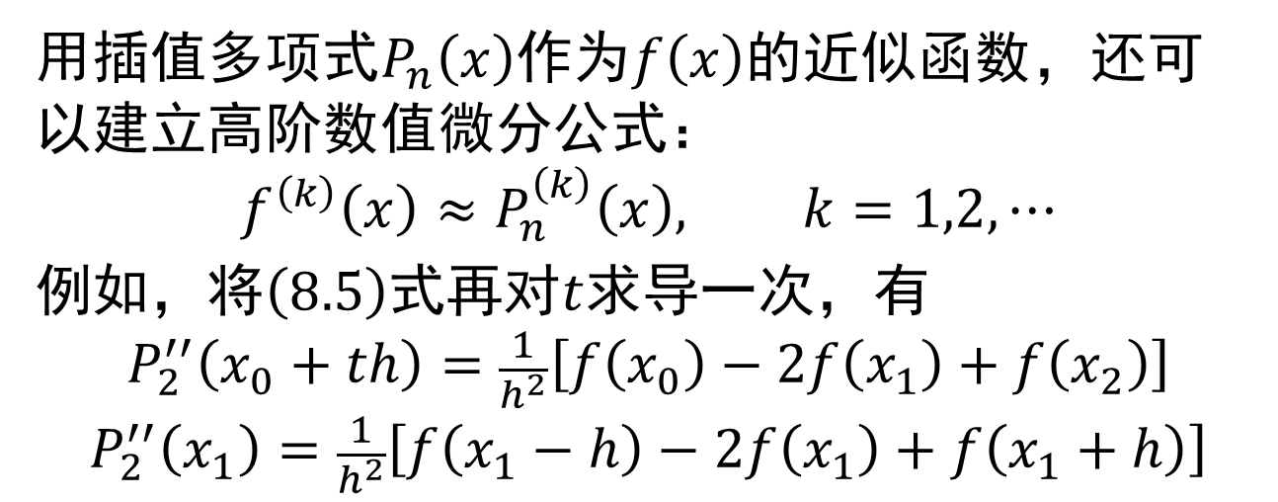
2
插值型的求导公式
用插值多项式$P_{n}\left(x\right)$作为$f\left(x\right)$的近似函数，还可以建立高阶数值微分公式：
$$f^{\left(k\right)}\left(x\right)≈P_{n}^{\left(k\right)}\left(x\right), k=1,2,⋯$$
例如，将$\left(8.5\right)$式再对$t$求导一次，有
$$P_{2}^{′′}\left(x_{0}+th\right)=\frac{1}{h^{2}}\left[f\left(x_{0}\right)−2f\left(x_{1}\right)+f\left(x_{2}\right)\right]$$
$$P_{2}^{′′}\left(x_{1}\right)=\frac{1}{h^{2}}\left[f\left(x_{1}−h\right)−2f\left(x_{1}\right)+f\left(x_{1}+h\right)\right]$$
$$\frac{1}{h^{2}}$$
$$+$$
$$f\left(x_{1}+h\right)$$
$$−$$
$$\frac{h^{2}}{12}$$
$$f^{\left(4\right)}\left(ξ\right)$$
$$−$$
$$2f\left(x_{1}\right)$$
$$f^{′′}\left(x_{1}\right)$$
$$=$$
$$\left[f\left(x_{1}−h\right) \right]$$

Slide 9





3
三次样条求导
三次样条函数$s\left(x\right)$作为$f\left(x\right)$的近似，不但函数值接近，导数值也很接近，并有
$${\left\|f^{\left(k\right)}\left(x\right)−s^{\left(k\right)}\left(x\right)\right\|}_{∞}≤C_{k}{\left\|f^{\left(4\right)}\right\|}_{∞}h^{4−k},k=0,1,2$$
$$f^{\left(k\right)}\left(x\right)≈s^{\left(k\right)}\left(x\right), k=0,1,2$$
$$f^{′}\left(x_{k}\right)≈s^{′}\left(x_{k}\right)=−\frac{h_{k}}{3}M_{k}−\frac{h_{k}}{6}M_{k+1}+f\left[x_{k},x_{k+1}\right]$$
$$f^{′′}\left(x_{k}\right)≈s^{′′}\left(x_{k}\right)=M_{k}$$
$${\left\|f^{′}\left(x\right)−s^{′}\left(x\right)\right\|}_{∞}≤\frac{1}{24}{\left\|f^{\left(4\right)}\right\|}_{∞}h^{3}$$
$${\left\|f^{′′}\left(x\right)−s^{′′}\left(x\right)\right\|}_{∞}≤\frac{3}{8}{\left\|f^{\left(4\right)}\right\|}_{∞}h^{2}$$

