Slide 1
 |  | Age grouped by median | Age grouped by 40-60 yr old | Combine median & 40-60
Tissue level |  | ◯ | ◯
Tissue-cellType level |  | ◯ | ◯ | ◯
Files | Gene * tissue/cell type matrix | gene-tissue(-cellType)_mtx.log2FC_old2young.txt |  | all_log2FC.txt
 |  | gene-tissue(-cellType)_mtx.log10P_greaterSide.txt |  | all_log10P.txt
 | Gene * gene matrix (for gene pairs, ) | allGenePairs_binMeanPearsonCor_mtx_pLT0.2_1ageGrpGE50genes
 |  | allGenePairs_commonCellNum_mtx_pLT0.2_1ageGrpGE50genes
 | list | old2young_list.log2FC_t-test_cellNum.txt
 |  | agingMarkers-related_genePairCor_pLT0.2_1ageGrpGE50genes.txt |  | allCor_agingMarkers-related_pLT0.2_1ageGrpGE50genes.txt
 |  |  |  | allCor_agingMarkers-related_pLT0.2_1ageGrpGE50genes. 1ageGrpGE50commonCells.txt
Cell number file | Cell number group | Usage
old2young-cellType_list.log2FC_t-test_cellNum.txt | Raw cell number of each gene | Filters with a minimum of 50 cells per age group are used for calculating the correlation coefficient.
allGenePairs_commonCellNum_mtx_pLT0.2_1ageGrpGE50genes | Common cell number of two genes | The minimum requirement for valid correlations is the use of filters with a minimum of 50 cells per age group.

Slide 2
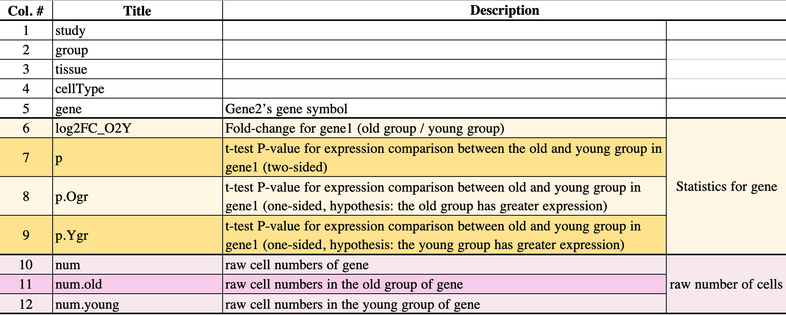
old2young_list.log2FC_t-test_cellNum.txt

Slide 3
agingMarkers-related_genePairCor_pLT0.2_1ageGrpGE50genes.txt

