Slide 1

A novel normalization
method
for GAN
2018.7.12
Made by Xue Minglong

Slide 2
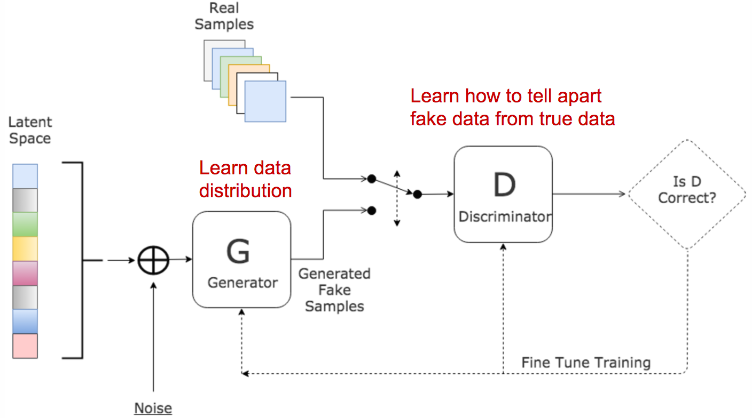

Slide 3
01
The problem
of GAN

Slide 4
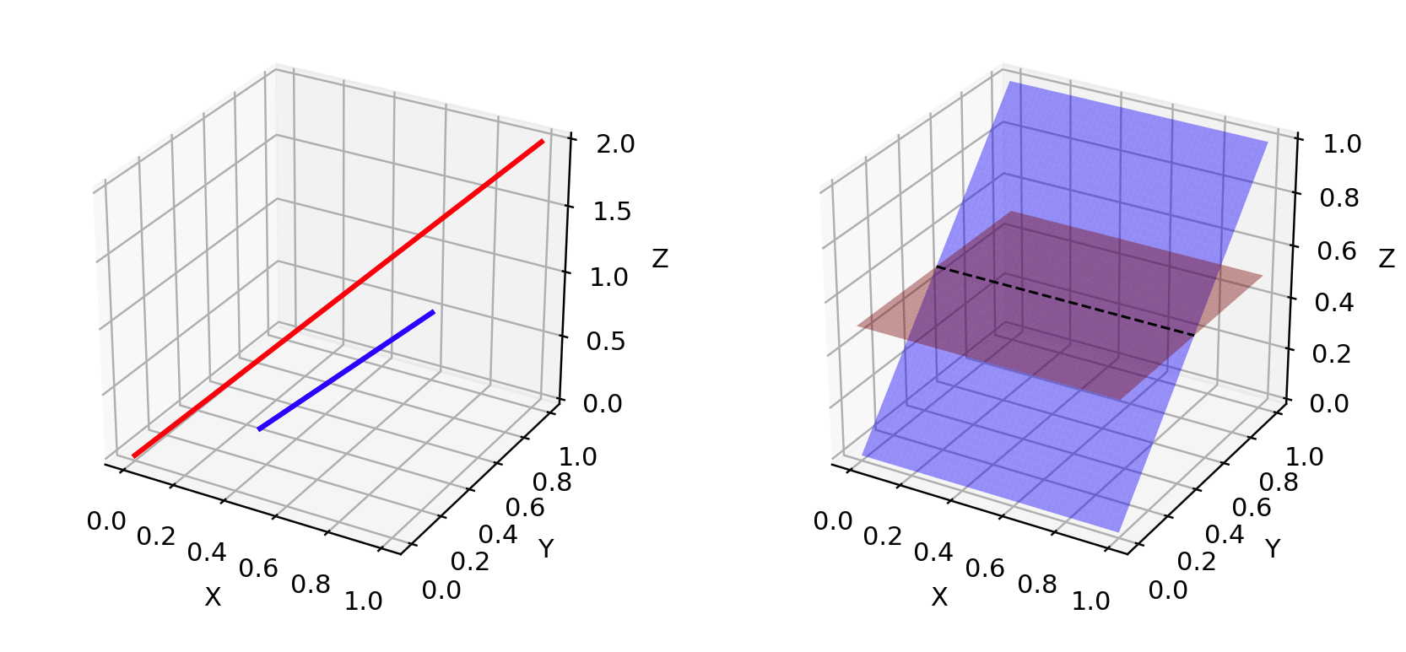
1.Low dimension support
Arjovsky, M., & Bottou, L. (2017). Towards principled methods for training generative adversarial networks. arXiv preprint arXiv:1701.04862.

Slide 5
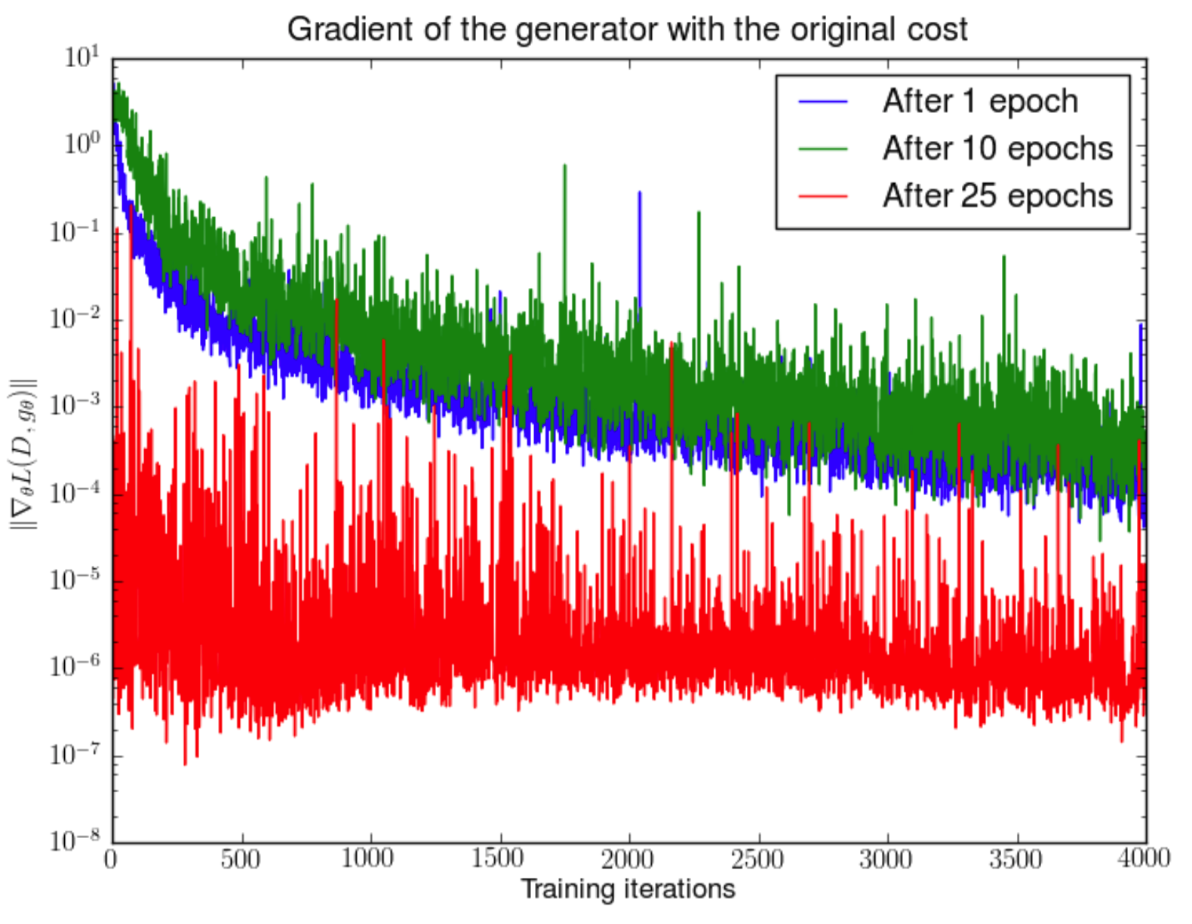
2.Vanishing gradient
Arjovsky, M., & Bottou, L. (2017). Towards principled methods for training generative adversarial networks. arXiv preprint arXiv:1701.04862.

Slide 6
2.Vanishing gradient
If the discriminator behaves badly, the generator does not have accurate feedback and the loss function cannot represent the reality.
If the discriminator does a great job, the gradient of the loss function drops down to close to zero and the learning becomes super slow or even jammed.
This dilemma clearly is capable to make the GAN training very tough!!!
Arjovsky, M., & Bottou, L. (2017). Towards principled methods for training generative adversarial networks. arXiv preprint arXiv:1701.04862.

Slide 7
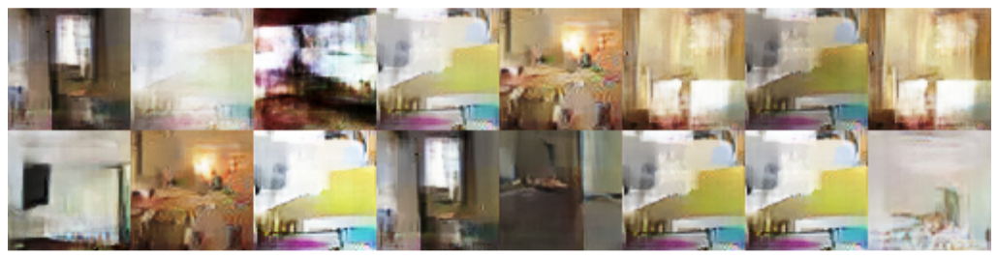
3.Mode collapse
Arjovsky, M., & Bottou, L. (2017). Towards principled methods for training generative adversarial networks. arXiv preprint arXiv:1701.04862.

Slide 8
02
The spectral
Normalization

Slide 9
1.Lipschitz continuous
$\left\|f\left(u\right)−f\left(x\right)\right\|≤C\left\|∇\left(y\right)−x\right\|$
In image processing tasks,
the smaller C is, the less effect the perturbation will make to the final image!
$C=sup\left(\frac{f\left(y\right)−f\left(x\right)}{y−x}\right)$

Slide 10
2.Lipschitz norm
$Lipschitznorm=supσ\left(g\left(h\right)\right)$
where
$σ\left(A\right):=\max_{h:h≠0}\frac{{\left\|Ah\right\|}_{2}}{\left\|h\right\|}=\max_{{\left\|h\right\|}_{2}≤1}{\left\|Ah\right\|}_{2}$

Slide 11
3.Lipschitz example
For a linear layer :
$g\left(h\right)=Wh$
The norm is given by :
${\left\|g\right\|}_{Lip}=sup_{h}σ\left(\left\|∇g\left(h\right)\right\|\right)=sup_{h}σ\left(W\right)=σ\left(W\right)$

Slide 12
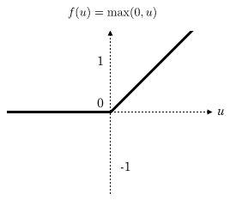
4.Lipschitz continuous
When doing back propagation in a single layer:
$W=W+λ∗\frac{∂y}{∂W}$
$h=h+λ∗\frac{∂y}{∂h}$
Due to the Relu activation method :
$\frac{∂y}{∂x}=1$

Slide 13
5.Spectral Normalization
$y=σ\left(W^{L}\left(σ\left(W^{L−1}\left(...W^{1}x+b^{1}\right)+b^{L−1}\right)\right)+b^{L}\right)$
${\bar{W}}_{SN}:=W/σ\left(W\right)$

Slide 14
5.Power method
${\bar{u}}_{l}∈R^{d_{l}}forl=1,...,L$
Initialize with a random vector (isotropic distribution)
For each update and each layer l:
Apply power iteration method to unnormalized weight
Calculate
Update with SGD on mini-batch dataset with
$W^{l}$
$\tilde{v}←{\left(W^{l}\right)}^{T}{\tilde{u}}/{{\left\|{\left(W^{l}\right)}^{T}\tilde{u}\right\|}_{2}}$
$\tilde{w}←{\left(W^{l}\right)}^{T}{\tilde{v}}/{{\left\|{\left(W^{l}\right)}^{T}\tilde{v}\right\|}_{2}}$
${\bar{W}}_{SN}\left(W^{l}\right)={W^{l}}/σ\left(W^{l}\right),whereσ\left(W^{l}\right)={\bar{u}}_{l}^{T}W^{l}{\bar{u}}_{l}^{T}$
$W^{l}$
$α$
$W^{l}←W^{l}−α∇_{W^{l}}l\left({\bar{W}}_{SN}^{l}\left(W^{l}\right),D_{M}\right)$

