Slide 1
多媒体播放
edison.xie
2023-7-28

Slide 2
目录
目录
1. 多媒体基础知识
CONTENTS
2. hichip播放框架

Slide 3
多媒体基础知识
多媒体(Multimedia)
指的是各种信息表示和传播的载体，包含图片，动画，声音，文本，视频等。

Slide 4
多媒体基础知识
多媒体的来源
硬盘，U盘，SD卡，CD
网线，蓝牙，wifi，天线
MIC，CVBS in，HDMI in

Slide 5
多媒体基础知识
多媒体的分类
按来源： 本地多媒体，网络多媒体，天流
按照实时性：直播流(livestream), 点播流(VOD, Video On Demand)
按照传输协议：http, https, mms, rtsp, rtmp, hls, dash......
按照封装格式：mp4, mpegts, flv, mkv, rm, asf......

Slide 6
多媒体基础知识
容器（container）：
存储多媒体文件时，需要把音视频等内容按照特定的格式组织起来，装载多媒体信息的框架被称为容器。
常见的容器格式：mp4, flv, mpegts, avi, mkv, mpegps,asf, rm, wav, mp3, aac,flac等。
ES流：
也叫基本码流，包含音频、视频的连续码流。
PES流：
打包的基本码流。

Slide 7
多媒体基础知识
index table：
大多数的多媒体容器里，都会有一张索引表，通过这张表格，我们能够找到指定时间点的音频或视频数据。
index1 | offset1 | duration1 | position1 | size1
index2 | offset2 | duration2 | position2 | size2
...... | ...... | ...... | ...... | ......
indexn | offsetn | durationn | positionn | sizen

Slide 8
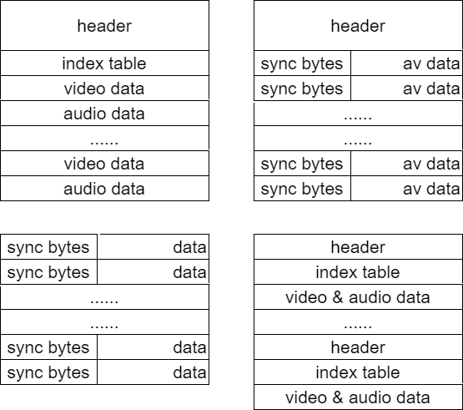
多媒体基础知识
容器的格式有很多，但是分析时一般从数据摆放方式查看问题。右图列出了一些主要的数据摆放格式。

Slide 9
多媒体基础知识
播放的基本流程
aparser
auddec
snddev
src
probe
demux
vparser
viddec
disdev
sparser
subdec
disdev

Slide 10
多媒体基础知识
多媒体的操作：
play
pause
resume
seek
stop
fast front play
fast back play
slow front play
change track
多媒体的基本信息：
duration
postion
filesize
track num
format

Slide 11
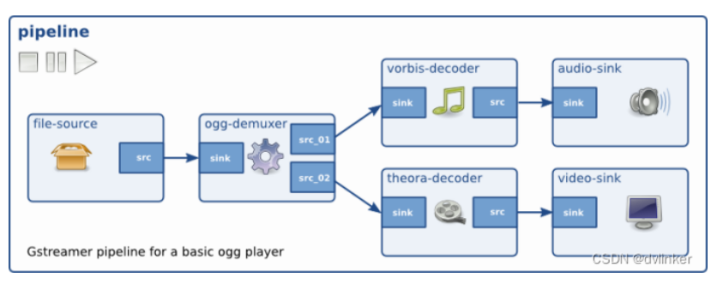
主流的多媒体播放框架
gstreamer

Slide 12
主流的多媒体播放框架
ffmpeg
ffplayer
AVUtil
AVFormat
AVCodec
AVFilter
AVDevice
swscale
swresample

Slide 13
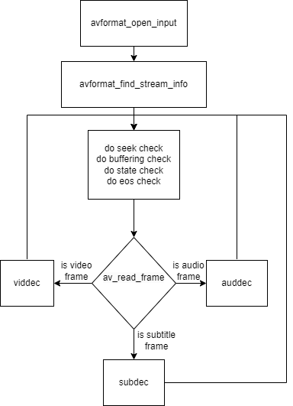
hichip ffplayer 框架

Slide 14
hichip ffplayer api1
int hcplayer_init (HCPlayerLogLevel log_level);
void hcplayer_deinit (void);
void *hcplayer_create (HCPlayerInitArgs *init_args);
void hcplayer_stop2 (void *player, bool closevp, bool fillblack);
void hcplayer_stop (void *player);
void hcplayer_play (void *player);
void hcplayer_play2 (void *player);
void hcplayer_pause (void *player);
void hcplayer_pause2 (void *player);
void hcplayer_resume (void *player);
void hcplayer_resume2 (void *player);
int hcplayer_seek (void *player, int64_t time_ms);
int hcplayer_change_audio_track (void *player, int index);
int hcplayer_change_video_track (void *player, int index);
int hcplayer_change_subtitle_track (void *player, int index);
int hcplayer_set_speed_rate (void *player, float rate);
int hcplayer_set_audio_output_dev (void *player, AudioOutDev snd_devs);
int hcplayer_set_display_rect (void *player, struct vdec_dis_rect *rect);
int hcplayer_change_rotate_type(void *player, rotate_type_e rotate_type);
int hcplayer_change_mirror_type(void *player, mirror_type_e mirror_type);
void hcplayer_change_log_level (HCPlayerLogLevel level);

Slide 15
hichip ffplayer api2
int64_t hcplayer_get_duration (void *player);
int64_t hcplayer_get_position (void *player);
int hcplayer_get_audio_streams_count (void *player);
int hcplayer_get_nth_audio_stream_info (void *player, int index, HCPlayerAudioInfo *audio_info);
int hcplayer_get_video_streams_count (void *player);
int hcplayer_get_nth_video_stream_info (void *player, int index, HCPlayerVideoInfo *video_info);
int hcplayer_get_subtitle_streams_count (void *player);
int hcplayer_get_nth_subtitle_stream_info (void *player, int index, HCPlayerSubtitleInfo *subtitle_info);
int hcplayer_get_cur_audio_stream_info (void *player, HCPlayerAudioInfo *audio_info);
int hcplayer_get_cur_video_stream_info (void *player, HCPlayerVideoInfo *video_info);
int hcplayer_get_cur_subtitle_stream_info (void *player, HCPlayerSubtitleInfo *subtitle_info);
int hcplayer_get_media_info (void *player, HCPlayerMediaInfo *media_info);
int64_t hcplayer_get_filesize (void *player);
int hcplayer_read_transcoded_picture(void *player, void *buf, int len);
int hcplayer_get_buffering_percent(void *hdl);
int hcplayer_set_audio_pitch_shift(void *player, int pitch);
int hcplayer_pic_transcode2(HCPlayerTranscodeArgs *transcode_args);
int hcplayer_get_bypass_mode(void *player);

Slide 16
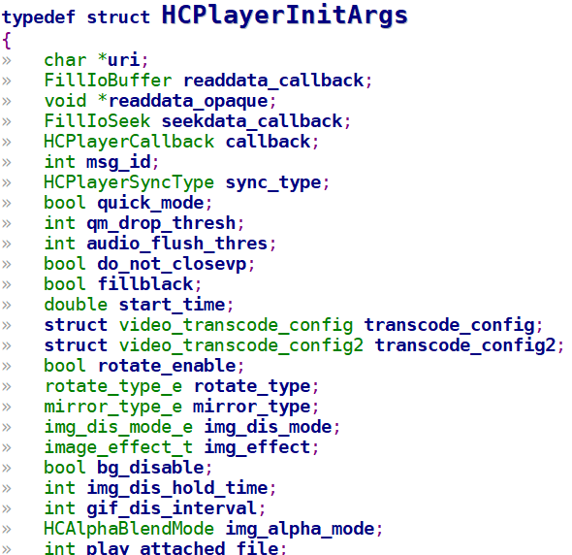
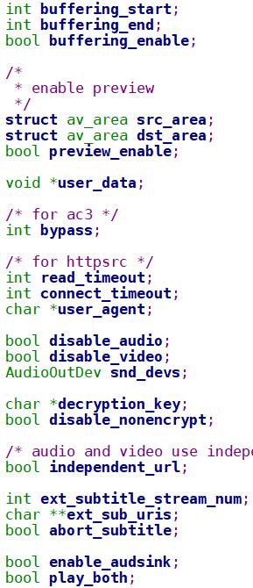
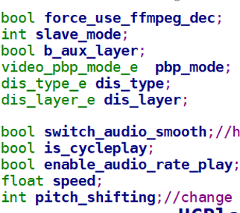
hichip ffplayer

Slide 17
ffmpeg的配置
make menuconfig -> Components ---> -*- ffmpeg ---> [*] ffmpeg plugins --->
--- ffmpeg plugins
[*] ffmpeg protocol plugins --->
[*] ffmpeg demuxer plugins --->
[*] ffmpeg parser plugins --->
[*] ffmpeg decoder plugins --->

Slide 18
ffmpeg的配置
[*] ffmpeg protocol plugins --->
[ ] file protocol
[ ] http protocol
[ ] https protocol
[ ] httpproxy protocol
[ ] ftp protocol
[ ] tcp protocol
[ ] udp protocol
[ ] rtp protocol
[*] ffmpeg parser plugins --->
[ ] mpegaudio parser
[ ] aac parser
[ ] aac_latm parser
[ ] flac parser
[ ] xma parser
[ ] opus parser
[ ] vorbis parser
[ ] cook parser
[ ] ac3 parser
......
[*] ffmpeg demuxer plugins --->
[ ] mov demuxer
[ ] m4v demuxer
[ ] asf demuxer
[ ] avi demuxer
[ ] flv demuxer
[ ] matroska demuxer
[ ] mpegps demuxer
[ ] mpegts demuxer
[ ] rm demuxer
......
[*] ffmpeg decoder plugins --->
[ ] aac decoder
[ ] aac latm decoder
[ ] pcm_bluray decoder
[ ] pcm_dvd decoder
[ ] ape decoder
[ ] dd decoder
[ ] ddp decoder
[ ] adpcm decoder
......

Slide 19
谢谢

