Slide 1
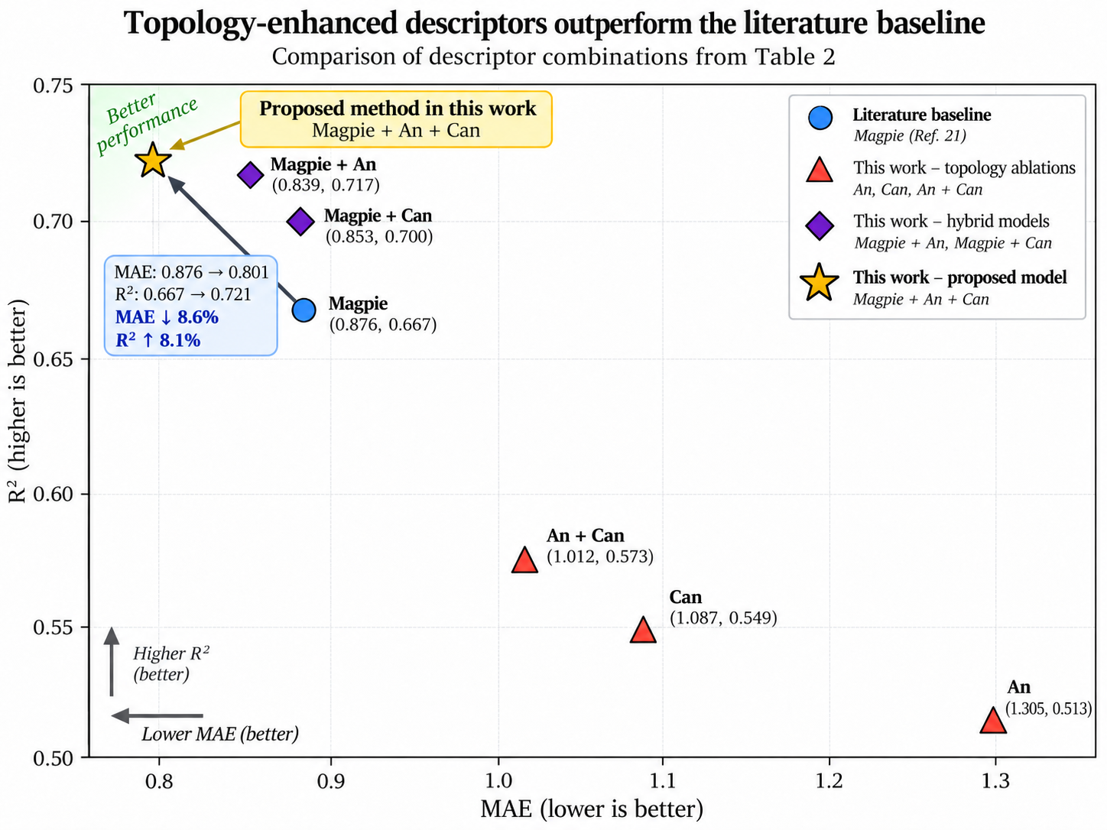
0.75
Better
performance
Proposed method in this work
Magpie + An + Can (0.804, 0.721)
This work – baseline
0.70
Magpie (CatBoost)
Magpie + An
(0.810, 0.714)
This work – topology
Magpie + Can
(0.822, 0.703)
An, Can, An + Can
0.65
This work – hybrid
Magpie
(0.853, 0.681)
Magpie + An, Magpie + Can
MAE ↓5.7%
R² ↑5.8%
This work – proposed model
0.60
Magpie + An + Can
R² (higher is better)
0.55
An + Can
(1.071, 0.551)
0.50
0.45
Can
(1.240, 0.427)
Higher R²
(better)
0.40
Lower MAE (better)
An
(1.296, 0.388)
0.35
0.8
0.9
1.0
1.1
1.2
1.3
1.4
1.5
1.6
MAE (lower is better)

