Slide 1
You should know: Homework 4
CS 3570 Introduction to Multimedia

Slide 2
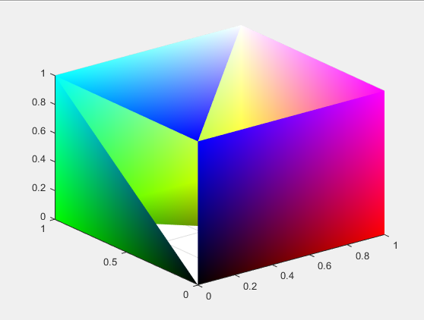
Prob2 – (a)
When you run makeRGBCube.m
You will get

Slide 3
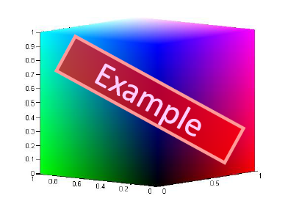
Prob2 – (a)
Modify the code to get a complete cube

Slide 4
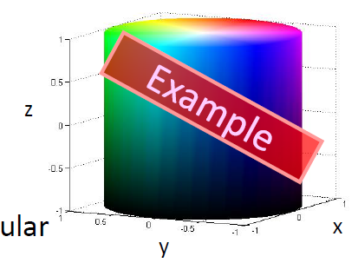
Prob2 – (b)
Generate a HSV color cylinder

Slide 5
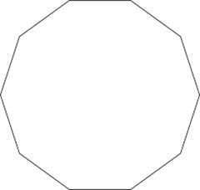
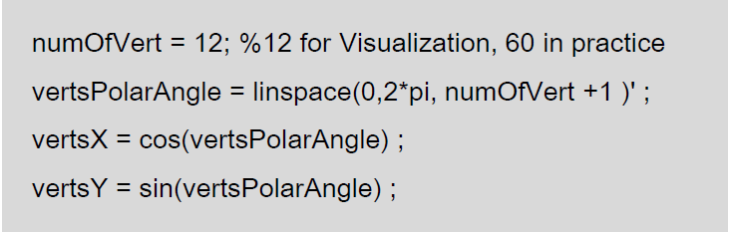
Cylinder Hints
To approximate a circle, we usually use a regular polygon.
To approximate a circle,
Your number of vertex should be at least 60.

Slide 6
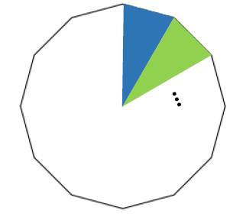
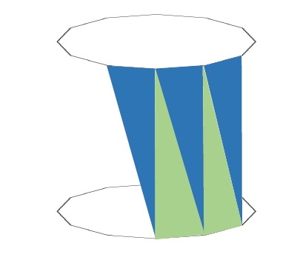
Cylinder Hints
To fill the top surface To fill the side surface:
or bottom surface:
See also: rgb2hsv, hsv2rgb

Slide 7
Rules
Plagiarism
Copy from classmates or from who ever took this course
If you refer any code from public web, Google / Stackoverflow, you must cite and explain how it works in your report.
Not complete homework package
Readme [-10%], should mention how to execute the code, or you’ll get zero.
Image results [-5%]
Late hand-in will get 20% off every day

Slide 8
Notes
任何會直接得到我們作業要求結果的內建functions 一律都不能使用，除非特別補充。
In report, it should contains at least
how you implement the methods
and discussion to the output results

