Slide 1
Tutorial 03: Lecture 04
TA: Yuehan Zhang
zyuehan@comp.nus.edu.sg

Slide 2
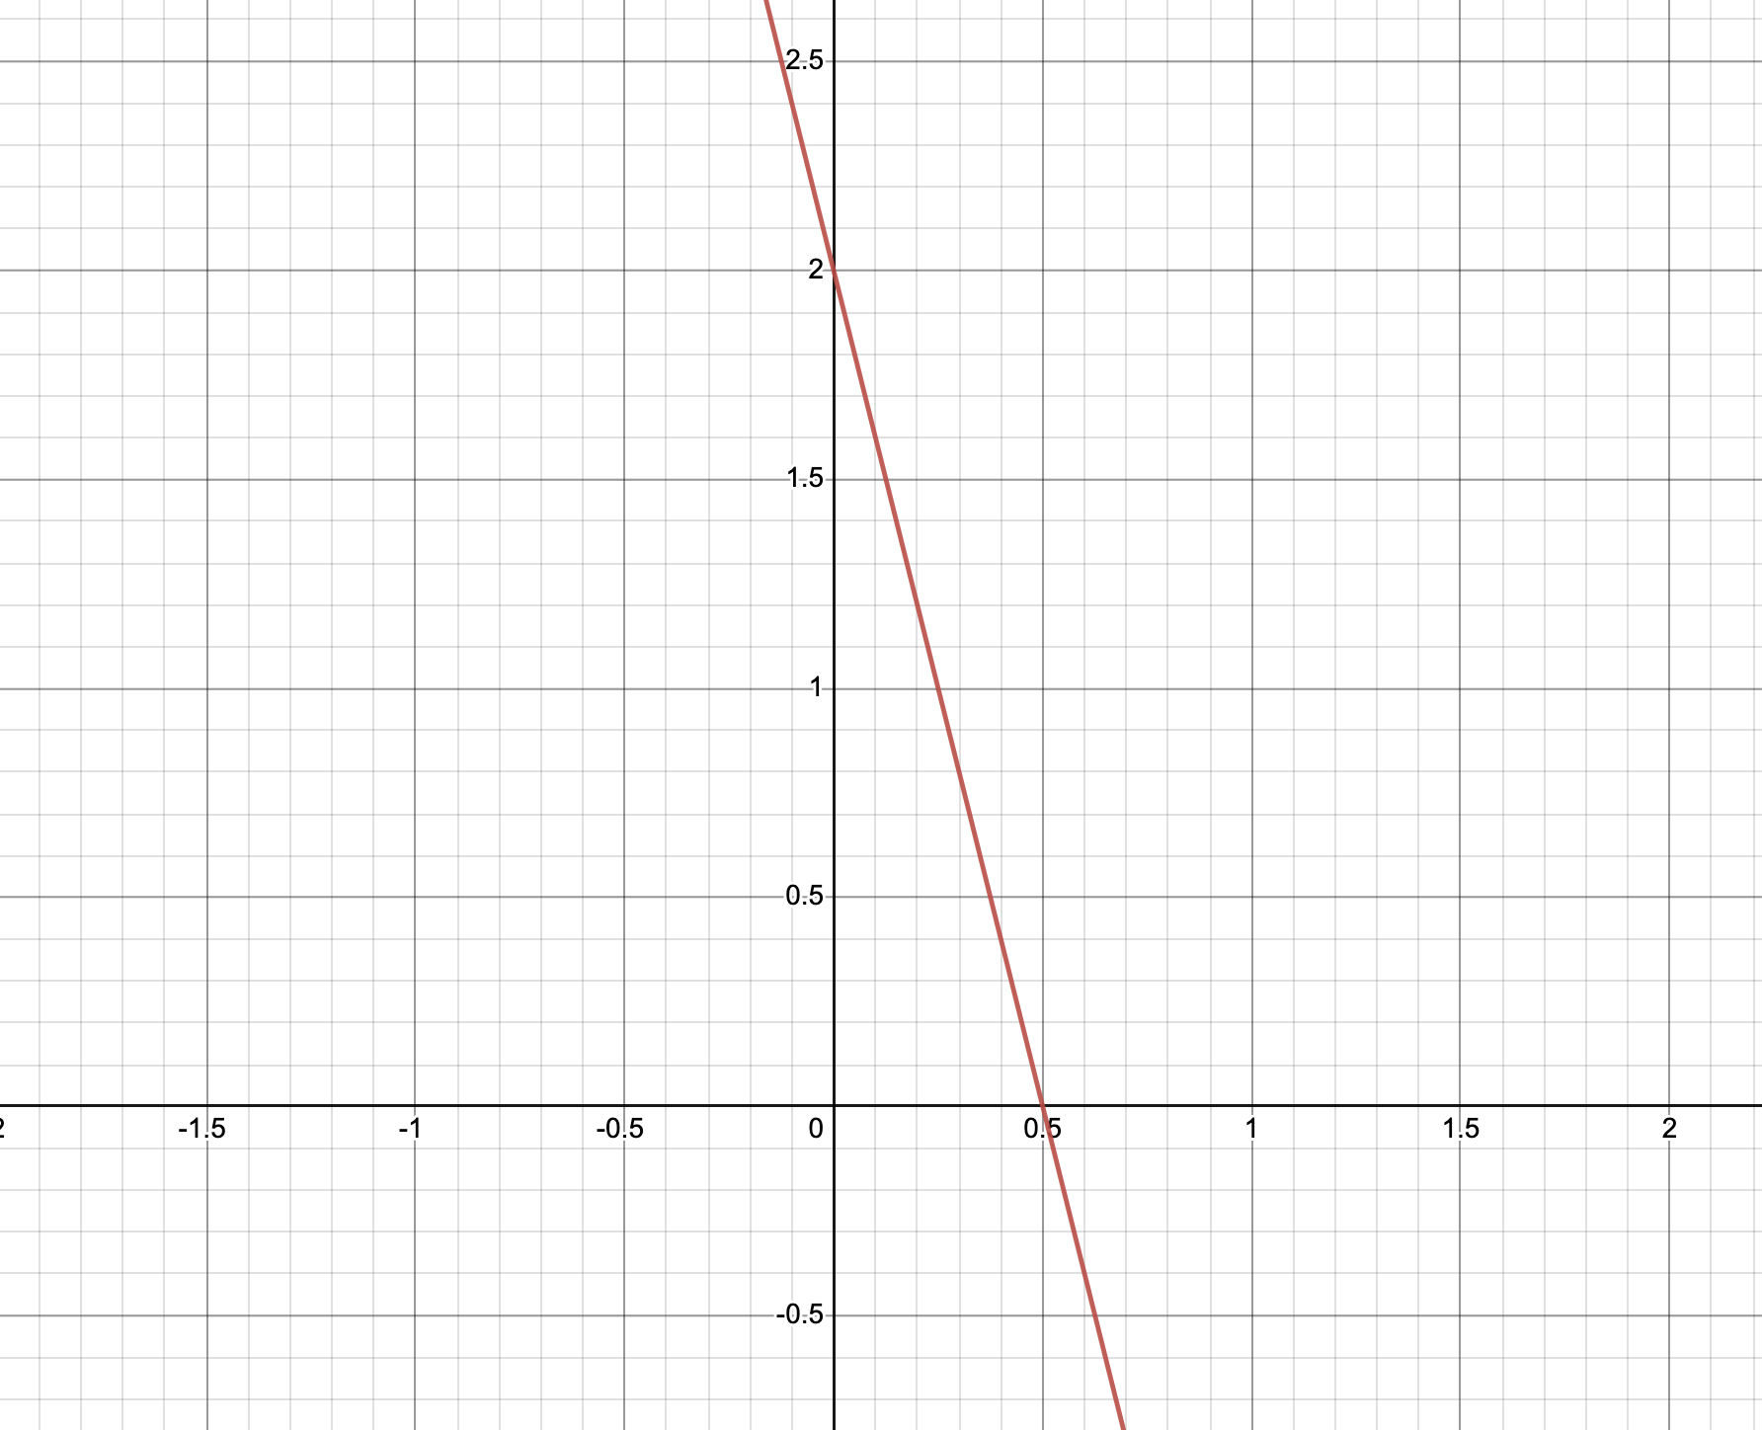

Theoretical Questions
Question 1
Consider the plot of a straight line in (a). Give the equation of the line in slope-intercept, double-intercept and normal form.
Slope-intercept form
y=mx+b (m=>slope, b=>y-intercept)
Double-intercept form
$\frac{x}{a}+\frac{y}{b}=1$ (a=>x-intercept, b=>y-intercept)
Normal form
$x\cos{θ}+y\sin{θ}=ρ$
$ρ^{2}=\frac{1}{{\frac{1}{a}}^{2}+{\frac{1}{b}}^{2}}$
(a)

Slide 3
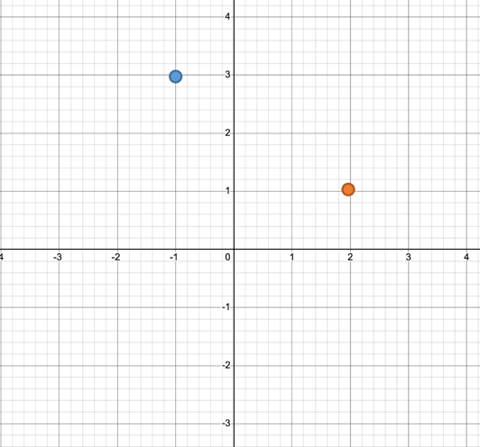
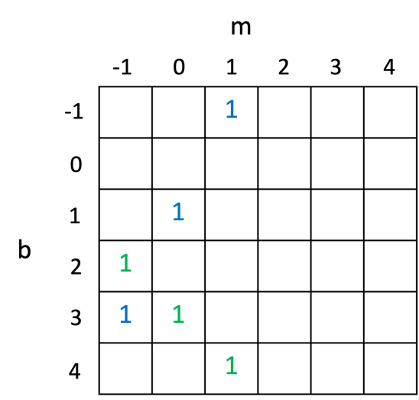
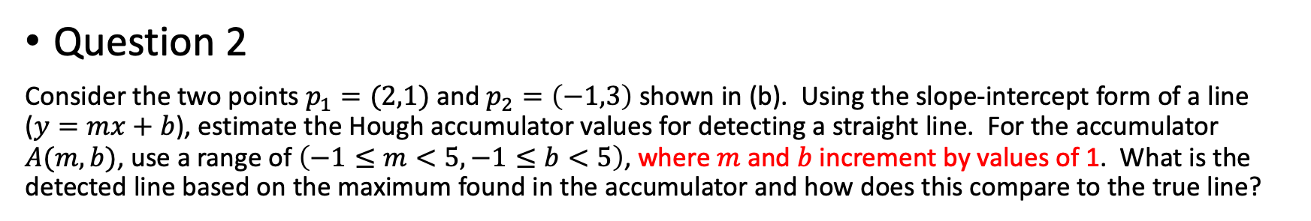
Theoretical Questions
Question 2
Consider the two points $p_{1}=(2,1)$ and $p_{2}=\left(−1,3\right)$ shown in (b). Using the slope-intercept form of a line ($y=mx+b$), estimate the Hough accumulator values for detecting a straight line. For the accumulator $A(m,b)$, use a range of $\left(−1≤m<5, −1≤b<5\right)$, where $m$ and $b$ increment by values of 1. What is the detected line based on the maximum found in the accumulator and how does this compare to the true line?
Similar to lecture slides 18, we can build the accumulator as follows:
(denoted as blue numbers)
b=3, y=mx+3 crosses (2,1), m=-1
b=1, y=mx+1 crosses (2,1), m=0
b=-1, y=mx-1 crosses (2,1), m=1
(denoted as green numbers)
b=2, y=mx+2 crosses (-1,3), m=-1
b=3, y=mx+3 crosses (-1,3), m=0
b=4, y=mx+4 crosses (-1,3), m=1

Slide 4
Coding
Task 1: Set appropriate threshold to decrease the number of false-positive detection.
Task 2: The explanation of parameters of cv2.HoughCircles()
minDist: minimum distance between the centers of detected circles.
Param1: the higher threshold of the two passed to the Canny Edge Detector. Lower value will category more edges to “sure-edge”, and the number of false-positive edges increase.
Param2: accumulator threshold in the detection stage.

Slide 5
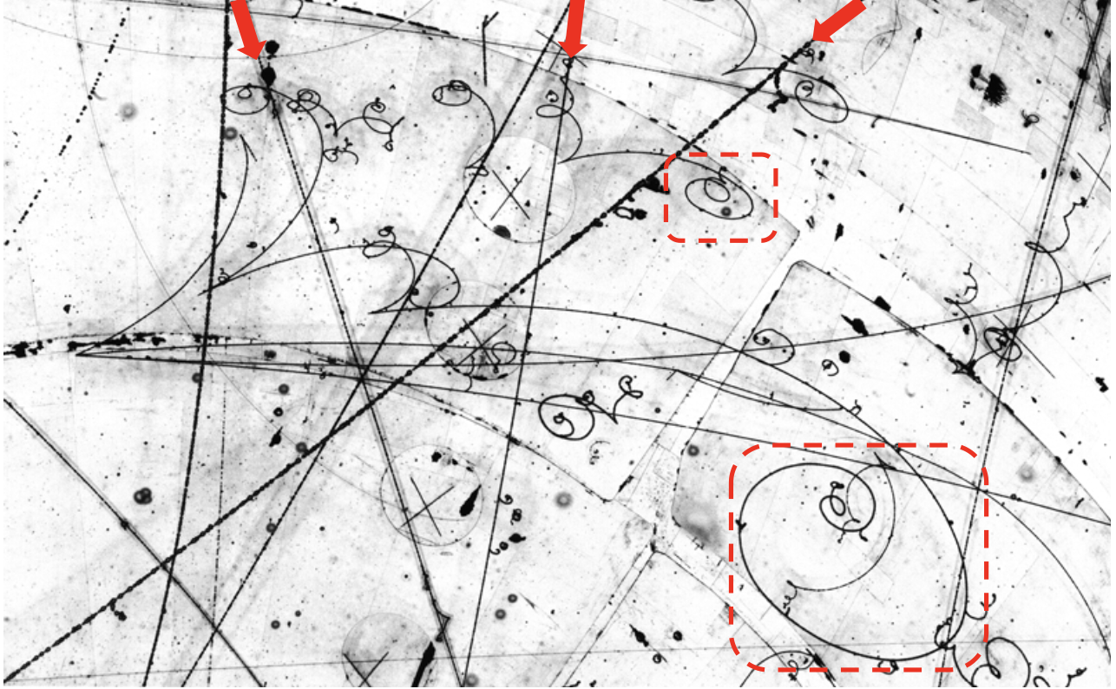
Past Quiz Question: AY2122-quiz 1: Q6
A bubble chamber is an imaging detector used in high-energy physics research. When atomic particles pass through the chamber, they produce tracks of tiny bubbles which can be photographed with a high-definition camera. Different particles produce different tracks; depending on their electric charge and mass, tracks can form straight lines, curved lines or even spiral patterns. A typical photograph obtained from a bubble chamber is shown below. Sample “straight” tracks are indicated by red arrows, while two sample spiral track are outlined with dashed red boxes. You are tasked to find the tracks in the image.

Slide 6
(a) Consider the following operations: (1) sharpening, (2) intensity-based thresholding, (3) histogram stretching, (4) histogram equalization, (5) Canny edge detection. For each operation, state whether or not it will be beneficial as a pre-processing step for our task of detecting tracks and explain why. In your explanation, either describe how the operation would benefit the task, or why we should not be applying the method. Note that your answer should be compatible with the parameter setting, i.e. a degenerate parameter value can always render an operation meaningless.
The pre-processing that achieve following effects should be helpful:
Make lines more distinguishable from each other or from the background.
Suppress noise.
Sharpening: may or may not be beneficial depending on the extent. A little bit should help emphasize the lines. Too much sharpening will over-emphasize the noise.
Intensity thresholding: should be helpful to remove background
Histogram stretching: will have little to no impact since we already have very dark and very bright pixels in
the image
Histogram equalization: not beneficial, this will map the majority of the brighter pixels darker.
Consider the histogram distribution of the image, which has a small percentage of pixels representing the tracks, and a large proportion of pixels of varying intensities from mid-levels onwards all the way to white; the bulk of the pixels are bright background pixels. These bright pixels will be darkened during the equalization process.
Canny Edge Detection: instinctively, one would expect that Canny edge detection should be helpful. However, we are working with a line image. Canny detects edges (there are two edges to a line), so Canny would result in duplicate lines on either side of the track. This will cause problems for later.

Slide 7
(b) Your are tasked with detection “straight” tracks angled at ±30° and ±60° off the horizontal axis. There is an allowed estimation error of ±5° in the tracks and your method should be able to distinguish two tracks which are a minimum of 3 pixels apart. For a track to be valid, it must be at least 100 pixels long. Outline a method to solve the problem using the Hough transform. Specify the dimensionality and parameters of your Hough voting space and the quantization (i.e. the parameter limits of each bin) for the smallest possible accumulator array. State any other assumptions you must make for your solution and evaluate the implications of the assumptions.
1. Detect “straight” tracks angled at ±30° and ±60° off the horizontal axis; allowed estimation error of ±5°. → Use normal form for the expression of lines for convenience (slope-intercept is also okay). The voting space is defined by (theta, rho).
→ We should at least set 4 bins for theta cover from [-65:-55, -35:-25, 25:35, 55:65] degrees.
2. Be able to distinguish two tracks which are a minimum of 3 pixels apart.
→ the the quantization of rho is 3 pixels per bin. The smallest number of rho bins is 2D/3+1, where D is the diagonal length of the image. The range if rho bins is [-D:3:D]. Negative rho is for the expression of lines with theta = (set theta bin + pi). For example,
[-D/2:3:D/2]
D/3+1
x sin(-60°) + y cos(-60°) = - rho
120 °
3. To 100 pixel long lines, threshold the accumulator array to only consider bins with > 100 votes.

Slide 8
(c) You find that it is difficult to isolate local maxima in your Hough accumulator in your solution in (b) as too many votes are cast. What modifications can you make to your voting scheme to reduce the number of votes cast without sacrificing accuracy?
Compute its gradient orientation associated with each edge pixel; only pixels with gradient orientations perpendicular to the (range of) angles of interest are allowed to vote. (1 points);
(d) Propose a method to detect the spiral-like tracks. You may assume that the approximate size of the spiral is known i.e. some range to the rough dimensions of the dashed boxes. State any assumptions you make and outline possible draw-back(s) of your method.
Solution 1: Detect spiral as a an ellipse defined by the outer edge, use Hough voting for ellipse model. Assumes that ”outside” part of spiral is regular enough to be fit with an ellipse. Weakness: ellipse has many parameters (5 / 3 if size fully specified), hard to accurately localize maxima in Hough space.
A “spiral template” via either a generalized Hough transform or parametrically is acceptable. Assumption and drawback should be appropriate to the usage of a spiral, i.e. difficult to define a single template / parameterize.
Solution 2: Sliding window approach, with window based on size given. Histogram all gradients within the window and ensure there is sufficient coverage over the entire range of gradients. Assumes that there is not much noise / interfering tracks present present. Weakness: histogramming the gradients alone doesn’t ensure there is an actual track (i.e. randomly distributed noise pixels will also have a similar histogram) so some post-processing is required to ensure gradients come from points which are linked.

