Slide 1
CS4243 Tutorial 04
Lecture 05

Slide 2
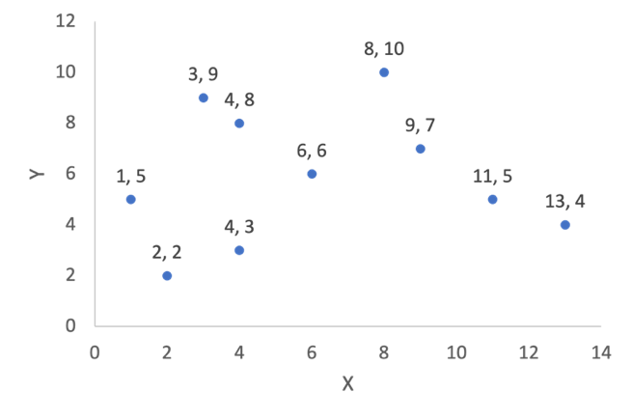
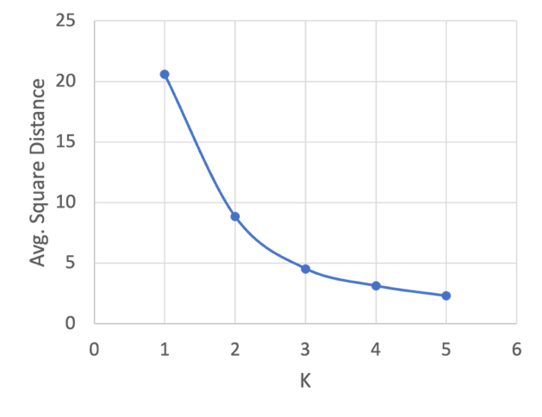
Theoretical Questions
Q1: Given a set of data points shown in figure 1, sketch (a schematic trend of change is enough, no need to calculate the exact numbers) a plot of how the average square distance of a data sample with respect to its corresponding cluster center will change as the number of clusters k increases.
The average square distance will decrease with the increase of cluster number k.
Fig 1

Slide 3
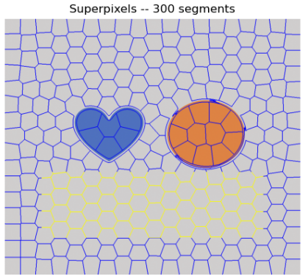

Q2: Apply SLIC algorithm to Fig 2, which consists of large flatten regions. The results is shown in Fig 3 when number of segments is set to 300. Why the resulting super-pixels in central uniform region tend to be hexagonal and not square or rectangular like the border?
Fig 2
Fig 3

Slide 4
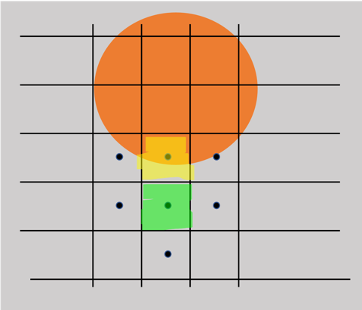
1. We initialize the clustering with rigid grid and sample the center of grids as initial cluster centers (represented as black dots). Here we show the change of yellow and green region after the first update.

Slide 5
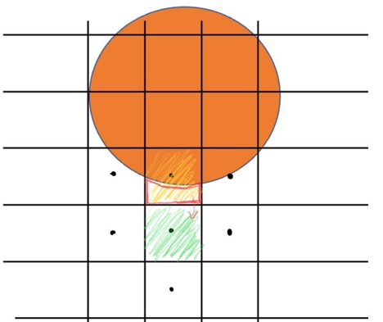
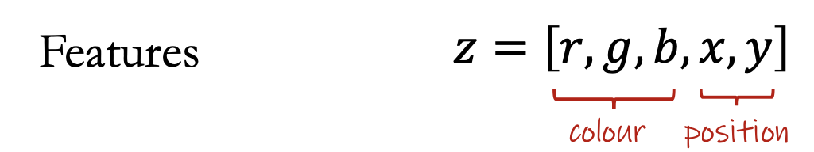
2. Within the neighbourhood, especially when number of segments is large, the color is dominant fact of feature distance. White region in the yellow grid will be assigned to the center of green grid.
In SILC

Slide 6
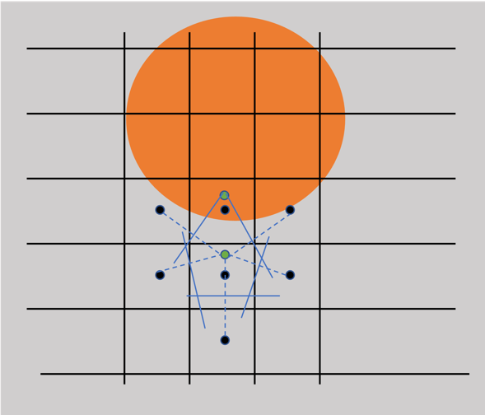
2. Then the positions of centers of these two grids shift (to the green dots). We focus on the reassign of pixels around the green dot below. As around region is of the same color, position determines the feature distance. Pixels are assigned to the spatially closest new center (illustrated by the perpendicular bisector of the line between two centers), which changes the “shape” of superpixels to be hexagonal.

Slide 7
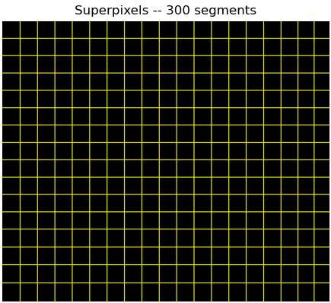
This will not happen if no centers shift. For example, SLIC superpixels of a purely black image will remain rectangular.

Slide 8
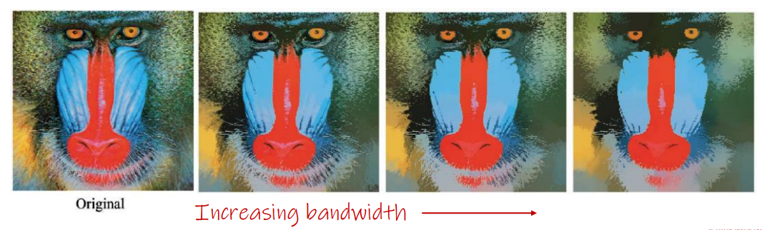
Q3: For Mean-Shift clustering, what happens to the number of clusters as the window size or bandwidth is increased? Explain your answer.
Reference: Understand MeanShift
The number of clusters should decrease. Bandwidth is the radius of kernels. Qualitatively, large bandwidth tend to consider more data points as a cluster when computing mean vector and clusters are more likely to be similar. Therefore, the number of cluster decrease.

Slide 9
Code Example - 1
Apply skimage.segmentation.slic to 100075-Bear.png and show outputs through skimage.segmentation.mark_boudaries. Fix sigma to 5 for all experiments.
Compare the results for 50, 100, 200, and 300 segments and discuss. Discussion: Too few segments are not enough to separate all segments; too many segments will produce redundant segments.
Fix the segment number to 100. Compare and discuss the results when compactness is set to 1, 10, and 100. Discussion: Compactness balances color proximity and space proximity. Higher values give more weight to space proximity. When compactness is very small, pixels with same color are easily clustered to one segments, although they are distant from each others; when compactness is too large, the algorithm will ignore the difference between colors and keep the local region to one segment as initialization.
Fix segment number to 100 and compactness to 10. Compare and discuss the results when the maximum number of iterations is set to 1, 2, 3, 4 and 5. Discussion: Too few iterations is not enough to find appropriate boundary of segments; the segments will not change after several iterations, and then the max iter does not influence the quality of segmentation.

Slide 10
Code Example - 2
Apply sklearn.cluster.KMeans to the data in Q1. Change the initialization method to see its impact on final average square distance of all samples with respect to the clustering centers. Results of KMeans heavily rely on initialization: reference

Slide 11
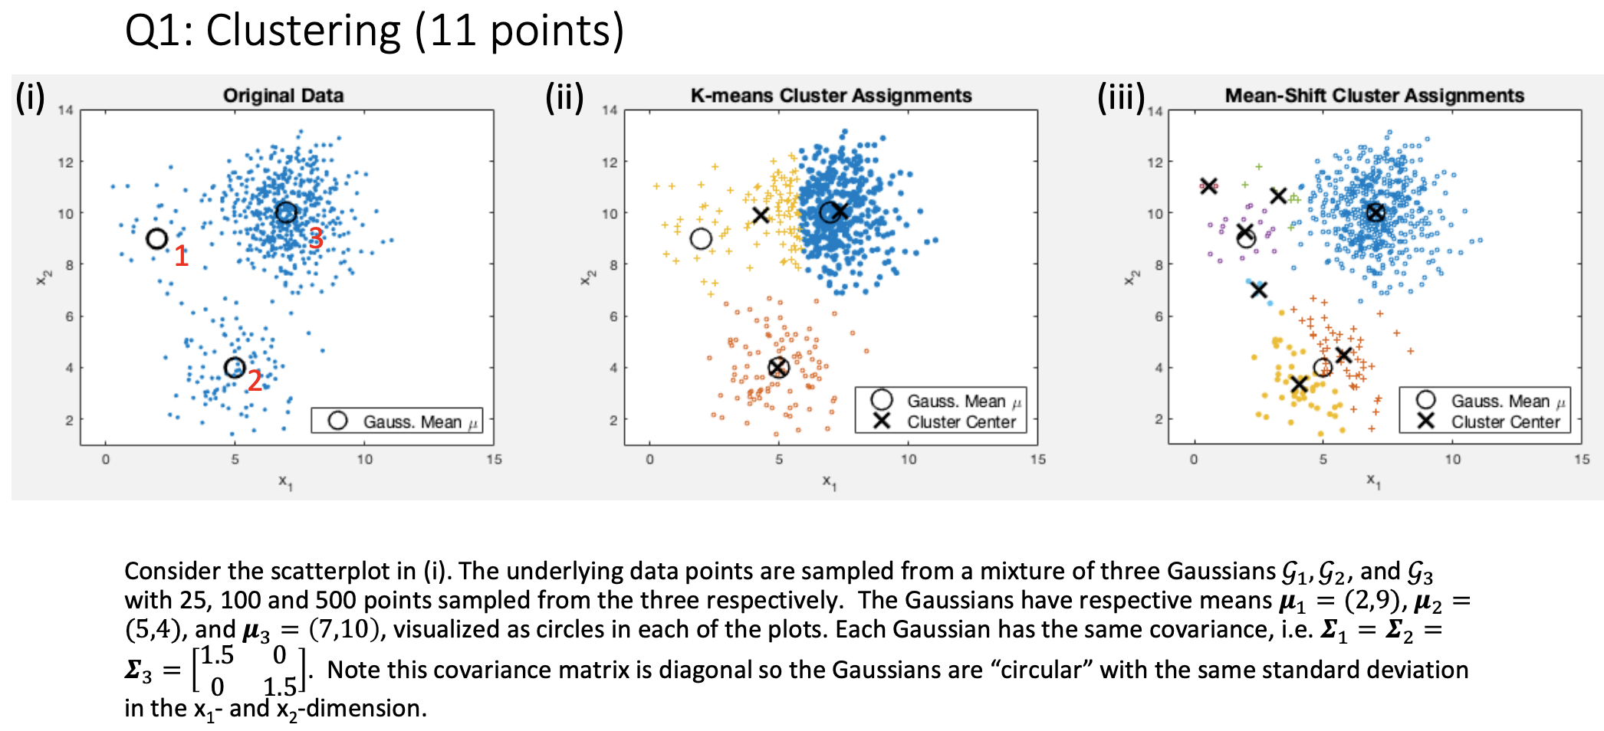
Quiz Question

Slide 12
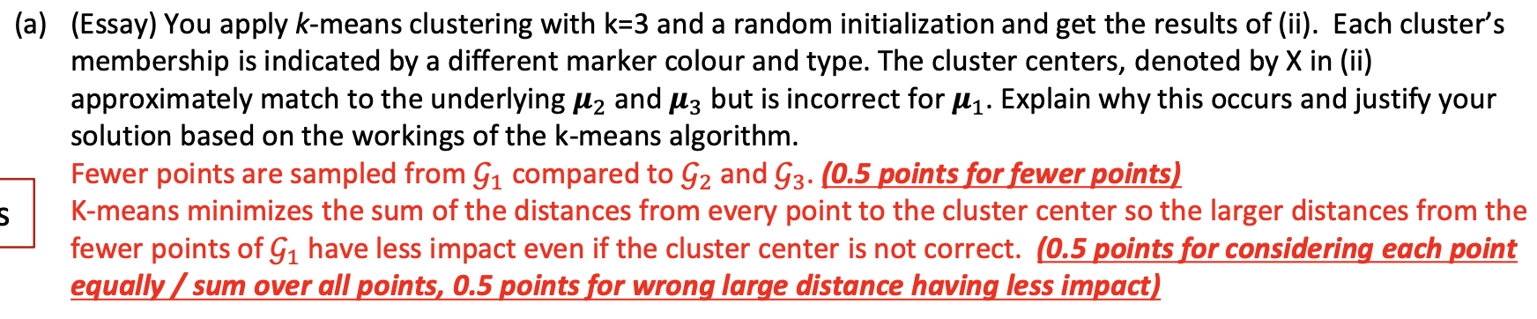




Slide 13
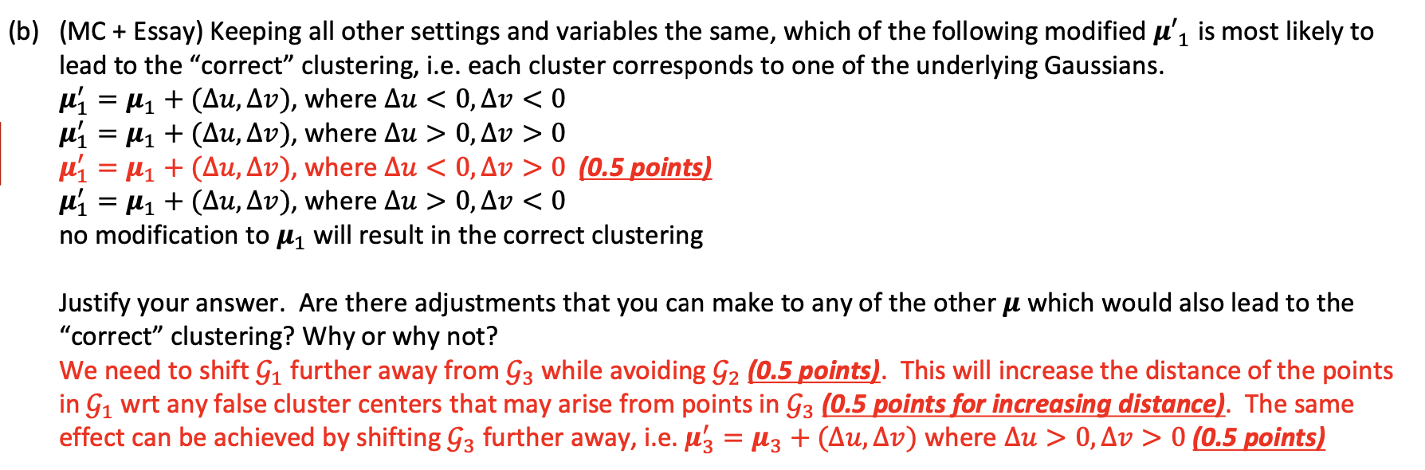
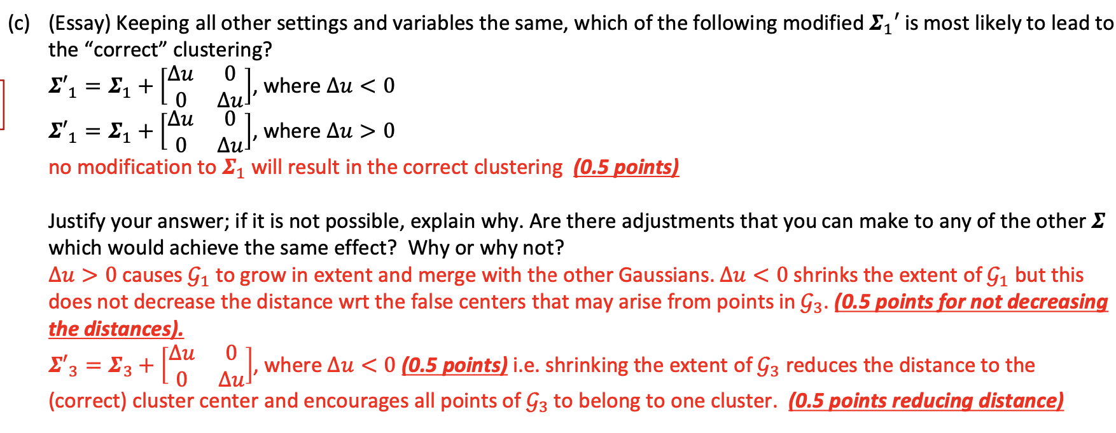

Slide 14
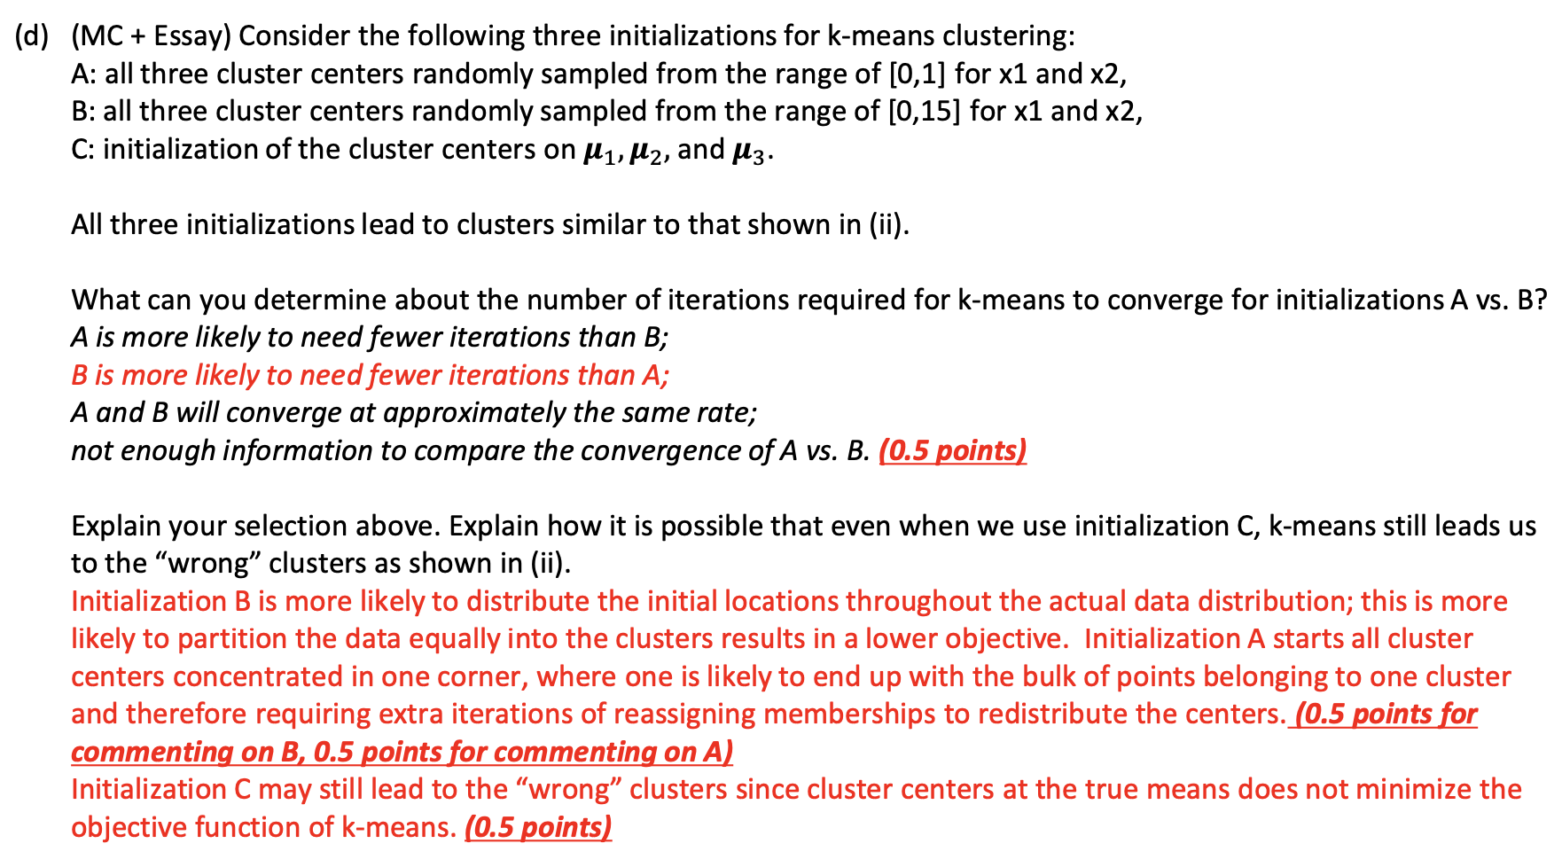

Slide 15
