Slide 1
Linux环境编程

Slide 2
课程全章节
Linux基础
Linux Shell命令操作
Linux Shell编程
Linux C语言编程基础
文件
标准I/O库
进程和信号
进程间通信

Slide 3
参考文献
Linux Manual & Devhelp
Beginning Linux Programming 4th Edition, Neil Matthew
Advanced Programming in the UNIX Environment, W.Richard Stevens
Foundations of GTK+ Development. Andrew Krause
GNU/Linux Application Programming, M. Tim Jones.
Linux教程(第2版), 孟庆昌,牛欣源

Slide 4
第1章
Linux基础

Slide 5
1.1 概述
Linux内核
  发音 —— [΄linəks]
  Kernel 0.01—— Sept,1991
  GPL (General Public License)
  最新内核稳定版本 —— 3.16.2 (https://www.kernel.org/)
Notes:
Finland, Helsinki['helsiŋki]
Important factors
Allow any person in any form use and spread the original program of Linux.
Reduce cost
In the rapid development and popularization of the Internet, and attracted by the Linux free copyright, numerous software superior devoted a lot of time to developing, improving the Linux kernel program, making Linux function became more and more powerful
(8413 lines) 0.01
(20,000, 000) 2.6 above

Slide 6
1.1 概述
Linux发行版
  贡献者
  FSD (Free Software Foundation)
  常见的Linux发行版
    Ubuntu: 基于debian，易于学习 / dpkg & apt / Canonical公司
    Fedora:出色的安全特性，偏向企业应用/ rpm & yum / Red Hat公司
    OpenSUSE:综合，直观的配置工具/ YaST & apt / Novell公司
    Debian: 非常稳定,支持最多的处理器架构/ dpkg & apt / Debian项目组
Notes:
Finland, Helsinki['helsiŋki]
Important factors
Allow any person in any form use and spread the original program of Linux.
Reduce cost
In the rapid development and popularization of the Internet, and attracted by the Linux free copyright, numerous software superior devoted a lot of time to developing, improving the Linux kernel program, making Linux function became more and more powerful
Apart from the kernel program, to make an softwares OS really practical, many other system softwares and application are required.
Most commonly used system program and applications are developed by the Free Software Foundation, besides, there were parts developed by some software institutions and individuals regardless of the pay.
These softwares are also free, anyone can get them from Internet.
But, it is very inconvenient for the general users to collect and install all of these softwares respectively.
So, There are some professional software companies which collect various softwares and integrate them with the kernel to build a complete operating system, which is called “Linux Release” or “Linux Distribution”. It makes general users easier to install and use the operating system.

Slide 7
1.1 概述
Linux Release (or Linux Distribution)
  Popular Linux Release (continue…)
    CentOS: 有效、稳定和可靠/ rpm & yum / Red Hat公司
    Mandriva:上手容易，操作界面友好/ rpm & RPMDrake
    Linux Mint:超强的“minty”工具集合，众多的多媒体编解码器/ dpkt & apt
    RHEL (Red Hat Enterprise Linux): 最流行的Linux服务器发行版，国内使用人群最多的Linux版本；图书和网上资源丰富/ rpm & yum

Slide 8
1.1 概述
Linux的发展要素
  Unix
    1969 年诞生在Bell 实验室, by Ken.Thompson and Dennis Ritchie.
    UNIX是大型系统采用的主流操作系统，采用固定机型的解决方案.
    用于运行Oracle、Sybase、DB2等大型数据库系统.
    Unix的操作风格主要分为SystemV（SVR4）和BSD两种。
    Unix变种非常多，最主要的也有 100 多种.
      AIX（Advanced Interactive eXecutive）: AIX是一个真正的服务器操作系统，IBM的pseries占领了小型机的大半江山 / IBM.
      HP-UX（Hewlett Packard Unix）:基于System V / HP,支持最多64个处理器进行并行计算.
      Solaris: 1.x基于BSD,其后转向SVR4,支持多种系统架构：SPARC、x86和x64,V10后提供Linux运行环境 / Sun (now Oracle)
      FreeBSD:由4.4BSD发展而来,被认为相当稳健可靠 / FreeBSD Foundation
      XENIX/SCO UNIX: 基于System V Release 3,微机版UNIX系统的主流 / Microsoft & SCO
Notes:
UNIX was born in 1969 at Bell Labs, a time-sharing operating system developed by Ken.Thompson and Dennis Ritchie.
UNIX is a mainstream operating system used by large systems solutions using fixed models, major computer manufacturer has its own UNIX.
AIX is generally used to run Oracle, Sybase, DB2, and other large-scale database systems. It will not be used for desktop systems.
提供Linux运行环境，允许Linux二进制程序直接在Solaris x86和x64系统上运行
XENIX是Microsoft公司与SCO公司联合开发的基于INTEL80x86系列芯片系统的微机UNIX版本

Slide 9
1.1 概述
UNIX System V Family | A/UX | AIX | HP-UX | IRIX
 | LynxOS | SCO OpenServer | Tru64 | Xenix
 | Solaris | OS/2
BSD UNIX-386BSD Family | BSD/OS | FreeBSD | NetBSD | NEXTSTEP
 | Mac OS X | iOS | OpenBSD | SUN OS
 | OpenSolaris
UNIX-Like | GNU | Linux | Android | Debian
 | Ubuntu | Red Hat | Linux Mint | Minix
 | QNX | GNU/Linux | GNU/Hurd | Debian GNU/Hurd
 | GNU/kFreeBSD | StartOS
Others | DOS | MS-DOS | Windows | Recat OS
Notes:
Recat OS is designed to be compatible with Windows XP, but free.

Slide 10
1.1 概述
Linux的发展要素
  Minix
    Mini UNIX，迷你版本的类Unix操作系统.
    于1987年由荷兰著名计算机教授Andrew S. Tanenbaum 开发完成.
    主要用 C语言开发.
    全部的代码共约12,000行，分为内核、内存管理及文件系统三部份.
    代码置于他的著作Operating Systems: Design and Implementation的附录里作为示例.
    Linux 刚开始就是参照Minix 系统于1991 年开发的.
Notes:
Operating Systems: Design and Implementation
limited in University
Learning unix is becoming popular because of it.

Slide 11
1.1 概述
Linux的发展要素
  GNU计划
    "GNU's Not Unix"的递归缩写.
    Richard Stallman于1984年创办，旨在开发一个类似 Unix、并且是自由软件的完整操作系统：GNU 系统.
    自由软件基金会(the Free Software Foundation)成立于1985年，除了软件开发的工作，FSF 还极力保护和推广自由软件。FSF 是 GNU 项目(计划)的主要组织和开发者.
    GNU项目已经开发出许多高质量的免费软件：emacs, bash, gcc, gdb.
Notes:
Operating Systems: Design and Implementation
limited in University
Learning unix is becoming popular because of it.
Development of GNU was initiated by Richard Stallman in 1983[1][8] and was the original focus of the Free Software Foundation (FSF), but no stable release of GNU yet exists as of January 2013
named because GNU's design is Unix-like, but differs from Unix by being free software and containing no Unix code
the original focus of the Free Software Foundation (FSF)
but no stable release of GNU yet exists
Richard Stallman views GNU as a "technical means to a social end".
2/3 of FSF’s funding comes from individual donation. Some from company donation.
Advocate the software is free to use, study, copy, modify, and publish
Lot’s of high-quality free software had been developed by FSF until 1990s
(the Free Software Foundation - FSF

Slide 12
1.1 概述
Linux的发展要素
  POSIX标准
    “Portable Operating System Interface of Unix”。由IEEE开发（ 1991-1993 ），由ANSI和ISO标准化。
    POSIX.1 (1995年修订) 提供了源代码级别的 C 语言应用编程接口（API）给操作系统的服务程序。已经被国际标准化组织ISO所接受，被命名为 ISO/IEC 9945-1:1990 标准。
    POSIX标准在推动Linux 操作系统以后朝着正规路上发展起着重要的作用。
Notes:
IEEE（Institute of Electrical and Electronic Engineering ) developed.
ANSI (Amerian national standards institude) and ISO(International Standardization Organization) standardized.
API (Application Program Interface)
originally developed by IEEE for portability of Unix application, in 1991-1993.
POSIX.1 in 1995, providing API in source code level, accepted by ISO.
it push forward Linux to a correct direction from the beginning.
as long as the program written for one OS complies with the standard, it can be ported to the other OS.

Slide 13
1.1 概述
Linux的发展要素
  Internet
    正是因为有了Intenet，有了遍布全世界的无数计算机骇客的无私奉献，Linux才得以越来越完善。
Notes:
IEEE（Institute of Electrical and Electronic Engineering ) developed.
ANSI (Amerian national standards institude) and ISO(International Standardization Organization) standardized.
API (Application Program Interface)
originally developed by IEEE for portability of Unix application, in 1991-1993.
POSIX.1 in 1995, providing API in source code level, accepted by ISO.
it push forward Linux to a correct direction from the beginning.
as long as the program written for one OS complies with the standard, it can be ported to the other OS.
it is just because of the selfless contribution of the developers that Linux becomes more and more powerful.

Slide 14
1.2 安装
虚拟机
  计算机硬件性能大幅提升。
  VMware, Oracle VirtualBox, Xen, Microsoft Virtual PC, Bochs.
  以VirtualBox为例.
    下载 https://www.virtualbox.org/wiki/Downloads
    安装
Notes:
As the computer hardware performance boosts, it is easy and usual to run more than one VM in a single PC.

Slide 15
1.2 安装
在VirtualBox虚拟机中安装Ubuntu
  下载 Ubuntu. http://www.ubuntu.com/download/desktop
  安装.
  启动Ubuntu安装增强工具。
在物理PC中安装Ubuntu
  刻录Ubuntu DVD.
  创建可启动USB安装盘.
  安装多系统时，注意分区时不要损坏有用数据.
Notes:
As the computer hardware performance boosts, it is easy and usual to run more than one VM in a single PC.
DVD(Digital Video Disk)

Slide 16
1.3 Linux操作环境
GNOME简介
  发音： /ɡəˈnoʊm/
  “GNU Network Object Model Environment”的缩写，GNU计划的一部分，最新版本3.6。
  X Window System
    X Window是一种以位图方式显示的软件窗口系统，是UNIX、类UNIX操作系统所一致适用的标准化软件工具包。
    为硬件创建了一个抽象层。
    GNOME和KDE等图形桌面的基础。
  GNOME属于集成式桌面环境，由很多功能强大的组件组成 。
    控制面板
    桌面
    桌面工具和应用程序
    协调各应用程序的规则
  高度可设置性
Notes:
The X Window System (commonly known as X11, based on its current major version being 11, or shortened to simply X, and sometimes informally X-Windows) is a computer software system and network protocol that provides a basis for graphical user interfaces (GUIs) and rich input device capability for networked computers. It creates a hardware abstraction layer where software is written to use a generalized set of commands, allowing for device independence and reuse of programs on any computer that implements X.
X originated at the Massachusetts Institute of Technology (MIT) in 1984. The protocol version has been X11 since September 1987. The X.Org Foundation leads the X project, with the current reference implementation, X.Org Server, available as free and open source software under the MIT License and similar permissive licenses
allows many people to share the processing power of a time-sharing computer and to collaborate with each other through client applications running on remote computers
control panel: start the application and display the state
desktop: place the desktop applications and data
a set of standard desktop tools and applications
rules for coordinating a group of applications.
highly configurable: users can set up their own desktop environment according to personal preferences and habits

Slide 17
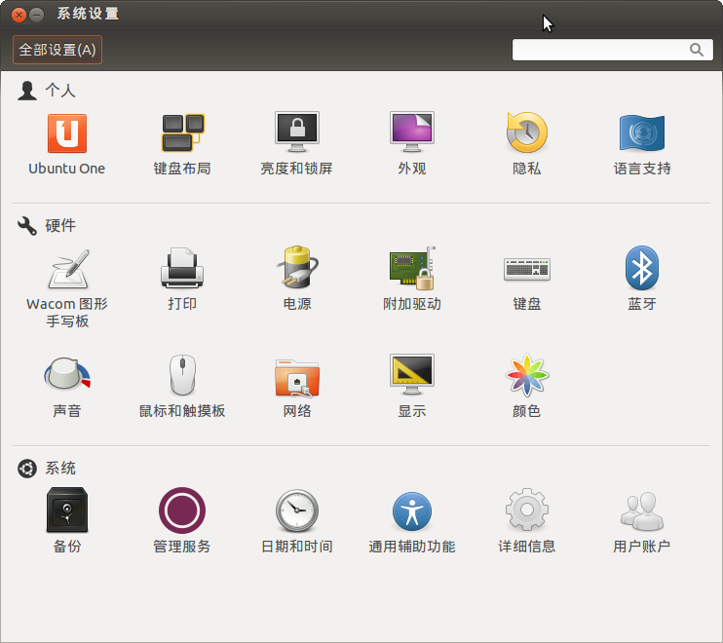
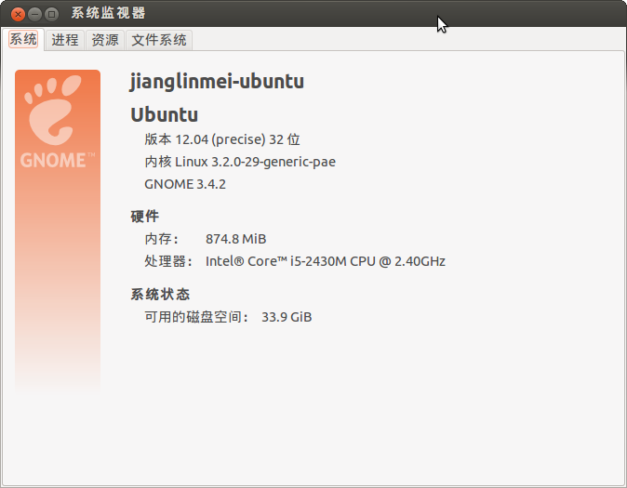
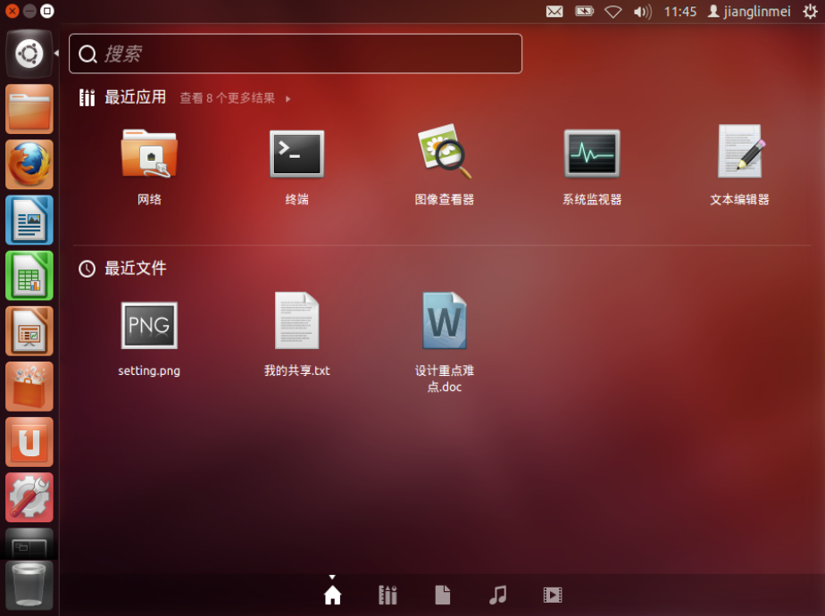
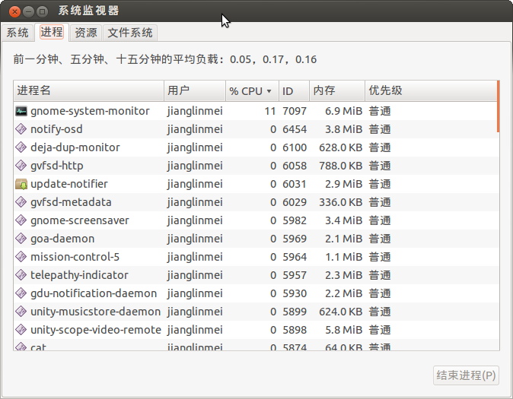
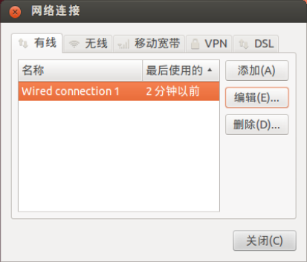
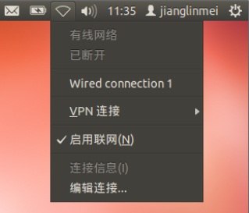
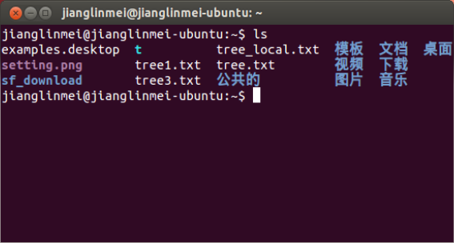
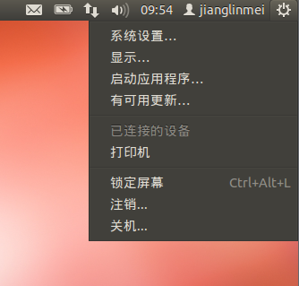

1.3 Linux操作环境
GNOME
  系统菜单
  系统设置(3个区域)
    个人区
    硬件区
    系统区
  网络设置
  启动栏和Dash
  系统监视器
  终端
    命令行提示符: user1@ubuntu:~$
    命令格式
      cmd [opt] [para1] [para2]…
      e.g., ls –l –a --full-time /tmp

Slide 18
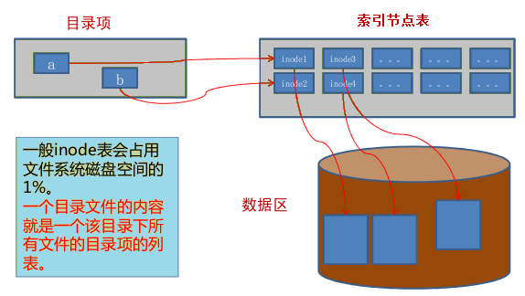
1.3 Linux操作环境
Linux文件系统
  文件组织
    文件系统
    目录层次结构
    索引节点（inode）, 一个结构体（C语言）
    一个文件系统维护了一个索引节点的数组。系统给每个索引节点进行了编号，称为索引节点号。
    目录是将文件的名称和它的索引节点号结合在一起的一张表，目录中每一对文件名称和索引节点号称为一个“连接”。
    软连接（符号连接）和硬连接
Notes:
each disk partition is a file system
all directory hierarchical structure are organized to a whole hierarchical structure.
inode is like file allocation table in windows
inode contains file size, creation time and modification time, permissions, right-belonging relationship, position in the disk, and so on.
Each inode is related to exactly one file, but each inode number can be related to more than one file name. So, we can access a file through different file path.
symbol link is like the shortcut in windows. its content is the path of a file. It’s ok to delete a file without deleting the related symbol link, which so becomes a floating link.
it is prohibitted to create hard link crossing a file system. a file will not be truly deleted until its link becomes zero.

Slide 19
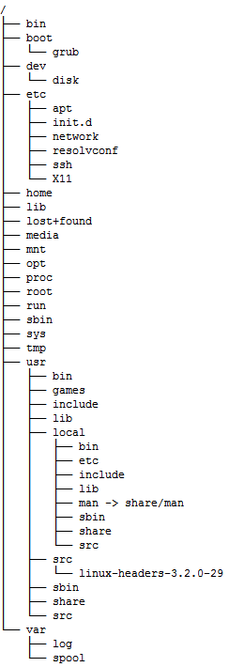
1.3 Linux操作环境
目录结构
  安装程序为用户创建了文件系统和完整而固定的目录组成形式，并指定了每个目录的作用和其中的文件类型。
  多级目录树型层次结构，最上层是根目录，用“/”表示。
  Linux系统中每个分区都是一个文件系统，都有自己的目录层次结构。
  挂载，将一个文件系统的顶层目录挂到另一个文件系统的子目录上。
    挂载点必须是一个目录，而不能是一个文件。
    要挂载到一个已存在的目录上。
    所要挂载的文件系统格式应被Linux支持。
      ext2,ext3,ext4,ISO9660,fat16,fat32, ntfs
Notes:
when mount to a directory, the previous files in that directory is unavailable.
/
top level directory. don’t put ordinary file in it.
/bin
contains basic operation commands, such as ls, cp, mkdir, and so on. all can be executed by ordinary users.
/boot
contains files needed by kernel and boot program, such as vmlinuz, initrd.img
/dev
device file is put here, such magnetic disk, cdrom, usb interface, sound card, terminal device, and so on.
/etc
contains system configuration files. it’s a very important directory that deserve special focus for system administrator. Many service config files are put here as well.
/etc/apt, constains config files for apt software suite.
/etc/init.d, stores the boot scripts of system and service program.
/etc/network, contains config files for network management.
/etc/resolv.conf & /etc/resolvconf, for domain info.
/etc/ssh, for ssh client & server config files
/etc/X11, for X-Windows related config files
/home
the default parent directory of the home directories of ordinary users.
/lib
contains library files.
/lost+found
file fragmentations generated when accidently corrupt or unexpectedly shut down in ext2, ext3 or ext4 file system. fsck tool would check here and try to fix the corrupted file system when system is booting.
/media
the mount point of automatically mounted Plug-and-play storage devices is created here. Only in latest Linux version, e.g., Ubuntu 10.04 above.
/mnt
used for the parent of mount point of manually mounted storage devices.
/opt
some softwares may be installed here. It is advised that install the self-compiled softwares in this directory.
/proc
contains process info and kernel info such as cpu, disk partition, memory info. Most files here is readonly.
/proc/cpuinfo, info about cpu’s type, manufacturer, model, performance.
/proc/devices, running device list
/proc/dma, info. of DMA channel in use
/proc/filesystems, info. of file system in use；
/proc/interrupts, using interrupt and how many interrupted used.
/proc/ioports, io ports info.
/root
home directory of root.
/sbin
command files that can only be run by the user who has root permission. so does /usr/sbin and /usr/local/sbin.
/tmp
temporary files. /var/tmp is similar to it.
/usr
stores software packages such as commands and help files. Most softwares provided by Linux Distribution Authority are installed here with configuration files to /etc
/usr/share, for shared files，/usr/share/man和/usr/share/doc for help files.
/usr/bin & /usr/local/bin, for commands that can be executed by ordinary user. Sometimes, /usr/bin contains the link file to files in /usr/local/bin.
/usr/sbin & /usr/local/sbin, for super user commands
/usr/include, for c program header file
/usr/local, for installing self-compiled software. something like Program Files in windows.
/var
its content is changed frequently
/var/log, for system log.
/var/www, for apache server site.
var/spool, spool files of printer, mail and proxy server.

Slide 20
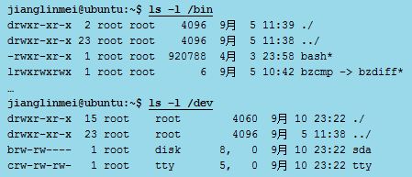
1.3 Linux操作环境
Linux文件类型
  流式文件，即把文件的内容看做是一系列有序的无格式的字节流。
    普通文件，指的是计算机用户和操作系统用于存放数据、程序等信息的文件。
      文本文件，基于字符编码的文件, ASCII, UNICODE, UTF-8, GBK, GB2312, GB18030.
      二进制文件，基于值编码的文件，由具体的应用程序指定或区分某个值是什么意思。
    目录文件
    链接文件，又称符号链接文件。
    设备文件，Linux系统把每一种I/O设备映射为一个设备文件。
    （命名）管道文件，又称先进先出（FIFO）文件，主要用于在进程间传递数据。
  如何查看文件类型?
    ls -l
Notes:
All files are taken as stream file
a directory file is composed of directory item that records file name, sub-directory name and their inode number.
we can make a link file that point to a file existed in the other file system. It can be used as a way for sharing files between file systems.
device file is a method enabling an application to process I/O device like processing an ordinary file.

Slide 21
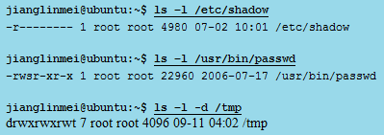
1.3 Linux操作环境
Linux的文件访问权限
  3 类用户
    文件所有者, 组用户,其他用户
  3 种权限
    读, 写, 执行
  用户与权限的组合
  3 种特殊权限
    SUID, SGID, 粘滞位
代表字符 | 权限 | 对文件的含义 | 对目录的含义
r | 读 | 允许查看文件内容 | 允许列出目录中的内容
w | 写 | 允许修改文件内容 | 允许在目录中创建、删除文件
x | 执行 | 允许执行文件 | 允许进入目录
代表字符 | 权限 | 含义 | 使用对象
s (所有者) | SUID | 允许所有用户以文件所有者的身份执行文件 | 仅用于二进制可执行文件
s (组用户) | SGID | 允许所有用户以组用户的身份执行文件 | 仅用于二进制可执行文件
t | 粘滞位 | 禁止用户删除目录中不属于自己的文件 | 仅用于目录文件

Slide 22
1.3 Linux操作环境
Shell
  简介
    一种命令行用户界面
    本质上，Shell是一个命令解释器
    一种解释性的高级程序设计语言
    Shell也有多种不同的版本
      Bourne Shell (sh)
      Korn Shell (ksh)
      C Shell (csh)
      BASH (bash)
      Z Shell (zsh)
    交互shell和非交互shell
      非交互shell只能继承父进程的环境变量
    登录shell和非登录shell
      登录shell: 系统启动并执行/bin/login时进入
      非登录shell : 在登录shell下执行shell命令或打开命令终端时进入
Notes:
It receives commands from the terminal and hand it over to OS to execute it.
Shell allows user to write the program which is composed of shell commands and called “script”. It has many features the same as ordinary programming languages such as c, java, c#. e.g., it has variable, operator, branch and loop statement. We’ll explain shell programming skill in chapter 3.
Bourne Shell is the first widely used and standardized shell, developed by Bell Laboratory. Its name is in memory of Steven Bourne who is the inventor.
Ksh is an evolution of bsh.
csh is mainly used in BSD compatible UNIX. It got this name for its grammar is like C.
BASH is the default shell in Linux (except ubuntu which use dash, a simplified bash). Bash is compatible with bsh. We only illustrate bash in this course.
zsh involves the important features of bash and Korn shell. Moreover, it has some more special features.
Shell do grammatical analysis with command line. The whole line is taken apart into tokens which previously differentiated by blank characters such as spaces, tabs and newlines.

Slide 23
1.3 Linux操作环境
Shell
  环境变量和自动运行脚本(启动脚本)
    环境变量
      系统级的环境变量
      用户级的环境变量
      示例
        PATH 命令搜寻路径.
        HOME当前用户的家目录.
        HISTSIZE 历史记录数.
        LOGNAME 当前用户的登录名.
        HOSTNAME 主机的名称.
        SHELL 当前用户使用的Shell类型.
        LANG 语言和编码
        PS1 基本提示符。对于root用户默认是“#”，对于普通用户默认是“$”。
        PS2 附属提示符，默认是“>”.
    启动脚本
      /etc/rc.local
      /etc/profile
      [/etc/environment]
      (~/.bash_profile | ~/.bash_login | ~/.profile)
      ~/.bashrc
      (/etc/bash.bashrc | /etc/bashrc)
      ~/.bash_logout
Notes:
Besides being a command interpreter, shell’s the other role is programming language.
A user can customize his working environment by setting various environment variables. There are many auto-run script in Linux, such as /etc/profile, ~/.bash_login, ~/.bashrc, and so on.
The environment variables are set value in these script.
According to the scope, environtment variables can be divided into system-level environment variables (effective for all users) and user-level environment variables (effective for current user only).
PATH where to find the command.
HOME home directory of current user.
HISTSIZE how many history commands should be kept.
LOGNAME the login name of current user.
HOSTNAME the host (computer) name.
SHELL the shell used.
LANG language and encoding
PS1 primary prompt. The default is “#” for root and “$” for ordinary user.
PS2 secondary prompt. The default is “>”
the starting order
/etc/rc.local => /etc/profile => [/etc/environment] => (~/.bash_profile | ~/.bash_login | ~/.profile) => ~/.bashrc => (/etc/bash.bashrc | /etc/bashrc) => ~/.bash_logout
/etc/rc.local started by kernel before login.
/etc/profile executed when login first time after Linux was started.
/etc/environment to set system-level environments.
(~/.bash_profile | ~/.bash_login | ~/.profile) called by /etc/profile. Linux find one of the files by the listed order and the first found one is executed.
~/.bashrc executed every time that the bash shell is opened (non-login shell).
(/etc/bash.bashrc | /etc/bashrc) executed after ~/.bashrc, for all users.
~/.bash_logout executed when exit or logout.

