Slide 1
Face Recognition
Group 17
11910828 安广言 11910903 刘通 11912222 吴子彧

Slide 2
Face Recognition System Overview
Three basic steps:
Face Detection: localization of the human faces in a particular image
Feature Extraction: extract the features of the face images detected
Face Recognition: considers the features extracted from the background during the feature extraction step and compares it with known faces stored in a specific database
Kortli, Y., Jridi, M., Al Falou, A., & Atri, M. (2020). Face recognition systems: A survey. Sensors, 20(2), 342.

Slide 3
Approaches
Classical Approach:
Holistic Methods
Local Feature Based Methods
Hybrid Models
Modern Approaches
Deep Learning Based
Dictionary Learning Based
Fuzzy Logic Based
Ali, W., Tian, W., Din, S. U., Iradukunda, D., & Khan, A. A. (2021). Classical and modern face recognition approaches: a complete review. Multimedia Tools and Applications, 80(3), 4825-4880.

Slide 4
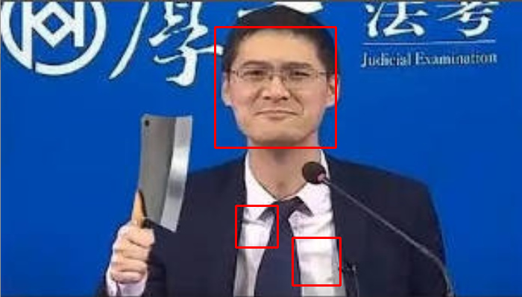
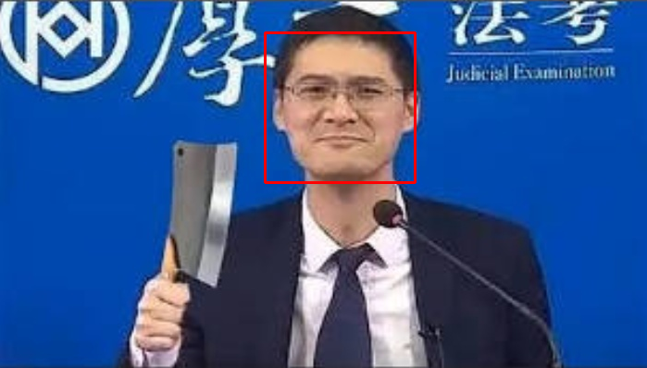
Early Attempts
We use “Cascade Classifier” with trained weight as face detector to rectangle the face. And tune the hyper-parameters.

Slide 5
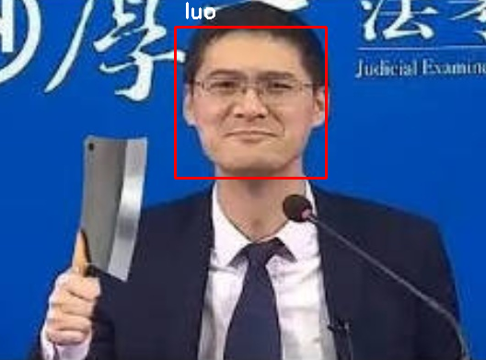
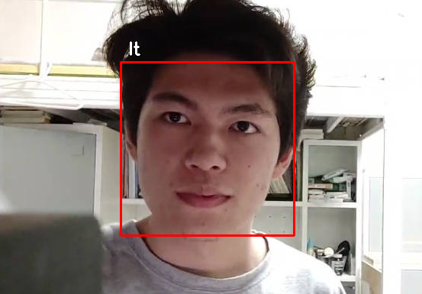
Early Attempts
Use “LBPH Face Recognizer” of OpenCV as face recognizer, recognize the face rectangle with detector, then marked with name

Slide 6
Our Implementation
Approach: Deep Learning Based
Steps:
Detect and locate face from input
Generate face landmarks
Produce feature vector
Backbone of our implementation:
OpenCV: A library mainly aimed at real-time computer vision.
Dlib: A modern machine learning toolkit.

Slide 7
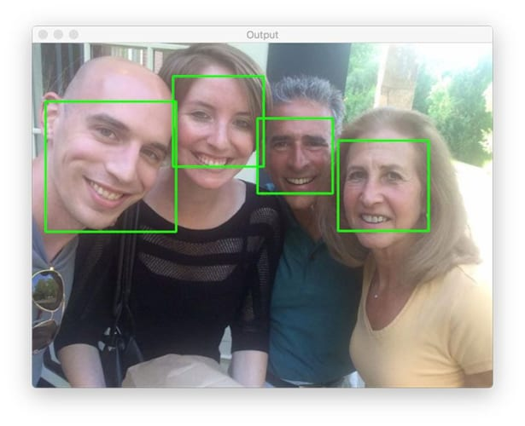
Face Detection
Face detection is a computer technology for human face identification.
Usually returns the bound box (Bbox) of human face in the input image.
Face detection with dlib (HOG and CNN) - PyImageSearch

Slide 8
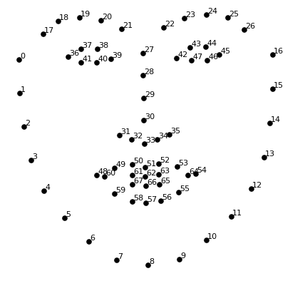
Face Landmark
Face landmark detection is a com-puter vision task that detect and track keypoints from a human face
In this project, we employed a 5-keypoint face landmark generation model.

Slide 9
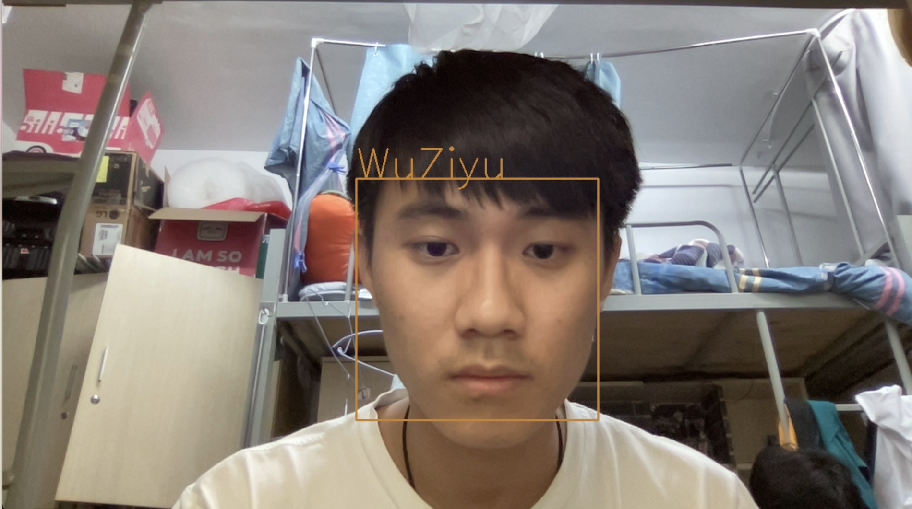
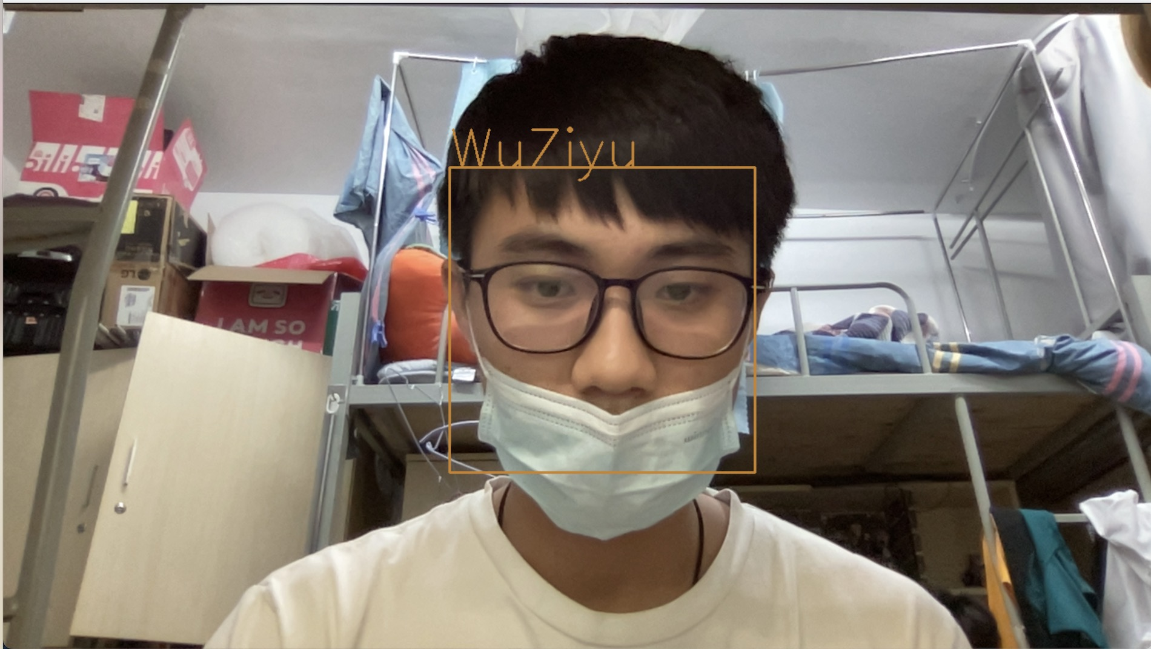
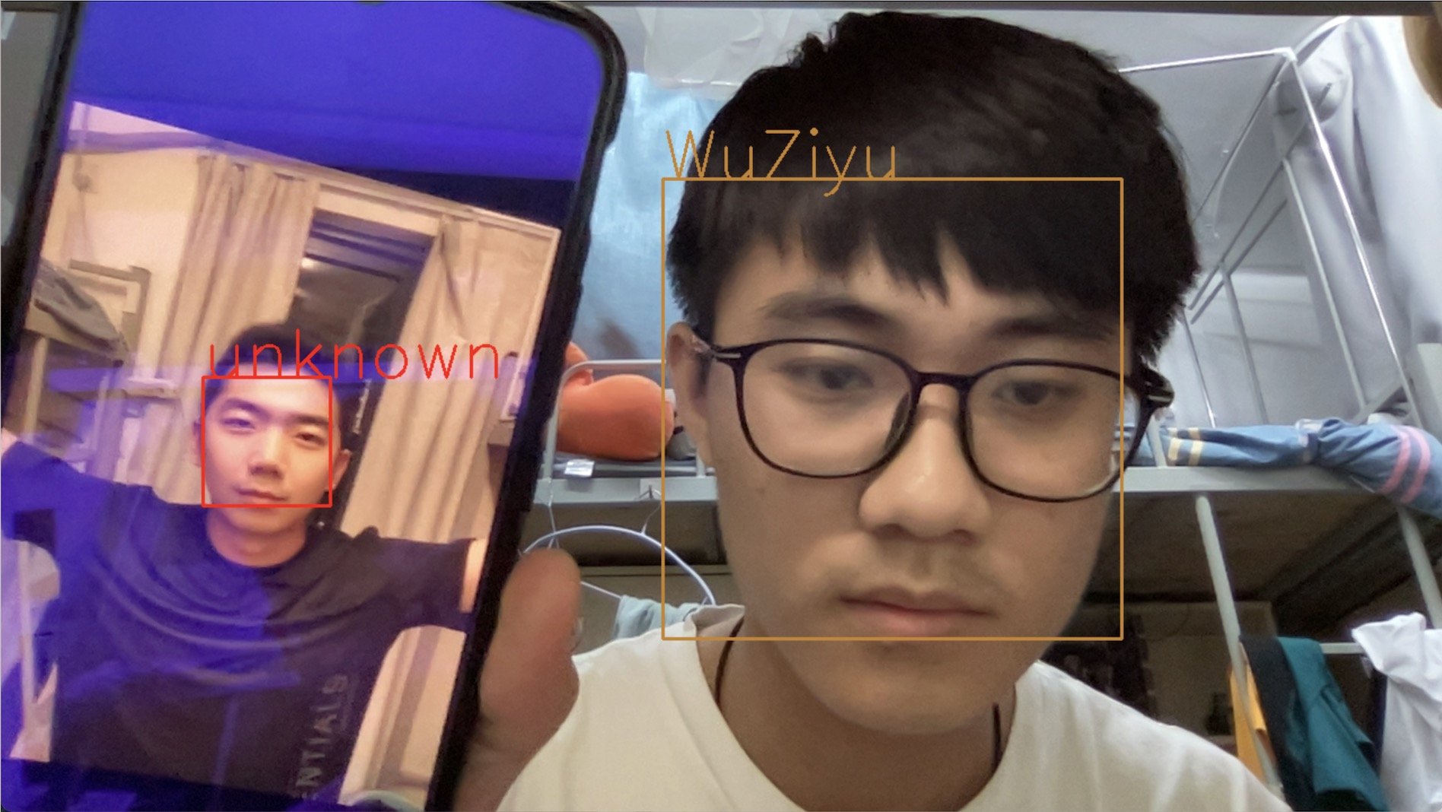
Experiment
Using a threshold to measure the distance between face feature vectors
threshold = 0.4

Slide 10
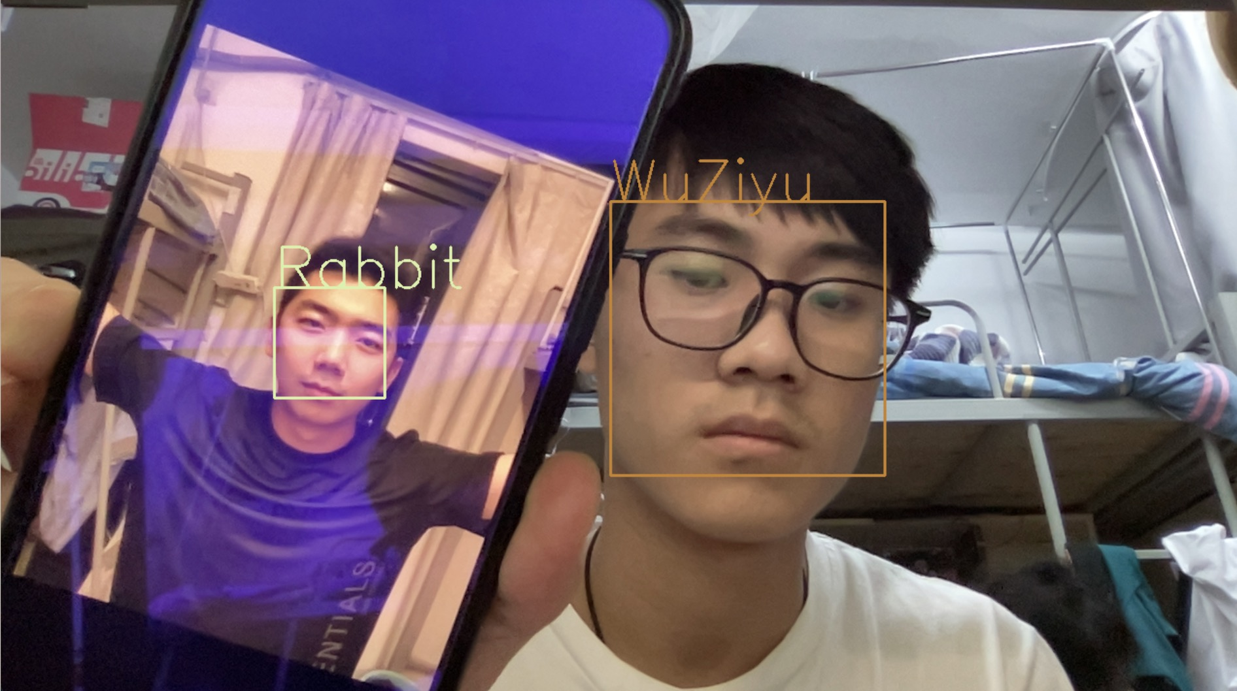
Experiment
Using a threshold to measure the distance between face feature vectors
threshold = 0.5

Slide 11
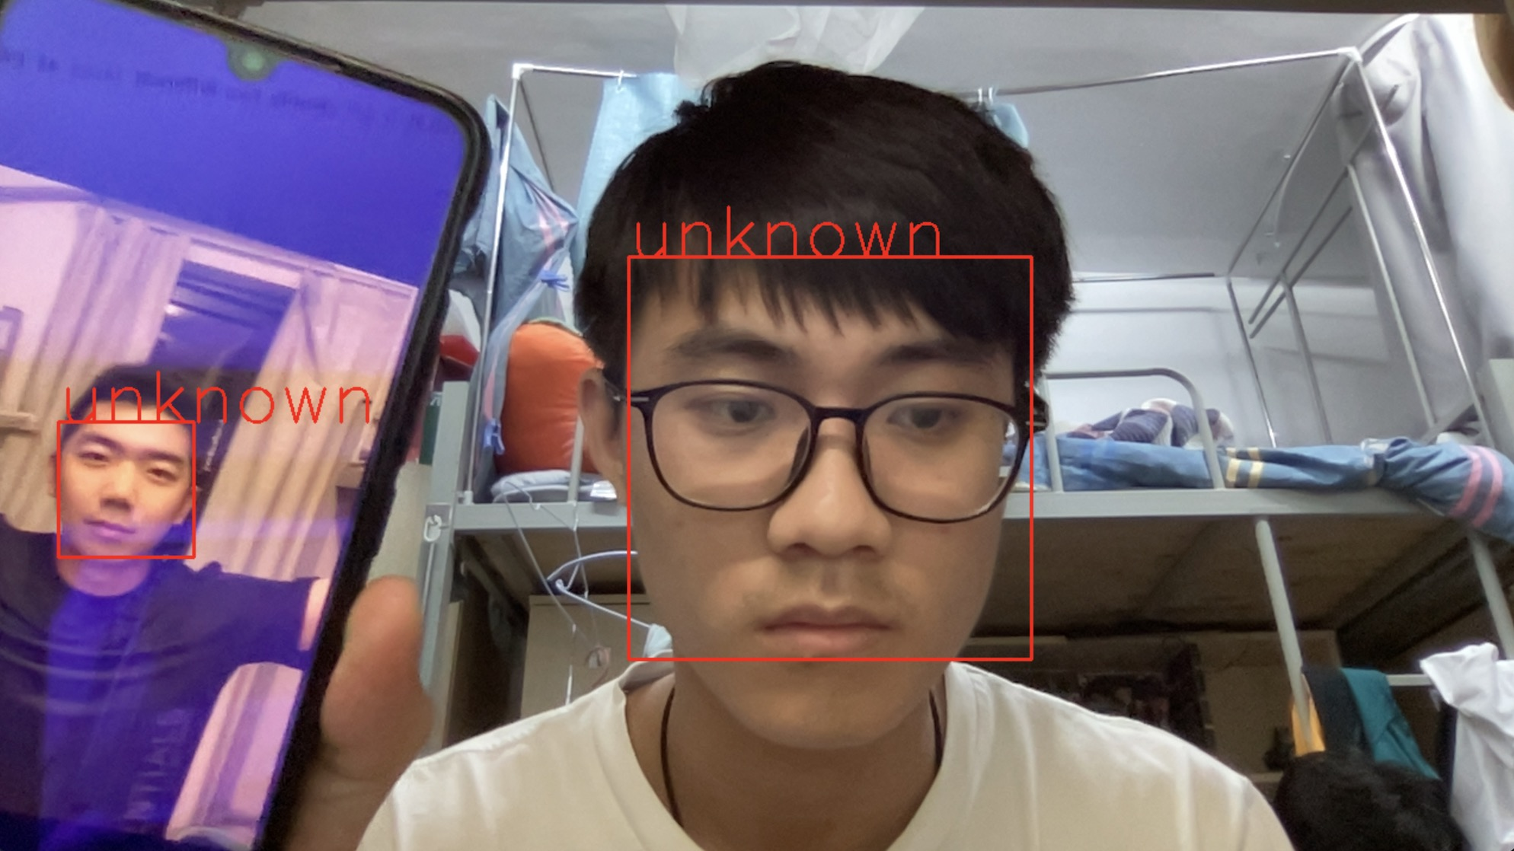
Experiment
Using a threshold to measure the distance between face feature vectors
threshold = 0.25

Slide 12
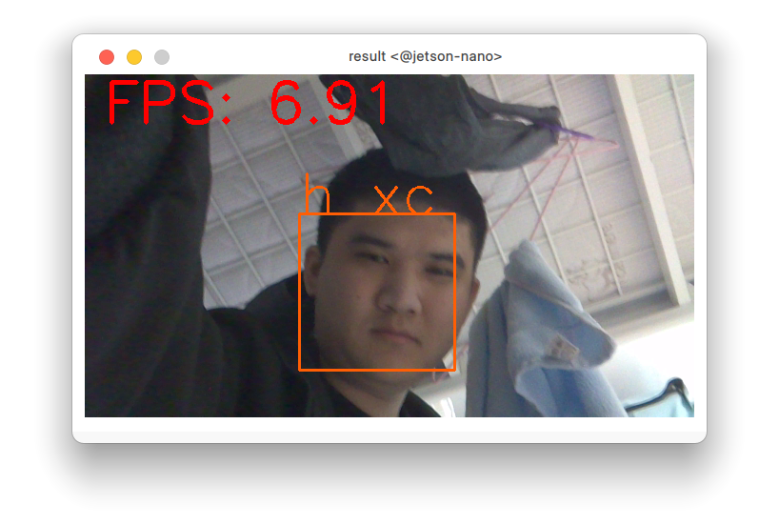
Experiment
Speed on Jetson Nano

Slide 13
Thanks

