Slide 1

Introduction
Liu Wenjia
Notes:
I would like invite everone of you to image this scence: you wake up on a typical weekday morning, but you feel like you might have fever because the smart watch warns you that your temperature is higher than regular. So you have to ask for a leave and drive to hosipital even without appointment. In hospital, you finish your blood test automatically, and in around 10 min you can get your prescription from your smart phone. It sounds a little crazy, isn't it? But please keep in mind------this might come into reality in the next few decades.

Slide 2
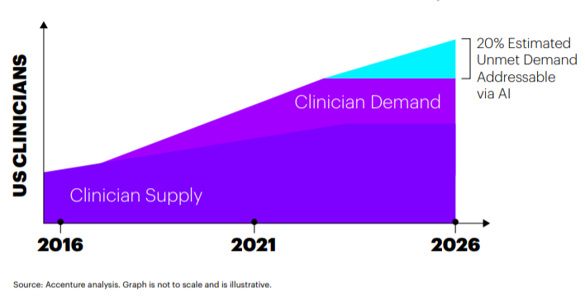

Increasing Demand
US government’s spend on healthcare
18% of GDP
AI can address unmet clinical demand and reduce cost in healthcare.
$3200 billion in 2015 ≈
↓
Reduce $150 billion in 2026
Notes:
One fact is that, population in this plane is increasing rapidly, and unprecedentedly.
And one result is increasing unmet demand for healthcare of high quality, which is clearly shown in this slide. Take the US for example,in 2026 twenty twenty six, demand might be twice as much as supply.
Also, the accelerating spend in healthcare has become one of government's major concernts.
what we should be aware of is that, the US spends 18% of its annual GDP in 2015 on health,which equals to the Germany's economy.
However, according to Accenture analysis, when combined,AIHC can potentially create $150 billion in annual savings for the United States healthcare economy by 2026.
Faced with tight buget and rasing labor costs, governments choose to turn to AI for help.

Slide 3
The AIHC Market is Seeing Explosive Growth
Market Size by Year
Notes:
The UK government has announced an AI investment deal worth £1 billion, and the US government has also increased investment in AI healthcare field.
Immense investment witnesses a huge potential market.
One apparent tendence from datas of recent market size changes is that the growth rate is explosive. It takes two years to increase from 633 million dollars to 667 million dollars. But accroding to prediction, it will only take 5 years for the whole market to grow more than 10 times.

Slide 4
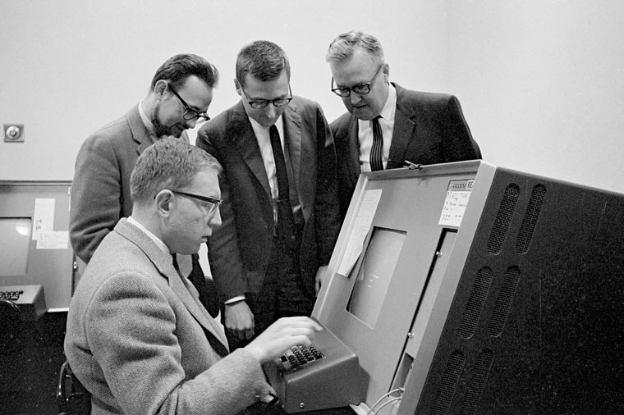
Timeline
1960s
1980s
2010s
Dendral & MYCIN
“AI winter”
“Renaissance”
First try in healthcare expert system
“AIHC is simply one component within a wide range of research and development activities.”
---Shortliffe EH
IBM---Watson
Google---Deepmind
Microsoft---Hanover project
Intel---investment in Luminata
Startups
… …
Notes:
It's not from recent years that people first tried to build a expert system---a computer system that emulates the decision-making ability of a human expert--- to assistant doctors to make diagnosis and treat patients.
As early as in the 1960s and 1970s, the first expert system was designed for applications in organic chemistry, known as Dendral, by Stanford University. It is the first time that computer scientists, chemists , geneticists , and philosophers of science were brought together in collaborative work that demonstrated the ability to represent and utilize expert knowledge in symbolic form. And the seated man in this picture is one of project director, EDWARD A. FEIGENBAUM, winner of the 1994 ACM Turing Award, also known as "father of expert systems." Dendral also provided the basis for the subsequent system MYCIN, considered one of the most significant early uses of artificial intelligence in medicine. However, now, those system are just discribed as structure searchers ,rather than 'artificial intelligence'.
(Photo credit: Chuck Painter/Stanford News Service)
The 1980s and 1990s brought the proliferation of the microcomputer and new levels of network connectivity.
During this time there was recognition by researchers and developers that AI systems in healthcare must be designed to accommodate the absence of perfect data and build on the expertise of physician.
That concept is actually quiet critical to help us build a real AI system. Approaches involving fuzzy set theory, Bayesian networks, and artificial neural networks, have been applied to intelligent computing systems in healthcare.
However,by that time the field was in the midst of “AI winter” , although the introduction of personal computers and high-performance workstations was enabling new types of AIM research, lots of projects ended up without significant achievement.
Ever since 2010s, with increasing computational power, algorithmic improvements, and access to large amounts of data, AI is getting smarter and smarter,and various specialties in medicine have shown an increase in research regarding AI. Take industry for example, lots of AIHC systems have already cooperated with governments to help analyzes medical research to predict the most effective cancer drug treatment options for patients, medical image analysis of tumor progression and the development of programmable cells,detect certain health risks by official medical records datasets and offer medical consultation based on personal medical history and common medical knowledge.

Slide 5

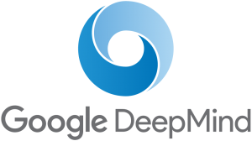

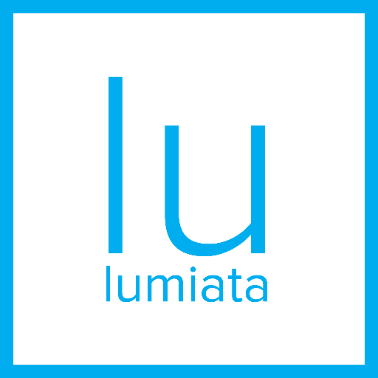

Industry
detect certain health risks with NHS’s datasets
analysis of medical images collected from NHS patients to improve computer vision algorithms
chronic disease treatment
analysis of scientific papers to find new connections for drug development
IBM’s Watson
medical image analysis of tumor progression
analysis medical research to predict the most effective cancer drug treatment options
development of programmable cells
identify at-risk patients and develop care options
Hanover Project
Startup Lumiata invested by Intel

Slide 6
Application Hierarch
Applications
Personal scope
An algorithm to diagnose skin cancer
A deep learning algorithm to observe biopsy
Intuitional scope
Disease Identification/Diagnosis
Nationwide scope
Notes:
The following picture is a tree map of
I'd like to hand over to Zhou Ji to explain the details of applications in personal scope for the next 5 min.

Slide 7
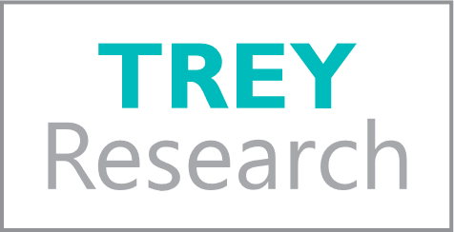

APPENDIX
1 SANDRO GALEA,"America Spends The Most On Healthcare But Isn’t the Healthiest Country",http://fortune.com/2017/05/24/us-health-care-spending/
2 Frost & Sullivan, http://ww2.frost.com/news/press-release/600-m-6-billion-artificial-intelligence-systems-poised-dramatic-market-expansion-healthcare
3 CB Insights; “From Virtual Nurses To Drug Discovery: 106 Artificial Intelligence Startups In Healthcare;” posted February 3, 2017 at https://www.cbinsights.com/blog/artificial-intelligence-startups-healthcare/
4 Vimla L. Patel,1,a Edward H. Shortliffe，“The Coming of Age of Artificial Intelligence in Medicine"，at https://www.ncbi.nlm.nih.gov/pmc/articles/PMC2752210/

