Slide 1

Summary
Liu Siyao
Notes:
So hello everyone, in this part I'll summary all the previous topics and talk about something general.
In the previous topics, we explored the applications of AI in personal, institutional and nationwide scope.

Slide 2
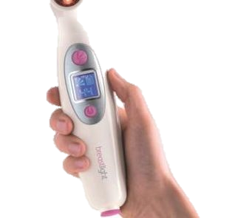
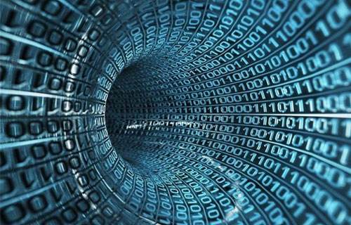
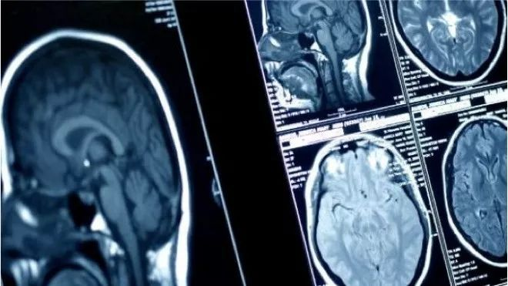
Personal Scope
3
2
The market
1
Limited Data
Computer Vision
Notes:
In the personal scope, AI can help us detect cancer in early stage, as well as many applications in pathology. Here are some important points of it.
- Computer Vision is an important area in diagnostic applications
- One important thing that limits the further improvements in _medical image recognition_ is the lack of data.
- medical device that provides accurate and reliable medical diagnostics is a huge profitable market.

Slide 3
Institutional Scope
3
2
Biomedical Research
1
With projected rapid growth in the medical device sector, companies making efforts to bring accurate and reliable medical diagnostics based on machine and deep learning applications to market may be poised to capture a percentage of this profitable market (the huge venture investments the healthcare AI sector would seem to suggest that AI stands a chance to make a dent in the next wave of medical diagnostic tech).
Management
Applications of AI in medical diagnostics are in the early adoption phase across multiple specialties with limited data currently available on patient outcomes.
Current Problems
Computer vision is emerging as a common thread across these diagnostic applications, and it should be noted that improvements in that field will correlate closely with reliable applications in diagnostics.
Notes:
In the institutional scope, we see that there are some problems in current healthcare institutions, and AI can help us with the management. Also, AI helps a lot in biomedical research. It's a perfect tool to analyse large amount of data and extract patterns behind it. That's really useful in drug discovery. Never the less, AI can be your personal health expert, working as online doctor consultations.

Slide 4
Nationwide Scope
3
2
Biomedical Research
1
With projected rapid growth in the medical device sector, companies making efforts to bring accurate and reliable medical diagnostics based on machine and deep learning applications to market may be poised to capture a percentage of this profitable market (the huge venture investments the healthcare AI sector would seem to suggest that AI stands a chance to make a dent in the next wave of medical diagnostic tech).
Management
Applications of AI in medical diagnostics are in the early adoption phase across multiple specialties with limited data currently available on patient outcomes.
Current Problems
Computer vision is emerging as a common thread across these diagnostic applications, and it should be noted that improvements in that field will correlate closely with reliable applications in diagnostics.
Notes:
In the nationwide scope, still, AI cannot replace the human in the entire diagnostic process, but it can help with the automation of trivial tasks, enabling the most urgent studies to be reviewed first and allowing specialist staff to focus on more complex cases.

Slide 5

About AI Itself
Why are we building it
The trend
Notes:
Thats all we've presented before, beyond that, I want to talk something more general.

Slide 6
Why are we building AI?
Liberate human from
dangerous
boring
special
jobs.
Notes:
First is, what's the ultimate goal of us in building artificial intelligence? In my opinion, we are trying to liberate human. There are all kinds of jobs, include dangerous jobs like stunt actor, builder and soldier; include boring and error prone jobs like driver; including special jobs like XXX. The ultimate goal of AI is to liberate human from these kinds of jobs. Of course the world is not a Utopia and most of the investigations are driven by the market, but we're kind of doing the same things.

Slide 7

Trends of AI (DNN)
Notes:
Then, what about the development state of AI? This is a model called deep neural network, rooted in linear algebra, is has many similarities with human neural network -- each node can be regarded as a neuron and the line represents a connection. That's why we are doing the following comparisons.

Slide 8
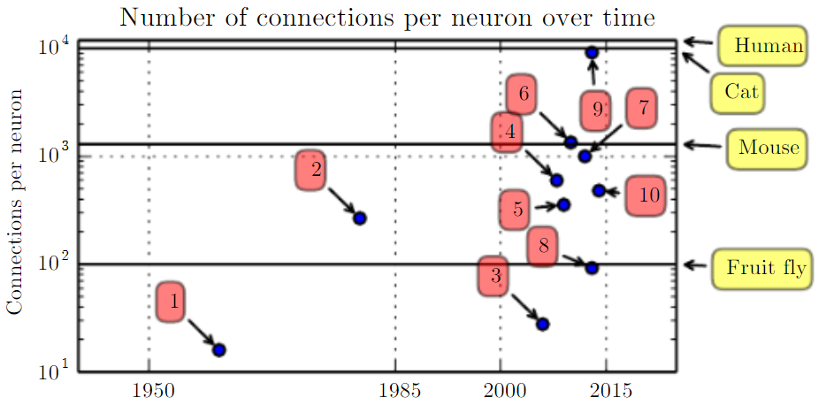
Trends of AI (DNN)
Notes:
First, we can see that in recent years the number of connections per neuron is near to human.

Slide 9
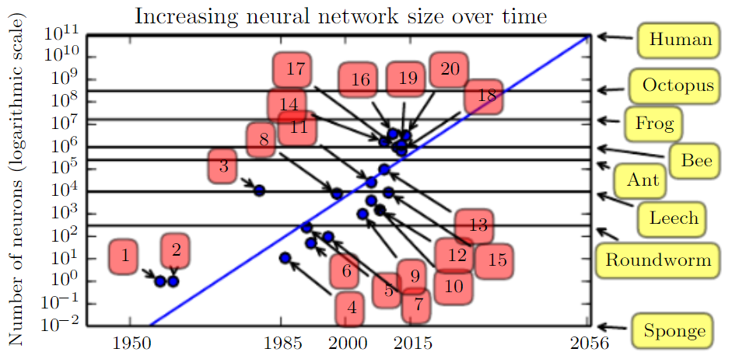
Trends of AI (DNN)
Notes:
However, the total size of the network still have a long way to go. Currently, the largest network has roughly the same size as a bee, while they are doing fairly well on some specific tasks. Maybe if we want to achieve higher intelligence, we'll need some breakthrough in computational resource.

Slide 10
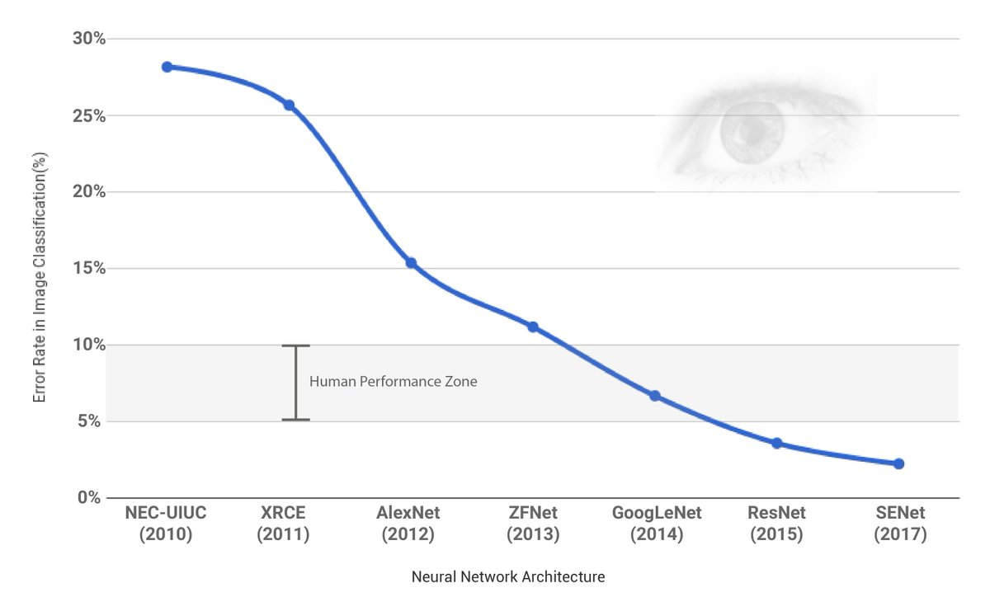
Trends of AI (DNN)
Notes:
This image indicates that, by 2015, the error rate of AI in image classification task is better that human!

Slide 11
The Future
Notes:
For the future if AI in healthcare industry, I think that the (currently assist) ultimate goal is to replace doctors and nurses. Once that is true, we don't have to wait long and pay much for healthcaring. One thing we need to worry about is the accountability, which means when an AI made some mistake, who will be in charge? Maybe we need further discussion and some regulations there. ---- need smooth transition to the end

Slide 12
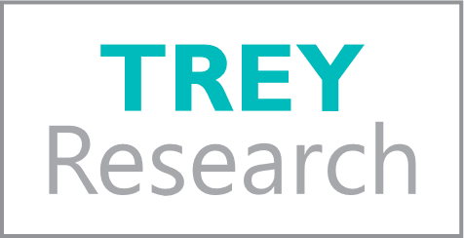
THANK YOU!
August Bergqvist
Phone:
678-555-0134
Email:
bergqvist@treyresearch.com
Website:
http://www.treyresearch.net/
Notes:
OK that's all, thanks for your listening!

