Slide 1

Summary
Liu Siyao
Notes:
So hello everyone, in this part I'll summary all the previous topics and talk about something general. In the previous topics, we explored the applications of AI in personal, institutional and nationwide scope.

Slide 2
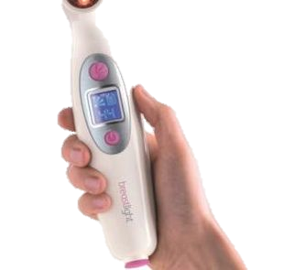
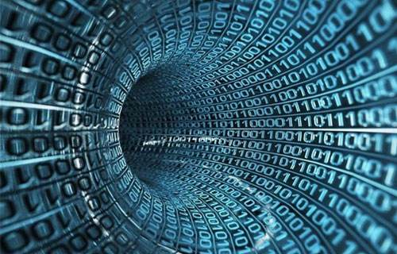
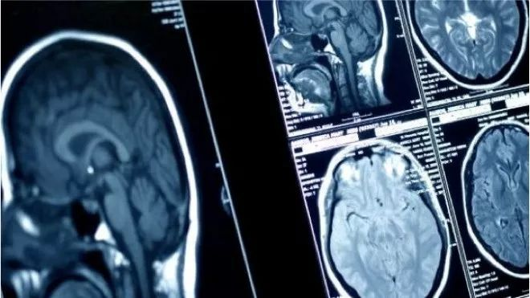
Personal Scope
3
2
The market
1
Limited Data
Computer Vision
Notes:
In the personal scpope, AI can help us detect cancer in early stage, as well as many applications in pathology. - Computer Vision is an important area in diagnostic applications
- One important thing that limits the further improvements in _medical image recognition_ is the lack of data.
- medical device that provides accurate and reliable medical diagnostics is a huge profitable market.

Slide 3
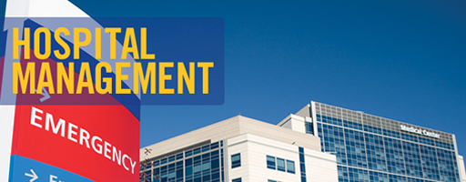
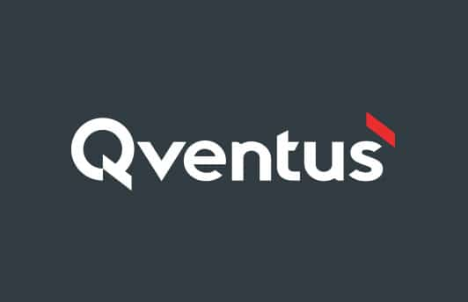
Institutional Scope
Notes:
In the institutional scope, we see that there are some problems in traditional hospital management. An example that AI helps in the management is the Qventus. We illustrated how Qventus works and some other achievements AI has made in hospital management.

Slide 4
Nationwide Scope
Automation of trivial tasks
Government's commitment
Notes:
In the nationwide scope, although AI has carried so much hope, it cannot replace the human in the entire diagnostic process in the short term. but it can help with the automation of trivial tasks, which will allow specialists to focus on more complex cases. Also, it is reassuring to see the government's commitment to this crucial area, that's a huge supplement in medical resources, which contributes to public health dramatically.

Slide 5

About AI Itself
Why are we building it
The trend
Notes:
Thats all we've presented before, beyond that, I want to talk something more general.

Slide 6
Why are we building AI?
Liberate human from
dangerous
boring
special
jobs.
Notes:
First is, what's the ultimate goal of us in building artificial intelligence? In my opinion, we are trying to liberate human. There are all kinds of jobs, include dangerous jobs like stunt actor, builder and soldier; include boring and error prone jobs like driver; including special jobs like teachers. The ultimate goal of AI is to liberate human from these kinds of jobs. Of course the world is not a Utopia and most of the investigations are driven by the market, but we're kind of doing the same things.

Slide 7

Trends of AI (DNN)
Notes:
Then, what about the development state of AI? This is a model called deep neural network, rooted in linear algebra, is has many similarities with human neural network -- each node can be regarded as a neuron and the line represents a connection. That's why we are doing the following comparisons.

Slide 8
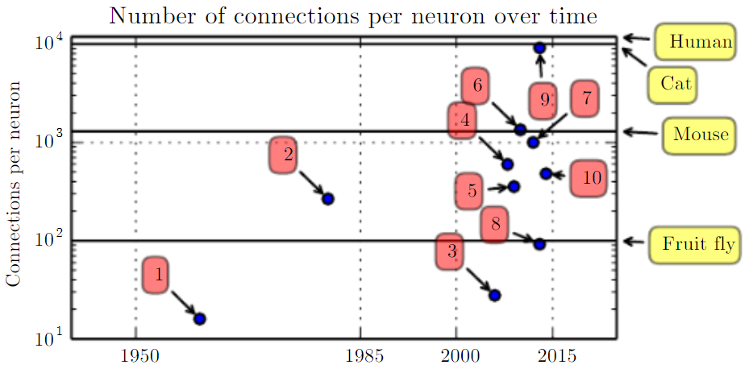
Trends of AI (DNN)
Notes:
First, we can see that in recent years the number of connections per neuron is near to human.

Slide 9
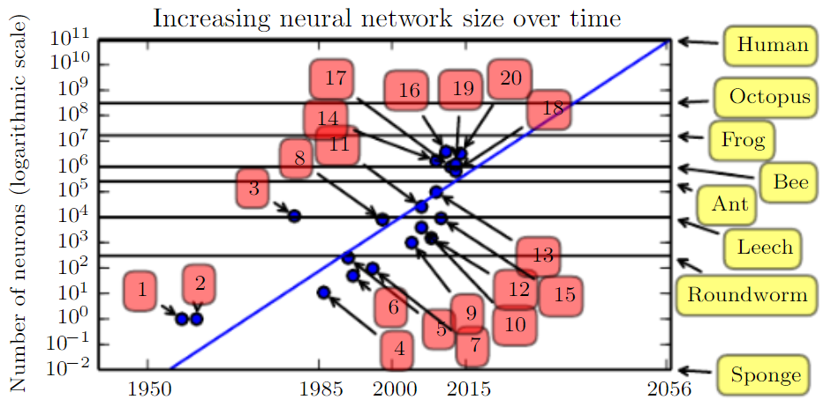
Trends of AI (DNN)
Notes:
However, the total size of the network still have a long way to go. Currently, the largest network has roughly the same size as a bee, while they are doing fairly well on some specific tasks. Maybe if we want to achieve higher intelligence, we'll need some breakthrough in computational resource.

Slide 10
The Future
Notes:
For the future if AI in healthcare industry, maybe after tens or hundreds of years, AI could replace doctors and nurses. In the near future, AI can assist us in many areas. Once that is true, we don't have to wait long and pay much for healthcaring. One thing we need to worry about is the accountability, which means when an AI made some mistake, who will be in charge? Maybe we need further discussion and some regulations there.

Slide 11
THANK YOU!
Notes:
OK that's all, let's expect the bright future AI bring to us and thanks for your listening!

