Slide 1
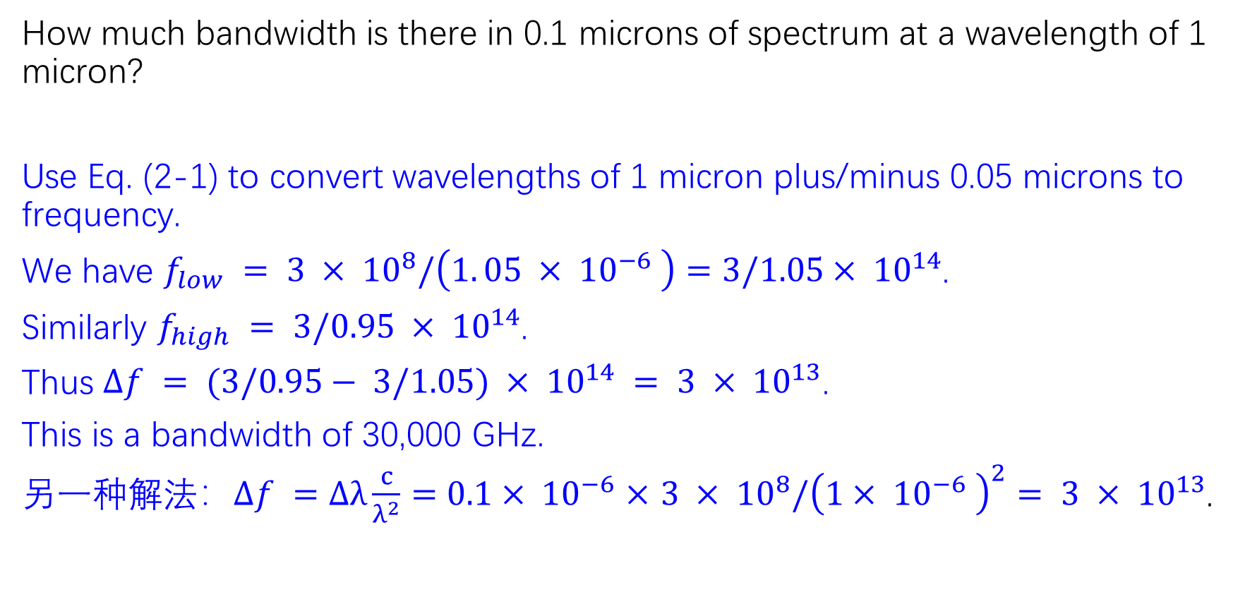
2-1
How much bandwidth is there in 0.1 microns of spectrum at a wavelength of 1 micron?
Use Eq. (2-1) to convert wavelengths of 1 micron plus/minus 0.05 microns to frequency.
We have $f_{low} = 3 × {10}^{8}/\left(1. 05 × {10}^{−6} \right)=3/1.05× {10}^{14}$.
Similarly $f_{high} = 3/0.95 × {10}^{14}$.
Thus $Δf = (3/0.95− 3/1.05) × {10}^{14} = 3 × {10}^{13}$.
This is a bandwidth of 30,000 GHz.
另一种解法：$Δf =$ $Δλ\frac{c}{λ^{2}}$ $=$ $0.1× {10}^{−6}$ $×$ $3 × {10}^{8}/{\left(1× {10}^{−6} \right)}^{2}$ $= 3 × {10}^{13}$.

Slide 2
2-2
If a binary signal is sent over a 3-kHz channel whose signal-to-noise ratio is 20 dB, what is the maximum achievable data rate?
A signal-to-noise ratio of 20 dB means S/N = 100.
Since log₂101 is about 6.658, the Shannon limit is about 19.975 kbps.
The Nyquist limit is 6 kbps for a binary signal (with 1 bit per symbol).
The bottleneck is therefore the Nyquist limit, giving a maximum channel capacity of 6 kbps.

Slide 3
2-3
Ten signals, each requiring 4000 Hz, are multiplexed onto a single channel using FDM. What is the minimum bandwidth required for the multiplexed channel? Assume that the guard bands are 400 Hz wide.
There are 10 4000 Hz signals. We need nine guard bands to avoid any interference.
The minimum bandwidth required is 4000 × 10 + 400 × 9 = 43, 600 Hz.

Slide 4
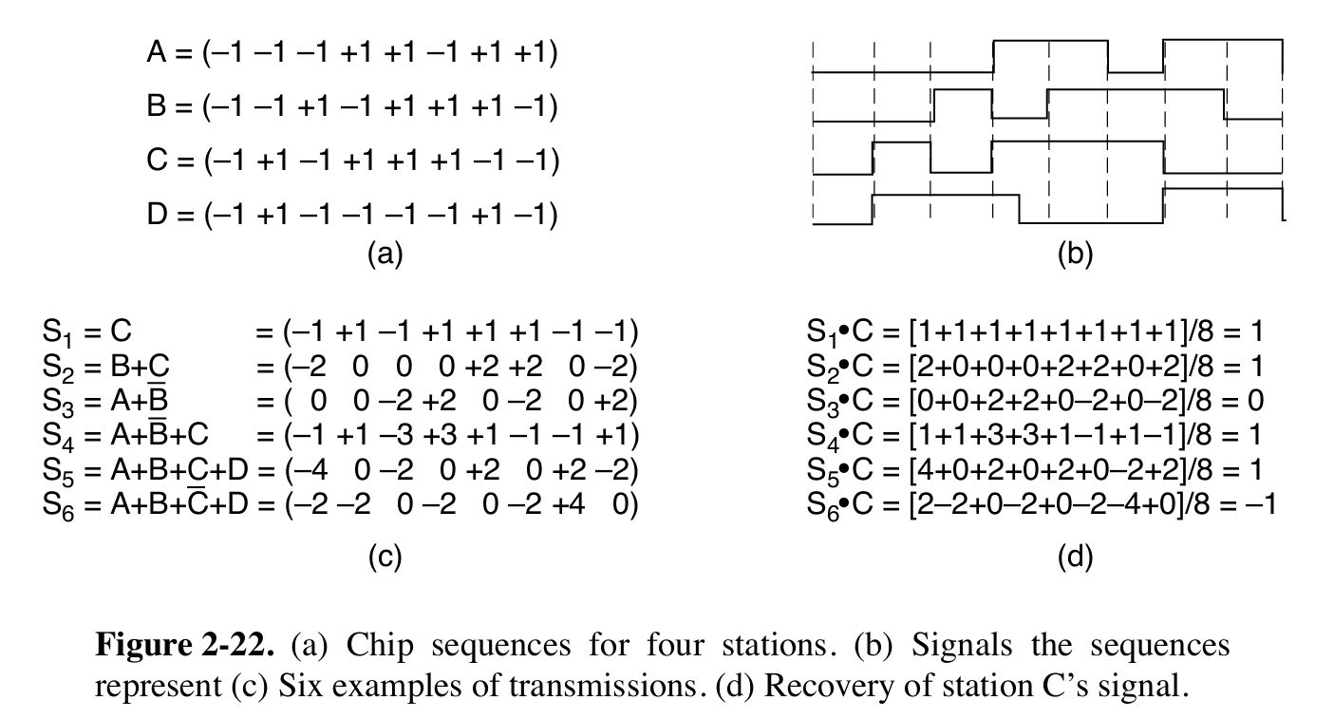
2-4
Suppose that A, B, and C are simultaneously transmitting 0 bits, using a CDMA system with the chip sequences of Fig. 2-22(a). What is the resulting chip sequence?
The result is obtained by negating each of A, B, and C and then adding the three chip sequences. Alternatively, the three can be added and then negated.
The result is (+3 +1 +1 -1 -3 -1 -1 +1).

Slide 5
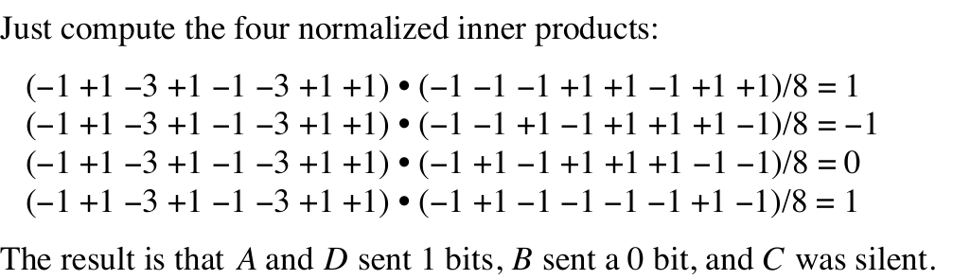
2-5
A CDMA receiver gets the following chips: (-1 +1 -3 +1 -1 -3 +1 +1). Assuming the chip sequences defined in Fig. 2-22(a), which stations transmitted, and which bits did each one send?

Slide 6
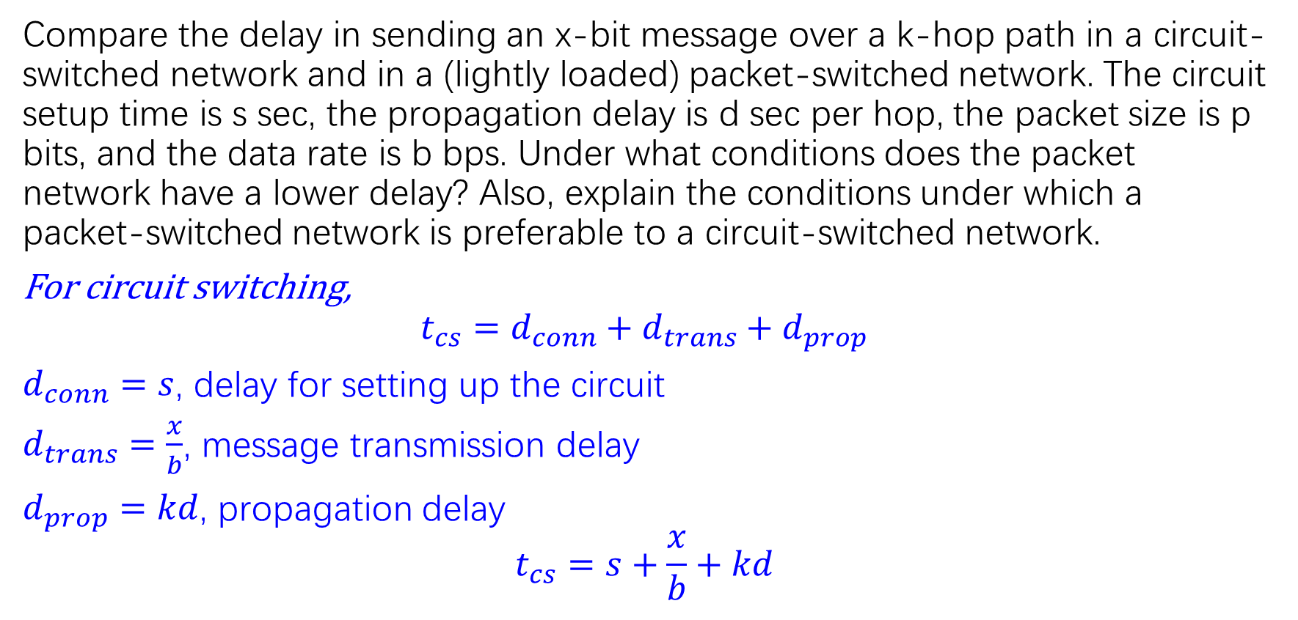
2-6
Compare the delay in sending an x-bit message over a k-hop path in a circuit-switched network and in a (lightly loaded) packet-switched network. The circuit setup time is s sec, the propagation delay is d sec per hop, the packet size is p bits, and the data rate is b bps. Under what conditions does the packet network have a lower delay? Also, explain the conditions under which a packet-switched network is preferable to a circuit-switched network.
For circuit switching,
$$t_{cs}=d_{conn}+d_{trans}+d_{prop}$$
$d_{conn}=s$, delay for setting up the circuit
$d_{trans}=\frac{x}{b}$, message transmission delay
$d_{prop}=kd$, propagation delay
$$t_{cs}=s+\frac{x}{b}+kd$$

Slide 7
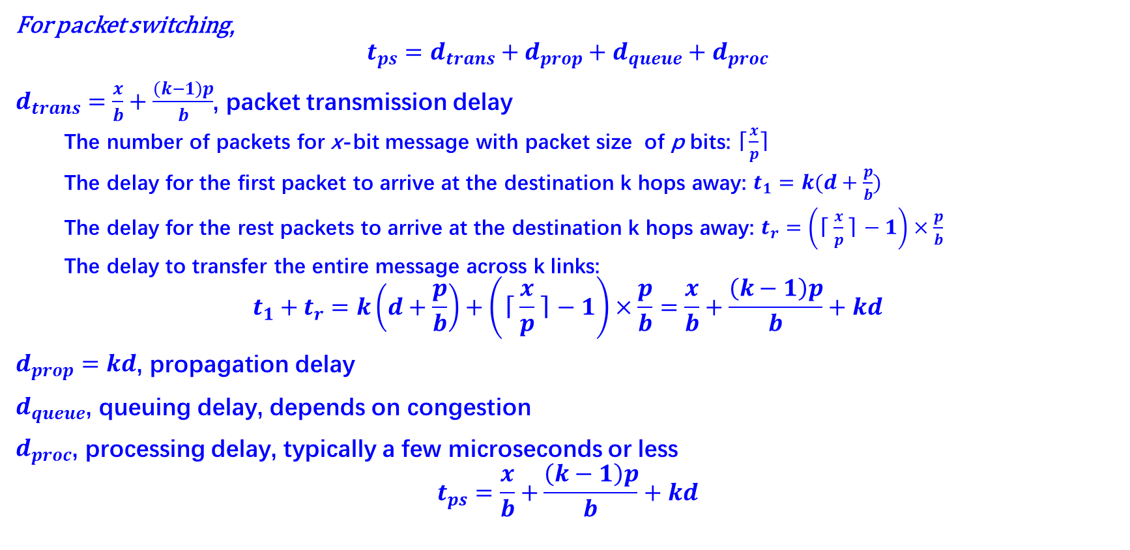
For packet switching,
$$t_{ps}=d_{trans}+d_{prop}+d_{queue}+d_{proc}$$
$d_{trans}=\frac{x}{b}+\frac{\left(k−1\right)p}{b}$, packet transmission delay
  The number of packets for x-bit message with packet size of p bits: ⌈$\frac{x}{p}$⌉
  The delay for the first packet to arrive at the destination k hops away: $t_{1}=k(d+\frac{p}{b})$
  The delay for the rest packets to arrive at the destination k hops away: $t_{r}=\left(\text{⌈}\frac{x}{p}\text{⌉}−1\right)×\frac{p}{b}$
  The delay to transfer the entire message across k links:
$$t_{1}+t_{r}=k\left(d+\frac{p}{b}\right)+\left(\text{⌈}\frac{x}{p}\text{⌉}−1\right)×\frac{p}{b}=\frac{x}{b}+\frac{\left(k−1\right)p}{b}+kd$$
$d_{prop}=kd$, propagation delay
$d_{queue}$, queuing delay, depends on congestion
$d_{proc}$, processing delay, typically a few microseconds or less
$$t_{ps}=\frac{x}{b}+\frac{\left(k−1\right)p}{b}+kd$$
Store and forward!
Notice: Here the overhead of packet header, $d_{queue}$ and $d_{proc}$are not considered.

Slide 8
Sender
R1
R2
Rn
Receiver
F1
d
F2
F3
p/b
(k-1)(d+p/b)
…
F1
d
F2
Fn
F3
p/b
…
F1
d
Fn
F2
…
F3
…
x/b
Fn

Slide 9
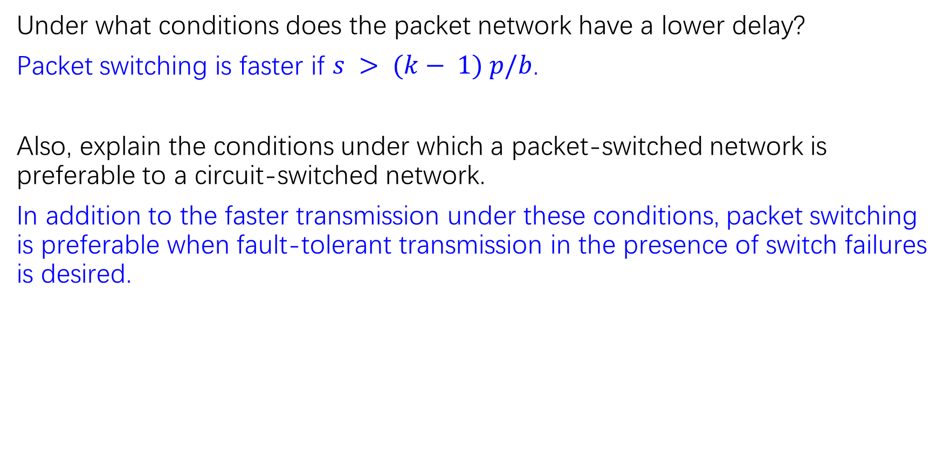
Under what conditions does the packet network have a lower delay?
Packet switching is faster if $s > (k− 1) p/b$.
Also, explain the conditions under which a packet-switched network is preferable to a circuit-switched network.
In addition to the faster transmission under these conditions, packet switching is preferable when fault-tolerant transmission in the presence of switch failures is desired.

Slide 10
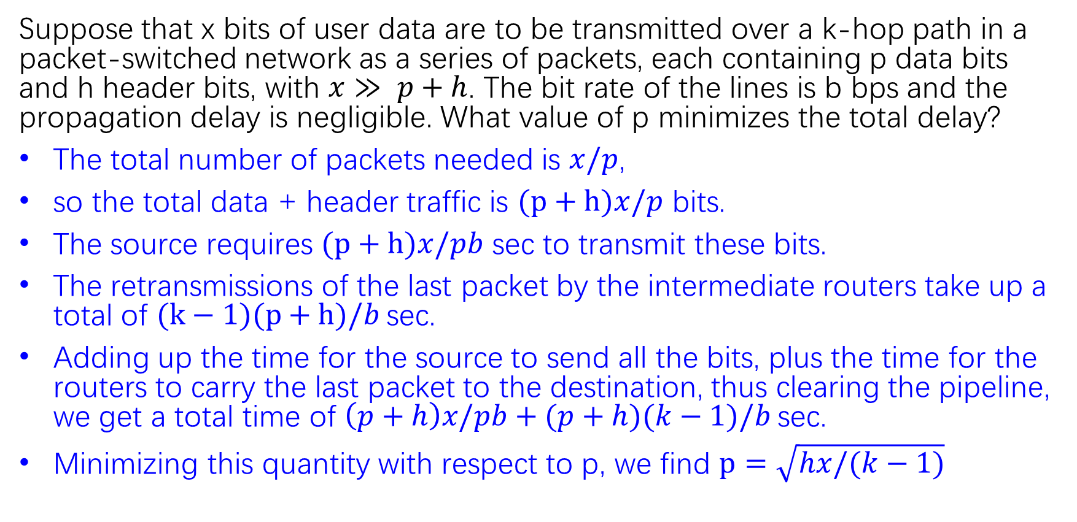
2-7
Suppose that x bits of user data are to be transmitted over a k-hop path in a packet-switched network as a series of packets, each containing p data bits and h header bits, with $x≫ p+h$. The bit rate of the lines is b bps and the propagation delay is negligible. What value of p minimizes the total delay?
The total number of packets needed is $x/p$,
so the total data + header traffic is $(p+h)x/p$ bits.
The source requires $(p+h)x/pb$ sec to transmit these bits.
The retransmissions of the last packet by the intermediate routers take up a total of $(k−1)(p+h)/b$sec.
Adding up the time for the source to send all the bits, plus the time for the routers to carry the last packet to the destination, thus clearing the pipeline, we get a total time of $\left(p+h\right)x/pb+(p+h)(k−1)/b$sec.
Minimizing this quantity with respect to p, we find $p=\sqrt{hx/(k−1)}$

Slide 11
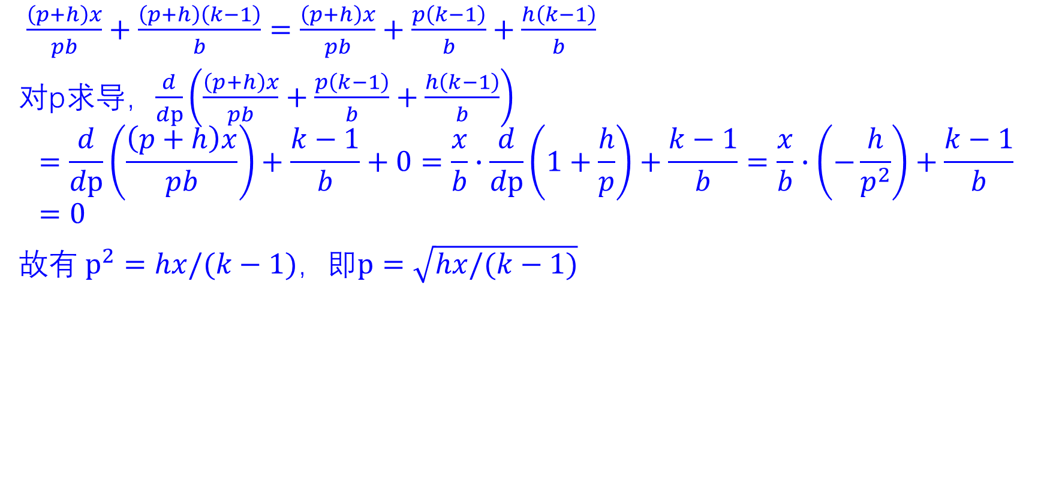
$\frac{\left(p+h\right)x}{pb}+\frac{\left(p+h\right)\left(k−1\right)}{b}=\frac{\left(p+h\right)x}{pb}+\frac{p\left(k−1\right)}{b}+\frac{h\left(k−1\right)}{b}$
对p求导，$\frac{d}{dp}\left(\frac{\left(p+h\right)x}{pb}+\frac{p\left(k−1\right)}{b}+\frac{h\left(k−1\right)}{b}\right)$
$$=\frac{d}{dp}\left(\frac{\left(p+h\right)x}{pb}\right)+\frac{k−1}{b}+0=\frac{x}{b}∙\frac{d}{dp}\left(1+\frac{h}{p}\right)+\frac{k−1}{b}=\frac{x}{b}∙\left(−\frac{h}{p^{2}}\right)+\frac{k−1}{b}=0$$
故有$p^{2}=hx/(k−1)$，即$p=\sqrt{hx/(k−1)}$

Slide 12
2-8
A cable company decides to provide Internet access over cable in a neighborhood consisting of 5000 houses. The company uses a coaxial cable and spectrum allocation al lowing 100 Mbps downstream bandwidth per cable. To attract customers, the company decides to guarantee at least 2 Mbps downstream bandwidth to each house at any time. Describe what the cable company needs to do to provide this guarantee.
A 2-Mbps downstream bandwidth guarantee to each house implies at most 50 houses per coaxial cable.
Thus, the cable company will need to split up the existing cable into 100 coaxial cables and connect each of them directly to a fiber node.

Slide 13
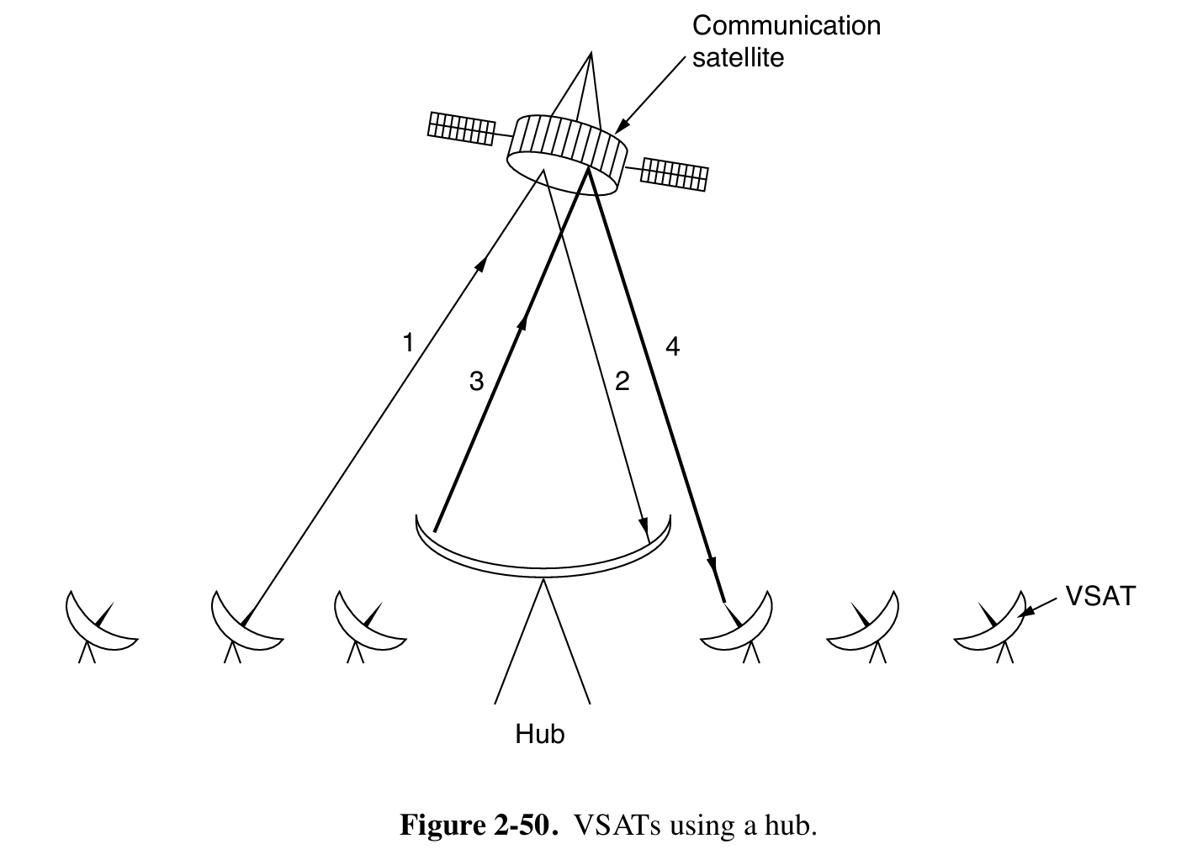
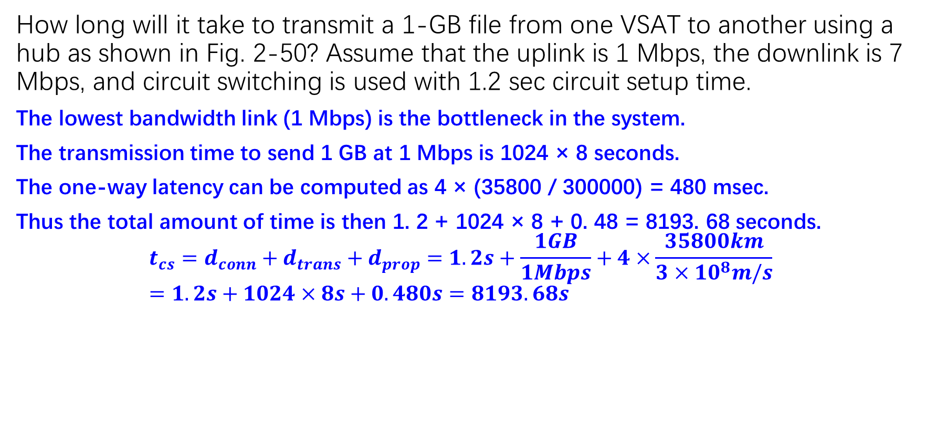
2-9
How long will it take to transmit a 1-GB file from one VSAT to another using a hub as shown in Fig. 2-50? Assume that the uplink is 1 Mbps, the downlink is 7 Mbps, and circuit switching is used with 1.2 sec circuit setup time.
The lowest bandwidth link (1 Mbps) is the bottleneck in the system.
The transmission time to send 1 GB at 1 Mbps is 1024 × 8 seconds.
The one-way latency can be computed as 4 × (35800 / 300000) = 480 msec.
Thus the total amount of time is then 1. 2 + 1024 × 8 + 0. 48 = 8193. 68 seconds.
$$t_{cs}=d_{conn}+d_{trans}+d_{prop}=1.2s+\frac{1GB}{1Mbps}+4×\frac{35800km}{3×{10}^{8}m/s}=1.2s+1024×8s+0.480s=8193.68s$$

Slide 14
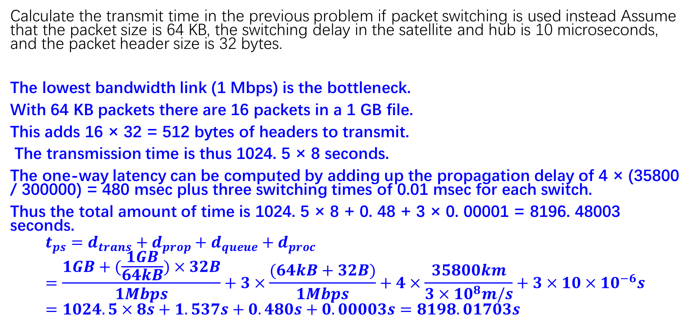
2-10
Calculate the transmit time in the previous problem if packet switching is used instead Assume that the packet size is 64 KB, the switching delay in the satellite and hub is 10 microseconds, and the packet header size is 32 bytes.
The lowest bandwidth link (1 Mbps) is the bottleneck.
With 64 KB packets there are 16 packets in a 1 GB file.
This adds 16 × 32 = 512 bytes of headers to transmit.
The transmission time is thus 1024. 5 × 8 seconds.
The one-way latency can be computed by adding up the propagation delay of 4 × (35800 / 300000) = 480 msec plus three switching times of 0.01 msec for each switch.
Thus the total amount of time is 1024. 5 × 8 + 0. 48 + 3 × 0. 00001 = 8196. 48003 seconds.
$$t_{ps}=d_{trans}+d_{prop}+d_{queue}+d_{proc}=\frac{1GB+(\frac{1GB}{64kB})×32B}{1Mbps}+3×\frac{(64kB+32B)}{1Mbps}+4×\frac{35800km}{3×{10}^{8}m/s}+3×10×{10}^{−6}s=1024.5×8s+1.537s+0.480s+0.00003s=8198.01703s$$

