Slide 1
1-1
The performance of a client-server system is strongly influenced by two major network characteristics: the bandwidth of the network (that is, how many bits/sec it can transport) and the latency (that is, how many seconds it takes for the first bit to get from the client to the server). Give an example of a network that exhibits high bandwidth but also high latency. Then give an example of one that has both low bandwidth and low latency.
A transcontinental fiber link might have many gigabits/sec of bandwidth, but the latency will also be high due to the speed of light propagation over thousands of kilometers. Similarly, a satellite link may run at megabits/sec but have a high latency to send a signal into orbit and back.
In contrast, a 56-kbps modem calling a computer in the same building has low bandwidth and low latency. So do low-end local and personal area wireless technologies such as Zigbee.

Slide 2
1-2
Besides bandwidth and latency, what other parameter is needed to give a good characterization of the quality of service offered by a network used for (i) digitized voice traffic? (ii) video traffic? (iii) financial transaction traffic?
A uniform delivery time is needed for voice as well as video, so the amount of jitter in the network is important. This could be expressed as the standard deviation（标准差） of the delivery time. Having short delay but large variability is actually worse than a somewhat longer delay and low variability.
For financial transaction traffic, reliability and security are very important.

Slide 3
1-3
A client-server system uses a satellite network, with the satellite at a height of 40,000 km. What is the best-case delay in response to a request?
The request has to go up and down, and the response has to go up and down. The total path length traversed is thus 160,000 km. The speed of light in air and vacuum is 300,000 km/sec, so the propagation delay alone is 160,000/300,000 sec or about 533 msec.

Slide 4
1-4
Five routers are to be connected in a point-to-point subnet. Between each pair of routers, the designers may put a high-speed line, a medium-speed line, a low-speed line, or no line. If it takes 50 ms of computer time to generate and inspect each topology, how long will it take to inspect all of them?
Call the routers A, B, C, D, and E.
There are ten potential lines: AB, AC, AD, AE, BC, BD, BE, CD, CE, and DE.
Each of these has four possibilities (three speeds or no line), so the total number of topologies is 4¹⁰ = 1, 048, 576.
At 100 ms each, it takes 104,857.6 sec, or slightly more than 29 hours to inspect them all.

Slide 5
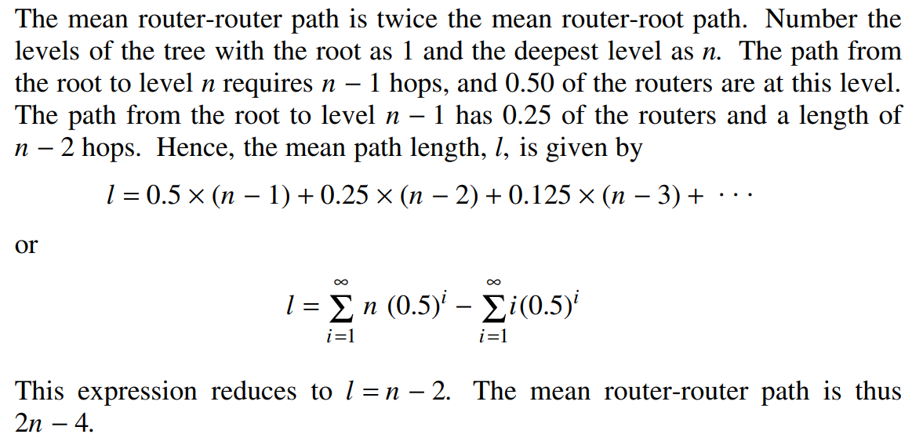
1-5
A group of 2^{𝑛}−1 routers are interconnected in a centralized binary tree, with a router at each tree node. Router i communicates with router j by sending a message to the root of the tree. The root then sends the message back down to j. Derive an approximate expression for the mean number of hops per message for large n, assuming that all router pairs are equally likely.
L1 r1
/ \
L2 r2 r3
/ \ / \
L3 r4 r5 r6 r7
…
Ln …

Slide 6
1-6
What is the principal difference between connectionless communication and connection-oriented communication? Give one example of a protocol that uses (i) connectionless communication; (ii) connection-oriented communication.
Connection-oriented communication has three phases. In the establishment phase a request is made to set up a connection. Only after this phase has been successfully completed can the data transfer phase be started and data trans ported. Then comes the release phase.
Connectionless communication does not have these phases. It just sends the data.

Slide 7
1-7
Two networks each provide reliable connection-oriented service. One of them offers a reliable byte stream and the other offers a reliable message stream. Are these identical? If so, why is the distinction made? If not, give an example of how they differ.
Message and byte streams are different.
In a message stream, the network keeps track of message boundaries.
In a byte stream, it does not.
For example, suppose a process writes 1024 bytes to a connection and then a little later writes another 1024 bytes. The receiver then does a read for 2048 bytes.
With a message stream, the receiver will get two messages, of 1024 bytes each.
With a byte stream, the message boundaries do not count and the receiver will get the full 2048 bytes as a single unit. The fact that there were originally two distinct messages is lost.

Slide 8
1-8
A system has an n-layer protocol hierarchy. Applications generate messages of length M bytes. At each of the layers, an h-byte header is added. What fraction of the network bandwidth is filled with headers?
With n layers and h bytes added per layer, the total number of header bytes per message is ℎ𝑛, so the space wasted on headers is ℎ𝑛. The total message size is 𝑀 +𝑛ℎ, so the fraction of bandwidth wasted on headers is ℎ𝑛/(𝑀 + ℎ𝑛).
This estimate does not take into account fragmentation (one higher layer message is sent as multiple lower layer messages) or aggregation (multiple higher layer messages are carried as one lower layer message) that may be present. If frag mentation is used, it will raise the overhead. If aggregation is used, it will lower the overhead.

Slide 9
1-9
When a file is transferred between two computers, two acknowledgement strategies are possible. In the first one, the file is chopped up into packets, which are individually acknowledged by the receiver, but the file transfer as a whole is not acknowledged. In the second one, the packets are not acknowledged individually, but the entire file is acknowledged when it arrives. Discuss these two approaches.
If the network tends to lose packets, it is better to acknowledge each one separately, so the lost packets can be retransmitted.
If the network is highly reliable, sending one acknowledgement at the end of the entire transfer saves bandwidth in the normal case (but requires the entire file to be retransmitted if even a single packet is lost).

Slide 10
1-10
The ping program allows you to send a test packet to a given location and see how long it takes to get there and back. Try using ping to see how long it takes to get from your location to several known locations. From these data, plot the one-way transit time over the Internet as a function of distance. It is best to use universities since the location of their servers is known very accurately. For example, berkeley.edu is in Berkeley, California; mit.edu is in Cambridge, Massachusetts; vu.nl is in Amsterdam; The Netherlands; www.usyd.edu.au is in Sydney, Australia; and www.uct.ac.za is in Cape Town, South Africa.

