Slide 1
Stirring

Slide 2
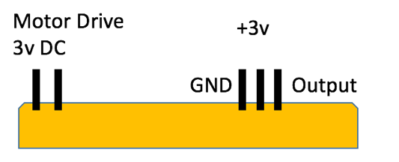
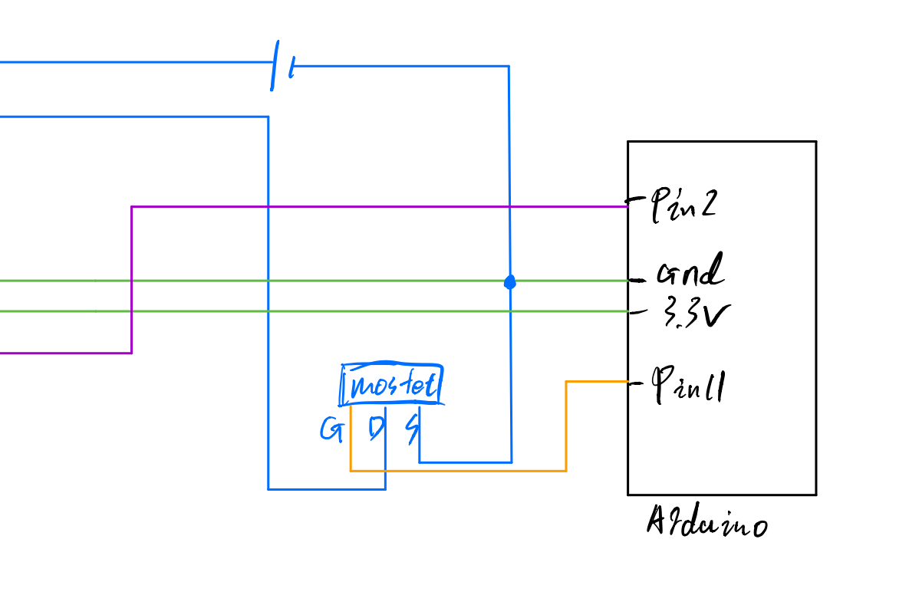

Slide 3
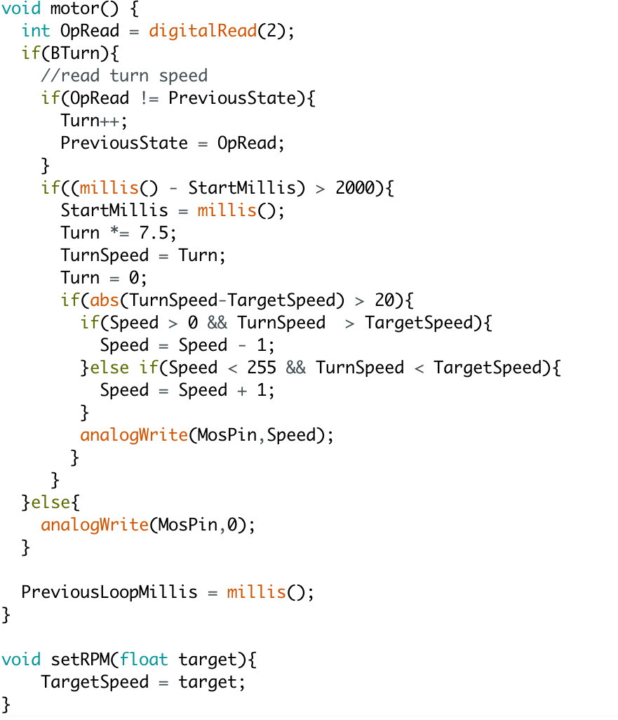

Slide 4
To collect current rotating speed data

Slide 5
To collect current rotating speed data
To moderate rotating speed

Slide 6
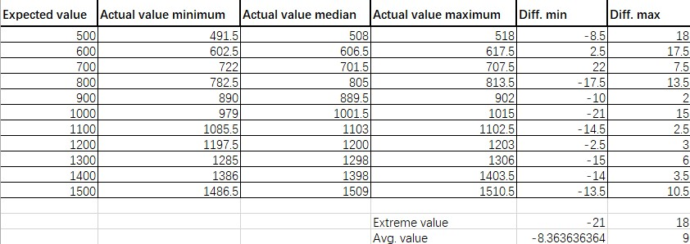
Both of them are under 20

Slide 7
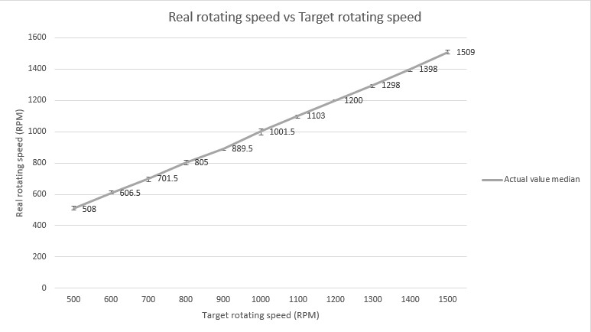

Pretty linear

Slide 8
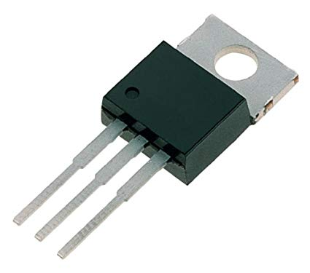
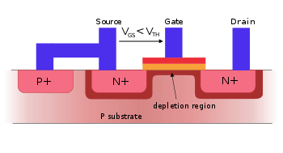
Problems & fix

