Slide 1





3S
RESET
3S

Slide 2




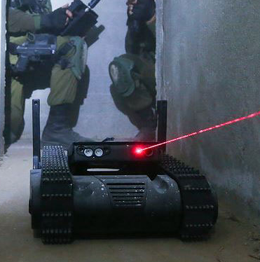
2D-S
imulation
\
2D-R
obot Simulation System

Slide 3
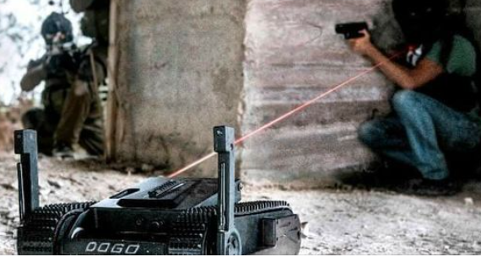




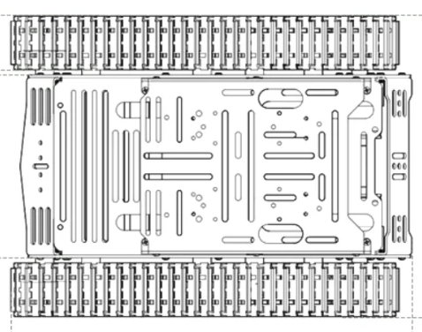



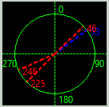

Enemy [2]
Obstacle
Obstacle Detection and Avoidance
Confirmed Enemy Position
Enemy visual detected
Robot Front Env Detection Sonar
Enemy sound detected
Robot Front Obstacle detection Lidar
UWB indoor position sensor
Robot Main Electro Optical Camera
Predict Enemy Position
Robot Left Env Detection Sonar
Robot Right Env Detection Sonar
Enemy [1]
Enemy detection data processer
CQB Robot
Robot Back Env Detection Sonar
Enemy sound detected
360’ LF Sound Direction detector

