Slide 1



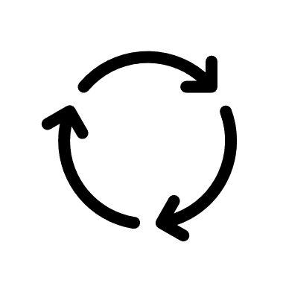
3S
RESET
3S

