Slide 1



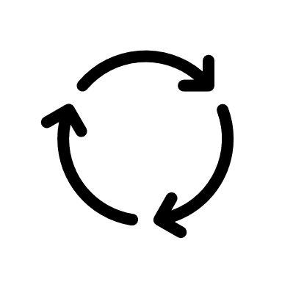
3S
RESET
3S

Slide 2




2D-S
imulation

