Slide 1



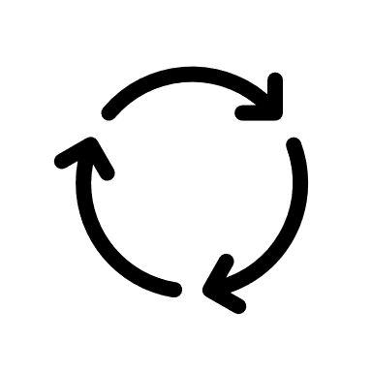

3S
RESET
3S

Slide 2




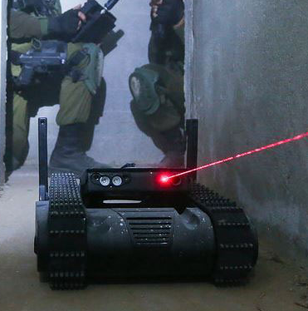
2D-S
imulation
\
2D-R
obot Simulation System

