Slide 1





3S
RESET
3S

Slide 2




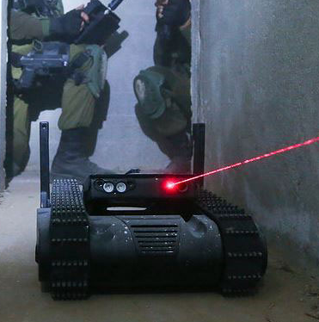
2D-S
imulation
\
2D-R
obot Simulation System

Slide 3
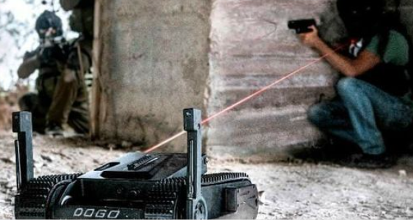




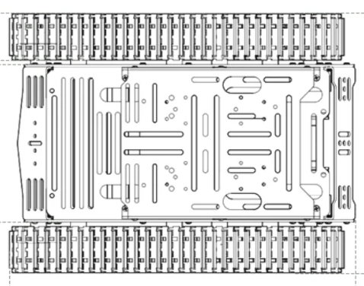



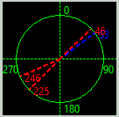

Enemy [2]
Obstacle
Obstacle Detection and Avoidance
Confirmed Enemy Position
Enemy visual detected
Robot Front Env Detection Sonar
Enemy sound detected
Robot Front Obstacle detection Lidar
UWB indoor position sensor
Robot Main Electro Optical Camera
Predict Enemy Position
Robot Left Env Detection Sonar
Robot Right Env Detection Sonar
Enemy [1]
Enemy detection data processer
CQB Robot
Robot Back Env Detection Sonar
Enemy sound detected
360’ LF Sound Direction detector

Slide 4
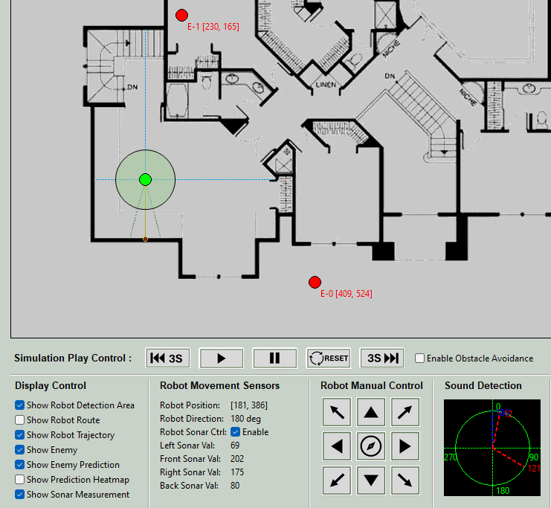
CQB Robot Sensor's Simulation
Sonar detection line
Robot Main Electro Optical Camera
Lidar detection area
Robot Front Obstacle detection Lidar
UWB indoor position sensor
Camera detection sector
Robot Left Env Detection Sonar
CQB Robot
360’ LF Sound Direction detector
UDB indoor position detection data
Sonar environment data

Slide 5
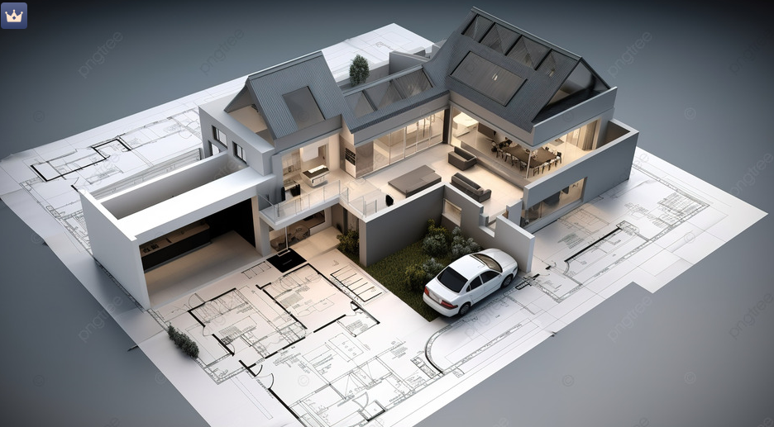
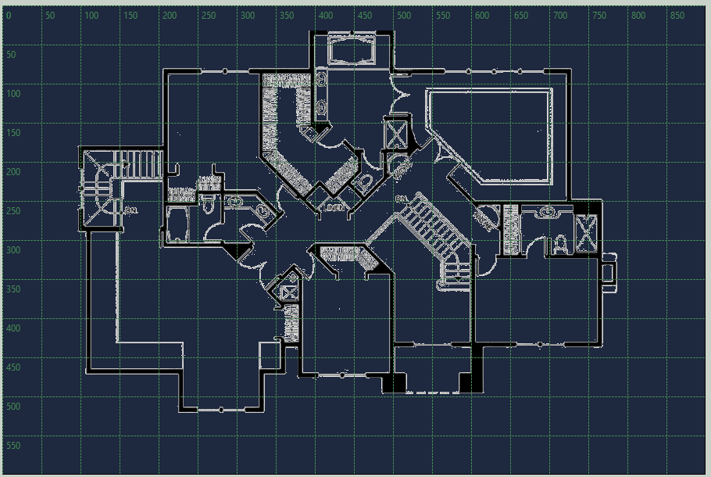
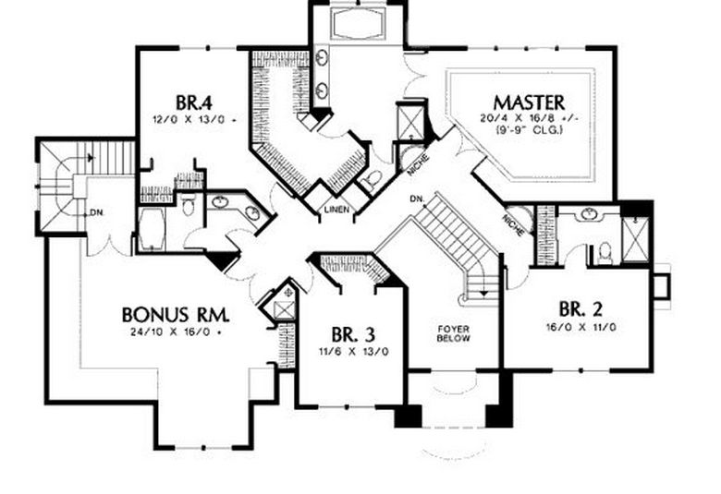
UWB location amplifier 02
UWB location amplifier 03
Building Floor Environment Coordinate System
UWB location amplifier 01
CQB Robot location UWB amplifier config
Building floor blueprint

Slide 6
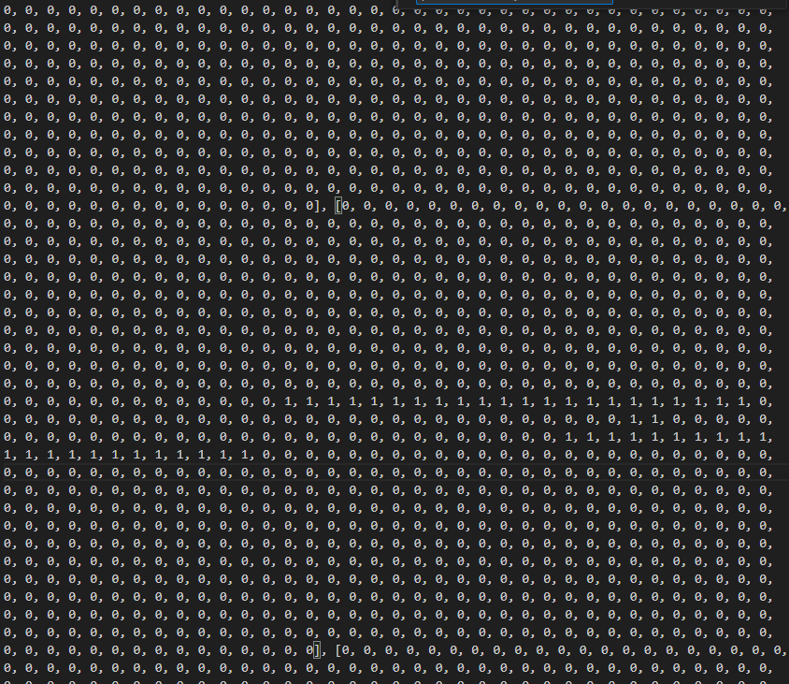
Building Floor Environment Coordinate System
Building Floor Environment Map Matrix
Robot Front Lidar
Robot Camera
Empty area in matrix
Glass door area in matrix
Build wall area in matrix
Robot Front Sonar
0
10
255
Sonar reflection distance
255
0
10
255
Camera left detect distance
0
10
Sound detection distance
255
0
10
255
Camera right detect distance
0
10
100
10
100
255
0
10
100
255
Lidar detect distance
0
10
100
255
Robot microphones array
0
10
100
255
0
10
Wood door area in matrix

Slide 7
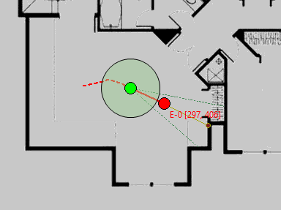
Enemy Cam and Lidar Detection
CQB Robot
Camera Visual Detection Area Sector
Camera Enemy Direction Detection
CQB Real World Simulation
Camera Detection Sector
Enemy direction data
Lidar Enemy Distance Detection
Object distance data
Robot position data
Enemy position data
Enemy detection data processer
Lidar Object Detection Beam

Slide 8
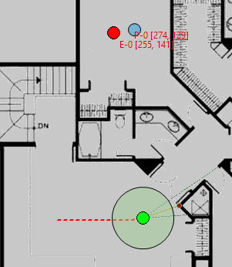
Enemy Prediction Based on Sound Sensors
CQB Real World Simulation
T0
T1
Robot T0 Position
Robot T1 Position
Robot trajectory record data
CQB Robot move direction
X
Y
Pos-0
Angle a
Pos-1
Enemy sound direction detection at T0
Angle b
Enemy sound direction detection at T1
Enemy sound direction detection at T0
Enemy sound direction detection at T1
Z
Tan(a) = Z/(X+Y)
Tan(b) = Z/Y
Predict Enemy Position
Enemy Actual Position

