Slide 1
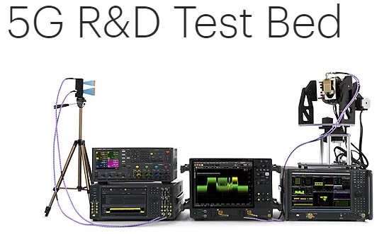
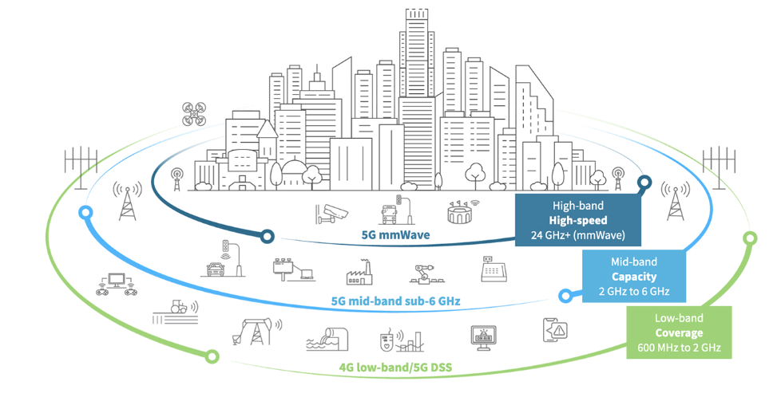
5G System/Network testbed
Hardware components
Firmware components
Core network components
Native network components
User plane Function (UPF)
Authentication Server Function (AUSF)
Network Slice Selection Function
Policy Control function (PCF)
5G env testbed

