Slide 1
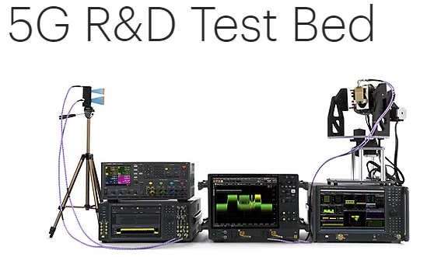
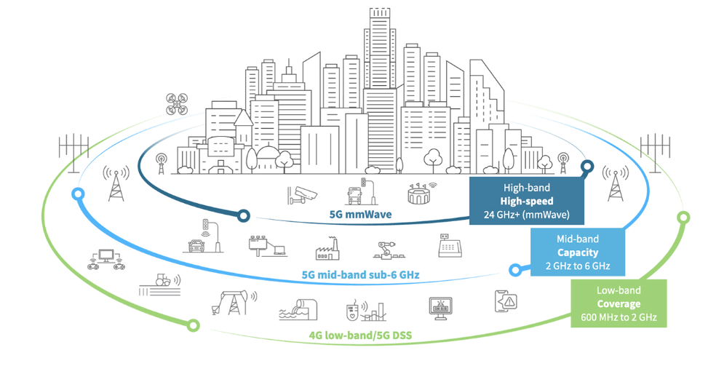
5G System/Network testbed
Hardware components
Firmware components
Core network components
Native network components
User plane Function (UPF)
Authentication Server Function (AUSF)
Network Slice Selection Function
Policy Control function (PCF)
5G env testbed

Slide 2
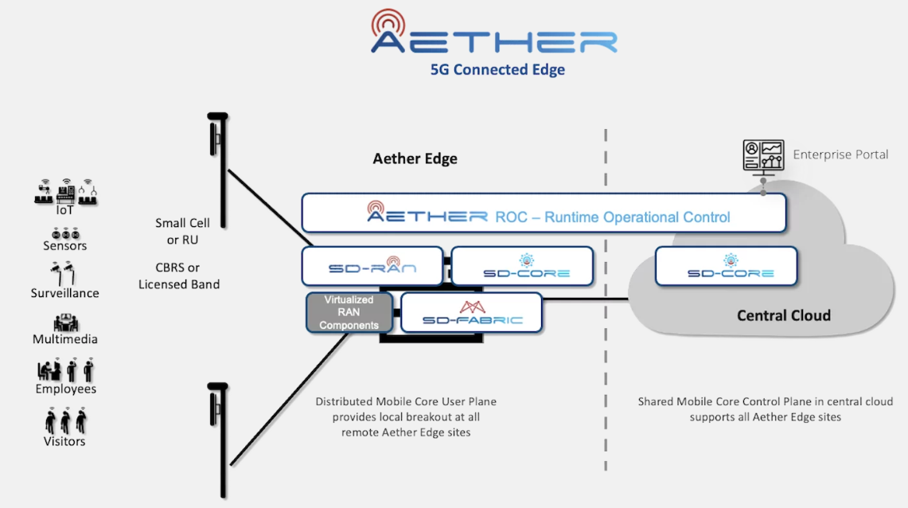
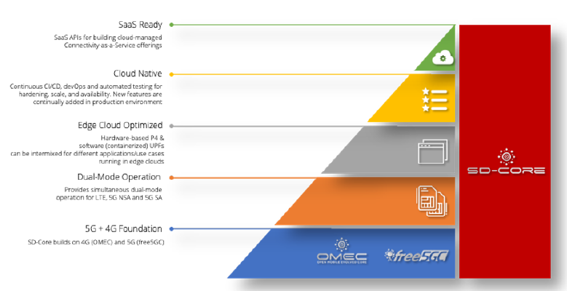
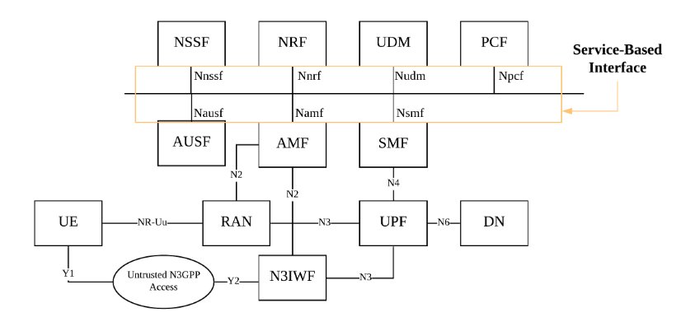


Slide 3
Strengths Low price. No need specific hardware required. Open Source and flexible for configuration. Can fast deploy an isolated 5G environment on OpenStack. | Weaknesses Simulation situation may not be same as the real 5G vendor’s solution. Hard to convince market people as currently there is no real-life use case. Hard to answer the question about why/how the 5G-function is implemented as we don’t hold the IP.
Opportunities Free for the research to add their algo in the platform. Design different attack and defence simulation (can config vulnerable point). Customized the 5G environment for cyber event/exercise. | Threats Several Opensource 5G project: my5G / my5G-RANTester K-SimNet/ 5G Network Simulator (5G) UERANSIM/ 5G UE and RAN (gNodeB) simulator

