Slide 1


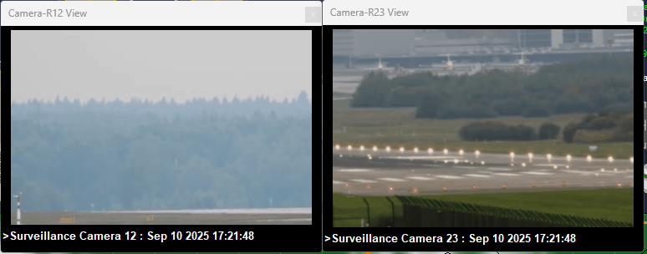
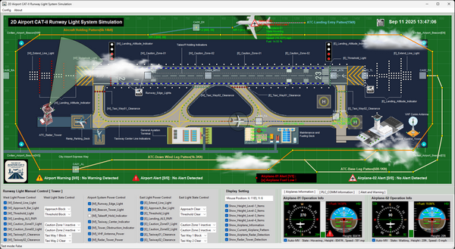
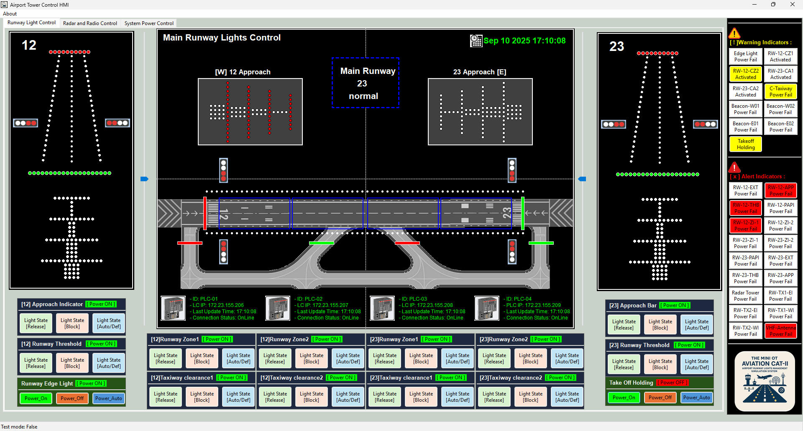


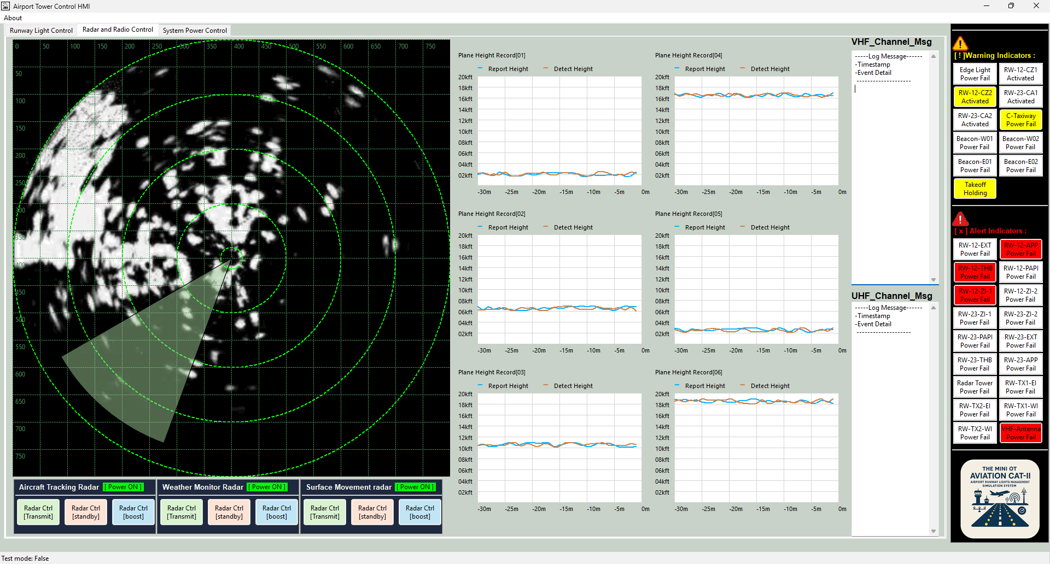








MITM Attack Scenario and Path
Level1 OT
Controller network
Level2 OT Tower Operation Room SCADA network
Level-0 Aviation Physical World Network
VM_ID: lvl1-Ci-PLC
BT_IP: 10.10.20.11
10
Green Team Subnet
GT_IP:
10.10.10.31
VM_ID: lvl2-CAM-Monitor
BT_IP: 10.10.20.21
VM_ID: aviation-lvl0-PWs
GT IP: 10.10.10.21
VM_ID: lvl1-RW12-P-PLC
BT_IP: 10.10.20.12
GT_IP:
10.10.10.32
3
11
VM_ID: lvl2-Light Ctrl-HMI
BT_IP: 10.10.20.22
VM_ID: lvl1-RW12-S-PLC
BT_IP: 10.10.20.13
GT_IP:
10.10.10.33
VM_ID: lvl1-RW23-P-PLC
BT_IP: 10.10.20.14
12
GT_IP:
10.10.10.34
Blue Team
Subnet router
IP: 10.10.20.1
8
VM_ID: aviation-lvl0-CAM1
GT IP: 10.10.10.22
Green Team
Subnet router
IP: 10.10.10.1
VM_ID: lvl2-Radar-Ctrl-HMI
BT_IP: 10.10.20.23
VM_ID: lvl1-RW23-S-PLC
BT_IP: 10.10.20.15
GT_IP:
10.10.10.35
VM_ID: aviation-lvl0-CAM1
GT IP: 10.10.10.23
VM_ID: lvl1-Radar-PLC
BT_IP: 10.10.20.16
GT_IP:
10.10.10.36
GT_IP:10.10.10.37
VM_ID: lvl1-Cam_Ctrl
BT_IP: 10.10.20.17
9
Blue team misconfigured maintenance RJ45 port
VM_ID: lvl2-Misconiftured –IOT –CAM
BT_IP: 10.10.20.23
Red team attacker
VM_ID: Ninja C2
BT_IP:172.25.121.243
Blue Team Subnet1
2
Blue Team Subnet2
Red Team Init Subnet / Internet
4
1
7
Victim Maintenance Laptop with Spy trojan
Victim Maintenance Engineer
Third party IoT camera with malicious firmware
5
6

Slide 2
Aviation Runway Cyber Twin [OT] Network
Level1 OT
Controller network
Level2 OT Tower Operation Room SCADA network
Level-0 Aviation Physical World Network
VM_ID: lvl1-Ci-PLC
BT_IP: 10.10.20.11
GT_IP:
10.10.10.31
VM_ID: lvl2-CAM-Monitor
BT_IP: 10.10.20.21
Green Team Subnet
VM_ID: aviation-lvl0-PWs
GT IP: 10.10.10.21
VM_ID: lvl1-RW12-P-PLC
BT_IP: 10.10.20.12
GT_IP:
10.10.10.32
VM_ID: lvl2-Light Ctrl-HMI
BT_IP: 10.10.20.22
VM_ID: lvl1-RW12-S-PLC
BT_IP: 10.10.20.13
GT_IP:
10.10.10.33
VM_ID: lvl1-RW23-P-PLC
BT_IP: 10.10.20.14
Blue Team
Subnet router
IP: 10.10.20.1
GT_IP:
10.10.10.34
VM_ID: aviation-lvl0-CAM1
GT IP: 10.10.10.22
Green Team
Subnet router
IP: 10.10.10.1
VM_ID: lvl2-Radar-Ctrl-HMI
BT_IP: 10.10.20.23
VM_ID: lvl1-RW23-S-PLC
BT_IP: 10.10.20.15
GT_IP:
10.10.10.35
VM_ID: aviation-lvl0-CAM1
GT IP: 10.10.10.23
VM_ID: lvl1-Radar-PLC
BT_IP: 10.10.20.16
GT_IP:
10.10.10.36
GT_IP:10.10.10.37
VM_ID: lvl1-Cam_Ctrl
BT_IP: 10.10.20.17
Blue team misconfigured maintenance RJ45 port
VM_ID: lvl2-Misconiftured –IOT –CAM
BT_IP: 10.10.20.23
Red team attacker
VM_ID: Ninja C2
BT_IP:172.25.121.243
Blue Team Subnet1
Blue Team Subnet2
Red Team Init Subnet / Internet
Victim Maintenance Laptop with Spy trojan
Victim Maintenance Engineer
Third party IoT camera with malicious firmware

Slide 3
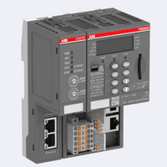




Runway Light Control PLC01
Light Control HMI
Runway Light
PLC Address [11]
Light state report data
Measurement point (M_SP_NA_1) IOA=01
Runway Light state sensor
Changeable Point (C_CR_TA_1) IOT=11
Runway Light Control PLC01
Light Control HMI
Runway Light
PLC Address [11]
Original Light state report data
Modified Light state report data
Measurement point (M_SP_NA_1) IOA=01
Runway Light state sensor
Changeable Point (C_CR_TA_1) IOT=11
Modified Light state change request
Original Light state change request
Fake ARP routing info
Fake ARP routing info
Attack media IoT camera run Ettercap

Slide 4
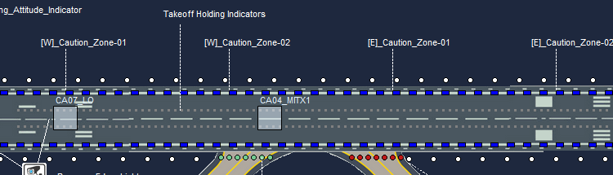
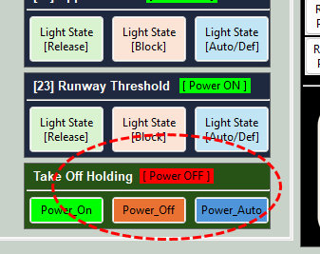
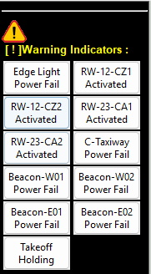
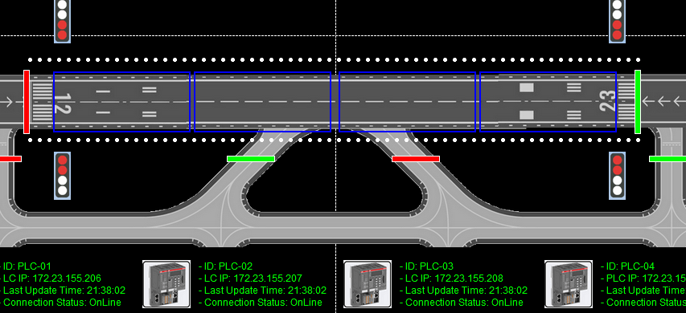
Normal state: Take off allow
Physical world Take off Holding light turn off
No Alert Indicator
HMI runway state panel no take off indicator light up
HMI light control panel shows power off state

Slide 5
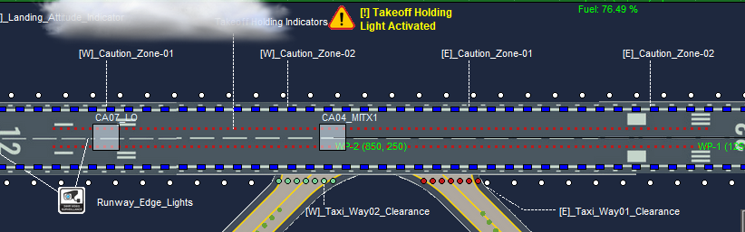
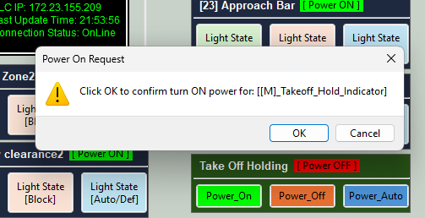
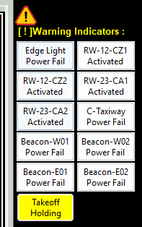
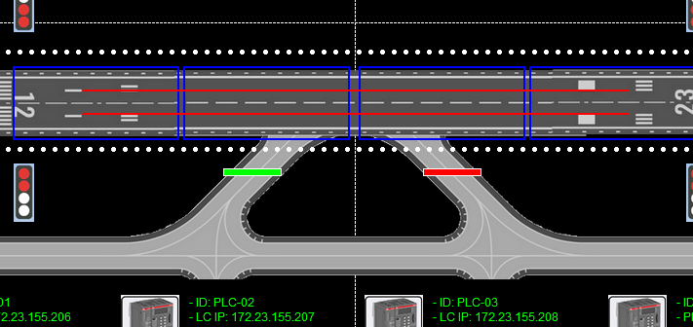
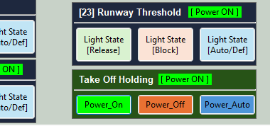
Normal state: Take off Holding
Tower Operator press the holding light on button on HMI
Physical world Take off Holding light turn on and the take off plane wait at the prepare area
Take off light power control indicator shows the current control state is power on
HMI runway state panel take off indicator light up shows PLC report sensor detect light up
Warning indicator shows there is a plane waiting take off on runway

Slide 6
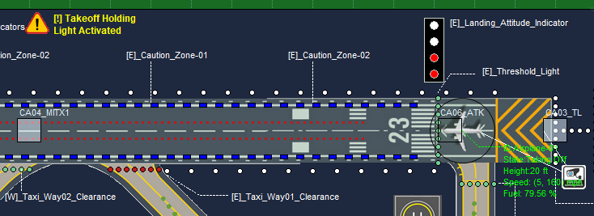
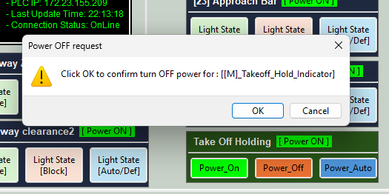
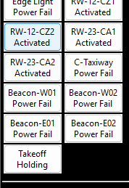
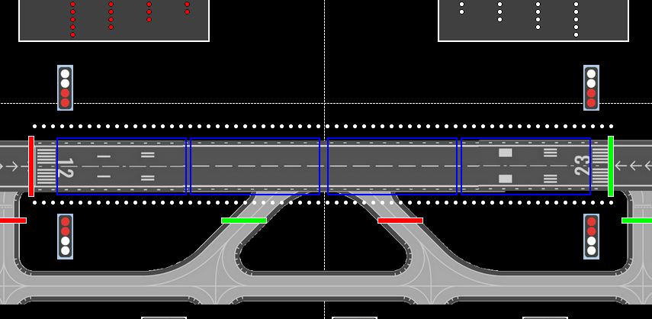
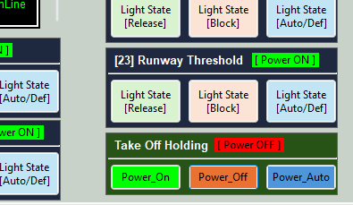
MITM Attack State: Take off delayed
Because of the HMI command data is modified by the MITM attack IoT Camera, the physical world simulation’s holding light is not turned off, plane still waring at the tale off prepare area, physical world generate the warning.
Tower Operator press the holding light off button on HMI to allow the plane1 take off
The take off warning is also not shown in the HMI warning indicator panel
MITM attack reverse the take off light sensor feed back value HMI runway state panel take off indicator light up shows PLC report sensor detect light off
MITM modify the control action confirm message, the power panel shows the power control is power off

