Slide 1


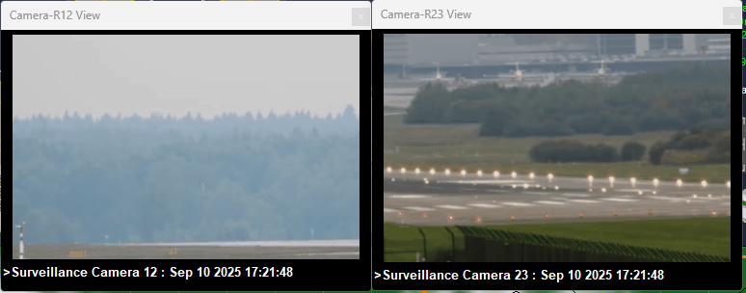
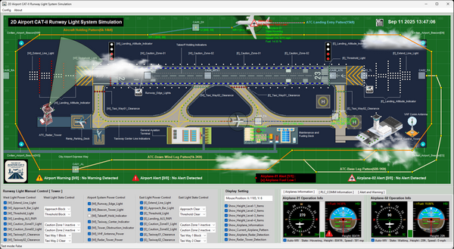
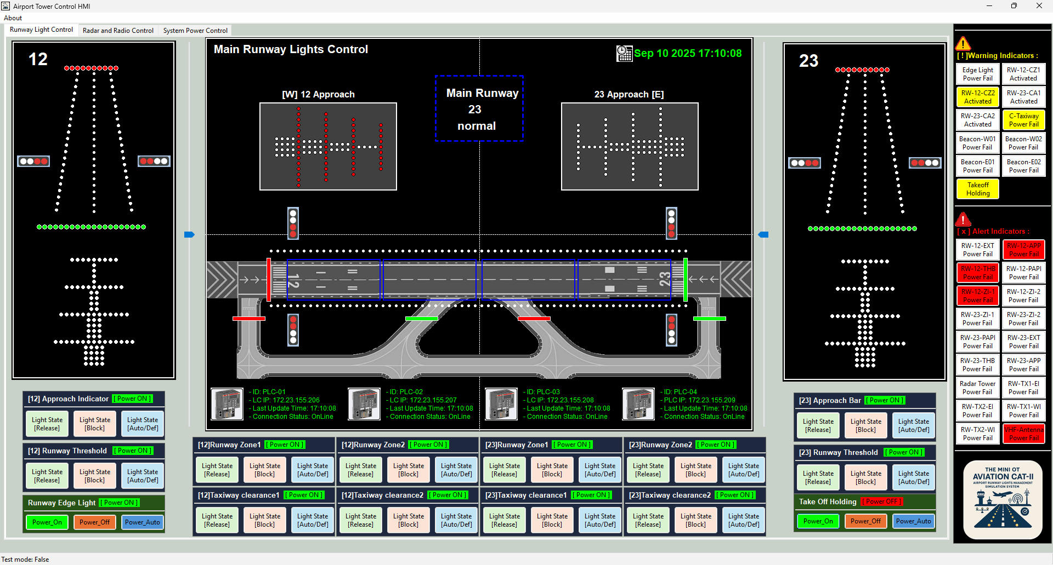


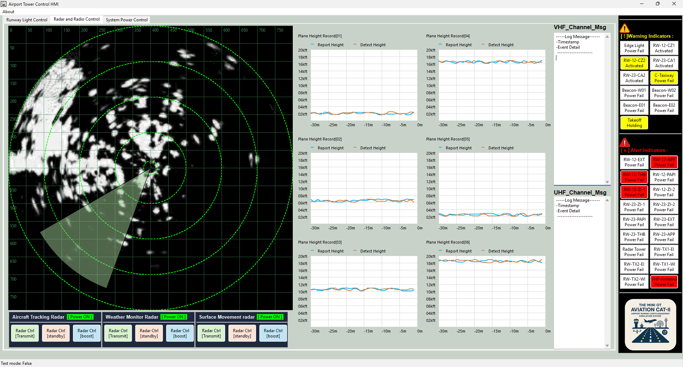








MITM Attack Scenario and Path
Level1 OT
Controller network
Level2 OT Tower Operation Room SCADA network
Level-0 Aviation Physical World Network
VM_ID: lvl1-Ci-PLC
BT_IP: 10.10.20.11
10
Green Team Subnet
GT_IP:
10.10.10.31
VM_ID: lvl2-CAM-Monitor
BT_IP: 10.10.20.21
VM_ID: aviation-lvl0-PWs
GT IP: 10.10.10.21
VM_ID: lvl1-RW12-P-PLC
BT_IP: 10.10.20.12
GT_IP:
10.10.10.32
3
11
VM_ID: lvl2-Light Ctrl-HMI
BT_IP: 10.10.20.22
VM_ID: lvl1-RW12-S-PLC
BT_IP: 10.10.20.13
GT_IP:
10.10.10.33
VM_ID: lvl1-RW23-P-PLC
BT_IP: 10.10.20.14
12
GT_IP:
10.10.10.34
Blue Team
Subnet router
IP: 10.10.20.1
8
VM_ID: aviation-lvl0-CAM1
GT IP: 10.10.10.22
Green Team
Subnet router
IP: 10.10.10.1
VM_ID: lvl2-Radar-Ctrl-HMI
BT_IP: 10.10.20.23
VM_ID: lvl1-RW23-S-PLC
BT_IP: 10.10.20.15
GT_IP:
10.10.10.35
VM_ID: aviation-lvl0-CAM1
GT IP: 10.10.10.23
VM_ID: lvl1-Radar-PLC
BT_IP: 10.10.20.16
GT_IP:
10.10.10.36
GT_IP:10.10.10.37
VM_ID: lvl1-Cam_Ctrl
BT_IP: 10.10.20.17
9
Blue team misconfigured maintenance RJ45 port
VM_ID: lvl2-Misconiftured –IOT –CAM
BT_IP: 10.10.20.23
Red team attacker
VM_ID: Ninja C2
BT_IP:172.25.121.243
Blue Team Subnet1
2
Blue Team Subnet2
Red Team Init Subnet / Internet
4
1
7
Victim Maintenance Laptop with Spy trojan
Victim Maintenance Engineer
Third party IoT camera with malicious firmware
5
6

Slide 2
Aviation Runway Cyber Twin [OT] Network
Level1 OT
Controller network
Level2 OT Tower Operation Room SCADA network
Level-0 Aviation Physical World Network
VM_ID: lvl1-Ci-PLC
BT_IP: 10.10.20.11
GT_IP:
10.10.10.31
VM_ID: lvl2-CAM-Monitor
BT_IP: 10.10.20.21
Green Team Subnet
VM_ID: aviation-lvl0-PWs
GT IP: 10.10.10.21
VM_ID: lvl1-RW12-P-PLC
BT_IP: 10.10.20.12
GT_IP:
10.10.10.32
VM_ID: lvl2-Light Ctrl-HMI
BT_IP: 10.10.20.22
VM_ID: lvl1-RW12-S-PLC
BT_IP: 10.10.20.13
GT_IP:
10.10.10.33
VM_ID: lvl1-RW23-P-PLC
BT_IP: 10.10.20.14
Blue Team
Subnet router
IP: 10.10.20.1
GT_IP:
10.10.10.34
VM_ID: aviation-lvl0-CAM1
GT IP: 10.10.10.22
Green Team
Subnet router
IP: 10.10.10.1
VM_ID: lvl2-Radar-Ctrl-HMI
BT_IP: 10.10.20.23
VM_ID: lvl1-RW23-S-PLC
BT_IP: 10.10.20.15
GT_IP:
10.10.10.35
VM_ID: aviation-lvl0-CAM1
GT IP: 10.10.10.23
VM_ID: lvl1-Radar-PLC
BT_IP: 10.10.20.16
GT_IP:
10.10.10.36
GT_IP:10.10.10.37
VM_ID: lvl1-Cam_Ctrl
BT_IP: 10.10.20.17
Blue team misconfigured maintenance RJ45 port
VM_ID: lvl2-Misconiftured –IOT –CAM
BT_IP: 10.10.20.23
Red team attacker
VM_ID: Ninja C2
BT_IP:172.25.121.243
Blue Team Subnet1
Blue Team Subnet2
Red Team Init Subnet / Internet
Victim Maintenance Laptop with Spy trojan
Victim Maintenance Engineer
Third party IoT camera with malicious firmware

Slide 3
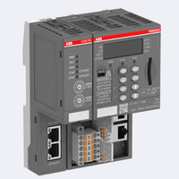




Runway Light Control PLC01
Light Control HMI
Runway Light
PLC Address [11]
Light state report data
Measurement point (M_SP_NA_1) IOA=01
Runway Light state sensor
Changeable Point (C_CR_TA_1) IOT=11
Runway Light Control PLC01
Light Control HMI
Runway Light
PLC Address [11]
Original Light state report data
Modified Light state report data
Measurement point (M_SP_NA_1) IOA=01
Runway Light state sensor
Changeable Point (C_CR_TA_1) IOT=11
Modified Light state change request
Original Light state change request
Fake ARP routing info
Fake ARP routing info
Attack media IoT camera run Ettercap

