Slide 1
180
270
90
0

Slide 2


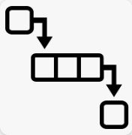

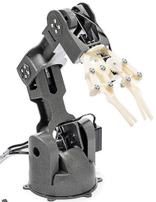
User’s computer
Arduino Nano RP2040
Braccio Controller start
Arduino start
Main thread
Communication thread
Communication manager
Start related request handler based on the firmware
User interface
TCP client
Wireless
Network
UDP server
Request manager
UDP client
TCP server
User
Potentiometer data
USB cable connection
Serial Connector
Read
Potentiometer display panel
Serial Connector
Edit
Action playbook config files
Task Queue
Braccio ++ API
Braccio ++ Arm
Change
User action handler
Selection communication type
Change motor axis/angle
Load arm action play book

